Slide 1
EECE.4810/EECE.5730 Operating Systems
Instructor:
Dr. Michael Geiger
Spring 2017
Lecture 20:
OS, networks, and distributed communication (cont.)

Slide 2
Lecture outline
Today’s lecture
Review
OS & network basics
Remote procedure calls
Distributed applications

Slide 3
Review: OS network abstractions
Multiple computers connected via network → seen as single computer
Machine-to-machine communication → process-to-process communication
Unreliable, unordered delivery of finite messages → reliable, ordered delivery of byte stream

Slide 4
Review: Sockets
Socket
Virtual network interface card
Named communication endpoint
NIC has MAC address; socket has port number
Supports abstraction of process-to-process communication
OS multiplexes multiple sockets to single NIC

Slide 5
Review: Ordered & reliable messages
Application interface: messages seen in order they’re sent
Per-connection sequence # in message header
Order messages at receiver
Detect duplicates (result of perceived drops)
Dropped messages detected by sender
Lack of acknowledgement from receiver prior to timeout
Sender retransmits message
Errors detected through redundant info (checksum)
Drop corrupted messages → leads to retransmission

Slide 6
Review: Client-server
Common distributed application structure
Server provides centralized service
Client makes request, then waits for response
Example: web server
Server stores, returns web pages
Clients run web browsers
Example: producer-consumer
Server manages state of coke machine
Clients call client_produce() or client_consume(), which send request to server and return when done
Client requests block at server until satisfied

Slide 7
Review: Producer-consumer client-server
server() {
receive request
if (produce request)
create thread that calls server_produce()
else
create thread that calls server_consume()
}
server_produce() {
lock
while (machine is full) {
wait
}
put coke in machine
send response to client
unlock
}

Slide 8
Remote procedure call
Explicit send/receive calls expose distributed nature of system
Remote procedure call hide complexity of message-based communication
Procedure calls more natural for inter-process communication
Goals of RPC
Client sending request → function call
Client receiving response → function return
Server receiving request → function invocation
Server sending response → returning to caller

Slide 9
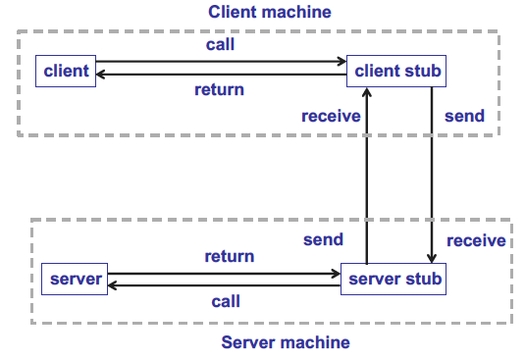
RPC stubs

Slide 10
RPC stubs
Stub: piece of code to convert parameters passed between client/server in RPC
Why do parameters need to be converted?
Local/remote processors may use different architectures
Different data representations (e.g., big- vs. little-endian)
Potentially different calling conventions
Client/server processes have different address spaces
Pointer arguments invalid
Client stub marshals parameters before sending
Converts to format appropriate for transmission
Packs all data into message to be sent via socket

Slide 11
Stub outlines
Client stub
Construct message with function name and parameters
Send request message to server
Receive response from server
Return response to client
Server stub
Receive request message
Invoke correct function with specified params
Construct response message with return value
Send response to client stub

Slide 12
Producer-consumer using RPC
Client stub
int produce(int n) {
int status;
send(sock, &n, sizeof(n));
recv(sock, &status, sizeof(status));
return status;
}
Server stub
void produce_stub() {
int n;
int status;
recv(sock, &n, sizeof(n));
status = produce(n);
send(sock, &status, sizeof(status));
}

Slide 13
Stub generation
Stub libraries need to be installed on both client & server
Stubs can be automatically generated from specification written in interface definition language (IDL)
Bridge between client, server architectures

Slide 14
Distributed systems
RPC: make request/response look like function call/return
Distributed shared memory: make multiple memories look like single memory
Distributed file system: make disks on multiple computers look like single file system
Parallelizing compilers: make multiple CPUs look like one CPU
Process migration/RPC: allow users to easily use remote processes

Slide 15
Distributed applications
Why build distributed applications?
Performance
Combined performance of many computers can be faster than performance of single computer
Reliability
Continuous service, even if some computers fail
Preserve data, even if some storage systems fail
Examples
Scientific computing (massively parallel datasets)
MMOs
Distributed info processing (banking, airline reservations)

Slide 16
Concurrency and distribution
Distributed applications must be multithreaded
Every computer runs at least one thread
Need two mechanisms for multithreaded programs
Atomic primitive to synchronize threads
A way to share data between threads
Do these work on distributed applications?
No—no shared memory
Can only communicate through send/receive

Slide 17
Synchronization in distributed application
Can race conditions exist without shared data?
Recall: race condition = output/result dependent on timing or ordering of earlier events
If you don’t impose ordering on messages, race condition absolutely possible!
Atomicity in network: send/receive packet
If two packets A & B sent to same receiver, receiver gets A, B, or both, but not combo
OS builds up from hardware
Multiple interleaved packets can be separated & ordered into single message
OS ensures packet contains data from single message

Slide 18
Final notes
Next time: distributed file systems
Lecture Wednesday, 4/19
No class Monday, 4/17

Slide 19
Acknowledgements
These slides are adapted from the following sources:
Silberschatz, Galvin, & Gagne, Operating Systems Concepts, 9th edition
Anderson & Dahlin, Operating Systems: Principles and Practice, 2nd edition
Chen & Madhyastha, EECS 482 lecture notes, University of Michigan, Fall 2016

