Slide 1
EECE.4810/EECE.5730 Operating Systems
Instructor:
Dr. Michael Geiger
Spring 2017
Lecture 21:
Distributed file systems
Protection

Slide 2
Lecture outline
Announcements/reminders
Program 1 due 4/26
Simple test programs, test outputs to be posted
Today’s lecture
Review
Remote procedure calls
Distributed applications
Distributed file systems
Protection and security

Slide 3
Review: Remote procedure call
Process on one machine calling procedure on another
Makes IPC appear like function call
Client sending request → function call
Client receiving response → function return
Server receiving request → function invocation
Server sending response → returning to caller
Stub: piece of code to convert parameters passed between client/server in RPC
Client stub marshals parameters and sends to server

Slide 4
Review: Distributed applications
Why build distributed applications?
Performance
Combined performance of many computers can be faster than performance of single computer
Reliability
Continuous service, even if some computers fail
Preserve data, even if some storage systems fail
Synchronization through messages
Hardware supports atomic packet transmission
OS reconstructs message

Slide 5
Distributed File System
Distributed file system (DFS) separates data storage from clients using data, but makes it look as if storage is all local
Manages set of dispersed storage devices
Usually a correspondence between constituent storage spaces and sets of files
Examples
AFS
Server Message Block (SMB) (used in Windows)
Dropbox
Google Docs
WWW

Slide 6
Naming and Transparency
Transparent DFS hides the location where in the network the file is stored
Naming mechanism must support
Track mapping between logical name and location
For a file being replicated in several sites, mapping returns set of replicas’ locations
Existence of multiple copies and their locations are hidden
Why store multiple copies?
Reliability/availability—more sites used in DFS, higher likelihood of server failure

Slide 7
Remote File Access
Remote-service mechanism is one transfer approach
Basic implementation: classic client-server
Each file request goes to server
What’s problem?
Performance—server/network becomes bottleneck
Reduce network traffic caching recently accessed blocks
If needed data not cached, copy brought from server to the user
Accesses are performed on the cached copy
Files identified with one master copy residing at the server machine, but copies of file are scattered in different caches

Slide 8
Cache Update Policy
Write-through – write data through to disk as soon as they are placed on any cache
Reliable, but poor performance
Delayed-write (write-back) – modifications written to the cache and then written through to the server later
Write accesses complete quickly; some data may be overwritten before they are written back, and so need never be written at all
Poor reliability; unwritten data will be lost whenever a user machine crashes
Variation – scan cache at regular intervals and flush blocks that have been modified since the last scan
Variation – write-on-close, writes data back to the server when the file is closed
Best for files that are open for long periods and frequently modified

Slide 9
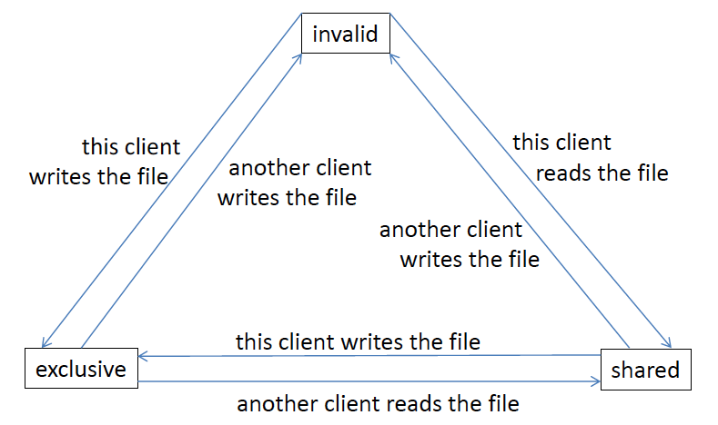
Consistency
Is locally cached copy of the data consistent with the master copy?
Client/server can initiate periodic check
Client tracks state of its copies

Slide 10
Goals of Protection
Computer system consists of a collection of objects (HW/SW)
Each object has unique name and can be accessed through well-defined set of operations
Protection problem - ensure that each object is accessed correctly and only by those processes that are allowed to do so

Slide 11
Principles of Protection
Guiding principle – principle of least privilege
Programs, users and systems should be given just enough privileges to perform their tasks
Limits damage if entity has a bug, gets abused
Can be static (during life of system, during life of process)
Or dynamic (changed by process as needed) – domain switching, privilege escalation
“Need to know” a similar concept regarding access to data

Slide 12
Principles of Protection (Cont.)
Must consider “grain” aspect
Rough-grained privilege management easier, simpler, but least privilege now done in large chunks
For example, traditional Unix processes either have abilities of the associated user, or of root
Fine-grained management more complex, more overhead, but more protective
File ACL (access control lists)
RBAC (role-based access control)
Domain can be user, process, procedure

Slide 13
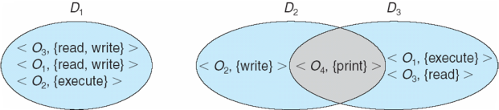
Domain Structure
Access-right = <object-name, rights-set> where rights-set is a subset of all valid operations that can be performed on the object
Domain = set of access-rights

Slide 14
Domain Implementation (UNIX)
Domain = user-id
Domain switch accomplished via file system
Each file has associated with it a domain bit (setuid bit)
When file is executed and setuid = on, then user-id is set to owner of the file being executed
When execution completes user-id is reset
Domain switch accomplished via passwords
su command temporarily switches to another user’s domain when other domain’s password provided
Domain switching via commands
sudo command prefix executes specified command in another domain (if original domain has privilege or password given)

Slide 15
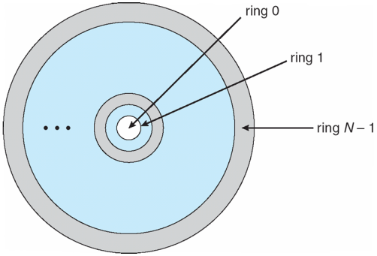
Domain Implementation (Multics)
Let D_{i} and D_{j} be any two domain rings
If j < i ⇒ D_{i} ⊆ D_{j}

Slide 16
Multics Benefits and Limits
Ring / hierarchical structure provided more than the basic kernel / user or root / normal user design
Fairly complex -> more overhead
But does not allow strict need-to-know
Object accessible in D_{j} but not in D_{i}, then j must be < i
But then every segment accessible in D_{i} also accessible in D_{j}

Slide 17
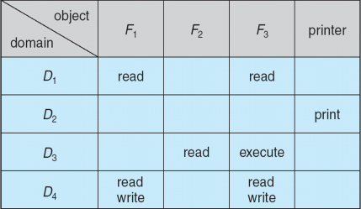
Access Matrix
View protection as a matrix (access matrix)
Rows represent domains
Columns represent objects
Access(i, j) is the set of operations that a process executing in Domain_{i} can invoke on Object_{j}

Slide 18
Use of Access Matrix
If a process in Domain D_{i} tries to do “op” on object O_{j}, then “op” must be in the access matrix
User who creates object can define access column for that object
Can be expanded to dynamic protection
Operations to add, delete access rights
Special access rights:
owner of O_{i}
copy op from O_{i} to O_{j} (denoted by “*”)
control – D_{i} can modify D_{j} access rights
transfer – switch from domain D_{i} to D_{j}
Copy and Owner applicable to an object
Control applicable to domain object

Slide 19
Use of Access Matrix (Cont.)
Access matrix design separates mechanism from policy
Mechanism
Operating system provides access-matrix + rules
It ensures that the matrix is only manipulated by authorized agents and that rules are strictly enforced
Policy
User dictates policy
Who can access what object and in what mode

Slide 20
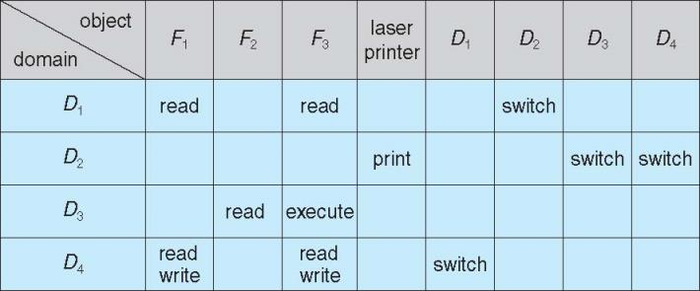
Access Matrix of Figure A with Domains as Objects

Slide 21
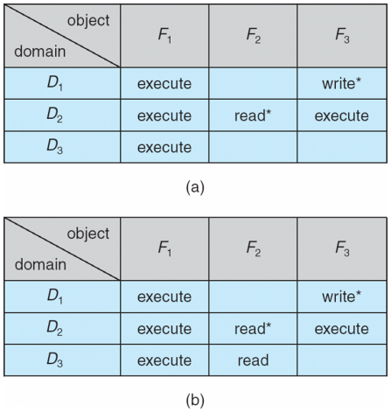
Access Matrix with Copy Rights
Starred rights can be copied across domains
Example: process in domain 2 can give read access on F₂
Variants: transfer of rights

Slide 22
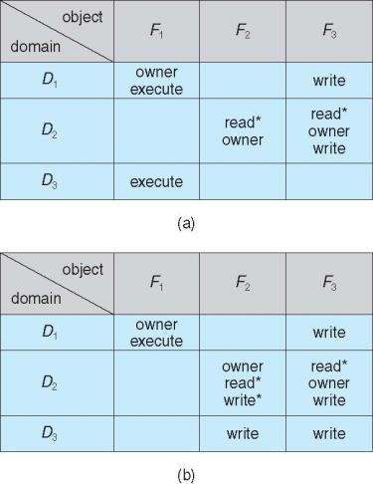
Access Matrix With Owner Rights
Owner domain can add/subtract rights

Slide 23
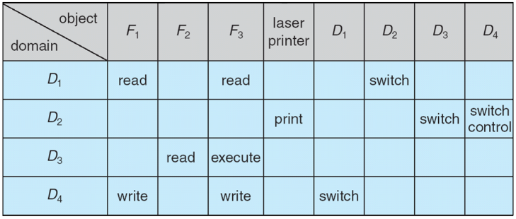
Control rights
Control right gives processes in one domain ability to add/remove rights from other domains

Slide 24
Implementation of Access Matrix
Generally, a sparse matrix
Option 1 – Global table
Store ordered triples <domain, object, rights-set> in table
A requested operation M on object O_{j} within domain D_{i} -> search table for < D_{i}, O_{j}, R_{k} >
with M ∈ R_{k}
But table could be large -> won’t fit in main memory
Difficult to group objects (consider an object that all domains can read)

Slide 25
Implementation of Access Matrix (Cont.)
Option 2 – Access lists for objects
Each column implemented as an access list for one object
Resulting per-object list consists of ordered pairs <domain, rights-set> defining all domains with non-empty set of access rights for the object
Easily extended to contain default set -> If M ∈ default set, also allow access

Slide 26
Implementation of Access Matrix (Cont.)
Each column = Access-control list for one object Defines who can perform what operation Domain 1 = Read, Write Domain 2 = Read Domain 3 = Read
Each Row = Capability List (like a key) For each domain, what operations allowed on what objects
Object F1 – Read
Object F4 – Read, Write, Execute
Object F5 – Read, Write, Delete, Copy

Slide 27
Implementation of Access Matrix (Cont.)
Option 3 – Capability list for domains
Instead of object-based, list is domain based
Capability list for domain is list of objects together with operations allows on them
Object represented by its name or address, called a capability
Execute operation M on object O_{j}, process requests operation and specifies capability as parameter
Possession of capability means access is allowed
Capability list associated with domain but never directly accessible by domain
Rather, protected object, maintained by OS and accessed indirectly
Like a “secure pointer”
Idea can be extended up to applications

Slide 28
Implementation of Access Matrix (Cont.)
Option 4 – Lock-key
Compromise between access lists and capability lists
Each object has list of unique bit patterns, called locks
Each domain has list of unique bit patterns called keys
Process in a domain can only access object if domain has key that matches one of the locks

Slide 29
Comparison of Implementations
Many trade-offs to consider
Global table is simple, but can be large
Access lists correspond to needs of users
Determining set of access rights for domain non-localized so difficult
Every access to an object must be checked
Many objects and access rights -> slow
Capability lists useful for localizing information for a given process
But revocation capabilities can be inefficient
Lock-key effective and flexible, keys can be passed freely from domain to domain, easy revocation

Slide 30
Comparison of Implementations (Cont.)
Most systems use combination of access lists and capabilities
First access to an object -> access list searched
If allowed, capability created and attached to process
Additional accesses need not be checked
After last access, capability destroyed
Consider file system with ACLs per file

Slide 31
Final notes
Next time: Security (Friday, 4/21)
Reminders
Program 1 due 4/26
Simple test programs, test outputs to be posted

Slide 32
Acknowledgements
These slides are adapted from the following sources:
Silberschatz, Galvin, & Gagne, Operating Systems Concepts, 9th edition
Anderson & Dahlin, Operating Systems: Principles and Practice, 2nd edition
Chen & Madhyastha, EECS 482 lecture notes, University of Michigan, Fall 2016

