Slide 1
EECE.4810/EECE.5730 Operating Systems
Instructor:
Dr. Michael Geiger
Spring 2017
Lecture 22:
Security

Slide 2
Lecture outline
Announcements/reminders
Program 1 due 4/26
Simple test programs, test outputs posted
Today’s lecture
Review
Distributed file systems
Protection
Security

Slide 3
Review: Distributed File Systems
Distributed file system (DFS) makes remote storage appear local
Transparent DFS hides the location where in the network the file is stored
May have multiple copies for reliability, performance (caching)
DFS hides existence of copies
Files often cached locally
Write-through caching for reliability; write-back for performance
Write-back variations—scan & flush files periodically, write-on-close
Cached copies must be kept consistent

Slide 4
Review: Protection
Ensure each object accessed correctly and only by those processes allowed to do so
Objects: HW (e.g. CPU, memory, printers, storage), SW (e.g. files, programs, semaphores)
Guiding principle – principle of least privilege
Programs, users and systems should be given just enough privileges to perform their tasks
Processes operate within domains
Collections of access rights
Access-right = <object-name, rights-set> where rights-set is a subset of all valid operations that can be performed on the object

Slide 5
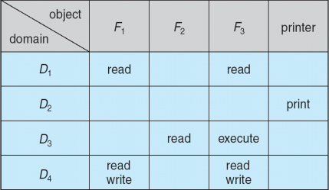
Review: Access Matrix
View protection as a matrix (access matrix)
Rows represent domains
Columns represent objects
Access(i, j) is the set of operations that a process executing in Domain_{i} can invoke on Object_{j}
Control change through copy, owner, control rights

Slide 6
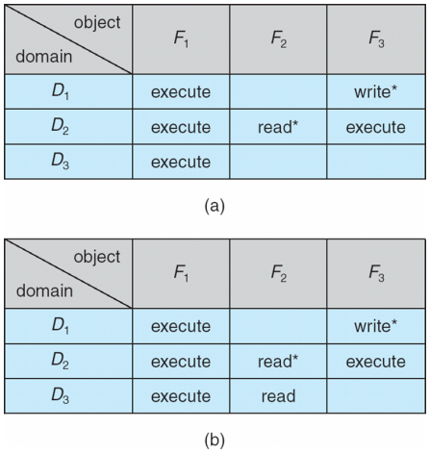
Review: Copy Rights
Copy rights used on per-object basis
Allows processes in one domain to share rights with others
Variants: transfer of rights, limit copy propagation

Slide 7
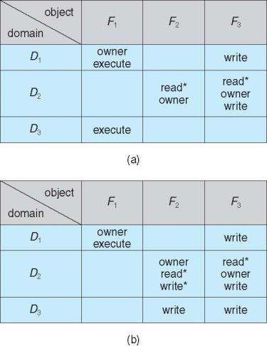
Access Matrix With Owner Rights
Owner domain can add/subtract any rights in given column

Slide 8
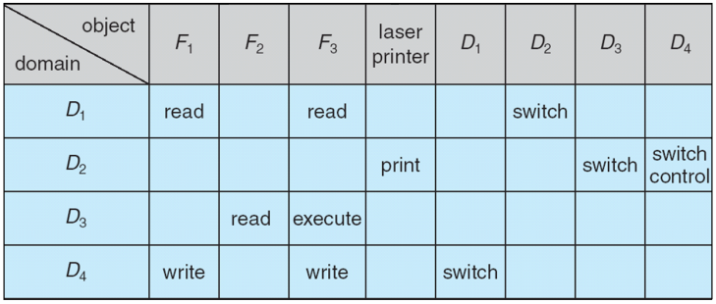
Control rights
Control right gives processes in one domain ability to add/remove rights from other domains
Copy/owner rights on column-by-column basis; control rights row-by-row

Slide 9
Review: Access list implementations
Global table is simple, but can be large
Can’t group objects/domains
Access lists correspond to needs of users
Per-object list of domains, privileges
Capability lists useful for localizing information for a given process
Per-domain list of objects, privileges
Lock-key effective and flexible, keys can be passed freely from domain to domain, easy revocation
Object holds lock patterns, domain has keys

Slide 10
The Security Problem
Protection: internal problem
Security: external problem
System secure if resources used and accessed as intended under all circumstances
Intruders attempt to breach security
Threat is potential security violation
Attack is attempt to breach security
Attack can be accidental or malicious
Protection mechanisms handle (most) accidental misuse

Slide 11
Security Violation Categories
Breach of confidentiality
Unauthorized reading of data
Example: credit-card/identity theft
Breach of integrity
Unauthorized modification of data
Example: modified source code for commercial app
Breach of availability
Unauthorized destruction of data
Example: website modification
Theft of service
Unauthorized use of resources
Example: installation of unauthorized file server
Denial of service (DOS)
Prevention of legitimate use
Example: Internet worm

Slide 12
Security Violation Methods
Masquerading
Breach authentication (correct ID of user)
Pretending to be an authorized user to escalate privileges
Replay attack
Repeat valid transmission, as is or with message modification
Man-in-the-middle attack
Intruder sits in data flow, masquerading as sender to receiver and vice versa
Session hijacking
Intercept an already-established session to bypass authentication
Often prerequisite for man-in-the-middle attack

Slide 13
Security Measure Levels
Impossible to have absolute security, but make cost to perpetrator sufficiently high to deter most intruders
Security must occur at four levels to be effective:
Physical
Data centers, servers, connected terminals
Human
Avoid social engineering, phishing, dumpster diving
Operating System
Protection mechanisms, debugging
Network
Intercepted communications, interruption, DOS
Security is as weak as the weakest link in the chain

Slide 14
Program Threats
Many variations, many names
Trojan Horse
Code segment that misuses its environment
Exploits mechanisms for allowing programs written by users to be executed by other users
Spyware, pop-up browser windows, covert channels
Up to 80% of spam delivered by spyware-infected systems
Trap Door
Specific user identifier or password that circumvents normal security procedures
Could be included in a compiler
Generate standard software + trap door regardless of source
How to detect them?
Analyze all source code

Slide 15
Program Threats (Cont.)
Logic Bomb
Program that initiates a security incident under certain circumstances
Stack and Buffer Overflow
Exploits a bug in a program (overflow either the stack or memory buffers)
Failure to check bounds on inputs, arguments
Write past arguments on the stack into the return address on stack
When routine returns from call, returns to hacked address
Pointed to code loaded onto stack that executes malicious code
Unauthorized user or privilege escalation

Slide 16
C Program with Buffer-overflow Condition
#include <stdio.h>
#define BUFFER SIZE 256
int main(int argc, char *argv[])
{
char buffer[BUFFER SIZE];
if (argc < 2)
return -1;
else {
strcpy(buffer,argv[1]);
return 0;
}
}

Slide 17
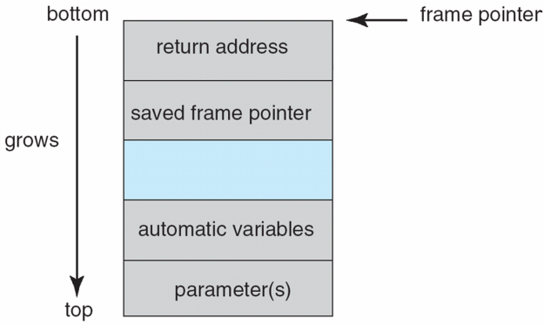
Layout of Typical Stack Frame

Slide 18
Modified Shell Code
#include <stdio.h>
int main(int argc, char *argv[])
{
execvp(‘‘\bin\sh’’,‘‘\bin \sh’’, NULL);
return 0;
}

Slide 19
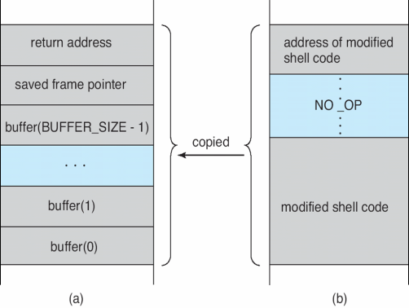
Hypothetical Stack Frame
Before attack
After attack

Slide 20
Great Programming Required?
For the first step of determining the bug, and second step of writing exploit code, yes
Attack code can get a shell with the processes’ owner’s permissions
Or open a network port, delete files, download a program, etc
Depending on bug, attack can be executed across a network using allowed connections, bypassing firewalls
Buffer overflow can be disabled by disabling stack execution or adding bit to page table to indicate “non-executable” state
Available in SPARC and x86
But still have security exploits

Slide 21
Program Threats (Cont.)
Viruses
Code fragment embedded in legitimate program
Self-replicating, designed to infect other computers
Very specific to CPU architecture, operating system, applications
Usually borne via email or as a macro
Visual Basic Macro to reformat hard drive
Sub AutoOpen()
Dim oFS
Set oFS = CreateObject(’’Scripting.FileSystemObject’’)
vs = Shell(’’c:command.com /k format c:’’,vbHide)
End Sub

Slide 22
Program Threats (Cont.)
Virus dropper inserts virus onto the system
Many categories of viruses, literally many thousands of viruses
File / parasitic
Boot / memory
Macro
Source code
Polymorphic to avoid having a virus signature
Encrypted
Stealth
Tunneling
Multipartite
Armored

Slide 23
System and Network Threats
Some systems “open” rather than secure by default
Open systems enable many services (FTP, telnet, etc.) by default
Secure by default → reduce attack surface
But harder to use, more knowledge needed to administer
Network threats harder to detect, prevent
Protection systems weaker
More difficult to have a shared secret on which to base access
No physical limits once system attached to internet
Or on network with system attached to internet
Even determining location of connecting system difficult
IP address is only knowledge

Slide 24
System and Network Threats (Cont.)
Worms – use spawn mechanism; standalone program
Internet worm
Exploited UNIX networking features (remote access) and bugs in finger (directory) and sendmail programs
Exploited trust-relationship mechanism used by rsh to access friendly systems without use of password
Grappling hook program uploaded main worm program
99 lines of C code
Hooked system then uploaded main code, tried to attack connected systems
Also tried to break into other users accounts on local system via password guessing
If target system already infected, abort, except for every 7th time

Slide 25
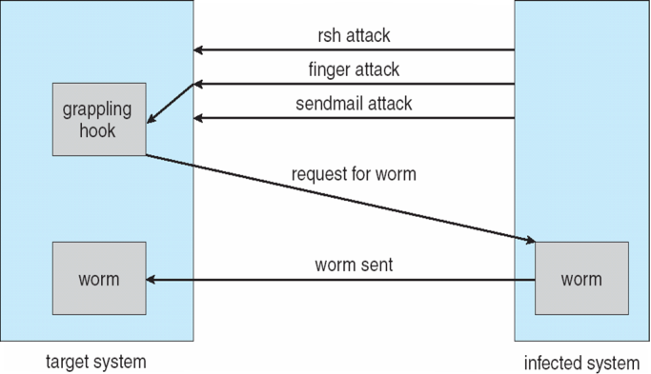
The Morris Internet Worm

Slide 26
System and Network Threats (Cont.)
Port scanning
Automated attempt to connect to a range of ports on one or a range of IP addresses
Not formally an attack—a search for vulnerabilities to attack
Detection of answering service protocol
Detection of OS and version running on system
nmap scans all ports in a given IP range for a response
nessus has a database of protocols and bugs (and exploits) to apply against a system

Slide 27
System and Network Threats (Cont.)
Denial of Service
Overload the targeted computer preventing it from doing any useful work
Distributed denial-of-service (DDOS) come from multiple sites at once
Consider the start of the IP-connection handshake
How many started-connections can the OS handle?
Consider traffic to a web site
How can you tell the difference between being a target and being really popular?
Accidental – CS students writing bad fork() code
Purposeful – extortion, punishment

Slide 28
Cryptography as a Security Tool
Broadest security tool available
Internal to a given computer, source and destination of messages can be known and protected
OS creates, manages, protects process IDs, communication ports
Source and destination of messages on network cannot be trusted without cryptography
Local network – IP address?
Consider unauthorized host added
WAN / Internet – how to establish authenticity
Not via IP address

Slide 29
Cryptography
Means to constrain potential senders (sources) and / or receivers (destinations) of messages
Based on secrets (keys)
Enables
Confirmation of source
Receipt only by certain destination
Trust relationship between sender and receiver

Slide 30
Encryption
Constrains the set of possible receivers of a message
Encryption algorithm consists of
Set K of keys
Set M of Messages
Set C of ciphertexts (encrypted messages)
A function E : K → (M→C). That is, for each k ∈ K, E_{k} is a function for generating ciphertexts from messages
Both E and E_{k} for any k should be efficiently computable functions
A function D : K → (C → M). That is, for each k ∈ K, D_{k} is a function for generating messages from ciphertexts
Both D and D_{k} for any k should be efficiently computable functions

Slide 31
Encryption (Cont.)
An encryption algorithm must provide this essential property: Given a ciphertext c ∈ C, a computer can compute m such that E_{k}(m) = c only if it possesses k
Thus, a computer holding k can decrypt ciphertexts to the plaintexts used to produce them, but a computer not holding k cannot decrypt ciphertexts
Since ciphertexts are generally exposed (for example, sent on the network), it is important that it be infeasible to derive k from the ciphertexts

Slide 32
Symmetric Encryption
Same key used to encrypt and decrypt
Therefore k must be kept secret
DES was most commonly used symmetric block-encryption algorithm (created by US Govt)
Encrypts a block of data at a time
Keys too short so now considered insecure
Triple-DES considered more secure
Algorithm used 3 times using 2 or 3 keys
For example
2001 NIST adopted new block cipher - Advanced Encryption Standard (AES)
Keys of 128, 192, or 256 bits, works on 128 bit blocks
RC4 is most common symmetric stream cipher, but known to have vulnerabilities
Encrypts/decrypts a stream of bytes (i.e., wireless transmission)
Key is a input to pseudo-random-bit generator
Generates an infinite keystream

Slide 33
Asymmetric Encryption
Public-key encryption based on each user having two keys:
public key – published key used to encrypt data
private key – key known only to individual user used to decrypt data
Must be an encryption scheme that can be made public without making it easy to figure out the decryption scheme
Most common is RSA block cipher
Efficient algorithm for testing whether or not a number is prime
No efficient algorithm is know for finding the prime factors of a number

Slide 34
Asymmetric Encryption (Cont.)
Formally, it is computationally infeasible to derive k_{d,N} from k_{e,N}, and so k_{e} need not be kept secret and can be widely disseminated
k_{e} is the public key
k_{d} is the private key
N is the product of two large, randomly chosen prime numbers p and q (for example, p and q are 512 bits each)
Encryption algorithm is E_{ke,N}(m) = m^{ke} mod N, where k_{e} satisfies k_{e}k_{d} mod (p−1)(q −1) = 1
The decryption algorithm is then D_{kd,N}(c) = c^{kd} mod N

Slide 35
Asymmetric Encryption Example
For example. make p = 7and q = 13
We then calculate N = 7∗13 = 91 and (p−1)(q−1) = 72
We next select k_{e} relatively prime to 72 and< 72, yielding 5
Finally, we calculate k_{d} such that k_{e}k_{d} mod 72 = 1, yielding 29
We how have our keys
Public key, k_{e,N} = 5, 91
Private key, k_{d,N} = 29, 91
Encrypting the message 69 with the public key results in the cyphertext 62
Cyphertext can be decoded with the private key
Public key can be distributed in cleartext to anyone who wants to communicate with holder of public key

Slide 36
Cryptography (Cont.)
Note symmetric cryptography based on transformations, asymmetric based on mathematical functions
Asymmetric much more compute intensive
Typically not used for bulk data encryption

Slide 37
Authentication
Constraining set of potential senders of a message
Complementary to encryption
Also can prove message unmodified
Algorithm components
A set K of keys
A set M of messages
A set A of authenticators
A function S : K → (M→ A)
That is, for each k ∈ K, S_{k} is a function for generating authenticators from messages
Both S and S_{k} for any k should be efficiently computable functions
A function V : K → (M × A→ {true, false}). That is, for each k ∈ K, V_{k} is a function for verifying authenticators on messages
Both V and V_{k} for any k should be efficiently computable functions

Slide 38
Authentication (Cont.)
For a message m, a computer can generate an authenticator a ∈ A such that V_{k}(m, a) = true only if it possesses k
Thus, computer holding k can generate authenticators on messages so that any other computer possessing k can verify them
Computer not holding k cannot generate authenticators on messages that can be verified using V_{k}
Since authenticators are generally exposed (for example, they are sent on the network with the messages themselves), it must not be feasible to derive k from the authenticators
Practically, if V_{k}(m,a) = true then we know m has not been modified and that send of message has k
If we share k with only one entity, know where the message originated

Slide 39
Authentication – Hash Functions
Basis of authentication
Creates small, fixed-size block of data message digest (hash value) from m
Hash Function H must be collision resistant on m
Must be infeasible to find an m’ ≠ m such that H(m) = H(m’)
If H(m) = H(m’), then m = m’
The message has not been modified
Common message-digest functions include MD5, which produces a 128-bit hash, and SHA-1, which outputs a 160-bit hash
Not useful as authenticators
For example H(m) can be sent with a message
But if H is known someone could modify m to m’ and recompute H(m’) and modification not detected
So must authenticate H(m)

Slide 40
Authentication - MAC
Symmetric encryption used in message-authentication code (MAC) authentication algorithm
Cryptographic checksum generated from message using secret key
Can securely authenticate short values
If used to authenticate H(m) for an H that is collision resistant, then obtain a way to securely authenticate long message by hashing them first
Note that k is needed to compute both S_{k} and V_{k}, so anyone able to compute one can compute the other

Slide 41
Authentication – Digital Signature
Based on asymmetric keys and digital signature algorithm
Authenticators produced are digital signatures
Very useful – anyone can verify authenticity of a message
In a digital-signature algorithm, computationally infeasible to derive k_{s} from k_{v}
V is a one-way function
Thus, k_{v} is the public key and k_{s} is the private key
Consider the RSA digital-signature algorithm
Similar to the RSA encryption algorithm, but the key use is reversed
Digital signature of message S_{ks} (m) = H(m)^{ks} mod N
The key k_{s} again is a pair (d, N), where N is the product of two large, randomly chosen prime numbers p and q
Verification algorithm is V_{kv}(m, a) (a^{kv} mod N = H(m))
Where k_{v} satisfies k_{v}k_{s} mod (p − 1)(q − 1) = 1

Slide 42
Authentication (Cont.)
Why authentication if a subset of encryption?
Fewer computations (except for RSA digital signatures)
Authenticator usually shorter than message
Sometimes want authentication but not confidentiality
Signed patches et al
Can be basis for non-repudiation

Slide 43
Key Distribution
Delivery of symmetric key is huge challenge
Sometimes done out-of-band
Asymmetric keys can proliferate – stored on key ring
Even asymmetric key distribution needs care – man-in-the-middle attack

Slide 44
Final notes
Next time: Case studies
Reminders
Program 1 due 4/26
Simple test programs, test outputs to be posted

Slide 45
Acknowledgements
These slides are adapted from the following sources:
Silberschatz, Galvin, & Gagne, Operating Systems Concepts, 9th edition
Anderson & Dahlin, Operating Systems: Principles and Practice, 2nd edition
Chen & Madhyastha, EECS 482 lecture notes, University of Michigan, Fall 2016

