Slide 1
EECE.4810/EECE.5730 Operating Systems
Instructor:
Dr. Michael Geiger
Spring 2017
Lecture 23:
Case studies

Slide 2
Lecture outline
Announcements/reminders
Program 1 due 4/26
Simple test programs, test outputs posted
Important clarification: child processes should execute simultaneously, not sequentially
Don’t wait for one child to finish before starting the next one
Today’s lecture
Review
Security
Case studies
Linux
Windows 7

Slide 3
Review: Security
System secure if resources used and accessed as intended under all circumstances
Intruders attempt to breach security
Threat is potential security violation
Program threats: trojan horse, trap door, logic bomb, stack/buffer overflow, viruses
Network threats: worms, port scanning, DoS
Attack is attempt to breach security
Network attacks: masquerading, replay attack, man-in-middle, session hijacking

Slide 4
Review: Cryptography
Means to constrain potential senders (sources) and / or receivers (destinations) of messages
Based on secrets (keys)
Enables
Confirmation of source
Receipt only by certain destination
Trust relationship between sender and receiver
Sender encrypts data; receiver decrypts
Cryptography can be symmetric (same key for decryption/encryption) or asymmetric (often public key for encryption; private key for decryption)

Slide 5
Review: Authentication
Constraining set of potential senders of a message
Complementary to encryption
Also can prove message unmodified
Useful even when message encrypted because authenticators are typically shorter and therefore take less time to decrypt
Authentication forms
Message authentication code (MAC): cryptographic checksum using symmetric keys
Digital signature: asymmetric keys

Slide 6
Linux History
Linux: modern, free OS based on UNIX standards
First developed as a small but self-contained kernel in 1991 by Linus Torvalds, with the major design goal of UNIX compatibility, released as open source
The core Linux operating system kernel is entirely original, but it can run much existing free UNIX software, resulting in an entire UNIX-compatible operating system free from proprietary code
Linux system has many, varying Linux distributions including the kernel, applications, and management tools

Slide 7
The Linux Kernel
Version 0.01 (May 1991) had no networking, ran only on 80386-compatible Intel processors and on PC hardware, had extremely limited device-drive support, and supported only the Minix file system
Linux 1.0 (March 1994) included these new features:
Support for UNIX’s standard TCP/IP networking protocols
BSD-compatible socket interface for networking programming
Device-driver support for running IP over an Ethernet
Enhanced file system
Support for a range of SCSI controllers for high-performance disk access
Extra hardware support
Version 1.2 (March 1995) was the final PC-only Linux kernel
Kernels with odd version numbers are development kernels, those with even numbers are production kernels

Slide 8
Linux 2.0
Released in June 1996, 2.0 added two major new capabilities:
Support for multiple architectures, including a fully 64-bit native Alpha port
Support for multiprocessor architectures
Other new features included:
Improved memory-management code
Improved TCP/IP performance
Support for internal kernel threads, for handling dependencies between loadable modules, and for automatic loading of modules on demand
Standardized configuration interface
Available for Motorola 68000-series processors, Sun Sparc systems, and for PC and PowerMac systems
2.4 and 2.6 increased SMP support, added journaling file system, preemptive kernel, 64-bit memory support
3.0 released in 2011, 20th anniversary of Linux, improved virtualization support, new page write-back facility, improved memory management, new Completely Fair Scheduler

Slide 9
The Linux System
Linux uses many tools developed as part of Berkeley’s BSD operating system, MIT’s X Window System, and the Free Software Foundation's GNU project
The main system libraries were started by the GNU project, with improvements provided by the Linux community
Linux networking-administration tools were derived from 4.3BSD code; recent BSD derivatives such as FreeBSD have borrowed code from Linux in return
The Linux system is maintained by a loose network of developers collaborating over the Internet, with a small number of public ftp sites acting as de facto standard repositories
File System Hierarchy Standard document maintained by the Linux community to ensure compatibility across the various system components
Specifies overall layout of a standard Linux file system, determines under which directory names configuration files, libraries, system binaries, and run-time data files should be stored

Slide 10
Linux Distributions
Standard, precompiled sets of packages, or distributions, include the basic Linux system, system installation and management utilities, and ready-to-install packages of common UNIX tools
The first distributions managed these packages by simply providing a means of unpacking all the files into the appropriate places; modern distributions include advanced package management
Early distributions included SLS and Slackware
Red Hat and Debian are popular distributions from commercial and noncommercial sources, respectively, others include Canonical and SuSE
The RPM Package file format permits compatibility among the various Linux distributions

Slide 11
Design Principles
Linux is a multiuser, multitasking system with a full set of UNIX-compatible tools
Its file system adheres to traditional UNIX semantics, and it fully implements the standard UNIX networking model
Modular set of simple tools providing limited, well-defined function
Unified file system as main means of communication
Shell scripting/command language combines tools for complex workflow
Main design goals are speed, efficiency, and standardization
Linux is designed to be compliant with the relevant POSIX documents; at least two Linux distributions have achieved official POSIX certification
POSIX = Portable Operating System Interface
IEEE-specified standards for OS compatibility
Supports Pthreads and a subset of POSIX real-time process control
The Linux programming interface adheres to the SVR4 UNIX semantics, rather than to BSD behavior

Slide 12
Components of a Linux System

Slide 13
Components of a Linux System
Like most UNIX implementations, Linux is composed of three main bodies of code; the most important distinction between the kernel and all other components.
The kernel is responsible for maintaining the important abstractions of the operating system
Kernel code executes in kernel mode with full access to all the physical resources of the computer
All kernel code and data structures are kept in the same single address space

Slide 14
Components of a Linux System (Cont.)
The system libraries define a standard set of functions through which applications interact with the kernel, and which implement much of the operating-system functionality that does not need the full privileges of kernel code
The system utilities perform individual specialized management tasks
User-mode programs rich and varied, including multiple shells like the bourne-again (bash)

Slide 15
Kernel Modules
Sections of kernel code that can be compiled, loaded, and unloaded independent of the rest of the kernel.
A kernel module may typically implement a device driver, a file system, or a networking protocol
The module interface allows third parties to write and distribute, on their own terms, device drivers or file systems that could not be distributed under the GPL.
Kernel modules allow a Linux system to be set up with a standard, minimal kernel, without any extra device drivers built in.
Four components to Linux module support:
module-management system
module loader and unloader
driver-registration system
conflict-resolution mechanism

Slide 16
Module Management
Supports loading modules into memory and letting them talk to the rest of the kernel
Module loading is split into two separate sections:
Managing sections of module code in kernel memory
Handling symbols that modules are allowed to reference
The module requestor manages loading requested, but currently unloaded, modules; it also regularly queries the kernel to see whether a dynamically loaded module is still in use, and will unload it when it is no longer actively needed

Slide 17
Driver Registration
Allows modules to tell the rest of the kernel that a new driver has become available
The kernel maintains dynamic tables of all known drivers, and provides a set of routines to allow drivers to be added to or removed from these tables at any time
Registration tables include the following items:
Device drivers
File systems
Network protocols
Binary format

Slide 18
Conflict Resolution
A mechanism that allows different device drivers to reserve hardware resources and to protect those resources from accidental use by another driver.
The conflict resolution module aims to:
Prevent modules from clashing over access to hardware resources
Prevent autoprobes (driver probes that detect device configuration) from interfering with existing device drivers
Resolve conflicts with multiple drivers trying to access the same hardware:
Kernel maintains list of allocated HW resources
Driver reserves resources with kernel database first
Reservation request rejected if resource not available

Slide 19
Process Management
UNIX process management separates the creation of processes and the running of a new program into two distinct operations.
The fork() system call creates a new process
A new program is run after a call to exec()
Under UNIX, a process encompasses all the information that the operating system must maintain to track the context of a single execution of a single program
Under Linux, process properties fall into three groups: the process’s identity, environment, and context

Slide 20
Process Identity
Process ID (PID) - The unique identifier for the process; used to specify processes to the operating system when an application makes a system call to signal, modify, or wait for another process
Credentials - Each process must have an associated user ID and one or more group IDs that determine the process’s rights to access system resources and files
Personality - Not traditionally found on UNIX systems, but under Linux each process has an associated personality identifier that can slightly modify the semantics of certain system calls
Used primarily by emulation libraries to request that system calls be compatible with certain specific flavors of UNIX
Namespace – Specific view of file system hierarchy
Most processes share common namespace and operate on a shared file-system hierarchy
But each can have unique file-system hierarchy with its own root directory and set of mounted file systems

Slide 21
Process Environment
The process’s environment is inherited from its parent, and is composed of two null-terminated vectors:
The argument vector lists the command-line arguments used to invoke the running program; conventionally starts with the name of the program itself.
The environment vector is a list of “NAME=VALUE” pairs that associates named environment variables with arbitrary textual values.
Passing environment variables among processes and inheriting variables by a process’s children are flexible means of passing information to components of the user-mode system software.
The environment-variable mechanism provides a customization of the operating system that can be set on a per-process basis, rather than being configured for the system as a whole.

Slide 22
Process Context
The (constantly changing) state of a running program at any point in time
The scheduling context is the most important part of the process context; it is the information that the scheduler needs to suspend and restart the process
The kernel maintains accounting information about the resources currently being consumed by each process, and the total resources consumed by the process in its lifetime so far
The file table is an array of pointers to kernel file structures
When making file I/O system calls, processes refer to files by their index into this table, the file descriptor (fd)

Slide 23
Process Context (Cont.)
Whereas the file table lists the existing open files, the file-system context applies to requests to open new files
The current root and default directories to be used for new file searches are stored here
The signal-handler table defines the routine in the process’s address space to be called when specific signals arrive
The virtual-memory context of a process describes the full contents of the its private address space

Slide 24
Processes and Threads
Linux uses the same internal representation for processes and threads; a thread is simply a new process that happens to share the same address space as its parent
Both are called tasks by Linux
A distinction is only made when a new thread is created by the clone() system call
fork() creates a new task with its own entirely new task context
clone() creates a new task with its own identity, but that is allowed to share the data structures of its parent
Using clone() gives an application fine-grained control over exactly what is shared between two threads

Slide 25
Scheduling
The job of allocating CPU time to different tasks within an operating system
While scheduling is normally thought of as the running and interrupting of processes, in Linux, scheduling also includes the running of the various kernel tasks
Running kernel tasks encompasses both tasks that are requested by a running process and tasks that execute internally on behalf of a device driver
As of 2.5, new scheduling algorithm – preemptive, priority-based, known as O(1)
Real-time range
nice value
Had challenges with interactive performance
2.6 introduced Completely Fair Scheduler (CFS)

Slide 26
CFS
Eliminates traditional, common idea of time slice
Instead all tasks allocated portion of processor’s time
CFS calculates how long a process should run as a function of total number of tasks
N runnable tasks means each gets 1/N of processor’s time
Then weights each task with its nice value
Smaller nice value -> higher weight (higher priority)

Slide 27
CFS (Cont.)
Then each task run with for time proportional to task’s weight divided by total weight of all runnable tasks
Configurable variable target latency is desired interval during which each task should run at least once
Consider simple case of 2 runnable tasks with equal weight and target latency of 10ms – each then runs for 5ms
If 10 runnable tasks, each runs for 1ms
Minimum granularity ensures each run has reasonable amount of time (which actually violates fairness idea)

Slide 28
Memory Management
Linux’s physical memory-management system deals with allocating and freeing pages, groups of pages, and small blocks of memory
It has additional mechanisms for handling virtual memory, memory mapped into the address space of running processes
Splits memory into four different zones due to hardware characteristics
Architecture specific, for example on x86:

Slide 29
Managing Physical Memory
The page allocator allocates and frees all physical pages; it can allocate ranges of physically-contiguous pages on request
The allocator uses a buddy-heap algorithm to keep track of available physical pages
Each allocatable memory region is paired with an adjacent partner
Whenever two allocated partner regions are both freed up they are combined to form a larger region
If a small memory request cannot be satisfied by allocating an existing small free region, then a larger free region will be subdivided into two partners to satisfy the request

Slide 30
Splitting of Memory in a Buddy Heap

Slide 31
Managing Physical Memory (Cont.)
Memory allocations in the Linux kernel occur either statically (drivers reserve a contiguous area of memory during system boot time) or dynamically (via the page allocator)
Also uses slab allocator for kernel memory
Page cache and virtual memory system also manage physical memory
Page cache is kernel’s main cache for files and main mechanism for I/O to block devices
Page cache stores entire pages of file contents for local and network file I/O

Slide 32
Slab Allocator in Linux

Slide 33
Virtual Memory
The VM system maintains the address space visible to each process: It creates pages of virtual memory on demand, and manages the loading of those pages from disk or their swapping back out to disk as required.
The VM manager maintains two separate views of a process’s address space:
A logical view describing instructions concerning the layout of the address space
The address space consists of a set of non-overlapping regions, each representing a continuous, page-aligned subset of the address space
A physical view of each address space which is stored in the hardware page tables for the process

Slide 34
Virtual Memory (Cont.)
Virtual memory regions are characterized by:
The backing store, which describes from where the pages for a region come; regions are usually backed by a file or by nothing (demand-zero memory)
The region’s reaction to writes (page sharing or copy-on-write
The kernel creates a new virtual address space
1. When a process runs a new program with the exec() system call
2. Upon creation of a new process by the fork() system call

Slide 35
Virtual Memory (Cont.)
On executing a new program, the process is given a new, completely empty virtual-address space; the program-loading routines populate the address space with virtual-memory regions
Creating a new process with fork() involves creating a complete copy of the existing process’s virtual address space
The kernel copies the parent process’s VMA descriptors, then creates a new set of page tables for the child
The parent’s page tables are copied directly into the child’s, with the reference count of each page covered being incremented
After the fork, the parent and child share the same physical pages of memory in their address spaces

Slide 36
Swapping and Paging
The VM paging system relocates pages of memory from physical memory out to disk when the memory is needed for something else
The VM paging system can be divided into two sections:
The pageout-policy algorithm decides which pages to write out to disk, and when
The paging mechanism actually carries out the transfer, and pages data back into physical memory as needed
Can page out to either swap device or normal files
Bitmap used to track used blocks in swap space kept in physical memory
Allocator uses next-fit algorithm to try to write contiguous runs

Slide 37
Kernel Virtual Memory
The Linux kernel reserves a constant, architecture-dependent region of the virtual address space of every process for its own internal use
This kernel virtual-memory area contains two regions:
A static area that contains page table references to every available physical page of memory in the system, so that there is a simple translation from physical to virtual addresses when running kernel code
The reminder of the reserved section is not reserved for any specific purpose; its page-table entries can be modified to point to any other areas of memory

Slide 38
File Systems
To the user, Linux’s file system appears as a hierarchical directory tree obeying UNIX semantics
Internally, the kernel hides implementation details and manages the multiple different file systems via an abstraction layer, that is, the virtual file system (VFS)
The Linux VFS is designed around object-oriented principles and is composed of four components:
A set of definitions that define what a file object is allowed to look like
The inode object structure represent an individual file
The file object represents an open file
The superblock object represents an entire file system
A dentry object represents an individual directory entry

Slide 39
File Systems (Cont.)
To the user, Linux’s file system appears as a hierarchical directory tree obeying UNIX semantics
Internally, the kernel hides implementation details and manages the multiple different file systems via an abstraction layer, that is, the virtual file system (VFS)
The Linux VFS is designed around object-oriented principles and layer of software to manipulate those objects with a set of operations on the objects
For example for the file object operations include (from struct file_operations in /usr/include/linux/fs.h
int open(. . .) — Open a file
ssize t read(. . .) — Read from a file
ssize t write(. . .) — Write to a file
int mmap(. . .) — Memory-map a file

Slide 40
The Linux ext3 File System
ext3 is standard on disk file system for Linux
Uses a mechanism similar to that of BSD Fast File System (FFS) for locating data blocks belonging to a specific file
Supersedes older extfs, ext2 file systems
Work underway on ext4 adding features like extents
Of course, many other file system choices with Linux distros

Slide 41
The Linux ext3 File System (Cont.)
The main differences between ext2fs and FFS concern their disk allocation policies
In ffs, the disk is allocated to files in blocks of 8Kb, with blocks being subdivided into fragments of 1Kb to store small files or partially filled blocks at the end of a file
ext3 does not use fragments; it performs its allocations in smaller units
The default block size on ext3 varies as a function of total size of file system with support for 1, 2, 4 and 8 KB blocks
ext3 uses cluster allocation policies designed to place logically adjacent blocks of a file into physically adjacent blocks on disk, so that it can submit an I/O request for several disk blocks as a single operation on a block group
Maintains bit map of free blocks in a block group, searches for free byte to allocate at least 8 blocks at a time

Slide 42
Ext2fs Block-Allocation Policies

Slide 43
Journaling
ext3 implements journaling, with file system updates first written to a log file in the form of transactions
Once in log file, considered committed
Over time, log file transactions replayed over file system to put changes in place
On system crash, some transactions might be in journal but not yet placed into file system
Must be completed once system recovers
No other consistency checking is needed after a crash (much faster than older methods)
Improves write performance on hard disks by turning random I/O into sequential I/O

Slide 44
The Linux Proc File System
The proc file system does not store data, rather, its contents are computed on demand according to user file I/O requests
proc must implement a directory structure, and the file contents within; it must then define a unique and persistent inode number for each directory and files it contains
It uses this inode number to identify just what operation is required when a user tries to read from a particular file inode or perform a lookup in a particular directory inode
When data is read from one of these files, proc collects the appropriate information, formats it into text form and places it into the requesting process’s read buffer

Slide 45
Input and Output
The Linux device-oriented file system accesses disk storage through two caches:
Data is cached in the page cache, which is unified with the virtual memory system
Metadata is cached in the buffer cache, a separate cache indexed by the physical disk block
Linux splits all devices into three classes:
block devices allow random access to completely independent, fixed size blocks of data
character devices include most other devices; they don’t need to support the functionality of regular files
network devices are interfaced via the kernel’s networking subsystem

Slide 46
Block Devices
Provide the main interface to all disk devices in a system
The block buffer cache serves two main purposes:
it acts as a pool of buffers for active I/O
it serves as a cache for completed I/O
The request manager manages the reading and writing of buffer contents to and from a block device driver
Kernel 2.6 introduced Completely Fair Queueing (CFQ)
Now the default scheduler
Fundamentally different from elevator algorithms
Maintains set of lists, one for each process by default
Uses C-SCAN algorithm, with round robin between all outstanding I/O from all processes
Four blocks from each process put on at once

Slide 47
Device-Driver Block Structure

Slide 48
Character Devices
A device driver which does not offer random access to fixed blocks of data
A character device driver must register a set of functions which implement the driver’s various file I/O operations
The kernel performs almost no preprocessing of a file read or write request to a character device, but simply passes on the request to the device
The main exception to this rule is the special subset of character device drivers which implement terminal devices, for which the kernel maintains a standard interface

Slide 49
Character Devices (Cont.)
Line discipline is an interpreter for the information from the terminal device
The most common line discipline is tty discipline, which glues the terminal’s data stream onto standard input and output streams of user’s running processes, allowing processes to communicate directly with the user’s terminal
Several processes may be running simultaneously, tty line discipline responsible for attaching and detaching terminal’s input and output from various processes connected to it as processes are suspended or awakened by user
Other line disciplines also are implemented have nothing to do with I/O to user process – i.e. PPP and SLIP networking protocols

Slide 50
Interprocess Communication
Like UNIX, Linux informs processes that an event has occurred via signals
There is a limited number of signals, and they cannot carry information: Only the fact that a signal occurred is available to a process
The Linux kernel does not use signals to communicate with processes with are running in kernel mode, rather, communication within the kernel is accomplished via scheduling states and wait_queue structures
Also implements System V Unix semaphores
Process can wait for a signal or a semaphore
Semaphores scale better
Operations on multiple semaphores can be atomic

Slide 51
Passing Data Between Processes
The pipe mechanism allows a child process to inherit a communication channel to its parent, data written to one end of the pipe can be read a the other
Shared memory offers an extremely fast way of communicating; any data written by one process to a shared memory region can be read immediately by any other process that has mapped that region into its address space
To obtain synchronization, however, shared memory must be used in conjunction with another Interprocess-communication mechanism

Slide 52
Network Structure
Networking is a key area of functionality for Linux
It supports the standard Internet protocols for UNIX to UNIX communications
It also implements protocols native to non-UNIX operating systems, in particular, protocols used on PC networks, such as Appletalk and IPX
Internally, networking in the Linux kernel is implemented by three layers of software:
The socket interface
Protocol drivers
Network device drivers
Most important set of protocols in the Linux networking system is the internet protocol suite
It implements routing between different hosts anywhere on the network
On top of the routing protocol are built the UDP, TCP and ICMP protocols
Packets also pass to firewall management for filtering based on firewall chains of rules

Slide 53
Security
The pluggable authentication modules (PAM) system is available under Linux
PAM is based on a shared library that can be used by any system component that needs to authenticate users
Access control under UNIX systems, including Linux, is performed through the use of unique numeric identifiers (uid and gid)
Access control is performed by assigning objects a protections mask, which specifies which access modes—read, write, or execute—are to be granted to processes with owner, group, or world access

Slide 54
Security (Cont.)
Linux augments the standard UNIX setuid mechanism in two ways:
It implements the POSIX specification’s saved user-id mechanism, which allows a process to repeatedly drop and reacquire its effective uid
It has added a process characteristic that grants just a subset of the rights of the effective uid
Linux provides another mechanism that allows a client to selectively pass access to a single file to some server process without granting it any other privileges

Slide 55
Windows 7
32-bit preemptive multitasking operating system for Intel microprocessors
Key goals for the system:
portability
security
POSIX compliance
multiprocessor support
extensibility
international support
compatibility with MS-DOS and MS-Windows applications.
Uses a micro-kernel architecture
Available in six client versions, Starter, Home Basic, Home Premium, Professional, Enterprise and Ultimate. With the exception of Starter edition (32-bit only) all are available in both 32-bit and 64-bit.
Available in three server versions (all 64-bit only), Standard, Enterprise and Datacenter

Slide 56
Design Principles
Extensibility — layered architecture
Executive, which runs in protected mode, provides the basic system services
On top of the executive, several server subsystems operate in user mode
Modular structure allows additional environmental subsystems to be added without affecting the executive
Portability — Windows 7 can be moved from one hardware architecture to another with relatively few changes
Written in C and C++
Processor-specific portions are written in assembly language for a given processor architecture (small amount of such code).
Platform-dependent code is isolated in a dynamic link library (DLL) called the “hardware abstraction layer” (HAL)

Slide 57
Design Principles (Cont.)
Reliability — Windows 7 uses hardware protection for virtual memory, and software protection mechanisms for operating system resources
Compatibility — applications that follow the IEEE 1003.1 (POSIX) standard can be complied to run on 7 without changing the source code
Performance — Windows 7 subsystems can communicate with one another via high-performance message passing
Preemption of low priority threads enables the system to respond quickly to external events
Designed for symmetrical multiprocessing
International support — supports different locales via the national language support (NLS) API

Slide 58
Windows 7 Architecture
Layered system of module
Protected mode — hardware abstraction layer (HAL), kernel, executive
User mode — collection of subsystems
Environmental subsystems emulate different operating systems
Protection subsystems provide security functions

Slide 59
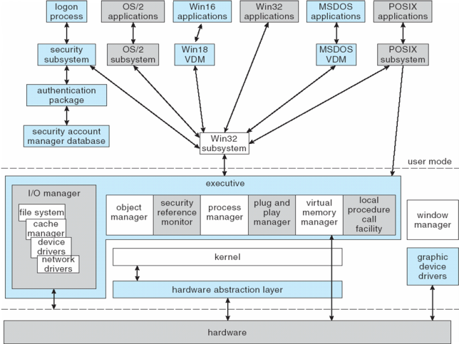
Depiction of 7 Architecture

Slide 60
System Components — Kernel
Foundation for the executive and the subsystems
Never paged out of memory; execution is never preempted
Four main responsibilities:
thread scheduling
interrupt and exception handling
low-level processor synchronization
recovery after a power failure
Kernel is object-oriented, uses two sets of objects
dispatcher objects control dispatching and synchronization (events, mutants, mutexes, semaphores, threads and timers)
control objects (asynchronous procedure calls, interrupts, power notify, power status, process and profile objects)

Slide 61
Kernel — Process and Threads
The process has a virtual memory address space, information (such as a base priority), and an affinity for one or more processors.
Threads are the unit of execution scheduled by the kernel’s dispatcher.
Each thread has its own state, including a priority, processor affinity, and accounting information.
A thread can be one of six states: ready, standby, running, waiting, transition, and terminated.

Slide 62
Kernel — Scheduling
The dispatcher uses a 32-level priority scheme to determine the order of thread execution.
Priorities are divided into two classes
The real-time class contains threads with priorities ranging from 16 to 31
The variable class contains threads having priorities from 0 to 15
Characteristics of Windows 7’s priority strategy
Trends to give very good response times to interactive threads that are using the mouse and windows
Enables I/O-bound threads to keep the I/O devices busy
Complete-bound threads soak up the spare CPU cycles in the background

Slide 63
Kernel — Scheduling (Cont.)
Scheduling can occur when a thread enters the ready or wait state, when a thread terminates, or when an application changes a thread’s priority or processor affinity
Real-time threads are given preferential access to the CPU; but 7 does not guarantee that a real-time thread will start to execute within any particular time limit .
This is known as soft realtime.

Slide 64
Executive — Object Manager
Windows 7 uses objects for all its services and entities; the object manger supervises the use of all the objects
Generates an object handle
Checks security
Keeps track of which processes are using each object
Objects are manipulated by a standard set of methods, namely create, open, close, delete, query name, parse and security.

Slide 65
Executive — Naming Objects
The Windows 7 executive allows almost any object to be given a name, which may be either permanent or temporary. Exceptions are process, thread and some others object types.
Object names are structured like file path names in MS-DOS and UNIX.
Windows 7 implements a symbolic link object, which is similar to symbolic links in UNIX that allow multiple nicknames or aliases to refer to the same file.
A process gets an object handle by creating an object by opening an existing one, by receiving a duplicated handle from another process, or by inheriting a handle from a parent process.
Each object is protected by an access control list.

Slide 66
Executive — Virtual Memory Manager
The design of the VM manager assumes that the underlying hardware supports virtual to physical mapping a paging mechanism, transparent cache coherence on multiprocessor systems, and virtual addressing aliasing.
The VM manager in Windows 7 uses a page-based management scheme with a page size of 4 KB.
The Windows 7 VM manager uses a two step process to allocate memory
The first step reserves a portion of the process’s address space
The second step commits the allocation by assigning space in the system’s paging file(s)

Slide 67
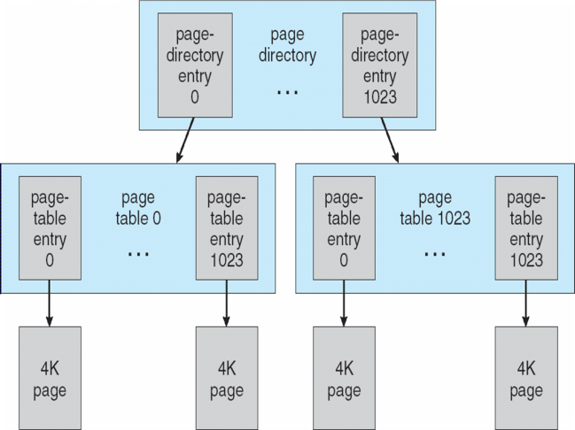
Virtual-Memory Layout

Slide 68
Virtual Memory Manager (Cont.)
The virtual address translation in Windows 7 uses several data structures
Each process has a page directory that contains 1024 page directory entries of size 4 bytes.
Each page directory entry points to a page table which contains 1024 page table entries (PTEs) of size 4 bytes.
Each PTE points to a 4 KB page frame in physical memory.
A 10-bit integer can represent all the values form 0 to 1023, therefore, can select any entry in the page directory, or in a page table.
This property is used when translating a virtual address pointer to a bye address in physical memory.
A page can be in one of six states: valid, zeroed, free standby, modified and bad.

Slide 69
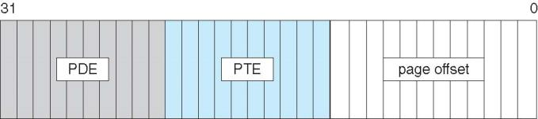
Virtual-to-Physical Address Translation
10 bits for page directory entry, 20 bits for page table entry, and 12 bits for byte offset in page

Slide 70
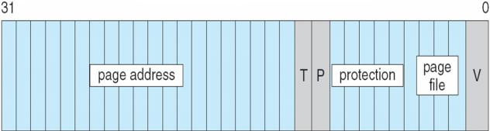
Page File Page-Table Entry
5 bits for page protection, 20 bits for page frame address, 4 bits to select a paging file, and 3 bits that describe the page state. V = 0

Slide 71
Executive — Process Manager
Provides services for creating, deleting, and using threads and processes
Issues such as parent/child relationships or process hierarchies are left to the particular environmental subsystem that owns the process.

Slide 72
Executive — Local Procedure Call Facility
The LPC passes requests and results between client and server processes within a single machine.
In particular, it is used to request services from the various Windows 7 subsystems.
When a LPC channel is created, one of three types of message passing techniques must be specified.
First type is suitable for small messages, up to 256 bytes; port's message queue is used as intermediate storage, and the messages are copied from one process to the other.
Second type avoids copying large messages by pointing to a shared memory section object created for the channel.
Third method, called quick LPC was used by graphical display portions of the Win32 subsystem.

Slide 73
Executive — I/O Manager
The I/O manager is responsible for
file systems
cache management
device drivers
network drivers
Keeps track of which installable file systems are loaded, and manages buffers for I/O requests
Works with VM Manager to provide memory-mapped file I/O
Controls the Windows 7 cache manager, which handles caching for the entire I/O system
Supports both synchronous and asynchronous operations, provides time outs for drivers, and has mechanisms for one driver to call another

Slide 74
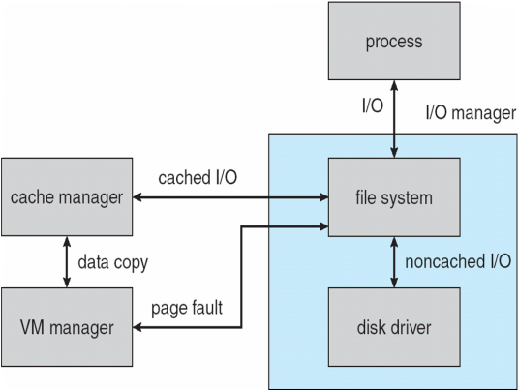
File I/O

Slide 75
File System
The fundamental structure of the Windows 7 file system (NTFS) is a volume
Created by the Windows 7 disk administrator utility
Based on a logical disk partition
May occupy a portions of a disk, an entire disk, or span across several disks
All metadata, such as information about the volume, is stored in a regular file
NTFS uses clusters as the underlying unit of disk allocation
A cluster is a number of disk sectors that is a power of two
Because the cluster size is smaller than for the 16-bit FAT file system, the amount of internal fragmentation is reduced

Slide 76
File System — Internal Layout
NTFS uses logical cluster numbers (LCNs) as disk addresses
A file in NTFS is not a simple byte stream, as in MS-DOS or UNIX, rather, it is a structured object consisting of attributes
Every file in NTFS is described by one or more records in an array stored in a special file called the Master File Table (MFT)
Each file on an NTFS volume has a unique ID called a file reference.
64-bit quantity that consists of a 48-bit file number and a 16-bit sequence number
Can be used to perform internal consistency checks
The NTFS name space is organized by a hierarchy of directories; the index root contains the top level of the B+ tree

Slide 77
File System — Recovery
All file system data structure updates are performed inside transactions that are logged.
Before a data structure is altered, the transaction writes a log record that contains redo and undo information.
After the data structure has been changed, a commit record is written to the log to signify that the transaction succeeded.
After a crash, the file system data structures can be restored to a consistent state by processing the log records.

Slide 78
File System — Recovery (Cont.)
This scheme does not guarantee that all the user file data can be recovered after a crash, just that the file system data structures (the metadata files) are undamaged and reflect some consistent state prior to the crash.
The log is stored in the third metadata file at the beginning of the volume.
The logging functionality is provided by the Windows 7 log file service.

Slide 79
File System — Security
Security of an NTFS volume is derived from the Windows 7 object model.
Each file object has a security descriptor attribute stored in this MFT record.
This attribute contains the access token of the owner of the file, and an access control list that states the access privileges that are granted to each user that has access to the file.

Slide 80
Volume Management and Fault Tolerance
FtDisk, the fault tolerant disk driver for Windows 7, provides several ways to combine multiple SCSI disk drives into one logical volume
Logically concatenate multiple disks to form a large logical volume, a volume set
Interleave multiple physical partitions in round-robin fashion to form a stripe set (also called RAID level 0, or “disk striping”)
Variation: stripe set with parity, or RAID level 5
Disk mirroring, or RAID level 1, is a robust scheme that uses a mirror set — two equally sized partitions on tow disks with identical data contents
To deal with disk sectors that go bad, FtDisk, uses a hardware technique called sector sparing and NTFS uses a software technique called cluster remapping

Slide 81
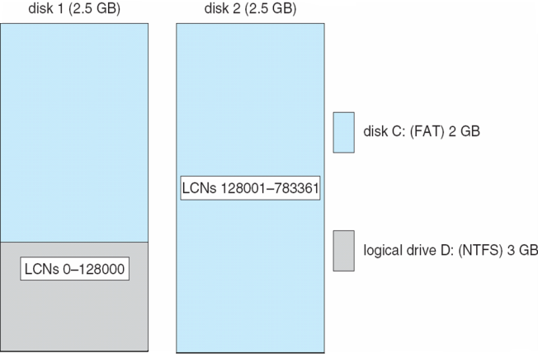
Volume Set On Two Drives

Slide 82
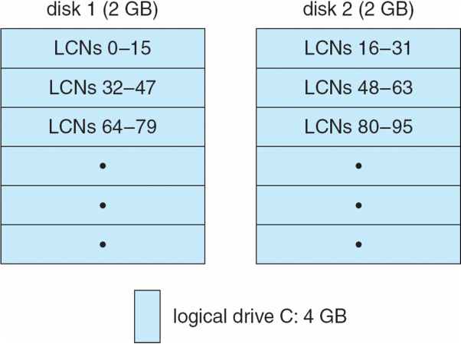
Stripe Set on Two Drives

Slide 83
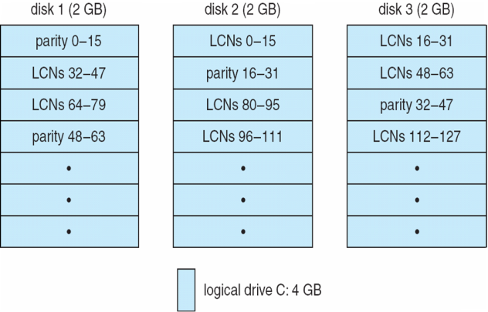
Stripe Set With Parity on Three Drives

Slide 84
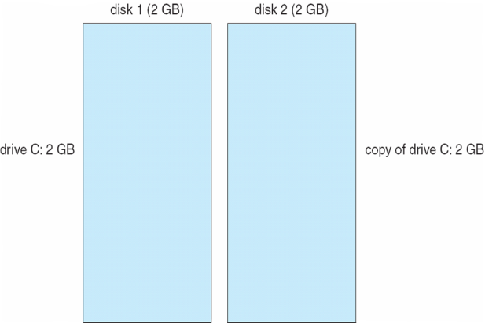
Mirror Set on Two Drives

Slide 85
File System — Compression
To compress a file, NTFS divides the file’s data into compression units, which are blocks of 16 contiguous clusters.
For sparse files, NTFS uses another technique to save space.
Clusters that contain all zeros are not actually allocated or stored on disk.
Instead, gaps are left in the sequence of virtual cluster numbers stored in the MFT entry for the file.
When reading a file, if a gap in the virtual cluster numbers is found, NTFS just zero-fills that portion of the caller’s buffer.

Slide 86
File System — Reparse Points
A reparse point returns an error code when accessed. The reparse data tells the I/O manager what to do next.
Reparse points can be used to provide the functionality of UNIX mounts.
Reparse points can also be used to access files that have been moved to offline storage.

Slide 87
Programmer Interface — Access to Kernel Obj.
A process gains access to a kernel object named XXX by calling the CreateXXX function to open a handle to XXX; the handle is unique to that process.
A handle can be closed by calling the CloseHandle function; the system may delete the object if the count of processes using the object drops to 0.
Windows 7 provides three ways to share objects between processes
A child process inherits a handle to the object
One process gives the object a name when it is created and the second process opens that name
DuplicateHandle function:
Given a handle to process and the handle’s value a second process can get a handle to the same object, and thus share it

Slide 88
Programmer Interface — Process Management
Process is started via the CreateProcess routine which loads any dynamic link libraries that are used by the process, and creates a primary thread.
Additional threads can be created by the CreateThread function.
Every dynamic link library or executable file that is loaded into the address space of a process is identified by an instance handle.

Slide 89
Process Management (Cont.)
Scheduling in Win32 utilizes four priority classes:
IDLE_PRIORITY_CLASS (priority level 4)
NORMAL_PRIORITY_CLASS (level8 — typical for most processes
HIGH_PRIORITY_CLASS (level 13)
REALTIME_PRIORITY_CLASS (level 24)
To provide performance levels needed for interactive programs, 7 has a special scheduling rule for processes in the NORMAL_PRIORITY_CLASS
7 distinguishes between the foreground process that is currently selected on the screen, and the background processes that are not currently selected.
When a process moves into the foreground, 7 increases the scheduling quantum by some factor, typically 3.

Slide 90
Process Management (Cont.)
The kernel dynamically adjusts the priority of a thread depending on whether it is I/O-bound or CPU-bound.
To synchronize the concurrent access to shared objects by threads, the kernel provides synchronization objects, such as semaphores and mutexes
In addition, threads can synchronize by using the WaitForSingleObject or WaitForMultipleObjects functions.
Another method of synchronization in the Win32 API is the critical section.

Slide 91
Process Management (Cont.)
A fiber is user-mode code that gets scheduled according to a user-defined scheduling algorithm.
Only one fiber at a time is permitted to execute, even on multiprocessor hardware.
Windows 7 includes fibers to facilitate the porting of legacy UNIX applications that are written for a fiber execution model.
Windows 7 also introduced user-mode scheduling for 64-bit systems which allows finer grained control of scheduling work without requiring kernel transitions.

Slide 92
Programmer Interface — Interprocess Communication
Win32 applications can have interprocess communication by sharing kernel objects.
An alternate means of interprocess communications is message passing, which is particularly popular for Windows GUI applications
One thread sends a message to another thread or to a window.
A thread can also send data with the message.
Every Win32 thread has its own input queue from which the thread receives messages.
This is more reliable than the shared input queue of 16-bit windows, because with separate queues, one stuck application cannot block input to the other applications

Slide 93
Programmer Interface — Memory Management
Virtual memory:
VirtualAlloc reserves or commits virtual memory
VirtualFree decommits or releases the memory
These functions enable the application to determine the virtual address at which the memory is allocated
An application can use memory by memory mapping a file into its address space
Multistage process
Two processes share memory by mapping the same file into their virtual memory

Slide 94
Memory Management (Cont.)
A heap in the Win32 environment is a region of reserved address space
A Win 32 process is created with a 1 MB default heap
Access is synchronized to protect the heap’s space allocation data structures from damage by concurrent updates by multiple threads
Because functions that rely on global or static data typically fail to work properly in a multithreaded environment, the thread-local storage mechanism allocates global storage on a per-thread basis
The mechanism provides both dynamic and static methods of creating thread-local storage

Slide 95
Final notes
Next time: Final exam preview
Reminders
Program 1 due 4/26
Simple test programs, test outputs to be posted
Important clarification: child processes should execute simultaneously, not sequentially
Don’t wait for one child to finish before starting the next one

Slide 96
Acknowledgements
These slides are adapted from the following sources:
Silberschatz, Galvin, & Gagne, Operating Systems Concepts, 9th edition
Anderson & Dahlin, Operating Systems: Principles and Practice, 2nd edition
Chen & Madhyastha, EECS 482 lecture notes, University of Michigan, Fall 2016

