Slide 1
EECE.4810/EECE.5730 Operating Systems
Instructor:
Dr. Michael Geiger
Spring 2017
Lecture 24:
Final Exam Preview

Slide 2
Lecture outline
Announcements/reminders
Program 1 due today
HW 4 (extra-credit problem set) due 2:30 PM, W 5/3
Electronic submissions strongly preferred
Course evaluations to be posted on website
Blank copies will also be available outside my office
Please complete an evaluation and bring it to the final exam
Final Exam: Sat 5/6, 8-11 AM, Ball 214
Today’s lecture: Final Exam Preview

Slide 3
Final exam notes
Allowed two 8.5” x 11” double-sided sheets of notes
No other notes; no electronic devices (calculator, phone)
Exam will last 3 hours—please be on time
Covers lectures 14-17, 19-22
6 questions, each with multiple parts
Storage devices
File system implementation (operations
Block allocation and free-space management
Reliability
Distributed systems
Protection and security
Formats include short answer (i.e., explain concept) or problem-solving (i.e. 1 correct numeric answer)
EECE.5730 students will have additional work on some problems

Slide 4
Review: Storage Devices
Magnetic disks
Performance takes into account:
Seek time: time for head to move from track to track
Rotation time: time for platter to turn to appropriate sector
Transfer time: time to read one sector
Mechanical nature makes random access slow, streaming access faster
Disk scheduling reduces overhead for multiple requests
FCFS: first-come, first-served
SSTF: order requests based on seek time
SCAN / C-SCAN: move disk arm in one direction, then back
Go all the way to inner/outer tracks
SCAN reads both directions; C-SCAN reads in one
LOOK / C-LOOK: like SCAN / C-SCAN, but stop at innermost / outermost request
Solid state disks
Faster, require no scheduling (other than FCFS)
More expensive, shorter lifetime than magnetic disk

Slide 5
Review: File System Abstraction
File system: data structure stored on persistent medium with two distinct parts
Files: named collection of persistent data + access control
Directory structure: hierarchical organization of files
File: unit of logical storage
Abstract away low-level details of storage device
Contiguous logical address space
Structure of file defines types
At a minimum, OS supports executable file
Other types usually imposed by applications
Text, source, etc.
Extensions → more detailed file typing
File system tracks file attributes (name, ID, type, file pointer, etc.)

Slide 6
Review: File Operations
Operations provide programmer interface to file system
What operations should file system provide?
Create
Write – at write pointer location
Read – at read pointer location
Reposition within file - seek
Delete
Truncate – remove some data from file without deleting entire file
Open(F_{i}) – search the directory structure on disk for entry F_{i}, and move the content of entry to memory
Close (F_{i}) – move the content of entry Fi in memory to directory structure on disk

Slide 7
Review: Working with open files
Open-file table: tracks open files
Per-process info
File pointer: pointer to last read/write location
Access rights: operations allowed by this process
Centralized info
File-open count: number of processes accessing file
Table entry can be removed when count == 0
Disk location of the file: cache of data access information
Accesses supported as sequential or direct (relative to start of file)

Slide 8
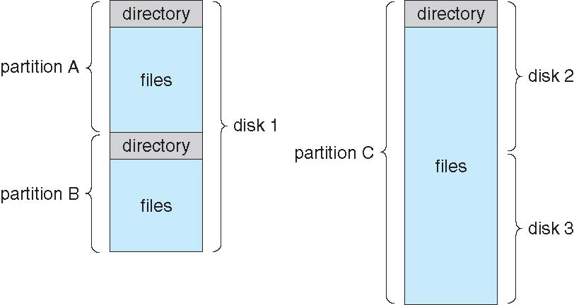
Review: Directory structure
Disk can be split into multiple partitions
Partitions can be raw (no file system) or formatted
Volume: formatted partition (e.g., C:\ on Windows)
Each volume needs its own directory
Effectively table of contents for volume
Tracks information about all files on volume
Imposes hierarchical structure in flat space

Slide 9
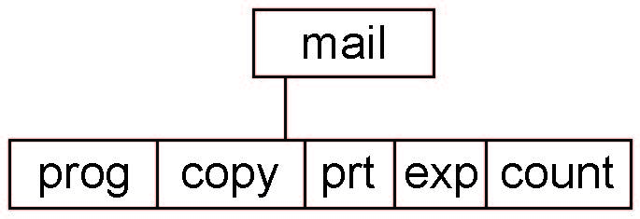
Review: Tree-Structured Directories
Absolute or relative path name
Absolute name is full path
Relative name—relative to current subdirectory or some other subdirectory
Creating a new file is done in current directory
Delete a file
rm <file-name>
Creating a new subdirectory is done in current directory
mkdir <dir-name>
Example: if in current directory /mail
mkdir count
Deleting “mail” ⇒ deleting the entire subtree rooted by “mail”

Slide 10
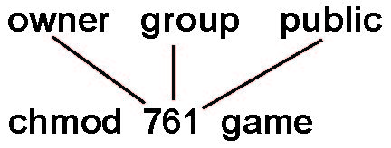
Review: Access Lists and Groups
Provides protection mechanism
Mode of access: read, write, execute
Three classes of users on Unix / Linux
RWX
a) owner access 7 ⇒ 1 1 1 RWX
b) group access 6 ⇒ 1 1 0
RWX
c) public access 1 ⇒ 0 0 1
Ask manager to create a group (unique name), say G, and add some users to the group.
For a particular file (say game) or subdirectory, define an appropriate access.
Attach a group to a file chgrp G game

Slide 11
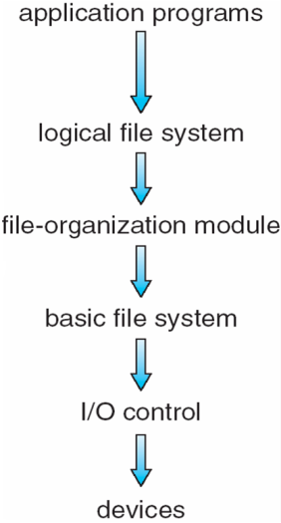
Review: file system layers
Device drivers manage I/O at I/O control layer
Basic file system translates higher-level commands to device driver
File organization module handles files, logical addresses, physical block
Logical file system handles metadata

Slide 12
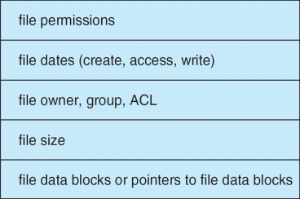
Review: file control blocks
Per-file File Control Block (FCB) contains many details about the file
inode number, permissions, size, dates
NTFS stores into in master file table using relational DB structures

Slide 13
Review: Allocation Methods
Contiguous allocation – each file occupies set of contiguous blocks
+ Simple, best performance in many cases
- Finding space (first fit/best fit/worst fit), knowing file size, external fragmentation, need compaction
Extent-based systems: modified contiguous alloc.
Extent = contiguous set of disk blocks
File = 1+ extents
Linked allocation – each file a linked list of blocks
+ No external fragmentation, compaction
- Slow block access; can improve by clustering blocks, but that increases internal fragmentation
File allocation table: modified linked allocation
Indexed allocation
Each file has its own index block(s) of pointers to its data blocks
Can have multi-level indexes to save space
Cluster blocks to improve performance
FFS asymmetric tree (next slide) → # levels based on file size

Slide 15
Review: Free-space management
File system maintains free-space list to track available blocks/clusters
Implementations
Bit vector or bit map
Linked list
Contiguous free blocks may be clustered to reduce amount of space needed to track free blocks

Slide 16
Review: Reliability
Reliability major factor for file systems
Losing data (due to system crash, power outage, etc.) in process’s address space is not a problem
Losing data in file system is
Transactions: mechanism for making multi-step operation atomic
Atomic HW operation: single-sector write
2 common methods
Shadowing: maintain two copies of data to update (inode, file block) with pointer to “current” version, update “shadow” version, then change pointer
Logging: write data to append-only log + commit sector, replay log later to write changes into file system

Slide 17
Review: Ordered & reliable messages
Application interface: messages seen in order they’re sent
Per-connection sequence # in message header
Order messages at receiver
Detect duplicates (result of perceived drops)
Dropped messages detected by sender
Lack of acknowledgement from receiver prior to timeout
Sender retransmits message
Errors detected through redundant info (checksum)
Drop corrupted messages → leads to retransmission

Slide 18
Review: Remote procedure call
Process on one machine calling procedure on another
Makes IPC appear like function call
Client sending request → function call
Client receiving response → function return
Server receiving request → function invocation
Server sending response → returning to caller
Stub: piece of code to convert parameters passed between client/server in RPC
Client stub marshals parameters and sends to server

Slide 19
Review: Distributed File Systems
Distributed file system (DFS) makes remote storage appear local
Transparent DFS hides the location where in the network the file is stored
May have multiple copies for reliability, performance (caching)
DFS hides existence of copies
Files often cached locally
Write-through caching for reliability; write-back for performance
Write-back variations—scan & flush files periodically, write-on-close
Cached copies must be kept consistent

Slide 20
Review: Protection
Ensure each object accessed correctly and only by those processes allowed to do so
Objects: HW (e.g. CPU, memory, printers, storage), SW (e.g. files, programs, semaphores)
Guiding principle – principle of least privilege
Programs, users and systems should be given just enough privileges to perform their tasks
Processes operate within domains
Collections of access rights
Access-right = <object-name, rights-set> where rights-set is a subset of all valid operations that can be performed on the object

Slide 21
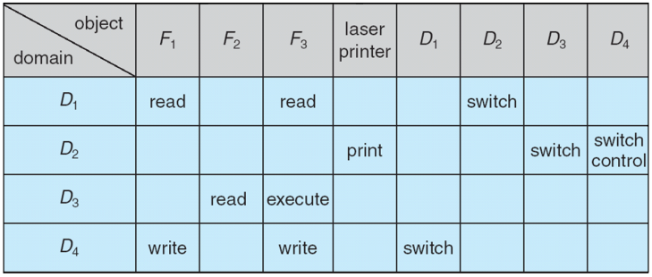
Review: Access Matrix
View protection as a matrix (access matrix)
Rows represent domains
Columns represent objects
Access(i, j) is the set of operations that a process executing in Domain_{i} can invoke on Object_{j}
Control change through copy, owner, control rights

Slide 22
Review: Access list implementations
Global table is simple, but can be large
Can’t group objects/domains
Access lists correspond to needs of users
Per-object list of domains, privileges
Capability lists useful for localizing information for a given process
Per-domain list of objects, privileges
Lock-key effective and flexible, keys can be passed freely from domain to domain, easy revocation
Object holds lock patterns, domain has keys

Slide 23
Review: Security
System secure if resources used and accessed as intended under all circumstances
Intruders attempt to breach security
Threat is potential security violation
Program threats: trojan horse, trap door, logic bomb, stack/buffer overflow, viruses
Network threats: worms, port scanning, DoS
Attack is attempt to breach security
Network attacks: masquerading, replay attack, man-in-middle, session hijacking

Slide 24
Review: Cryptography
Means to constrain potential senders (sources) and / or receivers (destinations) of messages
Based on secrets (keys)
Enables
Confirmation of source
Receipt only by certain destination
Trust relationship between sender and receiver
Sender encrypts data; receiver decrypts
Cryptography can be symmetric (same key for decryption/encryption) or asymmetric (often public key for encryption; private key for decryption)

Slide 25
Review: Authentication
Constraining set of potential senders of a message
Complementary to encryption
Also can prove message unmodified
Useful even when message encrypted because authenticators are typically shorter and therefore take less time to decrypt
Authentication forms
Message authentication code (MAC): cryptographic checksum using symmetric keys
Digital signature: asymmetric keys

Slide 26
Final notes
Next time: Final Exam (Sat, 5/6, 8-11 AM, Ball 214)
Reminders
Course evaluations to be posted on website
Blank copies will also be available outside my office
Please complete an evaluation and bring it to the final exam

Slide 27
Acknowledgements
These slides are adapted from the following sources:
Silberschatz, Galvin, & Gagne, Operating Systems Concepts, 9th edition
Anderson & Dahlin, Operating Systems: Principles and Practice, 2nd edition
Chen & Madhyastha, EECS 482 lecture notes, University of Michigan, Fall 2016

