Slide 1
EECE.4810/EECE.5730 Operating Systems
Instructor:
Dr. Michael Geiger
Spring 2017
Lecture 2:
Processes and process management

Slide 2
Lecture outline
Announcements/reminders
Sign up for the course discussion group on Piazza!
Correct info for TA: Peter Mack
E-mail: Peter_Mack1@student.uml.edu
Office hours: MW 12-1:50, T 1:20-2:30, Th 2:50-4
HW 1 to be posted by Wednesday; due TBD
Today’s lecture: processes
Process overview
Characteristics of process
Process control blocks and scheduling
Operating on processes

Slide 3
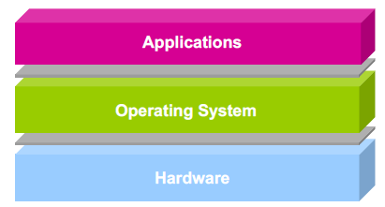
What does an OS do?
Software layer between application programs and physical hardware
Makes system easier to use for programs through abstractions
Manages allocation of resources

Slide 4
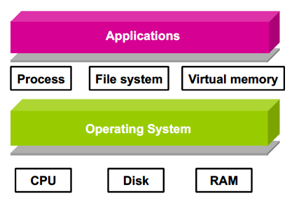
Operating system abstractions

Slide 5
Managing concurrency
Major source of OS complexity: managing concurrent use of resources
Execution cycles
Main memory & disk
I/O devices
Main techniques for managing complexity
Divide & conquer
Modularity and abstraction

Slide 6
Processes
Process: main abstraction for using CPU as resource
Processes make it simpler to run multiple things simultaneously
Sometimes called job or task
Process vs. program
Program is passive: i.e., executable file
Process is active: program in execution
One program may lead to multiple processes
i.e., multiple users running same program, one user running multiple copies of web browser
One process can create multiple child processes

Slide 7
Process management
Operating system is responsible for
Creation/deletion of processes
Scheduling processes
Maintaining state
Mapping processes to requested resources
Interaction between processes
Processes may be independent, but if they aren’t …
Synchronization: access to shared data
Communication: exchange of data/information
Deadlock handling: multiple processes get stuck waiting for shared resources

Slide 8
Components of a process
Process = 1+ running pieces of code (threads) + everything code can read/write
What information must OS track to manage process?
What do we need to know about code?
What specifically can process read/write?

Slide 9
Components of a process (cont.)
Process ID: “name” of process
Number uniquely identifying process
Program counter (PC): addr. of next inst.
For now, assume just 1 thread
Multiple threads → multiple PCs
Processor registers
Used for fast access to (intermediate) data
Address space
All memory process uses as it runs
What information is stored in memory?
How is memory organized?

Slide 10
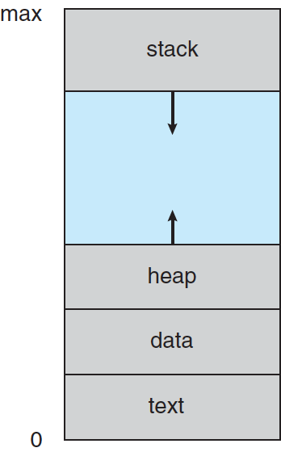
Process in memory
Text section: code
Data section: global variables
Stack: temp data, usually related to functions
Arguments
Return address
Local variables
Saved registers
Heap: dyn. allocated data
From C malloc(), C++ new …

Slide 11
Process State
As a process executes, it changes state
new: The process is being created
running: Instructions are being executed
waiting: The process is waiting for some event to occur
ready: The process is waiting to be assigned to a processor
terminated: The process has finished execution

Slide 12
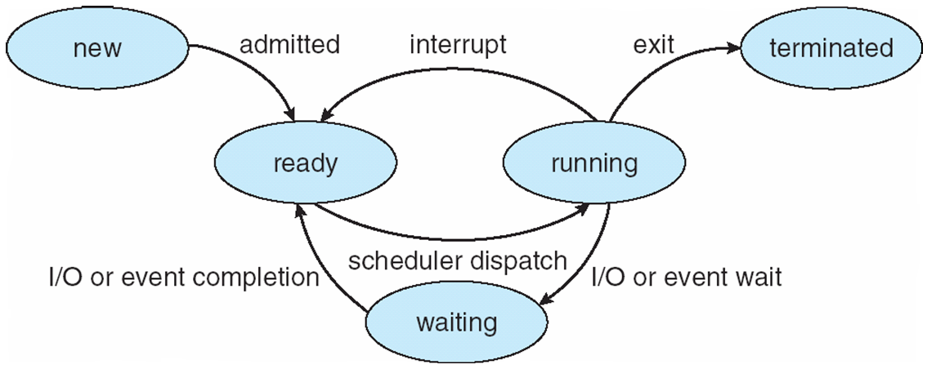
Diagram of Process State

Slide 13
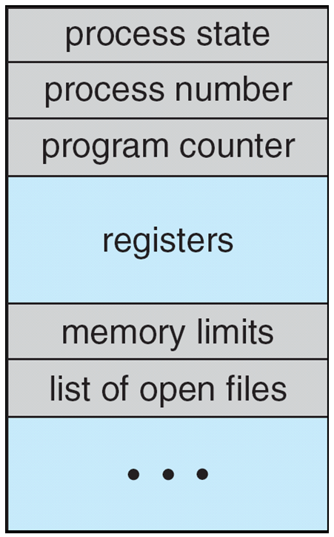
Process Control Block (PCB)
Information associated with each process
(also called task control block)
Process state – running, waiting, etc
Program counter – location of instruction to next execute
CPU registers – contents of all process-centric registers
CPU scheduling information- priorities, scheduling queue pointers
Memory-management information – memory allocated to the process
Accounting information – CPU used, clock time elapsed since start, time limits
I/O status information – I/O devices allocated to process, list of open files

Slide 14
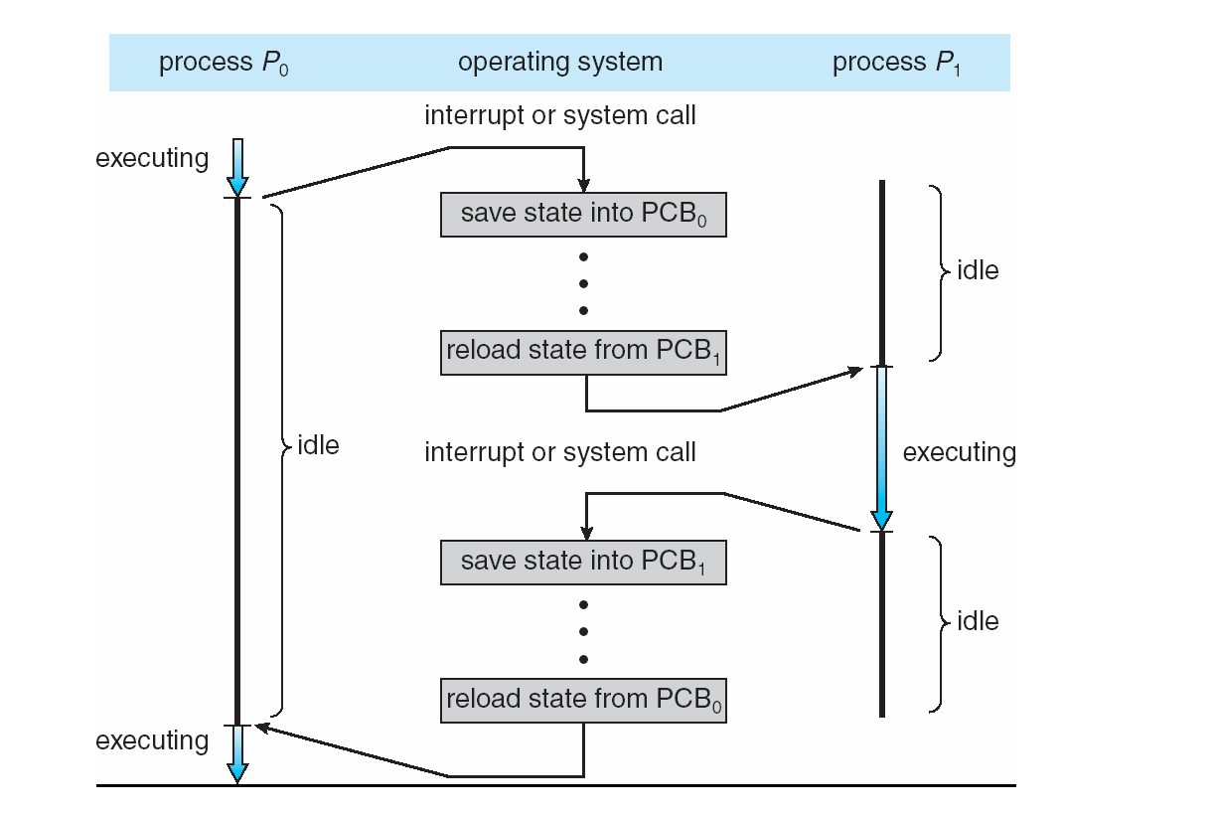
CPU Switch From Process to Process

Slide 15
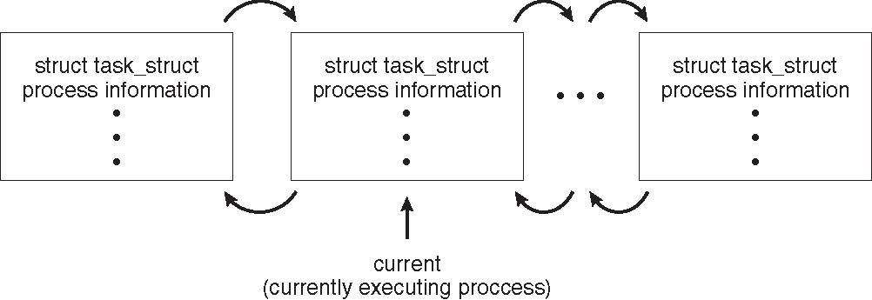
Process Representation in Linux
Represented by the C structure task_struct
pid t_pid; /* process identifier */ long state; /* state of the process */ unsigned int time_slice /* scheduling information */ struct task_struct *parent; /* this process’s parent */ struct list_head children; /* this process’s children */ struct files_struct *files; /* list of open files */ struct mm_struct *mm; /* address space of this process */

Slide 16
Process Scheduling
Process scheduler selects among available processes for next execution on CPU
Maintains scheduling queues of processes
Job queue – set of all processes in the system
Ready queue – set of all processes residing in main memory, ready and waiting to execute
Device queues – set of processes waiting for an I/O device
Processes migrate among the various queues

Slide 17
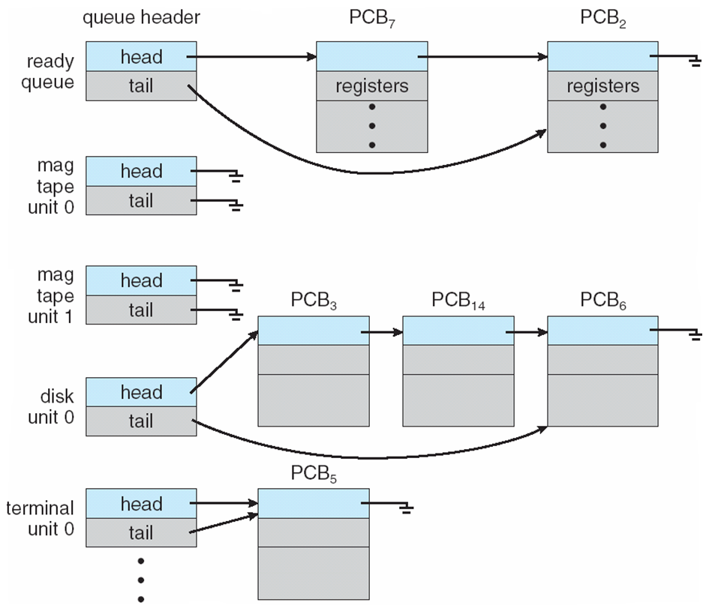
Ready Queue & I/O Device Queues

Slide 18
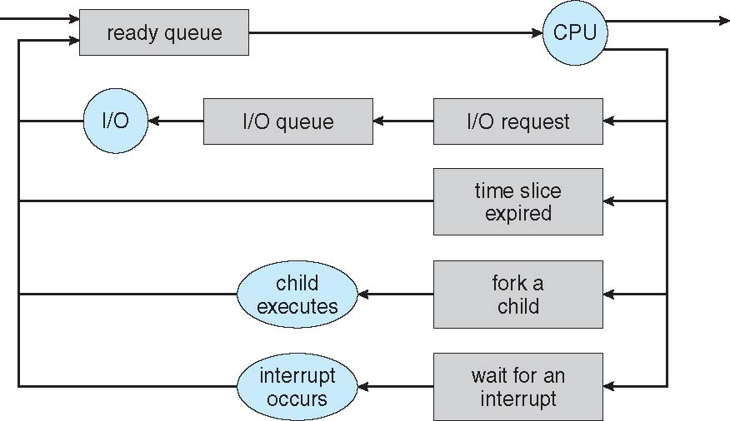
Representation of Process Scheduling
Queueing diagram represents queues, resources, flows
Shows how/why processes transition between queues

Slide 19
Context Switch
When CPU switches to another process, the system must save the state of the old process and load the saved state for the new process via a context switch
Context of a process represented in the PCB
Context-switch time is overhead; the system does no useful work while switching
The more complex the OS and the PCB ➔ the longer the context switch
Time dependent on hardware support
Some hardware provides multiple sets of registers per CPU ➔ multiple contexts loaded at once

Slide 20
Process Creation
Parent process create children processes, which, in turn create other processes, forming a tree of processes
Generally, process identified and managed via a process identifier (pid)
Resource sharing options
Parent and children share all resources
Children share subset of parent’s resources
Parent and child share no resources
Execution options
Parent and children execute concurrently
Parent waits until children terminate

Slide 21
Process tree in Linux

Slide 22
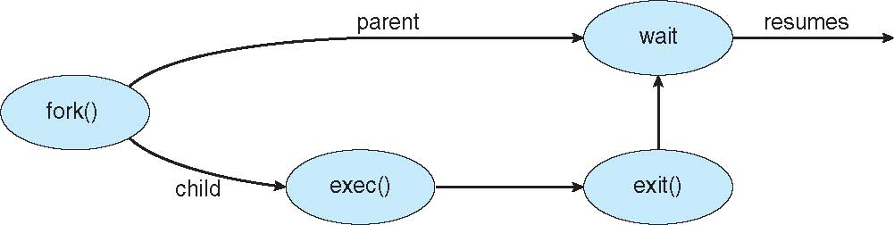
Process Creation (Cont.)
Address space
Child duplicate of parent
Child has a program loaded into it
UNIX examples
fork() system call creates new process
exec() system call used after a fork() to replace the process’ memory space with a new program

Slide 23
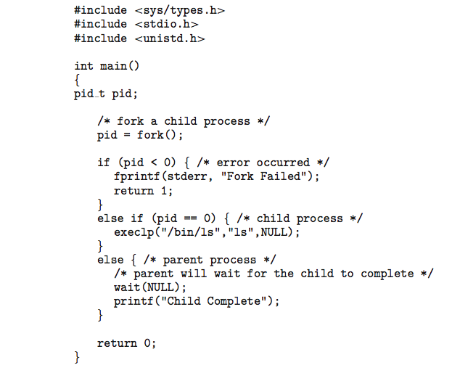
C Program Forking Separate Process
fork() return value
<0 if error
0 if child process
Remember, child initially copy of parent
>0 if parent
Child starts new executable using exec() or variation
execlp(): first argument is file to run
Others are arguments to that executable
Last execlp() arg must be NULL

Slide 24
C Program Forking Separate Process
Parent uses wait() system call to wait for child to finish
If expecting child to return status of completion, argument to wait() is address of int
i.e. wait(&status);

Slide 25
Process Termination
Process executes last statement and then asks the operating system to delete it using the exit() system call.
Returns status data from child to parent (via wait())
Process’ resources are deallocated by operating system
Parent may terminate the execution of children processes using the abort() system call. Some reasons for doing so:
Child has exceeded allocated resources
Task assigned to child is no longer required
The parent is exiting and the operating system does not allow a child to continue if its parent terminates

Slide 26
Process Termination
Some operating systems do not allow child to exists if its parent has terminated. If a process terminates, then all its children must also be terminated.
cascading termination. All children, grandchildren, etc. are terminated.
The termination is initiated by the operating system.
The parent process may wait for termination of a child process by using the wait()system call. The call returns status information and the pid of the terminated process
pid = wait(&status);
If no parent waiting (did not invoke wait()) process is a zombie
If parent terminated without invoking wait , process is an orphan

Slide 27
Final notes
Next time
Inter-process communication
Reminders:
Sign up for the course discussion group on Piazza!
HW 1 to be posted by Wednesday; due TBD

Slide 28
Acknowledgements
These slides are adapted from the following sources:
Silberschatz, Galvin, & Gagne, Operating Systems Concepts, 9th edition
Chen & Madhyastha, EECS 482 lecture notes, University of Michigan, Fall 2016

