Slide 1
EECE.4810/EECE.5730 Operating Systems
Instructor:
Dr. Michael Geiger
Spring 2017
Lecture 3:
Inter-process communication

Slide 2
Lecture outline
Announcements/reminders
Sign up for the course discussion group on Piazza!
Correct info for TA: Peter Mack
E-mail: Peter_Mack1@uml.edu
Office hours: MW 12-1:50, T 1:20-2:30, Th 2:50-4
HW 1 to be posted later today; due Wednesday, 2/1
Poll coming to schedule midterm (on or near W 3/8)
Ball 410 accounts created …
… not that you can get into the room yet
Will have ability to remotely access machines as well
Today’s lecture
Review
Characteristics of process
Process control blocks and scheduling
Operating on processes
Process deletion
Inter-process communication

Slide 3
Review: Processes
Process: program in execution
1+ running pieces of code (threads) + everything code can read/write
Program counter
Registers
Address space
Address space: all code/data stored in memory
Text section: code
Data section: global variables
Stack: temporary data related to functions
Heap: dynamically allocated data

Slide 4
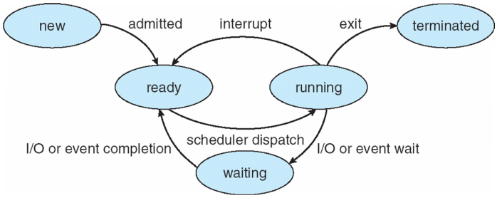
Review: Process State
new: Process is being created
running: Instructions are being executed
waiting: Process waiting for some event to occur
ready: Process waiting to be assigned to a processor
terminated: Process has finished execution

Slide 5
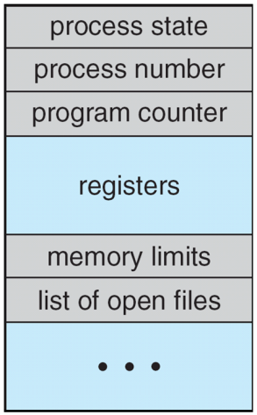
Review: Process Control Block (PCB)
Stored in memory
Used by OS to track process
Some info updated with every change
Process state
Scheduling queue pointers
Accounting info
Memory management
I/O status,
File list
Some info updated on context switch
Running → waiting/ready state
Save copies of PC, regs to PCB
Restored when running again

Slide 6
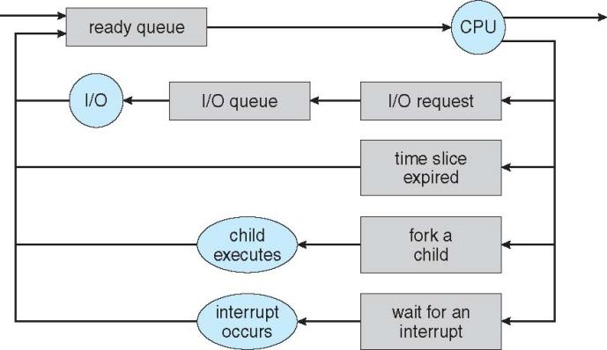
Review: Process scheduling basics
Ready queue: processes waiting to execute instructions
Each I/O device has its own queue as well

Slide 7
Review: Process creation
Each process has to be created by another process
Creator is called parent process
Created process is child process
Children can create other processes, forming process tree
Parent/child processes may share resources
Parent/child processes may execute concurrently, or parent may wait for child to terminate

Slide 8
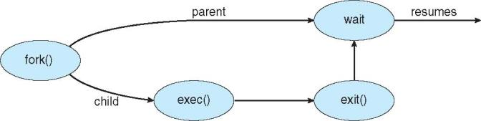
Review: Process creation (cont.)
Address space
Initially, child duplicate of parent
Child can load a separate program
UNIX examples
fork() system call creates new process
exec() system call used after a fork() to replace the process’ memory space with a new program

Slide 9
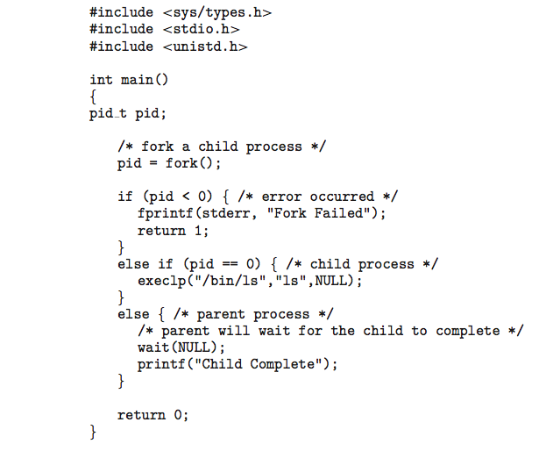
Review: Forking Separate Process
fork() return value
<0 if error
0 if child process
Remember, child initially copy of parent
>0 if parent
Actually returns PID of child
Child starts new executable using exec() or variation
execlp(): first argument is file to run
Others are arguments to that executable
Last execlp() arg must be NULL

Slide 10
Review: Forking Separate Process
Parent uses wait() system call to wait for child to finish
If expecting child to return status of completion, argument to wait() is address of int
i.e. wait(&status);

Slide 11
Process Termination
Process executes last statement and then asks the operating system to delete it using the exit() system call.
Returns status data from child to parent (via wait())
Process’ resources are deallocated by operating system
Parent may terminate the execution of children processes using the abort() system call. Some reasons for doing so:
Child has exceeded allocated resources
Task assigned to child is no longer required
The parent is exiting and the operating system does not allow a child to continue if its parent terminates

Slide 12
Process Termination
Some operating systems do not allow child to exists if its parent has terminated. If a process terminates, then all its children must also be terminated.
cascading termination. All children, grandchildren, etc. are terminated.
The termination is initiated by the operating system.
The parent process may wait for termination of a child process by using the wait()system call. The call returns status information and the pid of the terminated process
pid = wait(&status);
If no parent waiting (did not invoke wait()) process is a zombie
If parent terminated without invoking wait , process is an orphan

Slide 13

Multiprocess Architecture – Chrome
Many web browsers single process
If one web site causes trouble, entire browser can hang or crash
Google Chrome Browser is multiprocess with 3 different types of processes:
Browser process manages UI, disk and network I/O
Renderer process renders web pages, deals with HTML, Javascript. New renderer created for each website opened
Runs in sandbox restricting disk and network I/O, minimizing effect of security exploits
Plug-in process for each type of plug-in

Slide 14
Interprocess Communication
Processes may be independent or cooperating
Cooperating process can affect or be affected by other processes, including sharing data
Reasons for cooperating processes:
Information sharing
Computation speedup
Modularity
Convenience
Cooperating processes need interprocess communication (IPC)
Two models of IPC
Shared memory
Message passing

Slide 15
IPC Models
(a) Message passing (b) Shared memory

Slide 16
Cooperating Processes
Independent process cannot affect or be affected by the execution of another process
Cooperating process can affect or be affected by the execution of another process
Advantages of process cooperation
Information sharing
Computation speed-up
Modularity
Convenience

Slide 17
Producer-Consumer Problem
Paradigm for cooperating processes, producer process produces information that is consumed by a consumer process
unbounded-buffer places no practical limit on the size of the buffer
bounded-buffer assumes that there is a fixed buffer size

Slide 18
Bounded-Buffer – Shared-Memory Solution
Shared data
#define BUFFER_SIZE 10
typedef struct {
. . .
} item;
item buffer[BUFFER_SIZE];
int in = 0;
int out = 0;
Solution is correct, but can only use BUFFER_SIZE-1 elements

Slide 19
Bounded-Buffer – Producer
item next_produced;
while (true) {
/* produce an item in next produced */
while (((in + 1) % BUFFER_SIZE) == out)
; /* do nothing */
buffer[in] = next_produced;
in = (in + 1) % BUFFER_SIZE;
}

Slide 20
Bounded Buffer – Consumer
item next_consumed;
while (true) { while (in == out)
; /* do nothing */ next_consumed = buffer[out];
out = (out + 1) % BUFFER_SIZE;
/* consume the item in next consumed */
}

Slide 21
IPC– Shared Memory
An area of memory shared among the processes that wish to communicate
Communication under control of the user’s processes, not the operating system.
OS responsibility: providing mechanisms to allow user processes to synchronize actions when accessing shared memory
Synchronization (with regards to shared memory) means making sure accesses to memory seen in same order by all processes

Slide 22
IPC– Message Passing
Mechanism for processes to communicate and to synchronize their actions
Message system – processes communicate with each other without resorting to shared variables
IPC facility provides two operations:
send(message)
receive(message)
The message size is either fixed or variable

Slide 23
Message Passing (Cont.)
If processes P and Q wish to communicate, they need to:
Establish a communication link between them
Exchange messages via send/receive
Implementation issues:
How are links established?
Can a link be associated with more than two processes?
How many links can there be between every pair of communicating processes?
What is the capacity of a link?
Is the size of a message that the link can accommodate fixed or variable?
Is a link unidirectional or bi-directional?

Slide 24
Message Passing (Cont.)
Implementation of communication link
Physical:
Shared memory
Hardware bus
Network
Logical:
Direct or indirect
Synchronous or asynchronous
Automatic or explicit buffering

Slide 25
Direct Communication
Processes must name each other explicitly:
send (P, message) – send a message to process P
receive(Q, message) – receive a message from process Q
Properties of communication link
Links are established automatically
A link is associated with exactly one pair of communicating processes
Between each pair there exists exactly one link
The link may be unidirectional, but is usually bi-directional

Slide 26
Indirect Communication
Messages are directed and received from mailboxes (also referred to as ports)
Each mailbox has a unique id
Processes can communicate only if they share a mailbox
Properties of communication link
Link established only if processes share a common mailbox
A link may be associated with many processes
Each pair of processes may share several communication links
Link may be unidirectional or bi-directional

Slide 27
Indirect Communication
Operations
create a new mailbox (port)
send and receive messages through mailbox
destroy a mailbox
Primitives are defined as:
send(A, message) – send a message to mailbox A
receive(A, message) – receive a message from mailbox A

Slide 28
Indirect Communication
Mailbox sharing
P₁, P₂, and P₃ share mailbox A
P₁, sends; P₂ and P₃ receive
Who gets the message?
Solutions
Allow a link to be associated with at most two processes
Allow only one process at a time to execute a receive operation
Allow the system to select arbitrarily the receiver. Sender is notified who the receiver was.

Slide 29
Final notes
Next time
More on inter-process communication
Threads
Reminders:
Sign up for the course discussion group on Piazza!
HW 1 to be posted later today; due Wednesday, 2/1
Poll coming to schedule midterm (on or near W 3/8)

Slide 30
Acknowledgements
These slides are adapted from the following sources:
Silberschatz, Galvin, & Gagne, Operating Systems Concepts, 9th edition
Chen & Madhyastha, EECS 482 lecture notes, University of Michigan, Fall 2016

