Slide 1
EECE.4810/EECE.5730 Operating Systems
Instructor:
Dr. Michael Geiger
Spring 2017
Lecture 4:
More on inter-process communication

Slide 2
Lecture outline
Announcements/reminders
HW 1 due by 3:15 PM, Wednesday, 2/1
Everyone should now have card access to Ball 410
Will post directions on how to access machines directly
Poll coming to schedule midterm (on or near W 3/8)
Today’s lecture
Review
Process deletion
Inter-process communication basics
More details on inter-process communication

Slide 3
Review: Process Termination
Process ends using exit() system call
May be explicit, implicit (return from main → exit())
Returns status data from child to parent (via wait())
Process’ resources are deallocated by operating system
Parent may abort() executing child process if:
Child has exceeded allocated resources
Task assigned to child is no longer required
Parent exiting and OS does not allow child to continue if parent terminates
Not true in Linux, for example
OS initiates cascading termination

Slide 4
Review: Process Termination
Parent may wait() for child termination
wait() returns child PID, passes return status through pointer argument
pid = wait(&status);
If child terminates before parent invokes wait(), process is a zombie
If parent terminated without wait() , process is an orphan
Return status must be checked
In Linux, orphans assigned init as parent

Slide 5
Review: Interprocess Communication
May want processes to cooperate for
Information sharing (i.e., shared files)
Computation speedup (if procs can run in parallel)
Modularity (divide up program/system)
Convenience
Cooperating processes need 1 of 2 forms of interprocess communication (IPC)
Shared memory
Message passing

Slide 6
Review: IPC Models
(a) Message passing (b) Shared memory

Slide 7
Review: Shared Memory
One process creates shared region; allows others to access
Benefits:
Minimal OS involvement: just syscall to set up region
Otherwise, user processes manage communication
Typically need system-level synchronization primitives
Producer-consumer: share to 1+ variables
Unbounded buffer—no set size limit
Bounded buffer—fixed-length circular buffer

Slide 8
Shared Memory Example: POSIX
POSIX: Portable OS Interface
Standards for compatibility between OS
Defines API, shells, utilities for compatibility with UNIX
POSIX Shared Memory
Organized using memory-mapped files
In other words, shared region is treated as a file
Producer responsible for creating file, writing to shared memory
Consumer responsible for reading from shared memory

Slide 9
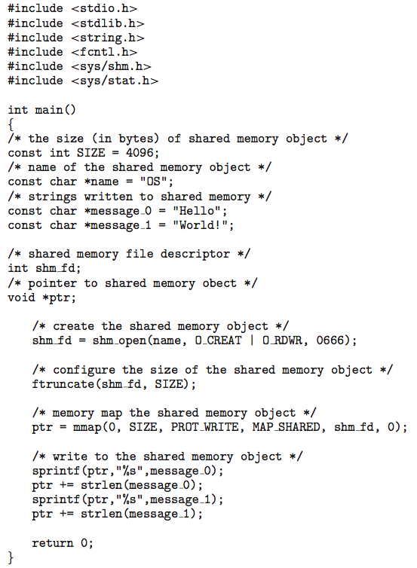
POSIX shared memory producer
shm_open(): create shared region
1st arg: name
2nd arg: mode for opening
O_CREAT: create if region does not exist
O_RDWR: region is both readable & writeable
3rd arg: file permissions
0666: user, group, and world have RW permissions
Returns file descriptor

Slide 10
POSIX shared memory producer (2)
ftruncate(): resize shared object
Newly created object defaults to size 0
mmap(): establishes mem-mapped file containing shared object
1st arg: starting address of mapping (if 0, let kernel choose address)
2nd arg: object size
3rd arg: memory protection
Writeable to producer
4th arg: determine if shareable
5th arg: file descriptor
6th arg: offset into file

Slide 11
POSIX shared memory producer (3)
mmap() returns pointer
Shared region can be written as a string
sprintf() takes string pointer as first argument; remaining arguments like printf()

Slide 12
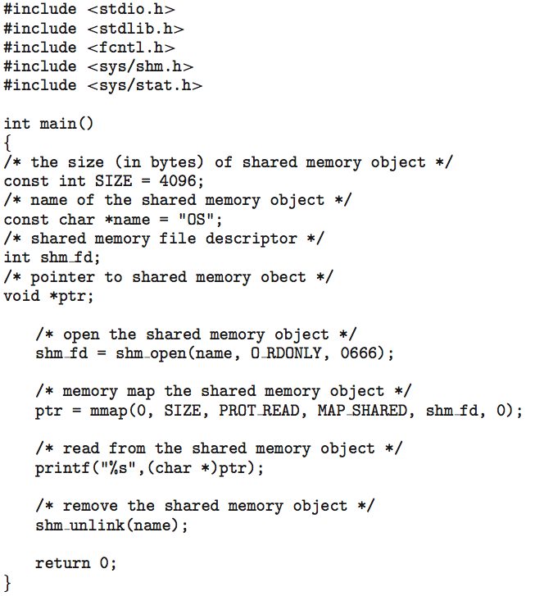
POSIX shared memory consumer
Consumer also opens/maps file
Uses read protection for mmap()
Removes shared object when it’s done

Slide 13
Review: Message Passing
OS provides mechanisms for processes to communicate and synchronize
Benefits
Good for small amounts of data—no synch. conflicts
Easier in distributed system—leverage existing links
Potentially faster on multi-core—no cache coherence issue
Message system – processes communicate with each other without resorting to shared variables
IPC facility provides two operations:
send(message)
receive(message)
The message size is either fixed or variable
Fixed is easier at system level; harder for programmer

Slide 14
Review: MP Producer-Consumer
Producer-consumer becomes trivial
message next_produced;
while (true) { /* produce an item in next produced */
send(next_produced);
}
message next_consumed;
while (true) {
receive(next_consumed);
/* consume the item in next consumed */
}

Slide 15
Review: Direct Communication
Processes must name each other explicitly:
send (P, message) – send a message to process P
receive(Q, message) – receive a message from process Q
Variant: receive from any process
Properties of communication link
Links are established automatically
A link is associated with exactly one pair of communicating processes
Between each pair there exists exactly one link
The link may be unidirectional, but is usually bi-directional
Downside: modifying process may require modifying all processes, since PIDs hard-coded

Slide 16
Review: Indirect Communication
Messages are directed and received from mailboxes (also referred to as ports)
Each mailbox has a unique id
Processes can communicate only if they share a mailbox
Properties of communication link
Link established only if processes share a common mailbox
A link may be associated with many processes
Each pair of processes may share several communication links
Link may be unidirectional or bi-directional

Slide 17
Review: Indirect Communication (2)
Mailbox may be
Process-owned: owner can receive, others can send
OS-owned: owner only receiver at first, but can share privilege
Operations
create a new mailbox (port)
send and receive messages through mailbox
destroy a mailbox
Primitives are defined as:
send(A, message) – send message to mailbox A
receive(A, message) – receive a message from mailbox A

Slide 18
Message Passing Example: Mach
Mach: microkernel-based OS
Microkernel: kernel contains minimal services
Process, memory management, IPC
Other OS services: system & user-level programs
Designed with distributed systems in mind
Basis for some modern OS (Tru64 UNIX, Mac OS X)
Mach communication is message based
Even system calls are messages
Each task gets two mailboxes at creation: Kernel and Notify
Notify: notifications of event occurrences

Slide 19
Message Passing Example: Mach
Only three system calls needed for message transfer
msg_send(), msg_receive(), msg_rpc()
RPC: remote procedure call
Mailboxes needed for communication, created via port_allocate()
Messages: fixed-length header, variable length body
Send and receive are flexible, for example four options if mailbox full:
Wait indefinitely (send only)
Wait at most n milliseconds
Return immediately
Temporarily cache a message (server task)

Slide 20
Message Passing Example: Windows
Message-passing centric via advanced local procedure call (LPC) facility
Only works between processes on the same system
Uses ports (like mailboxes) to establish and maintain communication channels
Communication works as follows:
The client opens a handle to the subsystem’s connection port object.
The client sends a connection request.
The server creates two private communication ports and returns the handle to one of them to the client.
The client and server use the corresponding port handle to send messages or callbacks and to listen for replies.

Slide 21
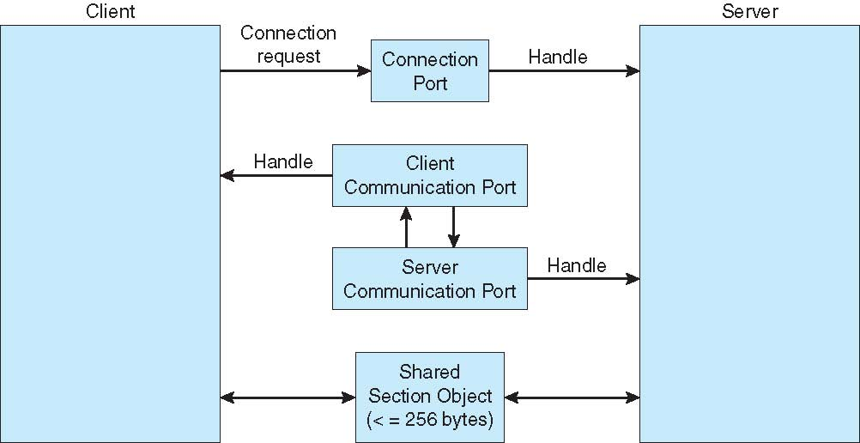
Local Procedure Calls in Windows

Slide 22
Communications in Client-Server Systems
Sockets
Remote Procedure Calls
Pipes

Slide 23
Sockets
A socket is defined as an endpoint for communication
Concatenation of IP address and port – a number included at start of message packet to differentiate network services on a host
The socket 161.25.19.8:1625 refers to port 1625 on host 161.25.19.8
Communication consists between a pair of sockets
All ports below 1024 are well known, used for standard services
Special IP address 127.0.0.1 (loopback) to refer to system on which process is running

Slide 24
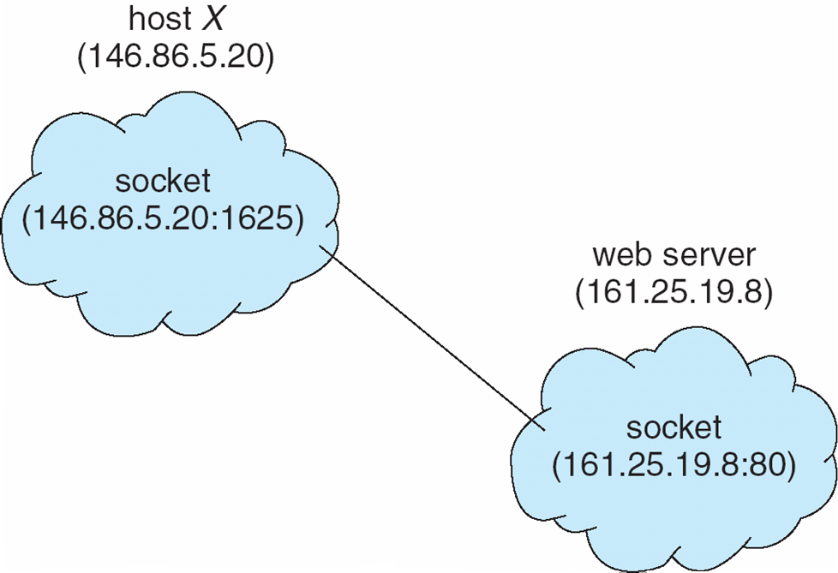
Socket Communication

Slide 25
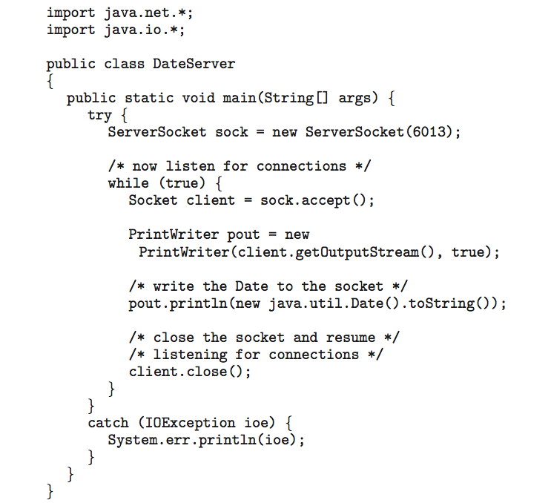
Sockets in Java
Three types of sockets
Connection-oriented (TCP)
Connectionless (UDP)
MulticastSocket class– data can be sent to multiple recipients
Consider this “Date” server:

Slide 26
Remote Procedure Calls
Remote procedure call (RPC) abstracts procedure calls between processes on networked systems
Again uses ports for service differentiation
Stubs – client-side proxy for the actual procedure on the server
The client-side stub locates the server and marshalls the parameters
The server-side stub receives this message, unpacks the marshalled parameters, and performs the procedure on the server
On Windows, stub code compile from specification written in Microsoft Interface Definition Language (MIDL)

Slide 27
Remote Procedure Calls (Cont.)
Data representation handled via External Data Representation (XDL) format to account for different architectures
Big-endian and little-endian
Remote communication has more failure scenarios than local
Messages can be delivered exactly once rather than at most once
OS typically provides a rendezvous (or matchmaker) service to connect client and server

Slide 28
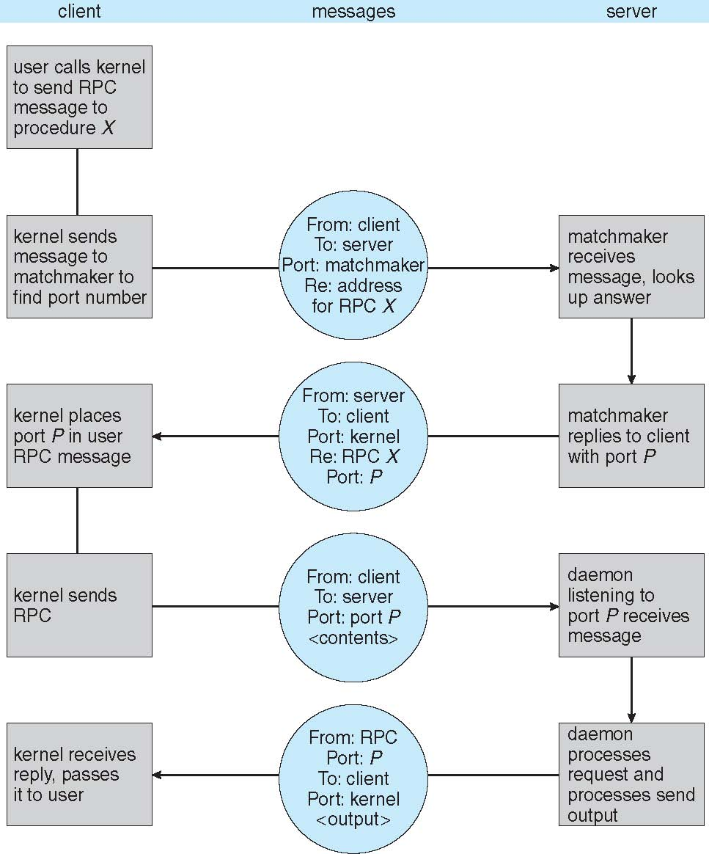
Execution of RPC

Slide 29
Pipes
Acts as a conduit allowing two processes to communicate
Issues:
Is communication unidirectional or bidirectional?
In the case of two-way communication, is it half or full-duplex?
Must there exist a relationship (i.e., parent-child) between the communicating processes?
Can the pipes be used over a network?
Ordinary pipes – cannot be accessed from outside the process that created it. Typically, a parent process creates a pipe and uses it to communicate with a child process that it created.
Named pipes – can be accessed without a parent-child relationship.

Slide 30
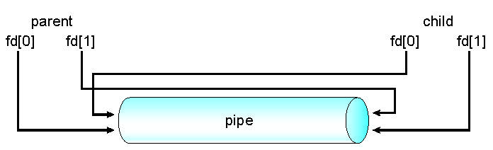
Ordinary Pipes
Ordinary Pipes allow communication in standard producer-consumer style
Producer writes to one end (the write-end of the pipe)
Consumer reads from the other end (the read-end of the pipe)
Ordinary pipes are therefore unidirectional
Require parent-child relationship between communicating processes
Windows calls these anonymous pipes

Slide 31
Named Pipes
Named Pipes are more powerful than ordinary pipes
Communication is bidirectional
No parent-child relationship is necessary between the communicating processes
Several processes can use the named pipe for communication
Provided on both UNIX and Windows systems

Slide 32
Final notes
Next time
Threads
Reminders:
HW 1 due by 3:15 PM, Wednesday, 2/1
Everyone should now have card access to Ball 410
Will post directions on how to access machines directly
Poll coming to schedule midterm (on or near W 3/8)

Slide 33
Acknowledgements
These slides are adapted from the following sources:
Silberschatz, Galvin, & Gagne, Operating Systems Concepts, 9th edition
Chen & Madhyastha, EECS 482 lecture notes, University of Michigan, Fall 2016

