Slide 1
EECE.4810/EECE.5730 Operating Systems
Instructor:
Dr. Michael Geiger
Spring 2017
Lecture 7:
Synchronization (continued)

Slide 2
Lecture outline
Announcements/reminders
HW 2 to be posted; likely due next Wednesday (2/15)
Poll coming to schedule midterm (on or near W 3/8)
Today’s lecture
Review: Synchronization
Locks
Condition variables
Monitors
More on synchronization
Programming with monitors
Semaphores
Low-level atomic operations
Deadlock

Slide 3
Review: Critical section
Code section that needs to be run atomically with respect to selected other pieces of code
If A and B are critical sections with respect to each other, multiple threads can’t interleave events from A and B
A and B mutually exclude each other
A and B often same piece of code
Critical sections must be atomic with respect to each other because they access shared resource

Slide 4
Review: Locks
A lock (or mutex) prevents another thread from entering a critical section
“Lock fridge while checking milk & shopping”
Two operations:
lock(): wait until lock is free, then acquire it
do {
if (lock is free) { // code in red
acquire lock // is atomic
break out of loop
}
} while (1);
unlock(): release lock
To minimize waiting, implement shared queue
Can lock entire queue or use fine-grained locking

Slide 5
Review: Condition variables
Avoid busy waiting by enabling thread to sleep inside critical section by (steps in red are atomic):
Release lock
Put thread on waiting list
Go to sleep
After being woken, call lock()
Each condition variable tracks list of threads waiting on that specific condition
Each condition variable associated with lock

Slide 6
Review: Condition variable operations
wait()
Atomically release lock, add thread to waiting list, then go to sleep
Thread must hold lock when calling wait()
signal()
Wake up one thread waiting on condition variable
If no thread waiting, does nothing
broadcast()
Wake up all threads waiting on condition variable
If no thread waiting, does nothing

Slide 7
Monitors
Combine two types of synchronization
Lock for mutual exclusion
Condition variables for ordering constraints
Monitor = 1 lock + CVs associated with lock

Slide 8
Programming with monitors
List shared data needed for problem
Assign locks to each group of shared data
Enforces mutual exclusion
Assign condition variables for every condition thread holding lock may have to wait on
Before/after conditions: while (!condition) wait
Call signal() or broadcast() when thread changes something another thread might be waiting for
Need queue of threads associated with every lock, condition variable

Slide 9
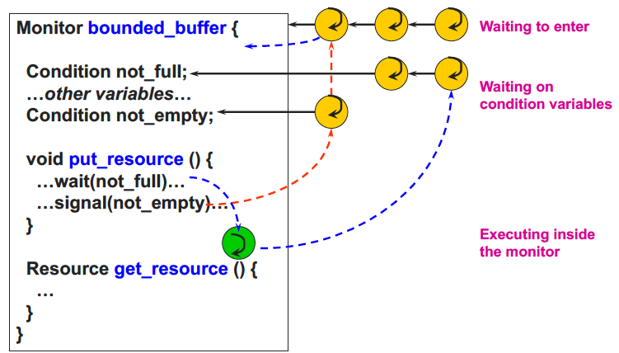
Monitor queues

Slide 10
Typical monitor programming
lock
while (!condition) {
wait
}
do work
signal other thread(s) about work
unlock

Slide 11
Producer-consumer with monitors
Re-examine producer-consumer problem using bounded buffer and monitors
Recall: bounded buffer
Allows producer(s)/consumer(s) to operate somewhat independently
If multiple threads, must synchronize actions to ensure shared buffer isn’t modified simultaneously
Common uses
Pipes
Communication systems

Slide 12
Producer-consumer with monitors (2)
Example: vending machine
Delivery person (producer) fills machine with drinks, 1 at a time
For simplification, assume 1 drink type (Coke)
Students (consumers) buy drinks
Finite space to store drinks
What variables are necessary?
Shared data?
Lock(s)?
Conditions to wait?

Slide 13
Producer-consumer with monitors(3)
Shared data
State of vending machine buffers
Number of Cokes in machine
Max number of cokes
Need one lock to protect data
Conditions
Producer must wait if buffer is full (waitProducer)
Consumer must wait if buffer is empty (waitConsumer)

Slide 14
Producer-consumer with monitors (4)
Consumer
cokeLock.lock()
take Coke
cokeLock.unlock();
Producer
cokeLock.lock()
add Coke
cokeLock.unlock();

Slide 15
Producer-consumer with monitors (5)
Consumer
cokeLock.lock()
if (numCokes == 0)
waitConsumer.wait();
take Coke
numCokes--;
waitProducer.signal();
cokeLock.unlock();
Producer
cokeLock.lock()
if (numCokes == MAX)
waitProducer.wait();
add Coke
numCokes++;
waitConsumer.signal();
cokeLock.unlock();

Slide 16
Semaphores
Generalized lock/unlock
Definition
Integer initialized to user-specific value
Supports two atomic operations
down(): wait for semaphore value to become positive, then atomically decrement by 1
Text calls this wait(); originally P()
To avoid busy waiting, semaphore can maintain list of waiters
Process calls block() once added to list
up(): increment semaphore value
Text calls this signal(); originally V()
If maintaining list, remove process from list and wake up
wakeup() call signals blocked process

Slide 17
Using semaphores
Semaphore types
Counting semaphore: Range of values unrestricted
Binary semaphore: values == 0 or 1 (same as lock)
Can implement both mutual exclusion and ordering
Mutual exclusion
Initialize semaphore to 1
down();
critical section
up();
Ordering
Typically initialize to 0
Say thread A must wait for thread B
Thread A Thread B
down(); complete task
continue work up();

Slide 18
Producer-consumer with semaphores
Need three semaphores
mutex: ensures mutual exclusion around code manipulating buffer
full: counts number of full slots in buffer
Initialized to 0
empty: counts number of empty slots in buffer
Initialized to maximum value

Slide 19
Producer-consumer with semaphores (2)
Producer
add Coke
Consumer
take coke

Slide 20
Producer-consumer with semaphores (3)
Producer
down(empty)
down(mutex)
add Coke
up(mutex)
up(full)
Consumer
down(full)
down(mutex)
take Coke
up(mutex)
up(empty)

Slide 21
Readers-Writers Problem
A data set is shared among a number of concurrent processes
Readers – only read the data set; they do not perform any updates
Writers – can both read and write
Problem – allow multiple readers to read at the same time
Only one single writer can access the shared data at the same time
Shared Data
Data set
Semaphore rw_mutex initialized to 1
Semaphore mutex initialized to 1
Integer read_count initialized to 0

Slide 22
Readers-Writers Problem (Cont.)
The structure of a writer process
do { down(rw_mutex);
... /* writing is performed */
...
up(rw_mutex);
} while (true);

Slide 23
Readers-Writers Problem (Cont.)
The structure of a reader process
do { down(mutex); read_count++; if (read_count == 1)
down(rw_mutex);
up(mutex);
... /* reading is performed */
...
down(mutex); read count--; if (read_count == 0)
up(rw_mutex);
up(mutex);
} while (true);

Slide 24
Readers-Writers Problem notes
mutex used to restrict access to read_count variable
rw_mutex uses:
Ensure only one writer active at a time
Decremented by 1st reader to enter critical section
Prevents writer from overwriting data as it’s read
Incremented by last reader to exit critical section
Allows writer to update data again
If writer is writing and n readers waiting
1 reader waiting on rw_mutex
n-1 readers waiting on mutex

Slide 25
Comparing monitors/semaphores
Semaphores provide 1 mechanism for both mutual exclusion and ordering, while monitors use separate mechanisms for each
Elegant mechanism
Can be difficult to use
Monitor lock = binary semaphore (init to 1)
lock() = down()
unlock() = up()

Slide 26
Comparing CVs/semaphores
Condition variable
while (cond) {wait();}
Conditional code in user program
User writes customized condition → more flexible
User provides shared var and protects with lock
No memory of past signals
Semaphore
down()
Conditional code in semaphore definition
Condition specified by semaphore definition
Semaphore provides shared var (int) and thread-safe ops (down, up)
Remembers past up calls

Slide 27
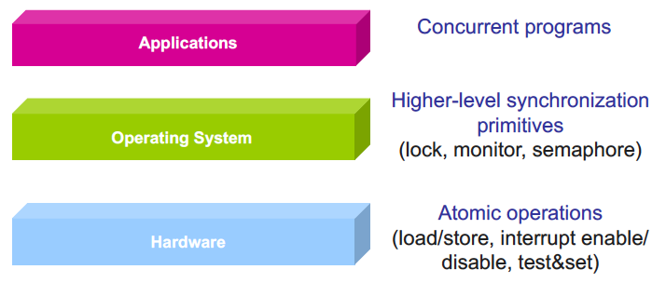
Higher-level synchronization
Higher-level abstraction → easier for programmers

Slide 28
test_and_set Instruction
Definition:
boolean test_and_set (boolean *target)
{
boolean rv = *target;
*target = TRUE;
return rv:
}
Executed atomically
Returns the original value of passed parameter
Set the new value of passed parameter to “TRUE”.

Slide 29
test_and_set operation
Definition:
boolean test_and_set (boolean *target)
{
boolean rv = *target;
*target = TRUE;
return rv:
}
If target is FALSE, it’s changed to TRUE
If target is TRUE, value is unchanged
Since test_and_set is atomic, only one thread sees change from FALSE to TRUE
Use this operation with lock variable → only one thread gains access to lock
If test_and_set returns TRUE, know another thread already gained access to lock

Slide 30
Solution using test_and_set()
Shared Boolean variable lock, initialized to FALSE
Solution:
do { while (test_and_set(&lock))
; /* do nothing */
/* critical section */
lock = false;
/* remainder section */
} while (true);

Slide 31
compare_and_swap Instruction
Definition:
int compare _and_swap(int *value, int expected, int new_value) {
int temp = *value;
if (*value == expected)
*value = new_value;
return temp;
}
Executed atomically
Returns the original value of passed parameter “value”
Set the variable “value” the value of the passed parameter “new_value” but only if “value” ==“expected”. That is, the swap takes place only under this condition.

Slide 32
Solution using compare_and_swap
Shared integer “lock” initialized to 0;
Solution:
do { while (compare_and_swap(&lock, 0, 1) != 0)
; /* do nothing */
/* critical section */
lock = 0;
/* remainder section */
} while (true);

Slide 33
Deadlock
Resources: something a thread needs and will therefore wait for
Locks, disk space, memory, CPU
Deadlock
Cyclical wait for resources, which prevents involved threads from making progress
Example:
Thread A Thread B
x.lock y.lock
y.lock x.lock
… …
y.unlock x.unlock
x.unlock y.unlock

Slide 34
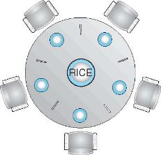
Dining-Philosophers Problem
Philosophers spend their lives alternating thinking and eating
Don’t interact with their neighbors, occasionally try to pick up 2 chopsticks (one at a time) to eat from bowl
Need both to eat, then release both when done
In the case of 5 philosophers
Shared data
Bowl of rice (data set)
Semaphore chopstick [5] initialized to 1

Slide 35
Dining-Philosophers Problem Algorithm
The structure of Philosopher i:
do {
down(chopstick[i] );
down(chopStick[ (i + 1) % 5] );
// eat
up(chopstick[i] );
up(chopstick[ (i + 1) % 5] );
// think
} while (TRUE);
What is the problem with this algorithm?

Slide 36
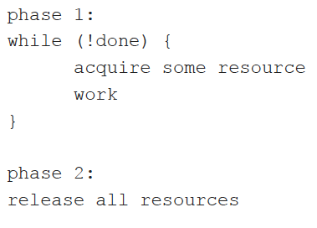
Generic multithreaded program

Slide 37
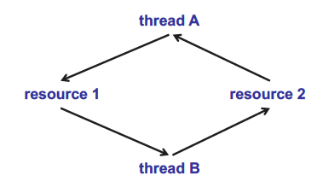
Necessary deadlock conditions
Limited resource: not enough to serve all threads simultaneously
Hold and wait: threads hold resources while waiting to acquire other resources
No preemption: thread system can’t force one thread to give up resources
Cyclical chain of requests

Slide 38
Handling deadlock
General strategies
Ignore (not very effective)
Detect and fix
Find cycles in resource graph
Don’t allow requests that would cause cycle to occur
Prevent

Slide 39
Deadlock prevention
Eliminate one of four necessary conditions
Increase resources to decrease waiting
Eliminate hold and wait: move resource acquisition to beginning
If can’t (atomically) get all resources, release everything
Phase 1a: acquire all resources
Phase 1b: while (!done) {work}
Phase 2: release all resources

Slide 40
Banker’s Algorithm
Similar to reserving all resources at beginning, but with more concurrency
State maximum resource needs in advance (without acquiring)
May block when thread attempts to acquire resource
General structure
Phase 1a: state maximum resource need
Phase 1b: while (!done) {
acquire some resource (block
if not safe)
work
}
Phase 2: release all resources

Slide 41
Banker’s Algorithm example
Model bank loaning money
Bank has $6000
Customers establish credit limit (max $ needed)
Customers borrow in stages and return all money when done
Solution 1: Bank promises to give money immediately upon request, up to limit
Ann asks for $2000 limit
Bob asks for $4000 limit
Charlie asks for $6000 limit
Can bank approve all of them?

Slide 42
Banker’s Algorithm example (2)
Solution 2: Bank approves all limits, but may block individual requests
Ann requests $2000 limit (bank ok’s)
Bob requests $4000 limit (bank ok’s)
Charlie requests $6000 limit (bank ok’s)
Ann takes out $1000 ($5000 left in bank)
Bob takes out $2000 ($3000 left in bank)
Charlie wants to take out $2000
Can this request be satisfied?
Is there a way for all threads to get maximum resources and therefore finish?

Slide 43
Banker’s Algorithm example (3)
Prior example can finish in following order
Charlie takes out $2000 ($1000 left in bank)
Ann takes out $1000, then finishes ($2000 left in bank)
Bob takes out $2000, then finishes ($4000 left in bank)
Charlie takes out $4000, then finishes ($6000 left in bank

Slide 44
Banker’s Algorithm example (4)
Another scenario
Ann requests $2000 limit (bank ok’s)
Bob requests $4000 limit (bank ok’s)
Charlie requests $6000 limit (bank ok’s)
Ann takes out $1000 ($5000 left in bank)
Bob takes out $2000 ($3000 left in bank)
Charlie wants to take out $2500
Request won’t be satisfied—no way for all to finish
Algorithm allows system to overcommit resources without deadlock
Sum of max resource needs can be greater than total resources as long as threads can finish
Difficult to anticipate maximum resources

Slide 45
Final notes
Next time
CPU scheduling
Reminders:
HW 2 to be posted; likely due next Wednesday (2/15)
Poll coming to schedule midterm (on or near W 3/8)

Slide 46
Acknowledgements
These slides are adapted from the following sources:
Silberschatz, Galvin, & Gagne, Operating Systems Concepts, 9th edition
Chen & Madhyastha, EECS 482 lecture notes, University of Michigan, Fall 2016

