Slide 1
EECE.2160
ECE Application Programming
Instructors:
Dr. Michael Geiger
Summer 2016
Lecture 10:
PE4: Structures
Dynamic memory allocation

Slide 2
Lecture outline
Announcements/reminders
  Program 7 due today
  Program 8 due Monday, 6/20
  P1-P4 grades complete; regrades due 6/24 (deadline for all programs)
    Fix errors and overwrite old file in Dropbox folder—do not create new version of same file
    E-mail Dr. Geiger once new submission uploaded
  Exam 3: Thursday, 6/23
    Will be allowed one 8.5” x 11” note sheet
Today’s class
  PE4: Structures
  Dynamic memory allocation
ECE Application Programming: Lecture 11

Slide 3
Review: Structures
User-defined types; example:
typedef struct {
char first[50];
char middle;
char last[50];
unsigned int ID;
double GPA;
} StudentInfo;
Can define variables of that type
  Scalar: StudentInfo student1;
  Array: StudentInfo classList[10];
  Pointer: StudentInfo *sPtr = &student1;
Access members using
  Dot operator: student1.middle = ‘J’;
  Arrow (if pointers): sPtr->GPA = 3.5;
Typically passed to functions by address
ECE Application Programming: Lecture 11

Slide 4
Review: Nested structures
Structures can contain other structures:
  typedef struct {
  char first[50]; // First name
  char middle; // Middle initial
  char last[50]; // Last name
  } Name;
  typedef struct {
  Name sname; // Student name
  unsigned int ID; // ID #
  double GPA; // Grade point
  } StudentInfo;
Will need multiple dot operators to access field within nested structure
  Given StudentInfo s1;
  s1.sname ← Name structure within s1
  s1.sname.middle ← middle initial of name within s1
ECE Application Programming: Lecture 11

Slide 5
Today’s exercise
Given header files, main program
Complete specified functions
  For the Name structure
    void printName(Name *n): Print the name pointed to by n, using format <first> <middle>. <last>
    void readName(Name *n): Prompt for and read a first, middle, and last name, and store them in the structure pointed to by n
  StudentInfo functions on next slide
ECE Application Programming: Lecture 11

Slide 6
Today’s exercise (continued)
Given header files, main program
Complete specified functions
  Name functions on previous slide
  For the StudentInfo structure
    void printStudent(StudentInfo *s): Print information about the student pointed to by s
    void readStudent(StudentInfo *s): Prompt for and read information into the student pointed to by s
    void printList(StudentInfo list[], int n): Print the contents of an array list that contains n StudentInfo structures
    int findByLName(StudentInfo list[], int n, char lname[]): Search for the student with last name lname in the array list. Return the index of the structure containing that last name, or -1 if not found
    int findByID(StudentInfo list[], int n, unsigned int sID): Search for the student with ID # sID in the array list. Return the index of the structure containing that last name, or -1 if not found
ECE Application Programming: Lecture 11

Slide 7
Name functions
void printName(Name *n) {
printf("%s %c. %s\n", n->first,
n->middle, n->last);
}
void readName(Name *n) {
printf("Enter name: ");
scanf("%s %c. %s", n->first,
&n->middle, n->last);
}
ECE Application Programming: Lecture 11

Slide 8
Single StudentInfo functions
void printStudent(StudentInfo *s) {
printName(&s->sname);
printf("ID #%.8u\n", s->ID);
printf("GPA: %.2lf\n",
s->GPA);
}
ECE Application Programming: Lecture 11

Slide 9
Single StudentInfo functions (cont.)
void readStudent(StudentInfo *s) {
readName(&s->sname);
printf("Enter ID #: ");
scanf("%u", &s->ID);
printf("Enter GPA: ");
scanf("%lf", &s->GPA);
}
ECE Application Programming: Lecture 11

Slide 10
printList()
void printList(StudentInfo list[],
int n) {
int i; // Loop index
for (i = 0; i < n; i++) {
printStudent(&list[i]);
printf("\n"); }
}
ECE Application Programming: Lecture 11

Slide 11
findByLName()
int findByLName(StudentInfo list[], int n,
char lname[]) {
int i; // Loop index
// Search for student with matching name
// in list
for (i = 0; i < n; i++) {
if (strcmp(lname, list[i].sname.last) == 0)
return i;
}
// If end of loop reached, student wasn’t
// found
return -1;
}
ECE Application Programming: Lecture 11

Slide 12
findByID()
int findByID(StudentInfo list[], int n,
unsigned int sID) {
int i; // Loop index
// Search for student with matching ID in list
for (i = 0; i < n; i++) {
if (sID == list[i].ID)
return i;
}
// If end of loop reached, student wasn’t
// found
return -1;
}
ECE Application Programming: Lecture 11

Slide 13
Justifying dynamic memory allocation
Data structures (i.e., arrays) usually fixed size
  Array length set at compile time
  Can often lead to wasted space
May want ability to:
  Choose amount of space needed at run time
    Allows program to determine amount
  Modify size as program runs
    Data structures can grow or shrink as needed
Dynamic memory allocation allows above characteristics
ECE Application Programming: Lecture 11

Slide 14
Allocation functions (in <stdlib.h>)
All return pointer to allocated data of type void * (no base type—just an address)
  Must cast to appropriate type
Arguments of type size_t: unsigned integer
Basic block allocation:
void *malloc(size_t size);
Allocate block and clear it:
void *calloc(size_t nmemb,
size_t size);
Resize previously allocated block:
void *realloc(void *ptr,
size_t size);
ECE Application Programming: Lecture 11

Slide 15
Basic allocation with malloc()
void *malloc(size_t size);
Allocates size bytes; returns pointer
  Returns NULL if unsuccessful
Example:
int *p;
p = malloc(10000);
if (p == NULL) {
/* Allocation failed */
}
ECE Application Programming: Lecture 11

Slide 16
Type casting
All allocation functions return void *
Automatically type cast to appropriate type
Can explicitly perform type cast:
int *p;
p = (int *)malloc(10000);
Some IDEs (including Visual Studio) strictly require type cast
ECE Application Programming: Lecture 11

Slide 17
Allocating/clearing memory: calloc()
void *calloc(size_t nmemb,
size_t size);
Allocates (nmemb * size) bytes
Sets all bits in range to 0
Returns pointer (NULL if unsuccessful)
Example: integer array with n values
int *p;
p = (int *)calloc(n, sizeof(int));
ECE Application Programming: Lecture 11

Slide 18
Resizing allocated space: realloc()
void *realloc(void *ptr,
size_t size);
ptr must point to previously allocated space
Will allocate size bytes and return pointer
  size = new block size
Rules:
  If block expanded, new bytes aren’t initialized
  If block can’t be expanded, returns NULL; original block unchanged
  If ptr == NULL, behaves like malloc()
  If size == 0, will free (deallocate) space
Example: expanding array from previous slide
p = (int *)realloc(p,
(n+1)*sizeof(int));
ECE Application Programming: Lecture 11

Slide 19
Deallocating memory: free()
All dynamically allocated memory should be deallocated when you are done using it
  Returns memory to list of free storage
  Once freed, program should not use location
Deallocation function:
void free(void *ptr);
Example:
int *p;
p = (int *)malloc(10000);
...
free(p);
ECE Application Programming: Lecture 11

Slide 20
Application: arrays
One common use of dynamic allocation: arrays
Can determine array size, then create space
  Use sizeof() to get # bytes per element
Array notation can be used with pointers
int i, n;
int *arr;
printf("Enter n: ");
scanf("%d", &n);
arr = (int *)malloc(n * sizeof(int));
for (i = 0; i < n; i++)
arr[i] = i;
ECE Application Programming: Lecture 11

Slide 21
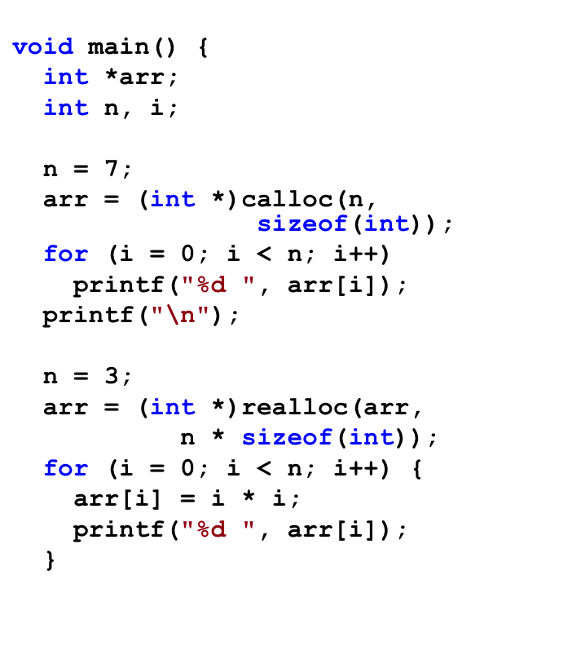
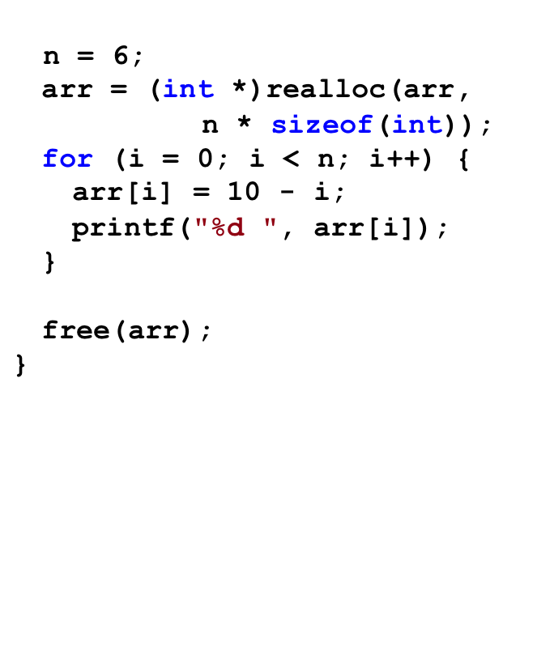
Example: what does program print?
ECE Application Programming: Lecture 11

Slide 22
Solution
Output:
0 0 0 0 0 0 0
0 1 4 10 9 8 7 6 5
ECE Application Programming: Lecture 11

Slide 23
Pitfalls: memory leaks
Changing pointers leaves inaccessible blocks
Example:
p = malloc(1000);
q = malloc(1000);
p = q;
Block originally accessed by p is “garbage”
  Won’t be deallocated—wasted space
Solution: free memory before changing pointer
p = malloc(1000);
q = malloc(1000);
free(p);
p = q;
ECE Application Programming: Lecture 11

Slide 24
Pitfalls: dangling pointers
free() doesn’t change pointer
  Only returns space to free list
Pointer is left “dangling”
  Holds address that shouldn’t be accessed
Solution: assign new value to pointer
  Could reassign immediately (as in previous slide)
  Otherwise, set to NULL
  free(p);
  p = NULL;
ECE Application Programming: Lecture 11

Slide 25
Dynamically allocated strings
Strings → arrays of characters
Basic allocation: based on string length
  sizeof(char) is always 1
  Need to account for null character
Example: copying from s to str
  char *str = (char *)malloc(strlen(s) + 1);
  strcpy(str, s);
Note: dynamically allocated strings must be deallocated when you are done with them
ECE Application Programming: Lecture 11

Slide 26
Dynamically allocated 2D arrays
Think of each row as 1D array
  2D array: an array of 1D arrays
Since array is technically a pointer, 2D array can be implemented as array of pointers
  Data type: “pointer to pointer”
    Example: int **twoDarr;
  1st dimension depends on # rows
    twoDarr = (int **)malloc(nRows * sizeof(int *));
  2nd dimension depends on # columns
    Must allocate for each row
    for (i = 0; i < nRows; i++)
    twoDarr[i] = (int *)malloc(nCols * sizeof(int));
ECE Application Programming: Lecture 11

Slide 27
Example
Complete each of the following functions
  char *readLine(): Read a line of data from the standard input, store that data in a dynamically allocated string, and return the string (as a char *)
    Hint: Read the data one character at a time and repeatedly reallocate space in the string
  int **make2DArray(int total, int nR): Given the total number of values and number of rows to be stored in a two-dimensional array, determine the appropriate number of columns, allocate the array, and return its starting address
    Note: if nR does not divide evenly into total, round up. In other words, an array with 30 values and 4 rows should have 8 columns, even though 30 / 4 = 7.5
ECE Application Programming: Lecture 11

Slide 28
Solution
char *readLine() {
char c; // Input character
// String to hold line
char *str = (char *)malloc(1);
int n = 1; // Length of str
// Repeatedly store character in str until
// '\n' is read; resize str to hold char
while ((c = getchar()) != '\n') {
str = (char *)realloc(str, n+1);
str[n-1] = c;
n++;
}
str[n-1] = '\0'; // Null terminator
return str;
}
ECE Application Programming: Lecture 11

Slide 29
Solution (continued)
int **make2DArray(int total, int nR) {
int **arr; // 2-D array
int nCols; // # of columns
int i; // Row index
// Calculate nCols; round up if nR does not divide evenly
nCols = total / nR;
if ((total % nR) != 0)
nCols++;
// Allocate array--first array of rows, then each row
arr = (int **)malloc(nR * sizeof(int *));
for (i = 0; i < nR; i++)
arr[i] = (int *)malloc(nCols * sizeof(int));
return arr;
}
ECE Application Programming: Lecture 11

Slide 30
Next time
Dynamically allocated data structures
Reminders:
  Program 7 due today
  Program 8 due Monday, 6/20
  P1-P4 grades complete; regrades due 6/24 (deadline for all programs)
    Fix errors and overwrite old file in Dropbox folder—do not create new version of same file
    E-mail Dr. Geiger once new submission uploaded
  Exam 3: Thursday, 6/23
    Will be allowed one 8.5” x 11” note sheet
ECE Application Programming: Lecture 11

