Slide 1
16.216
ECE Application Programming
Instructor: Dr. Michael Geiger
Summer 2015
Lecture 10:
Structures
Dynamic memory allocation

Slide 2
Lecture outline
Announcements/reminders
  Will drop lowest program score (keep 9 of 10)
  Program 8 due 6/19
  Program 9 due 6/23
  Program 10 due 12:00 noon, 6/26
  Final Exam: Thursday, 6/25
Review
  Binary and hexadecimal values
  Bitwise operators
Today’s lecture
  Structures
  Dynamic memory allocation
ECE Application Programming: Lecture 10

Slide 3
Review: bit manipulation
Bitwise operators: | & ^ ~
  Used for desired logical operations
  Used to set/clear bits
Bit shifts: << >>
  Used to shift bits into position
  Used for multiplication/division by powers of 2
ECE Application Programming: Lecture 10

Slide 4
Review: Common bitwise operations
General operation | Logical operation | Bit mask values in positions that change | Bit mask values in positions staying same | Example: modify bits 8-23 (middle 16 bits)
Set bit(s) Bits changed to 1 | OR | 1 | 0 | n = n | 0x00FFFF00
Clear bit(s) Bits changed to 0 | AND | 0 | 1 | n = n & 0xFF0000FF
Flip bit(s) All 0 → 1; All 1 → 0 | XOR | 1 | 0 | n = n ^ 0x00FFFF00
ECE Application Programming: Lecture 10

Slide 5
Review: Extracting bits
Isolate bits you want
  AND with bit mask to clear unwanted bits
    Positions you want to keep = 1
    Positions you want to clear = 0
Shift bits to right
  Shift amount = original position of lowest bit
Can combine steps in single operation
  Examples:
    Upper 16 bits of x = (x & 0xFFFF0000) >> 16
    Bits 1-6 of x = (x & 0x0000007E) >> 1
ECE Application Programming: Lecture 10

Slide 6
Review: hexadecimal output
To print a number in hex, use %x or %X
  %x prints characters a-f in lowercase
  %X prints characters A-F in uppercase
To show leading 0x, use the # flag
To show leading 0s, use precision with total # chars
  Field width + 0 flag also works unless value = 0
Examples (assume var1 = 0x1A2B)
  printf(“%x”, var1) → 1a2b
  printf(“%X”, var1) → 1A2B
  printf(“%#x”, var1) → 0x1a2b
  printf(“%.6x”, var1) → 001a2b
  printf(“%#.6x”, var1) → 0x001a2b
ECE Application Programming: Lecture 10

Slide 7
Structures
Arrays: groups of data with same type
Structures: groups of data with (potentially) different types
Example: record to store information about student:
  First name (char [])
  Middle initial (char)
  Last name (char [])
  ID # (unsigned int)
  GPA (double)
Any data type—scalar, array, pointer (even other structures) allowed
ECE Application Programming: Lecture 10

Slide 8
Declaring structure types
Can define structure as a type using typedef
  Could omit typedef, but would need “struct” before type name
Syntax: typedef struct {
<list of variables>
} <typeName>;
Example:
typedef struct {
char first[50];
char middle;
char last[50];
unsigned int ID;
double GPA;
} StudentInfo;
typedef usually at program start (with #include, #define)
<typeName> usually starts with capital letter
ECE Application Programming: Lecture 10

Slide 9
Using structure types
Once defined, can declare variables using that type
  Scalar: StudentInfo student1;
  Array: StudentInfo classList[10];
  Pointer: StudentInfo *sPtr;
ECE Application Programming: Lecture 10

Slide 10
Using structure variables
Initialization very similar to array initialization:
  StudentInfo student1 =
  { “John”, ‘Q’, “Smith”,
  12345678, 3.75 };
Accessing structure elements: . operator
  Syntax: <var name>.<element name>
  Examples:
    printf(“%s %c %s”, student1.first, student1.middle, student1.last);
    student1.GPA = 3.5;
ECE Application Programming: Lecture 10

Slide 11
Example: Using structures
What does the following print?
typedef struct {
double real;
double imag;
} Complex;
int main() {
Complex a = {1, 2};
Complex b = {3.4, 5.6};
Complex c, d, e;
printf("A = %.2lf+%.2lfi\n",
a.real, a.imag);
printf("B = %.2lf+%.2lfi\n", b.real, b.imag);
c = a;
d.real = a.real + b.real;
d.imag = a.imag + b.imag;
e.real = a.real - b.real;
e.imag = a.imag - b.imag;
printf("C = %.2lf+%.2lfi\n", c.real, c.imag);
printf("D = %.2lf+%.2lfi\n", d.real, d.imag);
printf("E = %.2lf+%.2lfi\n", e.real, e.imag);
return 0;
}
ECE Application Programming: Lecture 10

Slide 12
Example solution
A = 1.00 + 2.00i
B = 3.40 + 5.60i
C = 1.00 + 2.00i
D = 4.40 + 7.60i
E = -2.40 + -3.60i
Note: code in handout has spaces before and after ‘+’ for readability; code on previous slide doesn’t because it wouldn’t fit!
ECE Application Programming: Lecture 10

Slide 13
Structure assignments, pointers
As seen previously: once structure defined, can assign variables of that type to one another
  Will work both for scalars and arrays
Can also have pointers to structures
  Special notation to access structure elements through pointer: <ptr>-><element name>
  Example:
  StudentInfo *p = &student1;
  p->GPA = 3.5;
ECE Application Programming: Lecture 10

Slide 14
Structures and functions
Can pass structures to functions
  int f(StudentInfo s);
Structures consume significant memory
  Usually much more efficient to simply pass pointer
  int g(StudentInfo *s);
ECE Application Programming: Lecture 10

Slide 15
Example: Structures and functions
Write the following functions that use the StudentInfo structure
  Given a pointer to a single StudentInfo variable, print all of the student info to the screen using the following format:
    Michael J. Geiger
    ID #12345678
    GPA: 1.23
  Given an array of StudentInfo variables and the size of the array, compute and return the average GPA of all students in the list
  Prompt the user to enter 3 lines of input (using the format below), read the appropriate values into StudentInfo elements, and return a value of type StudentInfo
    Format (user input underlined)
    Enter name: Michael J. Geiger
    Enter ID #: 12345678
    Enter GPA: 1.23
ECE Application Programming: Lecture 10

Slide 16
Example solution
void printStudent(StudentInfo *s) {
printf(“%s %c. %s\n”, s->first,
s->middle, s->last);
printf(“ID #%u\n”, s->ID);
printf(“GPA %.2lf\n”, s->GPA);
}
ECE Application Programming: Lecture 10

Slide 17
Example solution (cont.)
double avgGPA(StudentInfo list[], int n) {
int i;
int sum = 0;
for (i = 0; i < n; i++)
sum += list[i].GPA;
return sum / n;
}
ECE Application Programming: Lecture 10

Slide 18
Example solution (cont.)
StudentInfo readStudent() {
StudentInfo s;
printf(“Enter name: ”);
scanf(“%s %c. %s”, s.first,
&s.middle, s.last);
printf(“Enter ID #: ”);
scanf(“%u”, &s.ID);
printf(“Enter GPA: ”);
scanf(“%lf”, &s.GPA);
return s;
}
ECE Application Programming: Lecture 10

Slide 19
Structures and File I/O
Formatted I/O: directly access each field of a structure
Unformatted I/O: Can read/write entire structure at once
  For example:
    StudentInfo s;
    FILE *fp = fopen("infile.bin", "rb");
    fread(&s, sizeof(StudentInfo), 1, fp);
ECE Application Programming: Lecture 10

Slide 20
Justifying dynamic memory allocation
Data structures (i.e., arrays) usually fixed size
  Array length set at compile time
  Can often lead to wasted space
May want ability to:
  Choose amount of space needed at run time
    Allows program to determine amount
  Modify size as program runs
    Data structures can grow or shrink as needed
Dynamic memory allocation allows above characteristics
ECE Application Programming: Lecture 10

Slide 21
Allocation functions (in <stdlib.h>)
All return pointer to allocated data of type void * (no base type—just an address)
  Must cast to appropriate type
Arguments of type size_t: unsigned integer
Basic block allocation:
void *malloc(size_t size);
Allocate block and clear it:
void *calloc(size_t nmemb,
size_t size);
Resize previously allocated block:
void *realloc(void *ptr,
size_t size);
ECE Application Programming: Lecture 10

Slide 22
Basic allocation with malloc()
void *malloc(size_t size);
Allocates size bytes; returns pointer
  Returns NULL if unsuccessful
Example:
int *p;
p = malloc(10000);
if (p == NULL) {
/* Allocation failed */
}
ECE Application Programming: Lecture 10

Slide 23
Type casting
All allocation functions return void *
Automatically type cast to appropriate type
Can explicitly perform type cast:
int *p;
p = (int *)malloc(10000);
Some IDEs (including Visual Studio) strictly require type cast
ECE Application Programming: Lecture 10

Slide 24
Allocating/clearing memory: calloc()
void *calloc(size_t nmemb,
size_t size);
Allocates (nmemb * size) bytes
Sets all bits in range to 0
Returns pointer (NULL if unsuccessful)
Example: integer array with n values
int *p;
p = (int *)calloc(n, sizeof(int));
ECE Application Programming: Lecture 10

Slide 25
Resizing allocated space: realloc()
void *realloc(void *ptr,
size_t size);
ptr must point to previously allocated space
Will allocate size bytes and return pointer
  size = new block size
Rules:
  If block expanded, new bytes aren’t initialized
  If block can’t be expanded, returns NULL; original block unchanged
  If ptr == NULL, behaves like malloc()
  If size == 0, will free (deallocate) space
Example: expanding array from previous slide
p = (int *)realloc(p,
(n+1)*sizeof(int));
ECE Application Programming: Lecture 10

Slide 26
Deallocating memory: free()
All dynamically allocated memory should be deallocated when you are done using it
  Returns memory to list of free storage
  Once freed, program should not use location
Deallocation function:
void free(void *ptr);
Example:
int *p;
p = (int *)malloc(10000);
...
free(p);
ECE Application Programming: Lecture 10

Slide 27
Application: arrays
One common use of dynamic allocation: arrays
Can determine array size, then create space
  Use sizeof() to get # bytes per element
Array notation can be used with pointers
int i, n;
int *arr;
printf("Enter n: ");
scanf("%d", &n);
arr = (int *)malloc(n * sizeof(int));
for (i = 0; i < n; i++)
arr[i] = i;
ECE Application Programming: Lecture 10

Slide 28
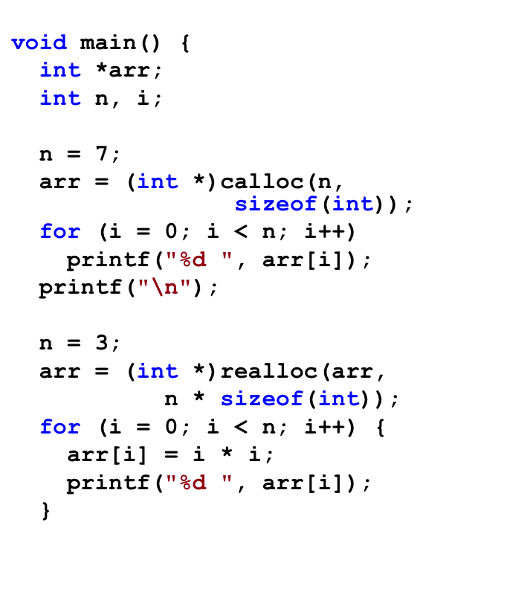
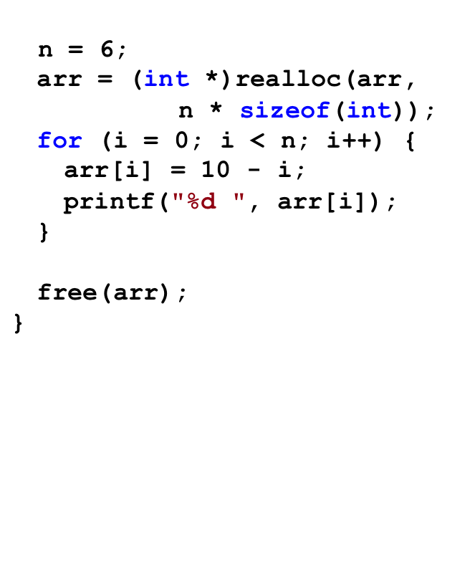
Example: what does program print?
ECE Application Programming: Lecture 10

Slide 29
Solution
Output:
0 0 0 0 0 0 0
0 1 4 10 9 8 7 6 5
ECE Application Programming: Lecture 10

Slide 30
Pitfalls: memory leaks
Changing pointers leaves inaccessible blocks
Example:
p = malloc(1000);
q = malloc(1000);
p = q;
Block originally accessed by p is “garbage”
  Won’t be deallocated—wasted space
Solution: free memory before changing pointer
p = malloc(1000);
q = malloc(1000);
free(p);
p = q;
ECE Application Programming: Lecture 10

Slide 31
Pitfalls: dangling pointers
free() doesn’t change pointer
  Only returns space to free list
Pointer is left “dangling”
  Holds address that shouldn’t be accessed
Solution: assign new value to pointer
  Could reassign immediately (as in previous slide)
  Otherwise, set to NULL
  free(p);
  p = NULL;
ECE Application Programming: Lecture 10

Slide 32
Dynamically allocated strings
Strings → arrays of characters
Basic allocation: based on string length
  sizeof(char) is always 1
  Need to account for null character
Example: copying from s to str
  char *str = (char *)malloc(strlen(s) + 1);
  strcpy(str, s);
Note: dynamically allocated strings must be deallocated when you are done with them
ECE Application Programming: Lecture 10

Slide 33
Dynamically allocated 2D arrays
Think of each row as 1D array
  2D array: an array of 1D arrays
Since array is technically a pointer, 2D array can be implemented as array of pointers
  Data type: “pointer to pointer”
    Example: int **twoDarr;
  1st dimension depends on # rows
    twoDarr = (int **)malloc(nRows * sizeof(int *));
  2nd dimension depends on # columns
    Must allocate for each row
    for (i = 0; i < nRows; i++)
    twoDarr[i] = (int *)malloc(nCols * sizeof(int));
ECE Application Programming: Lecture 10

Slide 34
Example
Complete each of the following functions
  char *readLine(): Read a line of data from the standard input, store that data in a dynamically allocated string, and return the string (as a char *)
    Hint: Read the data one character at a time and repeatedly reallocate space in the string
  int **make2DArray(int total, int nR): Given the total number of values and number of rows to be stored in a two-dimensional array, determine the appropriate number of columns, allocate the array, and return its starting address
    Note: if nR does not divide evenly into total, round up. In other words, an array with 30 values and 4 rows should have 8 columns, even though 30 / 4 = 7.5
ECE Application Programming: Lecture 10

Slide 35
Solution
char *readLine() {
char c; // Input character
char *str = NULL; // String to hold line
int n = 1; // Length of str
// Repeatedly store character in str until
// '\n' is read; resize str to hold char
while ((c = getchar()) != '\n') {
str = (char *)realloc(str, n+1);
str[n-1] = c;
n++;
}
str[n-1] = '\0'; // Null terminator
return str;
}
ECE Application Programming: Lecture 10

Slide 36
Solution (continued)
int **make2DArray(int total, int nR) {
int **arr; // 2-D array
int nCols; // # of columns
int i; // Row index
// Calculate nCols; round up if nR does not divide evenly
nCols = total / nR;
if ((total % nR) != 0)
nCols++;
// Allocate array--first array of rows, then each row
arr = (int **)malloc(nR * sizeof(int *));
for (i = 0; i < nR; i++)
arr[i] = (int *)malloc(nCols * sizeof(int));
return arr;
}
ECE Application Programming: Lecture 10

Slide 37
Final notes
Next time:
  Dynamically allocated data structures
  Final Exam Preview
Reminders:
  Will drop lowest program score (keep 9 of 10)
  Program 8 due 6/19
  Program 9 due 6/23
  Program 10 due 12:00 noon, 6/26
  Final Exam: Thursday, 6/25
ECE Application Programming: Lecture 10

