Slide 1
EECE.3170
Microprocessor Systems Design I
Instructor: Dr. Michael Geiger
Spring 2016
Lecture 26:
Exam 2 Review

Slide 2
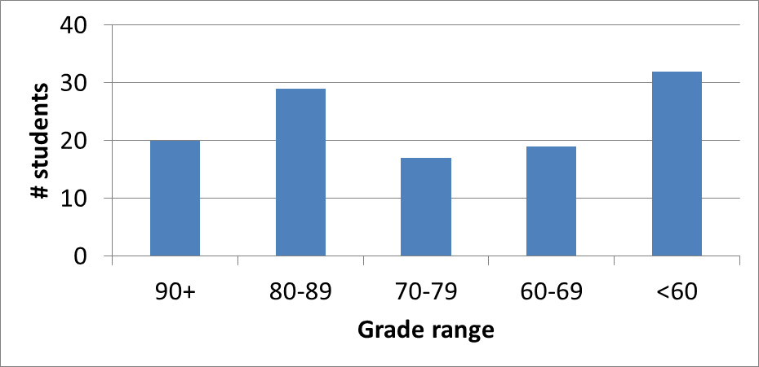
Exam stats & grade distribution
Question-by-question averages:
  Q1: 10.6 / 16 (67%)
  Q2: 13.4 / 16 (84%)
  Q3: 17.7 / 28 (63%)
  Q4: 29.2 / 40 (73%)
Extra credit
  54 students
  4. / 10 average
Average: 70.9
Median: 74
Std. deviation: 17.9
Max: 95
Microprocessors I: Lecture 27

Slide 3
Figuring out where you stand
Homework: 55% (6 done; 4 graded; 8 or 9 total)
Exams: 45% (15% + 15% + 15%)
~25-30% of your grade still to be determined
Estimating your grade
  Homework avg (HWA) =
  (HW1 + HW2 + HW3+HW4) / 4
  Exam avg (EA) =
  ((Exam1) + (Exam2)) / 2
  Overall avg = HWA * 0.55 + EA * 0.45
Microprocessors I: Lecture 27

Slide 4
Figuring out where you stand
Estimated avg. = HWA * 0.55 + EA * 0.45
Current course averages
  Without extra credit: ~79.7%, SD ≈ 14.9
  With extra credit: ~80.4%, SD ≈ 15.1
Key points
  Very likely there will be no grading curve
  Minimum grade to earn a C: 73%
  THESE NUMBERS WILL ALMOST CERTAINLY CHANGE BEFORE SEMESTER’S END—THESE FIGURES ARE JUST ROUGH ESTIMATES!!!!!
Microprocessors I: Lecture 27

