Slide 1
EECE.3220 Data Structures
Instructor:
Dr. Michael Geiger
Spring 2019
Lecture 32:
Binary trees
Heaps and priority queues

Slide 2
Lecture outline
Announcements/reminders
Program 4 due 5/1
Program 5 due 5/9 (extra credit)
Today’s lecture
Recursion
Binary search trees

Slide 3
Justifying trees
Linked data structures efficiently use space
Easier to dynamically grow/shrink than array-based structures
Array-based structures are easier to search efficiently
Linked lists require linear search
Arrays (if sorted) can use binary search
Trees: linked structures that can be searched in binary manner

Slide 4
Binary Search Tree
Consider the following ordered list of integers
Examine middle element
Examine left, right sublist (maintain pointers)
(Recursively) examine left, right sublists
13
28
35
49
62
66
80

Slide 5
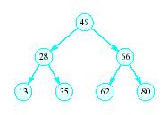
Binary Search Tree
Redraw the previous structure so that it has a treelike shape – a binary tree

Slide 6
Trees
A data structure which consists of
a finite set of elements called nodes or vertices
a finite set of directed arcs which connect the nodes
If the tree is nonempty
one of the nodes (the root) has no incoming arc
every other node can be reached by following a unique sequence of consecutive arcs

Slide 7
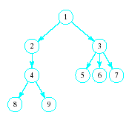
Trees
Tree terminology
Root node
Children of the parent (3)
Siblings to each other
Leaf nodes

Slide 8
Binary Trees
Each node has at most two children
Useful in modeling processes where
a comparison or experiment has exactly two possible outcomes
the test is performed repeatedly
Example
Multiple coin tosses
Decision trees where each decision is yes/no (example: guessing game)

Slide 9
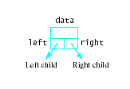

Linked Representation of Binary Trees
Uses space more efficiently
Provides additional flexibility
Each node has two links
one to the left child of the node
one to the right child of the node
if no child node exists for a node, the link is set to NULL

Slide 10
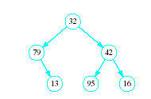
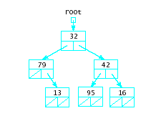
Linked Representation of Binary Trees
Example

Slide 11
Recursion
Recursive functions call themselves
A recursive function has two parts
Anchor / base case: function value is defined for one or more specific argument values
Inductive / recursive case: function value for current argument value defined in terms of previously defined function values and/or arguments
Example: Recursive power function
double power(double x, unsigned n){
if (n == 0)
return 1.0;
else
return x * power(x, n – 1);
}

Slide 12
Common recursive uses
Use if, on each iteration, problem splits into 2 or more similar tasks
Don’t want to repeat work
Graph/tree traversal
Will see this with binary trees
Divide and conquer algorithms
Search, sort algorithms very common examples
Think about binary search
Test value at midpoint of array
If higher than value you’re searching for, test lower half
If lower than value you’re searching for, test upper half

Slide 13
Binary Trees as Recursive Data Structures
A binary tree is either empty …
or
Consists of
a node called the root
root has pointers to two disjoint binary (sub)trees called …
right (sub)tree
left (sub)tree
Anchor
Inductive step
Which is either empty … or …
Which is either empty … or …

Slide 14
Tree Traversal is Recursive
If the binary tree is empty then do nothing
Else N: Visit the root, process data L: Traverse the left subtree R: Traverse the right subtree
The "anchor"
The inductive step

Slide 15
ADT Binary Search Tree (BST)
Collection of Data Elements
binary tree
each node x,
value in left child of x ≤ value in x ≤ in right child of x
Basic operations
Construct an empty BST
Determine if BST is empty
Search BST for given item

Slide 16
ADT Binary Search Tree (BST)
Basic operations (continued)
Insert a new item in the BST
Maintain the BST property
Delete an item from the BST
Maintain the BST property
Traverse the BST
Visit each node exactly once
The inorder traversal must visit the values in the nodes in ascending order

Slide 17
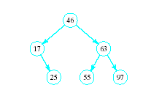

BST Searches
Search begins at root
If that is desired item, done
If item is less, move down left subtree
If item searched for is greater, move down right subtree
If item is not found, we will run into an empty subtree

Slide 18
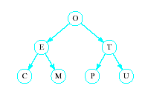
Problem of Lopsidedness
Tree can be balanced
each node except leaves has exactly 2 child nodes

Slide 19
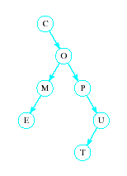
Problem of Lopsidedness
Trees can be unbalanced
not all nodes have exactly 2 child nodes

Slide 20
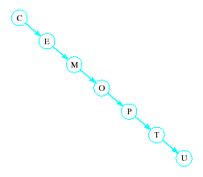
Problem of Lopsidedness
Trees can be totally lopsided
Suppose each node has a right child only
Degenerates into a linked list
Processing time affected by "shape" of tree

Slide 21
Balanced trees
Solutions to lopsidedness problem: balance tree as you insert/remove data
AVL trees
Red/black trees

Slide 22
Heaps
A heap is a binary tree with properties:
It is complete
Each level of tree completely filled
Except possibly bottom level (nodes in left most positions)
It satisfies heap-order property
Data in each node >= data in children

Slide 23
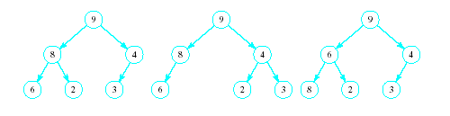
Heaps
Which of the following are heaps?
Only A
B isn’t complete—left subtree missing node
C doesn’t satisfy heap-order property—6 < 8
A
B
C

Slide 24
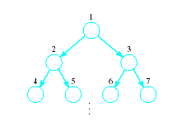
Implementing a Heap
Use an array or vector
Number the nodes from top to bottom
Number nodes on each row from left to right
Store data in i^{th} node in i^{th} location of array (vector)

Slide 25
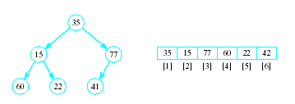
Implementing a Heap
Note the placement of the nodes in the array
Entry 0 in array kept empty to allow space in array to copy element for sorting

Slide 26
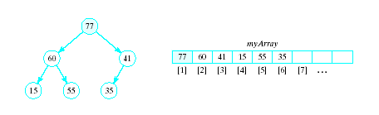
Implementing a Heap
In an array implementation children of i^{th} node are at myArray[2*i] and myArray[2*i+1]
Parent of the i^{th} node is at myArray[i/2]

Slide 27
Basic Heap Operations
Constructor
Set mySize to 0, allocate array
Empty
Check value of mySize
Retrieve max item
Return root of the binary tree, myArray[1]

Slide 28
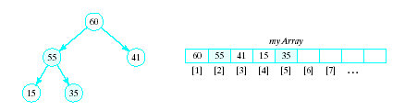
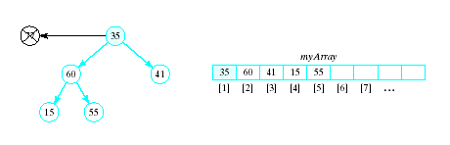
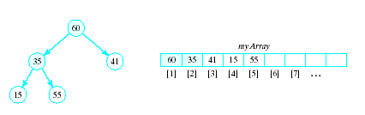
Basic Heap Operations
Delete max item
Max item is the root, replace with last node in tree
Then interchange root with larger of two children
Continue this with the resulting sub-tree(s)
Result called a semiheap

Slide 29
Percolate Down Algorithm
1. Set c = 2 * r // r = current node,
// c = left child
2. While r <= n do following
a. If c < n and myArray[c] < myArray[c + 1] Increment c by 1 b. If myArray[r] < myArray[c] i. Swap myArray[r] and myArray[c] ii. set r = c iii. Set c = 2 * c else Terminate repetition End while

Slide 30
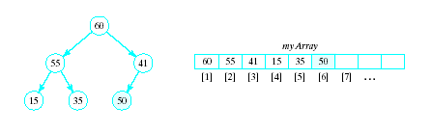
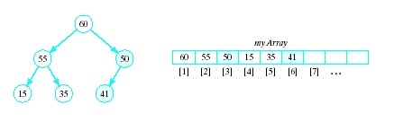
Basic Heap Operations
Insert an item
Amounts to a percolate up routine
Place new item at end of array
Interchange with parent so long as it is greater than its parent

Slide 31
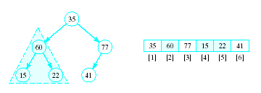
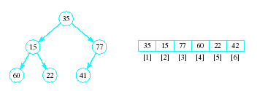
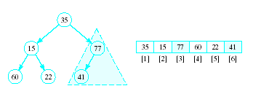
Heapsort
Given a list of numbers in an array
Stored in a complete binary tree
Convert to a heap
Begin at last node not a leaf
Apply percolate down to this subtree
Continue

Slide 32
Heapsort
Algorithm for converting a complete binary tree to a heap – called "heapify" For r = n/2 down to 1: Apply percolate_down to the subtree in myArray[r] , … myArray[n] End for
Puts largest element at root

Slide 33
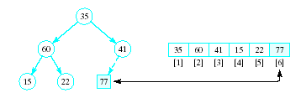
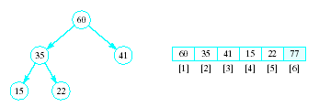
Heapsort
Now swap element 1 (root of tree) with last element
This puts largest element in correct location
Use percolate down on remaining sublist
Converts from semi-heap to heap

Slide 34
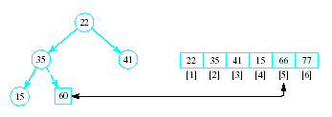
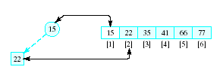
Heapsort
Again swap root with rightmost leaf
Continue this process with shrinking sublist

Slide 35
Heapsort Algorithm
1. Consider x as a complete binary tree, use heapify to convert this tree to a heap
2. for i = n down to 2: a. Interchange x[1] and x[i] (puts largest element at end) b. Apply percolate_down to convert binary tree corresponding to sublist in x[1] .. x[i-1]

Slide 36
Final notes
Next time:
More on binary trees
Reminders:
Program 4 due 5/1
Program 5 due 5/9 (extra credit)

Slide 37
Acknowledgements
These slides are adapted from slides provided with the course textbook:
Larry Nyhoff, ADTs, Data Structures, and Problem Solving with C++, 2nd edition, 2005, Pearson/Prentice Hall. ISBN: 0-13-140909-3

