Slide 1
EECE.4810/EECE.5730 Operating Systems
Instructor:
Dr. Michael Geiger
Spring 2020
Lecture 2:
Processes and process management

Slide 2
Lecture outline
Announcements/reminders
Program 1 to be posted (hopefully later this week); due TBD
Should have access to Ball 410 & Linux machines by tomorrow
Today’s lecture: processes
Process overview
Characteristics of process
Process control blocks
Operating on processes

Slide 3
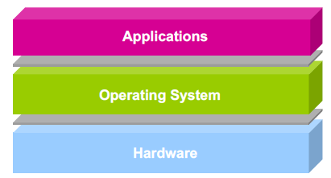
What does an OS do?
Software layer between application programs and physical hardware
Makes system easier to use for programs through abstractions
Manages allocation of resources

Slide 4
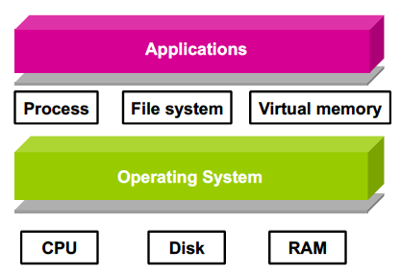
Operating system abstractions

Slide 5
Processes
Process: main abstraction for using CPU as resource
Processes make it simpler to run multiple things simultaneously
Sometimes called job or task
Process vs. program
Program is passive: i.e., executable file
Process is active: program in execution
One program may lead to multiple processes
i.e., multiple users running same program, one user running multiple copies of web browser
One process can create multiple child processes

Slide 6
Process management
Operating system is responsible for
Creation/deletion of processes
Scheduling processes
Maintaining state
Mapping processes to requested resources
Interaction between processes
Processes may be independent, but if they aren’t …
Synchronization: access to shared data
Communication: exchange of data/information
Deadlock handling: multiple processes get stuck waiting for shared resources

Slide 7
Components of a process
Process = 1+ running pieces of code (threads) + everything code can read/write
What information must OS track to manage process?
What do we need to know about code?
What specifically can process read/write?

Slide 8
Components of a process (cont.)
Process ID: “name” of process
Number uniquely identifying process
Program counter (PC): addr. of next inst.
For now, assume just 1 thread
Multiple threads → multiple PCs
Processor registers
Used for fast access to (intermediate) data
Address space
All memory process uses as it runs
What information is stored in memory?
How is memory organized?

Slide 9
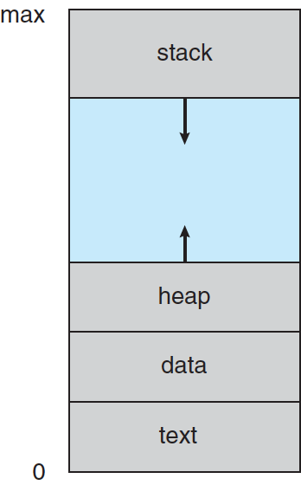
Process in memory
Text section: code
Data section: global variables
Stack: temp data, usually related to functions
Arguments
Return address
Local variables
Saved registers
Heap: dyn. allocated data
From C malloc(), C++ new …

Slide 10
Process State
As a process executes, it changes state
new: The process is being created
running: Instructions are being executed
waiting: The process is waiting for some event to occur
ready: The process is waiting to be assigned to a processor
terminated: The process has finished execution

Slide 11
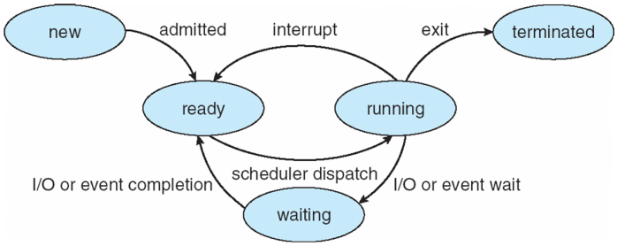
Diagram of Process State

Slide 12
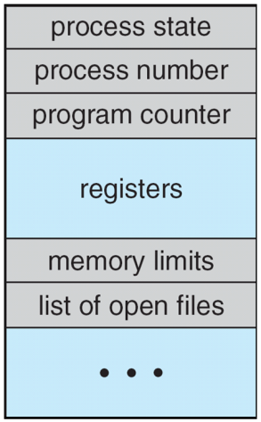
Process Control Block (PCB)
Information associated with each process
(also called task control block)
Process state – running, waiting, etc
Program counter – location of instruction to next execute
CPU registers – contents of all process-centric registers
CPU scheduling information- priorities, scheduling queue pointers
Memory-management information – memory allocated to the process
Accounting information – CPU used, clock time elapsed since start, time limits
I/O status information – I/O devices allocated to process, list of open files

Slide 13
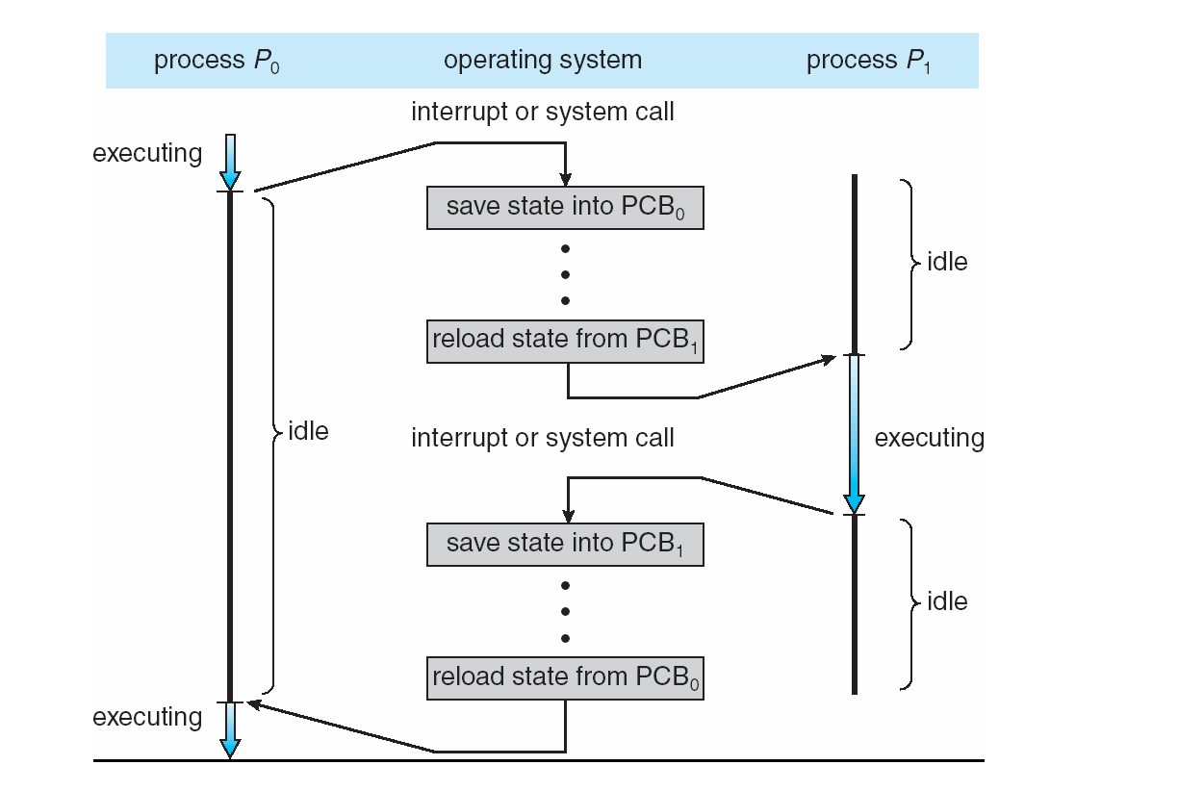
CPU Switch From Process to Process

Slide 14
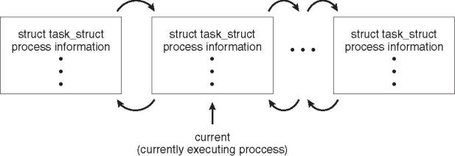
Process Representation in Linux
Represented by the C structure task_struct
pid_t pid; /* process identifier */ long state; /* state of the process */ unsigned int time_slice /* scheduling information */ struct task_struct *parent; /* this process’s parent */ struct list_head children; /* this process’s children */ struct files_struct *files; /* list of open files */ struct mm_struct *mm; /* address space of this process */

Slide 15
Process Scheduling
Process scheduler selects among available processes for next execution on CPU
Maintains scheduling queues of processes
Job queue – set of all processes in the system
Ready queue – set of all processes residing in main memory, ready and waiting to execute
Device queues – set of processes waiting for an I/O device
Processes migrate among the various queues

Slide 16
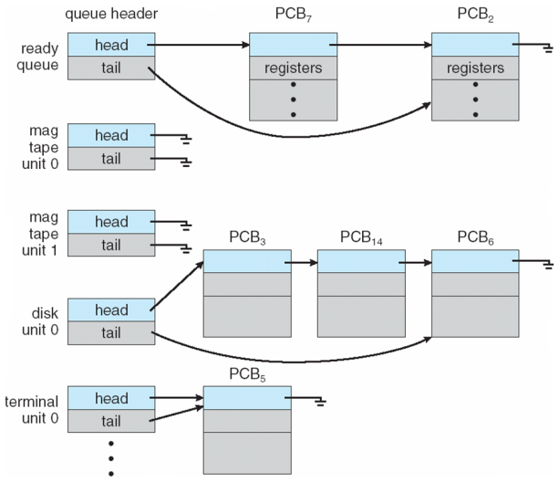
Ready Queue & I/O Device Queues

Slide 17
Context Switch
When CPU switches to another process, the system must save the state of the old process and load the saved state for the new process via a context switch
Context of a process represented in the PCB
Context-switch time is overhead; the system does no useful work while switching
The more complex the OS and the PCB ➔ the longer the context switch
Time dependent on hardware support
Some hardware provides multiple sets of registers per CPU ➔ multiple contexts loaded at once

Slide 18
Process Creation
Parent process create children processes, which, in turn create other processes, forming a tree of processes
Generally, process identified and managed via a process identifier (pid)
Resource sharing options
Parent and children share all resources
Children share subset of parent’s resources
Parent and child share no resources
Execution options
Parent and children execute concurrently
Parent waits until children terminate

Slide 19
Process tree in Linux

Slide 20
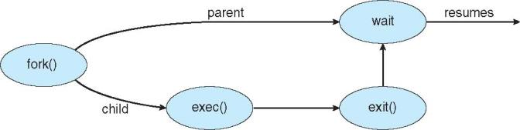
Process Creation (Cont.)
Address space
Child duplicate of parent
Same code/data (initially), different location
Could run same program; could load new program
UNIX examples
fork() system call creates new process
exec() system call used after a fork() to replace the process’ memory space with a new program
wait() system call ensures child complete before parent continues/exits

Slide 21
Example 1: process creation
fork() system call creates new process as a duplicate of original process
Copies original address space, code and all
Including initial parent process, how many processes does the program below create?
Draw a process tree to support your answer
int main() {
for (int i = 0; i < 4; i++)
fork();
return 0;
}

Slide 22
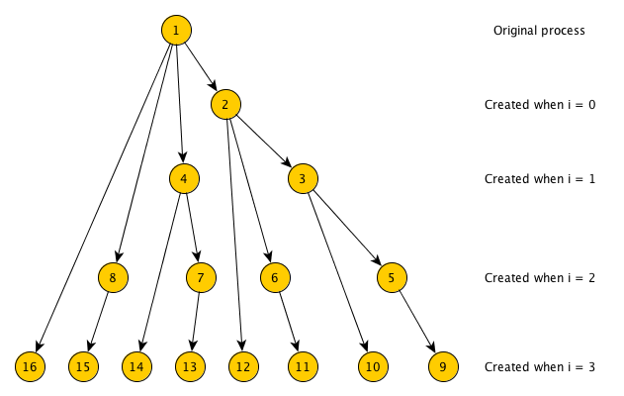
Example 1 solution
Each fork() call creates copy of currently running process
Each copy runs same code!
# processes doubles each loop iteration
1 → 2 → 4 → 8 → 16

Slide 23
More details on fork() and wait()
fork() return value is:
<0 if fork() fails (no child created)
0 within child process
PID of child (>0) within parent process
Can use to differentiate child from parent
Run same program but use conditional statement to send parent/child down different paths
wait() system call allows parent to wait for child to finish execution

Slide 24
Example 2: what does program print?
int nums[5] = {0,1,2,3,4};
int main() {
int i;
pid_t pid;
pid = fork();
if (pid == 0) {
for (i = 0; i < 5; i++) {
nums[i] *= -i;
printf("CHILD: %d\n", nums[i]);
}
}
else if (pid > 0) {
wait(NULL);
for (i = 0; i < 5; i++)
printf("PARENT: %d\n", nums[i]);
}
}

Slide 25
Example 2 solution
Since fork() copies all data from parent process, parent and child each get own copy
Doesn’t matter if data are local or global
nums[] array only changed in child
Parent doesn’t print its array until child done
So, output is:
CHILD: 0
CHILD: -1
CHILD: -4
CHILD: -9
CHILD: -16
PARENT: 0
PARENT: 1
PARENT: 2
PARENT: 3
PARENT: 4

Slide 26
Starting new program: exec system calls
To start new program, replace address space of current process with new process
On UNIX systems, use exec system calls
Family of functions allowing you to specify
Location of executable
execlp(), execvp() don’t require full path
Command line arguments to executable, either as
Separate strings passed to execl(), execle(), execlp()
Array of strings passed to execv(), execve(), execvp()
Optional list of new environment variables

Slide 27
Command line arguments
Provide arguments to executable at start
Example: ./program1 2 3
Access arguments in main() if written as:
int main(int argc, char **argv) {
…
}
argc: argument count
# of arguments—would be 3 in example above
Executable name is first “argument”
argv: argument vector
List of strings containing arguments
So, in example, argv[0] = "./program1", argv[1] = "2", argv[2] = "3"

Slide 28
Forking Separate Process
int main() {
pid_t pid;
pid = fork(); // Create a child process
if (pid < 0) { // Error occurred
fprintf(stderr, "Fork failed");
return 1;
}
else if (pid == 0) { // Child process
printf("Child: listing of current directory\n\n");
execlp("/bin/ls", "ls", NULL);
}
else { // Parent process—wait for child to complete
printf("Parent: waits for child to complete\n\n");
wait(NULL);
printf("Child complete\n\n");
}
return 0;
}

Slide 29
Process Termination
Process ends using exit() system call
May be explicit, implicit (return from main → exit())
Returns status data from child to parent (via wait())
Process’ resources are deallocated by operating system
Parent may abort() executing child process if:
Child has exceeded allocated resources
Task assigned to child is no longer required
Parent exiting and OS does not allow child to continue if parent terminates
Not true in Linux, for example
OS initiates cascading termination

Slide 30
Process Termination
Parent may wait() for child termination
wait() returns child PID, passes return status through pointer argument
pid = wait(&status);
If child terminates before parent invokes wait(), process is a zombie
If parent terminated without wait() , process is an orphan
Return status must be checked
In Linux, orphans assigned init as parent

Slide 31
Process termination questions
What’s downside of zombie processes?
Unnecessary clutter and use of resources
Worst case: fill process table
Any reason to allow orphan processes?
Long running process not requiring user
Indefinitely running background process (daemon)
Examples: respond to network requests (i.e. sshd), system logging (syslogd)
Can 1 process be both zombie & orphan?
Sure—child terminates first, then parent terminates without wait
On UNIX system init “adopts” orphans to ensure exit status collected

Slide 32
Final notes
Next time
Continue with process management
Reminders:
Program 1 to be posted (planning later this week); due TBD
Likely start with simple individual assignment
First larger project after that
Should have access to Ball 410 & Linux machines by tomorrow

Slide 33
Acknowledgements
These slides are adapted from the following sources:
Silberschatz, Galvin, & Gagne, Operating Systems Concepts, 9th edition
Chen & Madhyastha, EECS 482 lecture notes, University of Michigan, Fall 2016

