Slide 1
EECE.3170
Microprocessor Systems Design I
Instructor: Dr. Michael Geiger
Summer 2017
Lecture 14:
PIC C practice problems
Exam 3 Preview

Slide 2
Lecture outline
Announcements/reminders
  HW 6 due 1:00 PM, Thursday, 6/22
    Submissions received by 11:59 PM on Wednesday, 6/21 will earn an extra 10%
    Must return PICkit by end of exam on Thursday, 6/22
  Exam 3: Thursday, 6/22
    Will again be allowed one 8.5” x 11” note sheet, calculator
    Instruction list to be provided
Today’s lecture:
  PIC C practice problems
  Exam 3 Preview
Microprocessors I: Lecture 14

Slide 3
Review: Interrupts
PIC controllers allow internal and external interrupts
Single interrupt service routine
  Must determine interrupt cause, then handle
  Code addresses handled slightly differently
    Processor goes to address 0 on reset, 4 on interrupt
    Reset “vector”: jump to start of main program
    Interrupt “vector”: jump to start of ISR
Interrupt setup
  Enable device-specific interrupts first
  Enable global interrupts (GIE bit on PIC16F1829)
Interrupt handling
  Determine which device caused interrupt
  Clear device-specific interrupt flag
  Execute code to actually process interrupt, then retfie
Microprocessors I: Lecture 14

Slide 4
Review: Analog to digital conversion
10-bit resolution (result = (V / V_{REF}) * 1023)
Configuration requires
  Choosing reference voltage
    V_{DD}/V_{SS}, internal fixed voltage ref, or external source
  Choosing conversion speed via clock source
    Divided system clock or external oscillator
  Choosing input channel
    11 channels split across ports A, B, C
  Configuring input channel(s) as analog input(s)
    Appropriate bit(s) = 1 in ANSELx register
  Left- or right-justifying result
    L: ADRESH = upper 8 result bits, lower 6 bits of ADRESL = 0
    R: ADRESL = lower 8 result bits, upper 6 bits of ADRESH = 0
  Setting ADON bit in ADCON0
Conversions
  Wait ~5 us for charging cap to settle
  Assert GO bit in ADCON0
    Bit will be cleared when conversion is complete
Microprocessors I: Lecture 14

Slide 5
Exam practice problems
Two problems from Spring 2014 exam
Given short, partially complete programs to be completed
Comments next to each blank tells you what statement(s) in those spaces should do
Microprocessors I: Lecture 14

Slide 6
Example 1 solution
void interrupt ISR(void) {
if (IOCAF) { // SW1 was pressed
IOCAF = 0; // Clear flag in software
__delay_ms(5); // Delay for debouncing
if (SWITCH == DOWN) { // If switch still pressed
LATC = 0; // clear LEDs
i = 0; // and reset i
}
}
if (INTCONbits.T0IF) { // Timer 0 interrupt
INTCONbits.T0IF = 0; // Clear flag in software
LATC = st[i]; // Update LEDs to show
// current st[] value
i++; // Increment i
if (i > 7) // If i exceeds max index
i = 0; // reset i
}
}
Microprocessors I: Lecture 14

Slide 7
Example 2 solution
void read_adc(void) {
unsigned char lobits; // Variable to hold lowest 2
// bits of ADC result
__delay_us(5); // Wait for ADC cap to settle
GO = 1; // Start conversion
while (GO) continue; // Wait until conversion done
lobits = ADRESL & 0x03; // lobits = lowest two bits
// of ADC result
if (lobits == 0b01) { // In this case, toggle
LATC = LATC ^ 0x01; // lowest LED
}
else if (lobits == 0b10) { // In this case, toggle
LATC = LATC ^ 0x02; // second LED
}
else if (lobits == 0b11) { // In this case, turn first &
LATC = LATC | 0x03; // second LEDs on
}
}
Microprocessors I: Lecture 14

Slide 8
Exam 3 notes
Allowed
  One 8.5” x 11” double-sided sheet of notes
  Calculator
No other notes or electronic devices (phone, laptop, etc.)
Exam will last two hours and 20 minutes
Covers most PIC programming material (Lec. 11-13)
  Will not have basic “reading PIC instructions” problem
Format similar to previous exams
  1 multiple choice question
  2-3 short problems to solve
  Will have short answer questions
Microprocessors I: Lecture 14

Slide 9
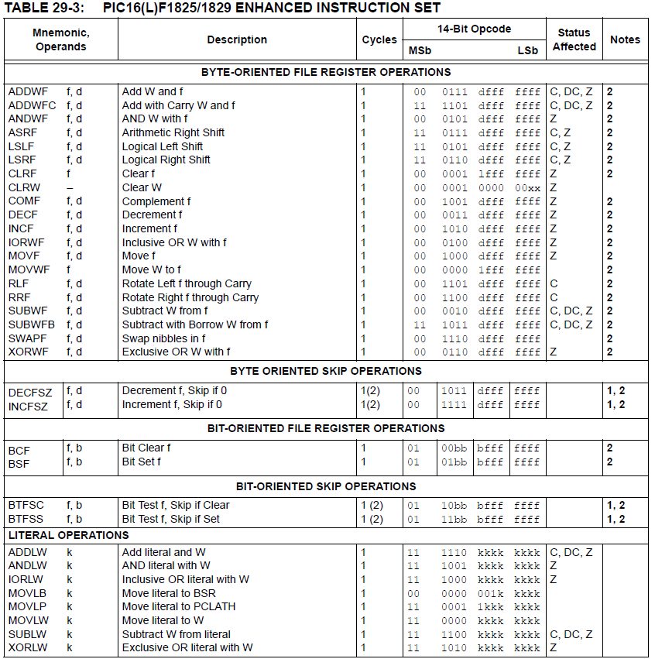
Microprocessors I: Lecture 14

Slide 10
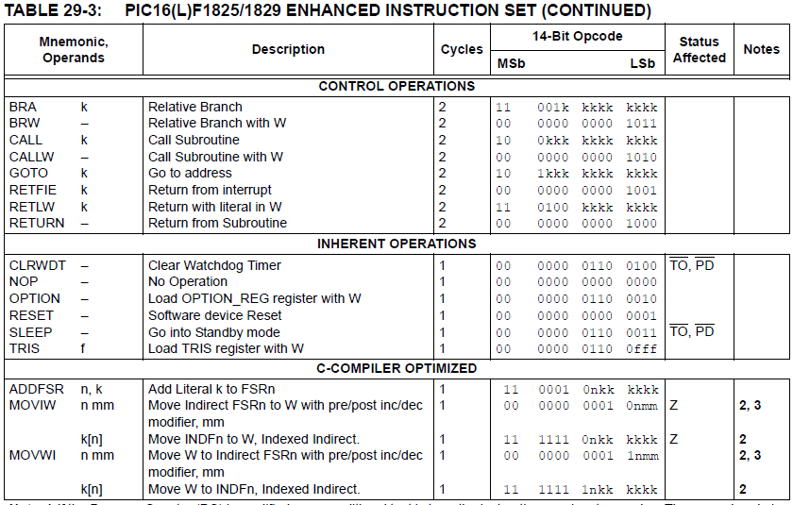
Microprocessors I: Lecture 14

Slide 11
Review: PIC instructions (cont.)
Clearing register: clrw/clrf
Moving values: movlw/movwf/movf
Swap nibbles: swapf
Single bit manipulation: bsf/bcf
Unary operations: incf/decf/comf
Arithmetic: addlw/addwf/addwfc/
sublw/subwf/subwfb
Microprocessors I: Lecture 14

Slide 12
Review: PIC instructions (cont.)
Logical operations
  andlw/andwf
  iorlw/iorwf
  xorlw/xorwf
Rotates/shifts
  rrf/lsrf/asrf
  rlf/lslf
Jumps/calls/return
  goto/bra
  call
  return/retlw/retfie
Conditional execution
  Test bit and skip next instruction if clear/set: btfsc/btfss
  Increment/decrement register and skip next instruction if zero: incfsz/decfsz
Example use: combined with goto to create conditional jump
Microprocessors I: Lecture 14

Slide 13
Review: complex operations
Multiple registers
  Data must be transferred through working register
Conditional jumps
  Usually btfsc/btfss instruction + goto
  Equality/inequality—use subtract in place of CMP
  If you subtract X – Y:
    X > Y → Z = 0, C = 1
    X == Y → Z = 1, C = 1
    X < Y → Z = 0, C = 0
    X <= Y → Z == C
    X != Y → Z = 0
    X >= Y → C = 1
Shift/rotate
  Manipulate carry before operation (or appropriate bit after)
  Use loop for multi-bit shift/rotate
Microprocessors I: Lecture 14

Slide 14
Review: Multi-byte data
Logical operations can be done byte-by-byte
Arithmetic and shift/rotate operations require you to account for data flow between bytes
  Carry/borrow in arithmetic
    Addition: if carry from lower byte, increment one of the upper bytes (addwfc)
    Subtraction: if borrow from lower byte, decrement one of the upper bytes (subwfb)
  Bit shifted between bytes in shift/rotate
    Performing instructions in correct order ensures bit transferred correctly through C bit
    All instructions after first one must be rrf/rlf
    Rotate/shift left: start with LSB
    Rotate/shift right: start with MSB
Microprocessors I: Lecture 14

Slide 15

Review: A Delay Subroutine
; ***********************************************************************************
; TenMs subroutine and its call inserts a delay of exactly ten milliseconds
; into the execution of code.
; It assumes a 4 MHz crystal clock. One instruction cycle = 4 * Tosc.
; TenMsH equ 13 ; Initial value of TenMs Subroutine's counter
; TenMsL equ 250
; COUNTH and COUNTL are two variables
TenMs
nop ; one cycle
movlw TenMsH ; Initialize COUNT
movwf COUNTH
movlw TenMsL
movwf COUNTL
Ten_1
decfsz COUNTL,F ; Inner loop
goto Ten_1
decfsz COUNTH,F ; Outer loop
goto Ten_1
return
Microprocessors I: Lecture 14
Notes:
Chapter 9

Slide 16

Review: Strategy to “Blink”
The LEDs are toggled in sequence - green, yellow, red, green, yellow, red…
Let’s look at the lower three bits of PORTD
  001=green, 010=yellow, 100=red
The next LED to be toggled is determined by the current LED.
001->010->100->001
->…
Microprocessors I: Lecture 14

Slide 17
Coding “Blink” with Table Use
BlinkTable
movf PORTD, W ; Copy present state of LEDs into W
andlw B'00000111' ; and keep only LED bits
addwf PCL,F ; Change PC with PCLATH and offset in W
retlw B'00000001' ; (000 -> 001) reinitialize to green
retlw B'00000011' ; (001 -> 010) green to yellow
retlw B'00000110' ; (010 -> 100) yellow to red
retlw B'00000010' ; (011 -> 001) reinitialize to green
retlw B'00000101' ; (100 -> 001) red to green
retlw B'00000100' ; (101 -> 001) reinitialize to green
retlw B'00000111' ; (110 -> 001) reinitialize to green
retlw B'00000110' ; (111 -> 001) reinitialize to green
In calling program
call BlinkTable ; get bits to change into W
xorwf PORTD, F ; toggle them into PORTD
Microprocessors I: Lecture 14

Slide 18
Review: PICkit example programs
Be comfortable with the following:
  Working with I/O ports
    Configuring as inputs (1)/outputs (0) using TRISx
    Writing using LATx
    Reading using PORTx
  Delay
    Instruction count-based
    Timer-based
  Interrupts
    General setups
    Specific ones we covered (timer, negative edge)
  Analog-to-digital conversion
    General setup
    Performing conversion
    Reading result from ADRESH or ADRESL
Microprocessors I: Lecture 14

Slide 19
Final notes
Next time:
  Exam 3
Reminders:
  HW 6 due 1:00 PM, Thursday, 6/22
    Submissions received by 11:59 PM on Wednesday, 6/21 will earn an extra 10%
    Must return PICkit by end of exam on Thursday, 6/22
  Exam 3: Thursday, 6/22
    Will again be allowed one 8.5” x 11” note sheet, calculator
    Instruction list to be provided
Microprocessors I: Lecture 14

