Slide 1
16.216
ECE Application Programming
Instructor: Dr. Michael Geiger
Fall 2011
Lecture 26: Exam 2 Review

Slide 2
Lecture outline
Announcements/reminders
  Program 6 will be posted today, due 11/21
    Yes, I mean it this time—very sorry for the delay
Today: Exam 2 Review
  Exam stats
  Regrade requests—as with Exam 1, can submit in writing within one week (11/21)
  Figuring out where you stand
  Exam solution
ECE Application Programming: Lecture 26

Slide 3
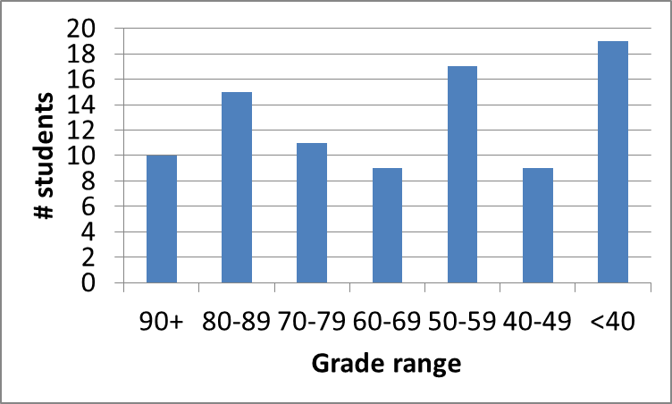
Exam stats & grade distribution
Average: 59.2
Median: 60
Std. deviation: 26.7
Max: 98
Question-by-question averages:
  Q1: 13.1 / 24 (55%)
  Q2: 24.2 / 40 (61%)
  Q3: 24.6 / 36 (68%)
ECE Application Programming: Lecture 26

Slide 4
Figuring out where you stand
Programs: 60%
Exams: 40% (10% + 15% + 15%)
Estimating your grade
  Program avg = (total program points) / 4.5
  Exam avg = ((Exam1) + (Exam2 * 1.5)) / 2.5
  Overall avg = (prog. avg) * 0.6 + (exam avg) * 0.4
Current course average: ~74%
  “Curve” adds at most 6 points to your average
  Therefore, right now (may change by semester’s end)
    Min grade for C-: 64
    Min grade for D-: 54
ECE Application Programming: Lecture 26

Slide 5
Next time
One-dimensional arrays
ECE Application Programming: Lecture 26

