Slide 1
16.216
ECE Application Programming
Instructor: Dr. Michael Geiger
Fall 2012
Lecture 25:
Exam 2 Review

Slide 2
Lecture outline
Announcements/reminders
  No class Monday (Veterans Day)
  Program 7 posted; due 11/16
  Plan to return Program 5/6 grades over weekend; regrades due Tuesday 11/13
Today’s class: Exam 2 Review
  Exam stats
  Regrade requests: due, in writing, 11/16
  Figuring out where you stand
  Exam solution
ECE Application Programming: Exam 2 Review

Slide 3
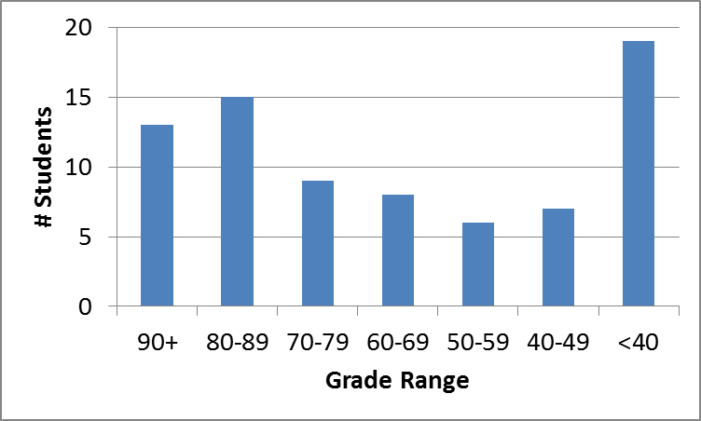
Exam stats & grade distribution
Average: 64.4
Median: 67
Std. deviation: 23.3
Max: 98
Question-by-question averages:
  Q1: 13.4 / 20 (67%)
  Q2: 29.7 / 40 (74%)
  Q3: 21.3 / 40 (53%)
Extra credit
  41 students completed
  6.1 average
ECE Application Programming: Exam 2 Review

Slide 4
Figuring out where you stand
Programs: 60% (6/9 done; 4/9 graded)
  May be a 10th assignment (extra credit only)
Exams: 40% (10% + 15% + 15%)
~35-40% of your grade still to be determined
Estimating your grade
  Program avg (PA) = (total program points) / 3.5
  Exam avg (EA) =
  ((Exam1) + (Exam2 * 1.5)) / 2.5
  Overall avg = PA * 0.6 + EA * 0.4
ECE Application Programming: Exam 2 Review

Slide 5
Figuring out where you stand
Estimated avg = PA * 0.6 + EA * 0.4
Current course avg (will change): ~78%, SD = 18
  Likely avg up, SD down once grades/regrades done
  May be curve, but do not assume there will be
Typical grading scale without curve
  A: 93+
  A-: 90-92
  B+: 88-89
  B: 83-87
  B-: 80-82
  C+: 78-79
  C: 73-77
  C-: 70-72
  D+: 68-69
  D: 60-67
  F: < 60
ECE Application Programming: Exam 2 Review

Slide 6
Next time
File I/O
Unformatted I/O
Line I/O
Reminders:
  No class Monday (Veterans Day)
  Program 7 posted; due 11/16
  Plan to return Program 5/6 grades over weekend; regrades due Tuesday 11/13
ECE Application Programming: Exam 2 Review

