Slide 1
16.216
ECE Application Programming
Instructor: Dr. Michael Geiger
Fall 2013
Lecture 34:
Dynamically allocated data structures (continued)

Slide 2
Lecture outline
Announcements/reminders
  Program 10 due 12/11
Review
  Dynamically allocated data structures
Today’s class
  Continue discussion of linked lists
ECE Application Programming: Lecture 34

Slide 3

Review: pointer-based data structures
Data structures to optimize data organization
Structure containing pointer(s) to other structure
  Adding data: allocate space for new node, then adjust pointers
  Deleting data: adjust pointers, then free space for node
Example: linked list
typedef struct node {
int value; // Data
struct node *next; // Pointer to
// next node
} LLnode;
    Image source: http://en.wikipedia.org/wiki/Linked_list
ECE Application Programming: Lecture 11

Slide 4
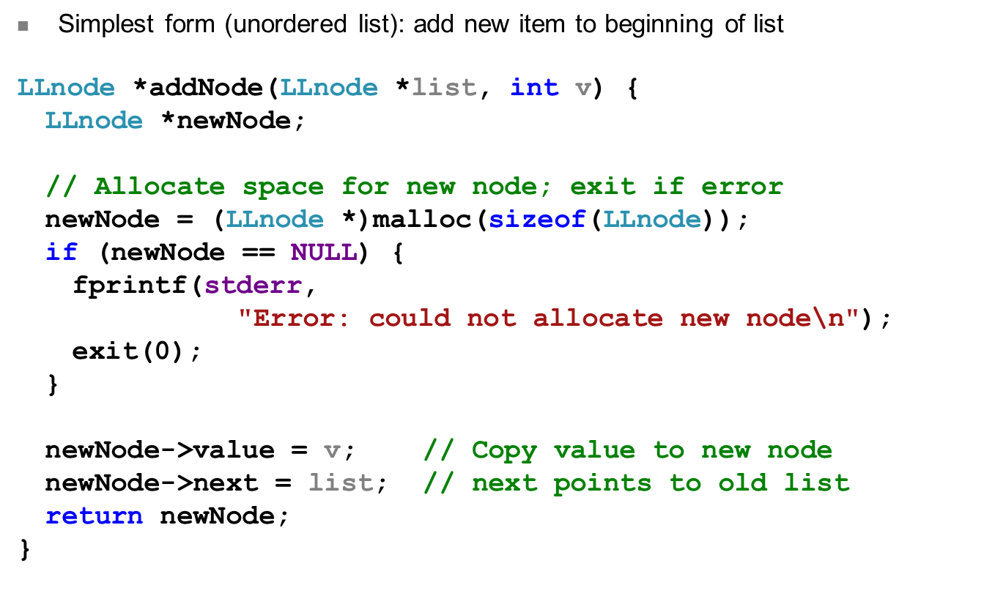
Review: Adding to list
ECE Application Programming: Lecture 11

Slide 5
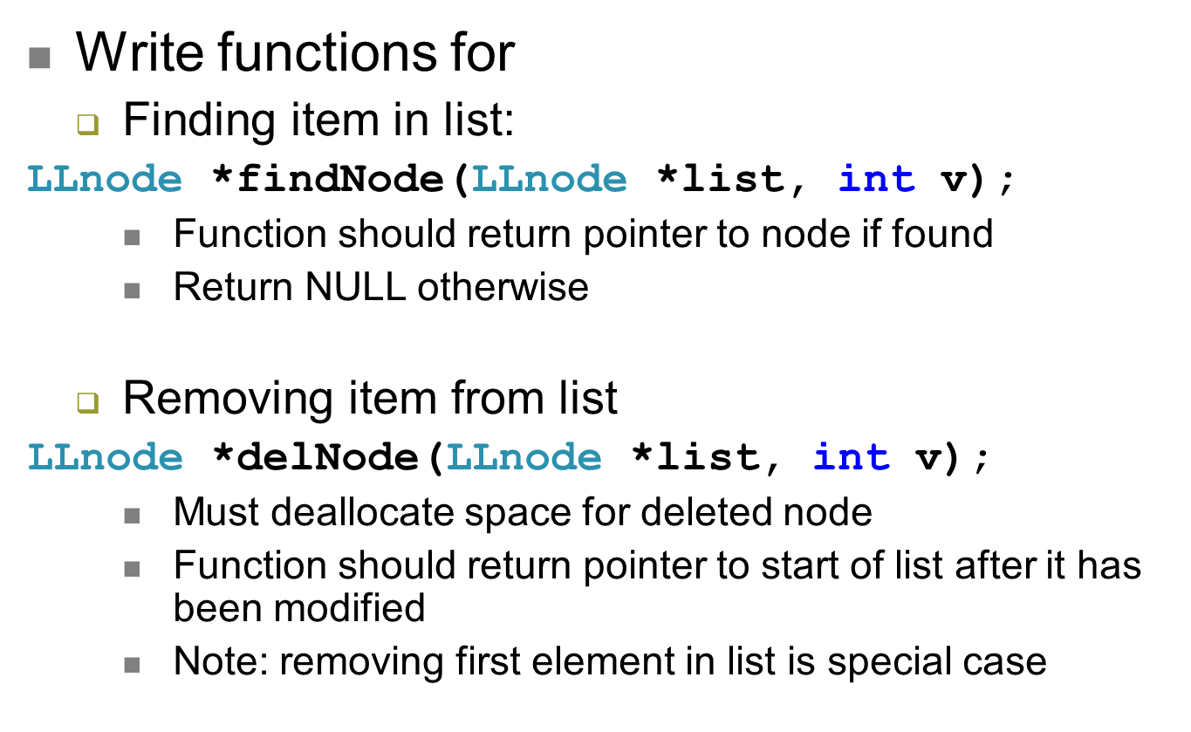
Examples
ECE Application Programming: Lecture 34

Slide 6
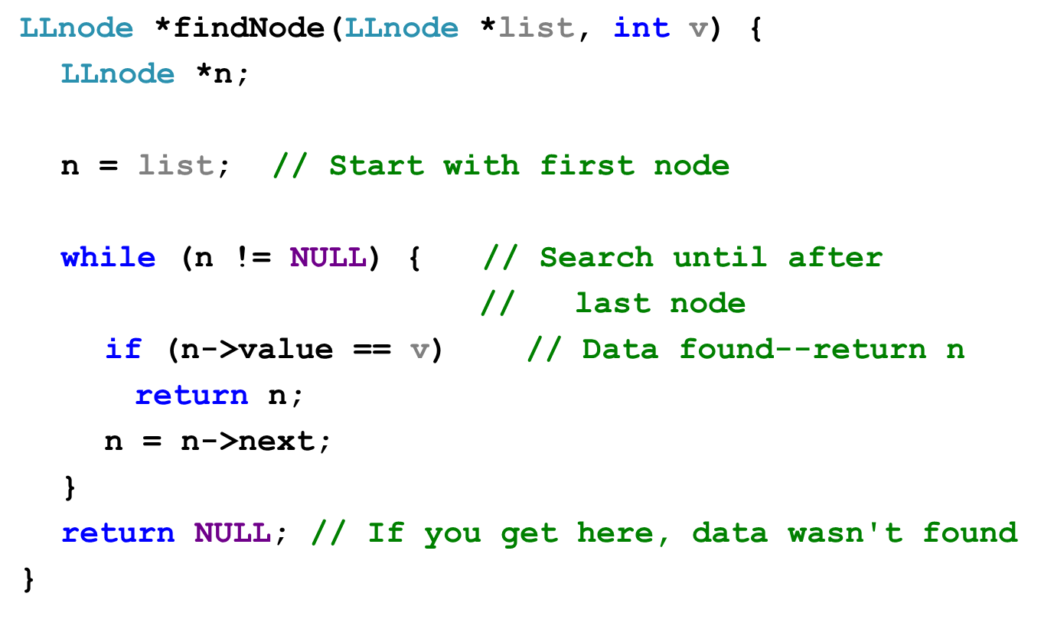
Solution: findNode()
ECE Application Programming: Lecture 34

Slide 7
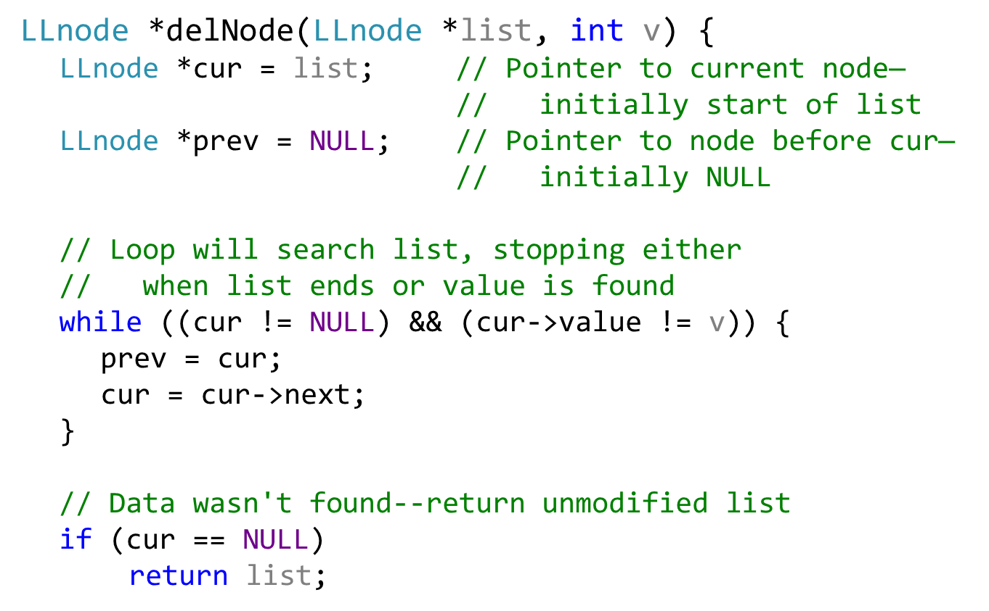
Solution: delNode() (slide 1 of 2)
ECE Application Programming: Lecture 34

Slide 8
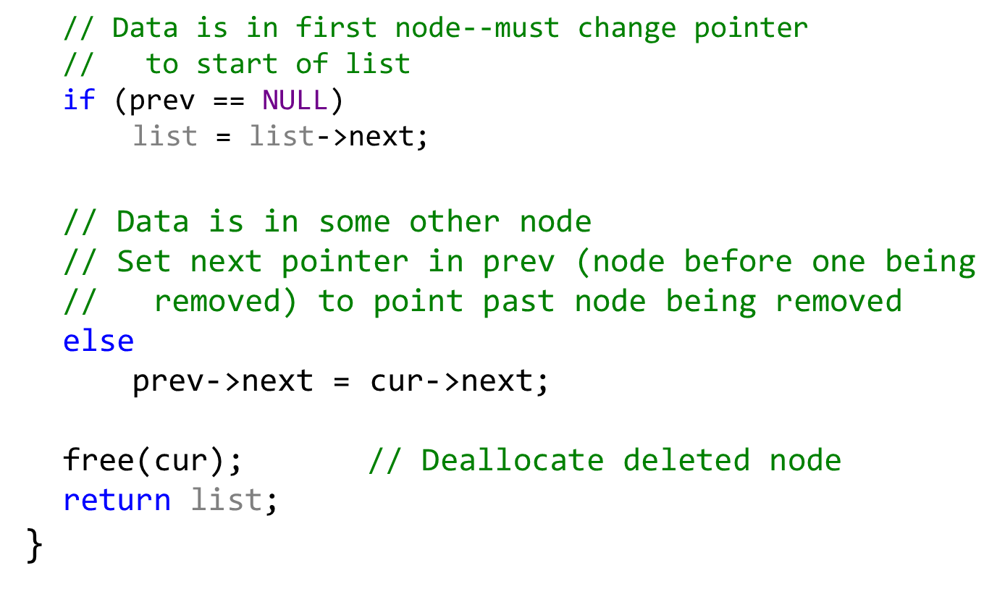
Solution: delNode() (slide 2 of 2)
ECE Application Programming: Lecture 34

Slide 9
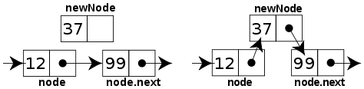
Sorted linked list
Can ensure each item is sorted as it’s added
  Slower item insertion, but faster search
Not easy with arrays: must move existing data
Keeping linked list sorted
  Find appropriate location
    Often done by going “past” appropriate spot
  Modify pointers
    Node before correct spot points to new node
    New node points to node after correct spot
    Image source: http://en.wikipedia.org/wiki/Linked_list
ECE Application Programming: Lecture 34

Slide 10
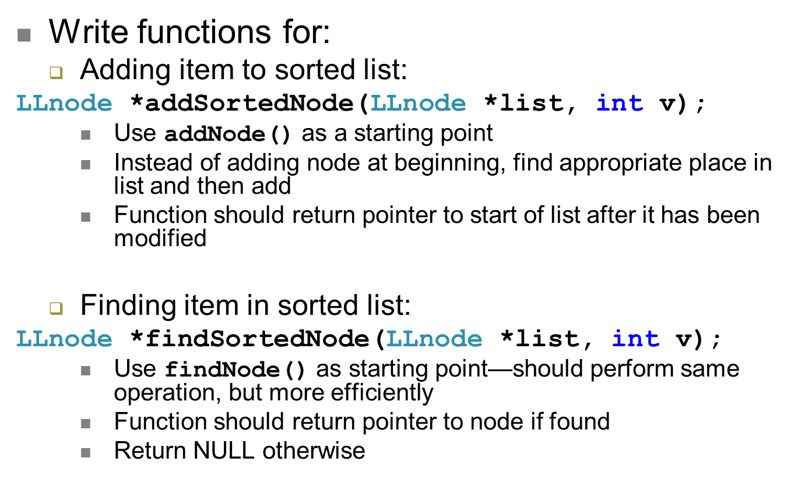
Examples
ECE Application Programming: Lecture 34

Slide 11
Next time
If we finish linked lists today, no lecture Friday/Monday
  Office hours in Ball 301—feel free to bring your laptops and work on your code
If we don’t finish linked lists today, will finish on Friday and hold office hours Monday
Wednesday, 12/11: Exam 3 Preview lecture
Exam 3: Wednesday, 12/18, 8:00-11:00 AM
Reminders:
  Program 10 due 12/11
ECE Application Programming: Lecture 34

