Slide 1
16.216
ECE Application Programming
Instructor: Dr. Michael Geiger
Spring 2012
Lecture 1: Course Overview and Introduction
Program development cycle

Slide 2
Lecture outline
Course overview
  Instructor information
  Course materials
  Course policies
  Resources
  Course outline
Introduction to C programming
  Program development cycle
  Development environments
ECE Application Programming: Lecture 1

Slide 3
Course staff & meeting times
Lectures: MWF 12-12:50, Ball Hall 314
Instructor: Dr. Michael Geiger
  E-mail: Michael_Geiger@uml.edu
  Phone: 978-934-3618 (x3618 on campus)
  Office: Engineering 118A
  Office hours: M 1-3, W 1-3, Th 1-3
Teaching Assistant: Sai Chalamalasetti
  E-mail: Sairahul_Chalamalasetti@student.uml.edu
  Office hours: TBD
ECE Application Programming: Lecture 1

Slide 4
Course materials
Textbook: K.N. King, C Programming: A Modern Approach, 2nd edition, 2008, W.W. Norton.
  ISBN: 978-0-393-97950-3
Course tools: Will need access to C compiler
  Labs on campus
  Windows
    Microsoft Visual C++ Express (MS website)
    Full Visual Studio free at www.dreamspark.com
  Mac
    Xcode (Mac App Store)
  Linux
    gcc/gdb (text-based; can run through terminal on Mac as well)
  All platforms: NetBeans
    Used previously for Mac with some success
ECE Application Programming: Lecture 1

Slide 5
Additional course materials
Course website: http://mgeiger.eng.uml.edu/16216/sp12/index.htm
  Will contain lecture slides, handouts, assignments
Discussion group through piazza.com:
  Allow common questions to be answered for everyone
  All course announcements will be posted here
  Will use as class mailing list—you must enroll by the end of the week
ECE Application Programming: Lecture 1

Slide 6
Course policies
Prerequisite: 25.108 (Intro to Engineering II), ECE major
Academic honesty
  All assignments are to be done individually unless explicitly specified otherwise by the instructor
  Any copied solutions, whether from another student or an outside source, are subject to penalty
  You may discuss general topics or help one another with specific errors, but not share assignment solutions
    Must acknowledge assistance from classmate in submission
Programming assignments
  Penalty after due date: -(2^{n-1}) points per day
    i.e., -1 after 1 day, -2 after 2 days, -4 after 3 days …
  Regrade policy: one penalty-free resubmission per assignment
    Must resubmit within 24 hours of grade posting to Dr. Geiger
    Further resubmissions will be subject to late penalty
    Note: late penalty still applies if original submission is late
  Will submit all code/output electronically (via e-mail)
ECE Application Programming: Lecture 1

Slide 7
Course policies (cont.)
Grading breakdown
  Programming assignments: 60%
  Exam 1: 10%
  Exam 2: 15%
  Exam 3: 15%
Exam dates
  Exam 1: Friday, February 24
  Exam 2: Wednesday, April 4
  Exam 3: Tuesday, May 15, 8:00-11:00 AM
ECE Application Programming: Lecture 1

Slide 8
What you should learn in this class
Fundamentals of procedural programming
  Variables
  Expressions and statements
  Operations, including bit manipulation
  Console and file input/output
  Modular programming with functions
  Arrays, pointers, and strings
  Structures
  Dynamic memory allocation (time permitting)
ECE Application Programming: Lecture 1
· To understand the interconnection of the CPU, memory, and I/O

Slide 9
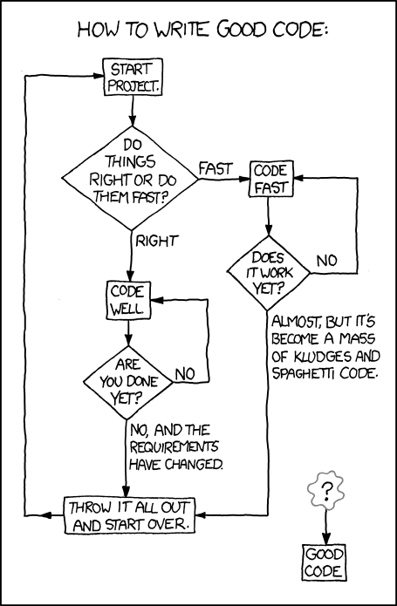
What you’ll really learn … ?
http://xkcd.com/844
ECE Application Programming: Lecture 1

Slide 10
Tentative course outline
Basic C program structure and development
Working with data: data types, variables, operators, expressions, bit manipulation
Basic console input/output
Control flow
Functions: basic modular programming, argument passing
Pointers, arrays, and strings
Creating new data types: structures
File input/output
Dynamic memory allocation (time permitting)
ECE Application Programming: Lecture 1

Slide 11
Programming exercises
Note on course schedule: several days marked as “PE#”
  Those classes will contain supervised, in-class programming exercises
    We’ll write/complete short programs to illustrate previously covered concepts
  If you have a laptop, bring it
  May have to do some design ahead of time
ECE Application Programming: Lecture 1

Slide 12
C program development cycle
Top down design
  Requirements: what is the program supposed to do?
    Translate basic requirements into formal specification
  Design: translate requirements into product
    Start with broad outline: what’s overall functionality we need?
    Break that down further: what pieces (data) are needed? What details are needed for each piece? How do pieces interact (functions)?
    Final result of this stage: design specification
    Can include
      Verbal description of design, both at high & low level
      Diagrams showing varying levels of detail about project
        e.g. Flow charts, UML, etc.
ECE Application Programming: Lecture 1

Slide 13
C program development cycle (cont.)
Programming: turn design into code
  Often works best as a “bottom up” process
    Start with small pieces—code sections, single function, etc.
    Put the pieces together as you go
      Requires good design to specify how they integrate
Compile: convert code to object file
  Deal with compiler errors here (primarily syntax)
Link: join all objects into executable file
  Deal with linker errors here (no main program, missing objects, etc.)
Execute: actually run the program!
  May read input, generate output
  Verify correctness of code; if problems, edit program
ECE Application Programming: Lecture 1

Slide 14
C program development cycle (cont.)
Formal software engineering includes testing
  Test at several levels throughout process
  Unit testing: does a given piece function in the expected manner?
    Every time you debug an individual section of code
  Integration testing: do modules fit together?
    Multiple functions calling one another; compatibility among data structures; merging files from different parts of the program
  System testing: does whole system work together?
  Acceptance testing: user-designed tests with developer support to ensure product meets requirements
Good idea to formulate testing plans in design stage
  As you determine design spec, think about how you’re going to test your software
ECE Application Programming: Lecture 1

Slide 15
Development environments
Can do previous tasks separately
  Typical in Unix applications—write makefiles to run compiler/linker appropriately; separate debugging
An integrated development enviroment (IDE) bundles tools, usually in graphical environment
  Source code editor
  Compiler
  Build automation tools (linker, etc.)
  Debugger
  May have additional tools for GUI design, viewing class hierarchy
Examples: Microsoft Visual Studio, Eclipse (Java + others), Xcode (Mac OS/iOS apps), NetBeans
ECE Application Programming: Lecture 1

Slide 16
Next time
Basic C program structure
ECE Application Programming: Lecture 1

