Slide 1
16.216
ECE Application Programming
Instructor: Dr. Michael Geiger
Spring 2012
PE1: Flowcharts, basic debugging skills

Slide 2
Lecture outline
Announcements/reminders
  Program 2 due Monday, 2/6
  Program 3 to be posted; due 2/13
Today: PE1
  Flowchart intro
    Basic elements
    Designing flowchart for given problem
    Converting flowchart into program
  Debugging
    Viewing variables in debugger
    Stepping through program
    Setting breakpoints
ECE Application Programming: Lecture 6

Slide 3
Flowcharts
Graphical representation of process
  Shows all steps and their order
  In programming, use to organize program before writing code
Basic elements
Process
Terminator (start/end)
Input/Output
Connector
Decision
Connector (off page)
ECE Application Programming: Lecture 6

Slide 4

Example: Quadratic Equation Solver
Start
Output
“Quadratic Equation Solver”
Output
“Enter A, B, C: ”
Input A, B, C
ECE Application Programming: Lecture 6

Slide 5

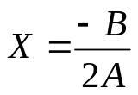

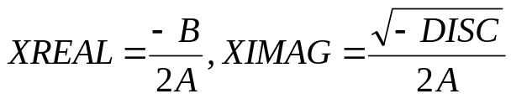
Quadratic Equation Solver (cont.)
A = 0?
TRUE
Output
X
FALSE
DISC=B*B-4*A*C
DISC = 0?
TRUE
Output
X
FALSE
DISC>0?
TRUE
Output
X1,X2
FALSE
Output
XREAL + XIMAG i
XREAL – XIMAG i
ECE Application Programming: Lecture 6
Done

Slide 6
Exercise: Flowchart
Design a flowchart to solve the following:
  Prompt a user to enter four numbers on a single line, which represent the contents of a 2x2 array
  After reading the values, your program should print the matrix represented by these values
    For example, if the user enters “1 2 3 4”, print:
  1 2
  3 4
    Assume all values have the same number of digits
  Also, calculate the matrix discriminant and print it on a separate line
    In the example above, discriminant = (1x4) - (2x3) = 4-6 = -2
ECE Application Programming: Lecture 6

Slide 7
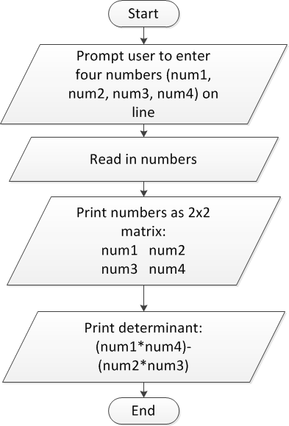
Flowchart: solution
ECE Application Programming: Lecture 6

Slide 8
Converting flowchart to program
What data are used in the process?
  Can those data be represented as constants?
  If not, what variables are needed?
    How many?
    What type(s)?
    How should variables be named?
What C statement corresponds to each process step?
  Input statements: scanf()
  Output statements: printf()
  Terminators: start/end of main() function
    Will generalize later to any function
  General process steps: basic expressions
    May need multiple lines of code
ECE Application Programming: Lecture 6

Slide 9
Debugging
Most IDEs allow ability to view state of program while running through debugger
  View variable values
  Execute program:
    One line at a time (single step)
    By running until reaching a pre-defined stopping point (breakpoint)
Can isolate bugs without altering program
  Alternate solution: inserting print statements to show program state at various points
  Disadvantages
    Inefficient--repeated compilation, must keep adding statements
    May actually alter operation of other statements
ECE Application Programming: Lecture 6

Slide 10
Debugger demonstration
Demonstration of Visual Studio debugger
  Variables
    Watch window
    Autos window
    Locals window
  Single step options
    Step over
    Step into/step out
  Breakpoints
    Setting breakpoints
    Running to next breakpoint
ECE Application Programming: Lecture 6

Slide 11
Next time
Operators
ECE Application Programming: Lecture 6

