Slide 1
16.216
ECE Application Programming
Instructor: Dr. Michael Geiger
Spring 2013
Lecture 12:
Exam 1 Review

Slide 2
Lecture outline
Announcements/reminders
  Program 4 posted; due 2/27
    Use loops to calculate GCD of fraction & reduce
    One major piece: repeatedly reading input until correct
  Early feedback forms Monday
Today’s class: Exam 1 Review
  Exam stats
  Regrade requests
  Solution
ECE Application Programming: Exam 1 Review

Slide 3
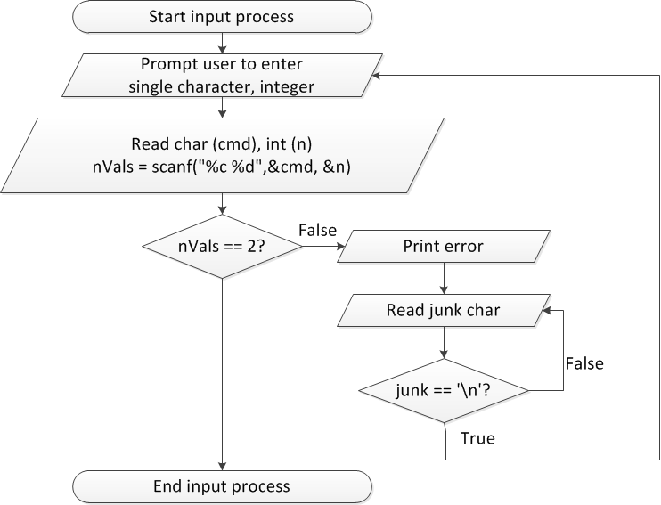
Flow charts: reading input
ECE Application Programming: Lecture 10

Slide 4
Discussion: Reading input
Loop that repeats as long as input incorrect
Loop inside that one to handle reading of remainder of line
  Read character until you reach end of line
Both while/do-while loops
ECE Application Programming: Lecture 10

Slide 5
Code: Reading input
do {
printf("Enter command and integer: ");
nVals = scanf("%c %d", &cmd, &n);
// Otherwise, print error & clear line
if (nVals != 2) {
printf("Incorrectly formatted input\n“);
do {
scanf("%c", &junk);
} while (junk != '\n');
}
} while (nVals != 2);
ECE Application Programming: Lecture 10

Slide 6
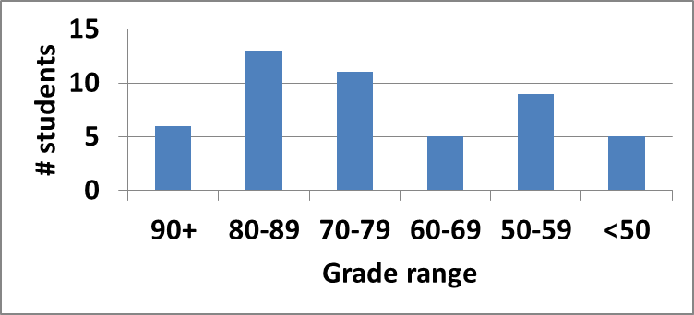
Exam stats & grade distribution
Average: 71.8
Median: 73
Std. deviation: 15.4
Max: 96
Question-by-question averages:
  Q1: 13.5 / 20 (67%)
  Q2: 29.0 / 40 (73%)
  Q3: 29.3 / 40 (73%)
Extra credit
  32 students completed
  5.0 average
ECE Application Programming: Exam 1 Review

Slide 7
Regrade requests
Due 3/1
Must be written
You must also return your exam
  Do not write on your exam if you plan on submitting a regrade request
Must demonstrate understanding of problem
  Bad: “I deserve more points on Problem 2a.”
  Good: “I deserve more points on Problem 2a because I calculated a wrong value for f based on an incorrect value for x. I used the right formula; I just plugged in the wrong value.”
ECE Application Programming: Exam 1 Review

Slide 8
Next time
For loops
Early feedback form
Reminders:
  Program 4 due 2/27
ECE Application Programming: Exam 1 Review

