Slide 1
16.216
ECE Application Programming
Instructor: Dr. Michael Geiger
Spring 2014
Lecture 10:
PE2: Loops and conditionals

Slide 2
Lecture outline
Announcements/reminders
  Program 3 due today
  Program 2 regrades due 2/17
  Next week
    Lecture on Tuesday, not Monday
    Exam 1: Wednesday, 2/19
      Will be allowed one 8.5” x 11” double-sided note sheet
      No calculators or other electronic devices allowed
Review
  While/do-while loops
Today’s lecture
  PE2: Conditionals and while loops
ECE Application Programming: Lecture 10

Slide 3
Review: while/do-while loops
Used for repetition of code
while (<expression>)
  <statement> ← loop body
do {
<statements>
} while ( <expression> );
ECE Application Programming: Lecture 10

Slide 4
Today’s program should:
Prompt user to enter an input character and an integer, n.
  If not correctly formatted, print error, clear line, and repeat
Depending on the character entered, do the following:
  ‘F’ or ‘f’: Compute and print the factorial of n, n!
    For example, if the user enters F 5, print 5! = 120
  ‘P’ or ‘p’: Compute 2^{n}, but only if n >= 0.
    For example, if the user enters p 2, print 2^2 = 4
    Print an error if n < 0.
  ‘X’ or ‘x’: Exit the program
  In all other cases, print an error:
    For example: Invalid command Z entered
If the user enters any command other than ‘X’ or ‘x’, return to the initial prompt and repeat the program.
Will complete parts in red in a later lecture
ECE Application Programming: Lecture 10

Slide 5
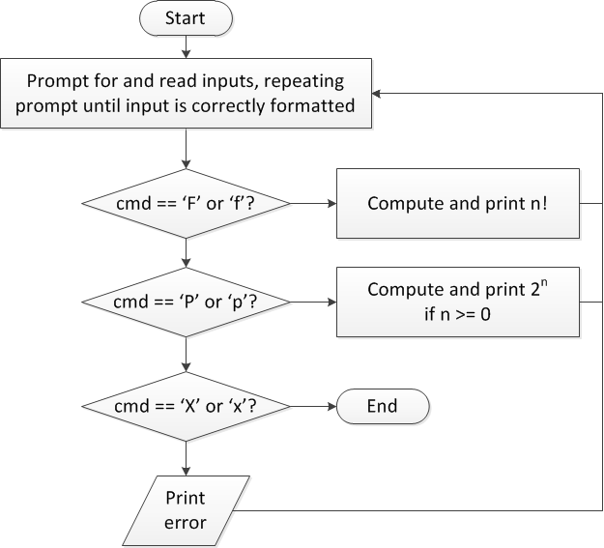
Flow charts: overall flow
ECE Application Programming: Lecture 10

Slide 6
Discussion: Overall flow
Whole program contains loop
  Repeats process until user enters ‘X’ or ‘x’
  Use while or do-while—unknown # of iterations
  Since exit condition ends program, infinite loop
Testing cmd: switch statement
  Checking equality of cmd to constant values
Exiting program: return statement
  Use return at any point to end current function (including main)
ECE Application Programming: Lecture 10

Slide 7
Code: overall flow (skeleton code)
while (1) { // Loop repeats until user enters 'X' or 'x'
/* Code to read cmd, n */
/* Evaluate cmd and perform appropriate operation */
switch (cmd) {
case 'F':
case 'f':
/* Calculate n! */
break;
case 'P':
case 'p':
/* Calculate 2^n, if n >= 0; print error otherwise */
break;
case 'X':
case 'x':
return; // Exit program
default:
printf("Invalid command %c entered\n", cmd);
}
}
ECE Application Programming: Lecture 10

Slide 8
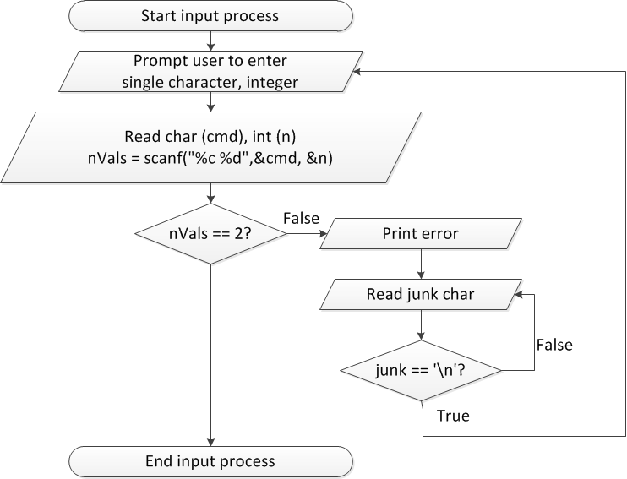
Flow charts: reading input
ECE Application Programming: Lecture 10

Slide 9
Discussion: Reading input
Loop that repeats as long as input incorrect
Loop inside that one to handle reading of remainder of line
  Read character until you reach end of line
Both while/do-while loops
ECE Application Programming: Lecture 10

Slide 10
Code: Reading input
do {
printf("Enter command and integer: ");
nVals = scanf("%c %d", &cmd, &n);
// Otherwise, print error & clear line
if (nVals != 2) {
printf("Incorrectly formatted input\n“);
do {
scanf("%c", &junk);
} while (junk != '\n');
}
} while (nVals != 2);
ECE Application Programming: Lecture 10

Slide 11
Final notes
Next time
  Exam 1 Preview (Tuesday, 2/18)
Reminders:
  Program 3 due today
  Program 2 regrades due 2/17
  Next week
    Lecture on Tuesday, not Monday
    Exam 1: Wednesday, 2/19
      Will be allowed one 8.5” x 11” double-sided note sheet
      No calculators or other electronic devices allowed
ECE Application Programming: Lecture 10

