Slide 1
16.317
Microprocessor Systems Design I
Instructor: Dr. Michael Geiger
Fall 2013
Lecture 22
x86 protected mode (continued)

Slide 2
Lecture outline
Announcements/reminders
  HW 5 due 10/30
  Advising: 10/28-11/8
Today’s lecture
  Continue with x86 protected mode
Microprocessors I: Lecture 18

Slide 3
Review: protected mode memory accesses
Determine if access is local or global
  Use TI bit in selector
    Segment registers now function as selectors
    TI == 0 → global access
    TI == 1 → local access
Find the starting address of the appropriate descriptor table
  Global access uses GDT
    GDTR holds base/limit of GDT
  Local access uses current LDT
    LDTR cache holds base/limit of LDT
Microprocessors I: Exam 2 Preview

Slide 4
Review: protected mode memory accesses
Find the right descriptor in GDT/LDT
  Index field in selector chooses entry in GDT/LDT
    Tables are 0 indexed → 1st descriptor = descriptor #0
  Starting address of descriptor =
  (table base) + (index * 8)
  Descriptor holds base/limit for segment
Use the segment base address found in the descriptor to calculate the physical address
  Physical address = (segment base) + (EA)
Microprocessors I: Exam 2 Preview

Slide 5
Illustrating global memory access
MOV AX, [10H]
→ Logical addr = DS:10H
GDT | 00002000H
 | 000020FFH
DS = 0013H =
0000 0000 0001 0 | 0 | 11
RPL = 3
Index = 2
TI = 0 → global
Desc. 2
Base = 00000100H
Limit =
0FFFH
00002010H
GDTR =
00002000 | 00FF
Base Limit
Descriptor addr: (GDT base) + (selector index * 8)
00002000H
+ (0002H * 8)
00002010H
Actual mem addr: (seg base) + (effective address)
00000100H
+ 10H
00000110H
Microprocessors I: Lecture 7

Slide 6
Local Descriptor Table Register (LDTR)
Local descriptor table
  Defines local memory address space for the task
  Each task has its own LDT
  Contains local segment descriptors
LDTR: 16 bit selector pointing into GDT
  Each LDT is essentially a segment in global memory
  LDTR cache automatically loads when LDTR changed
LDTR cache: 48bit
  Lower 2 bytes define LDT LIMIT (or size)
  Upper 4 bytes define LDT base (physical address)
Microprocessors I: Lecture 7
Notes:
Chapter 8

Slide 7
Illustrating local memory access
MOV AX, [10H]
→ Logical addr = DS:10H
GDT | 00002000H
 | 000020FFH
DS = 0027H =
0000 0000 0010 0 | 1 | 11
RPL = 3
Index = 4
TI = 1 → local
Desc. 7
Base = 00002100H
Limit =
001FH
00002038H
LDTR = 003BH =
0000 0000 0011 1 | 0 | 11
GDTR =
00002000 | 00FF
Base Limit
Descriptor addr: (GDT base) + (selector index * 8)
00002000H
+ (0007H * 8)
00002038H
Microprocessors I: Lecture 7

Slide 8
Illustrating local memory access
MOV AX, [10H]
→ Logical addr = DS:10H
GDT | 00002000H
 | 000020FFH
LDT | 00002100H
 | 0000211FH
DS = 0027H =
0000 0000 0010 0 | 1 | 11
RPL = 3
Index = 4
TI = 1 → local
GDT descriptor 7 describes LDT for this task
→ LDTR cache =
00002100 | 001F
Desc. 4
Base = 00100000H
Limit =
001FH
00002120H
Base Limit
Descriptor addr: (LDT base) + (selector index * 8)
00002100H
+ (0004H * 8)
00002120H
Actual mem addr: (seg base) + (effective address)
00100000
+ 10H
00100010H
Microprocessors I: Lecture 7

Slide 9
Interrupt Descriptor Table Register (IDTR)
Interrupt descriptor table
  Up to 256 interrupt descriptors
    Describes segments holding interrupt service routines
  Described by IDTR
  Each entry (interrupt descriptor) takes 8 bytes
IDTR: 48-bit
  Lower 2 bytes define LIMIT (or size)
  Upper 4 bytes define the base (physical address)
  Initialized before switching to protected mode
Microprocessors I: Lecture 7
Notes:
Chapter 8

Slide 10
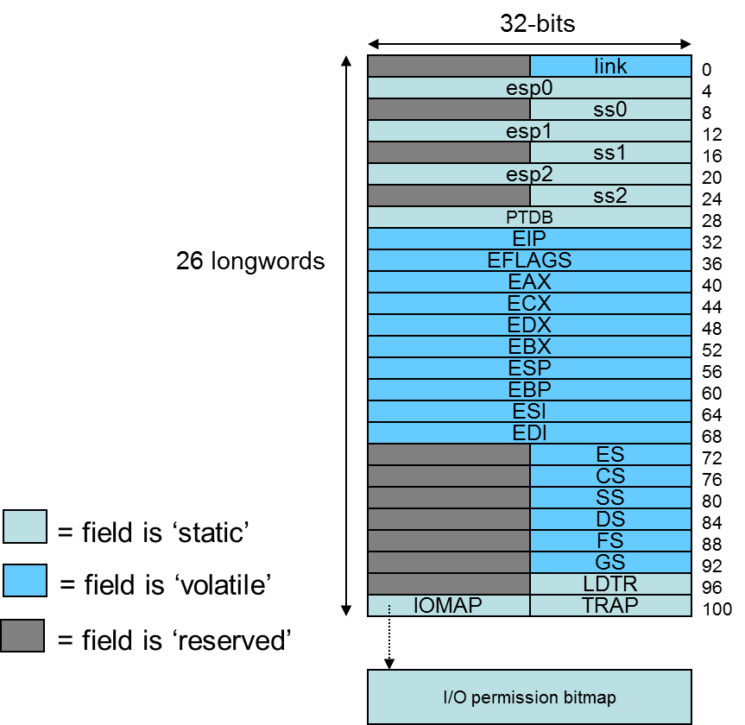
Multitasking
Most systems run multiple tasks
  Different programs
  Different threads in same program
Task switch: save state of current task; transfer control to new task
80386 specifics
  Task state segment (TSS): saved task state (picture at right)
    Every TSS resides in global memory
  Task register (TR): selector pointing to descriptor in GDT for current TSS
    Limit, base of current TSS cached
  Task switch = jump or call instruction that changes task
Figure from cs.usfca.edu/~cruse/cs630f06/lesson08.ppt
Microprocessors I: Lecture 7
Notes:
Chapter 8

Slide 11
Protected mode memory access examples
See handout
Microprocessors I: Lecture 7

Slide 12
Final notes
Next time:
  Continue with protected mode
Reminders:
  HW 5 due 10/30
  Advising: 10/28-11/8
Microprocessors I: Lecture 18

