Slide 1
16.317
Microprocessor Systems Design I
Instructor: Dr. Michael Geiger
Fall 2014
Lecture 13:
Exam 1 Review

Slide 2
Lecture outline
Announcements/reminders
  Early feedback forms to be distributed this week
  HW 3 to be posted; due date TBD
Today’s lecture: Exam 1 Review
  Regrade requests
  Exam stats
  Solution
Microprocessors I: Exam 1 Review

Slide 3
Regrade requests
Due Friday, 10/10
Must be written (preferably on a separate sheet)
You must also return your exam
  Do not write on your exam if you plan on submitting a regrade request
Must demonstrate understanding of problem
  Bad: “I deserve more points on Problem 3.”
  Good: “I deserve more points on Problem 3 because I calculated a wrong result for one instruction based on a wrong result from a previous instruction. I used the right operation; I just plugged in the wrong value.”
Microprocessors I: Exam 1 Review

Slide 4
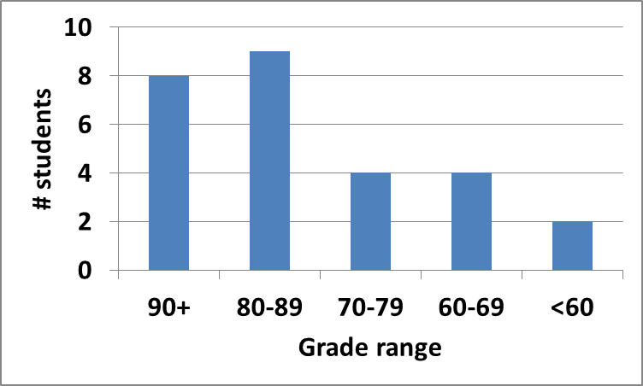
Exam stats & grade distribution
Question-by-question averages:
  Q1: 12.8 / 20 (64%)
  Q2: 26 / 30 (87%)
  Q3: 21 / 25 (84%)
  Q4: 20.1 / 25 (81%)
  Q5: 4.1 / 10 (16 responses)
Average: 79.9
Median: 84
Std. deviation: 15.9
Max: 98
Microprocessors I: Exam 1 Review

Slide 5
Final notes
Next time:
  HLL → assembly
Microprocessors I: Exam 1 Review

