Slide 1
16.317
Microprocessor Systems Design I
Instructor: Dr. Michael Geiger
Fall 2014
Lecture 3:
x86 introduction

Slide 2
Lecture outline
Announcements/reminders
  Sign up for the course discussion group on Piazza
  HW 1 to be posted this week
Review
  Data types
  Storage media
  Alignment
  Endianness
Today’s lecture
  x86 introduction
Microprocessors I: Lecture 3

Slide 3
Review: ISA, storage
Operands: the data being operated on
  How are the bits interpreted? (int, FP, signed/unsigned)
  What size are they? (byte, word, etc.)
Data storage
  Registers
    Small, fast set of on-chip storage (primarily for speed)
    Referenced by name
  Memory
    Larger, slower set of storage (primarily for capacity)
    Organized as hierarchy …
    … but programmer references single range of addresses
    Memory issues
      Aligned data: address divisible by number of bytes
      Endianness: 80x86 data is little endian
Microprocessors I: Lecture 3

Slide 4
Addressing modes
Addressing modes: ways of specifying operand location
Where are operands stored? (3 location types)
  Registers → register addressing
    Provide name of register; value read from register
  Memory
    Provide address in memory; value read from that location
    Several modes for specifying memory address
  In the instruction → immediate addressing
Microprocessors I: Lecture 3

Slide 5
Memory addressing
Instructions accessing memory generate effective address (EA)
  Address calculated as part of instruction
  EA can be used as
    Actual memory address in a simple memory system
    Address within a particular segment in a segmented memory architecture
Effective address calculations can involve
  A constant value
  One or more values stored in registers
  Some combination of register and constant
Microprocessors I: Lecture 3

Slide 6
General memory addressing modes
Memory direct addressing
  EA = constant value encoded in instruction
Register indirect addressing
  EA = value stored in register
Base + displacement addressing
  EA = constant displacement + base register(s)
  Can have variations of this mode based on number and type of registers
Scaled addressing
  EA = constant displacement + (scale * base)
  Used for array addressing
Microprocessors I: Lecture 3

Slide 7
x86 intro
“x86” → family of Intel processors
  Starts with 8086 processor (1978)
  Used (w/extensions) in current processors
General purpose processor
Supports use of 8, 16, 32, or 64 bit data
Allows both register and memory operands
Segmented or flat memory architecture
Real and protected mode operation
  Protected mode supports virtual memory
Microprocessors I: Lecture 3

Slide 8
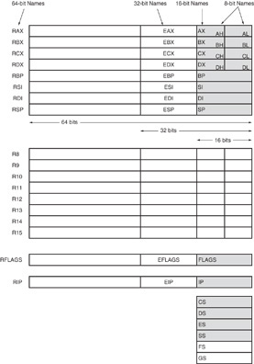
Register Set
Nine 32-bit registers
  (4) Data registers- EAX, EBX, ECX, EDX, can be used as 32, 16 or 8bit
  (2) Pointer registers- EBP, ESP
  (2) Index registers- ESI, EDI
  (1) Instruction pointer- EIP
Six 16-bit registers
  (6) Segment registers- CS, DS, SS, ES, FS, GS
Flags (status) register-EFLAGS
Microprocessors I: Lecture 3
Notes:
Chapter 2

Slide 9
Register Set
64-bit extensions
  Added with Pentium 4
  Data/pointer/index/IP/ flag register extended to 64 bits
  For example:
    RAX = 64-bit register A
    RSP = 64-bit stack pointer
  8 additional data registers (R8-R15)
Microprocessors I: Lecture 3
Notes:
Chapter 2

Slide 10
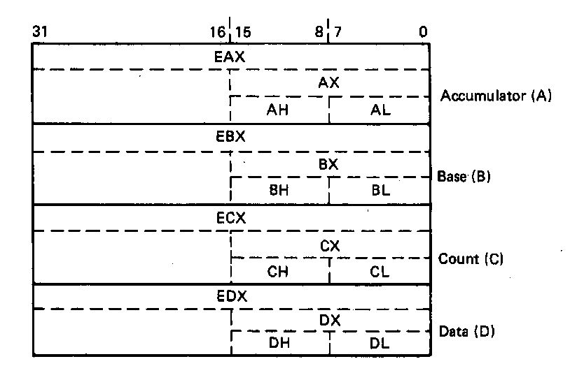
General Purpose Data Registers
Four general purpose data registers
  Accumulator (A) register
  Base (B) register
  Count (C) register
  Data (D) register
Can hold 8-bit, 16-bit, or 32-bit data
  AH/AL = high and low byte value
  AX = word value
  EAX = double word value
General uses:
  Hold data such as source or destination operands for most operations—ADD, AND, SHL
  Hold address pointers for accessing memory
Some also have dedicated special uses
  C—count for loop,
  B—table look-up translations, base address
  D—indirect I/O and string I/O
Microprocessors I: Lecture 3
Notes:
Chapter 2

Slide 11
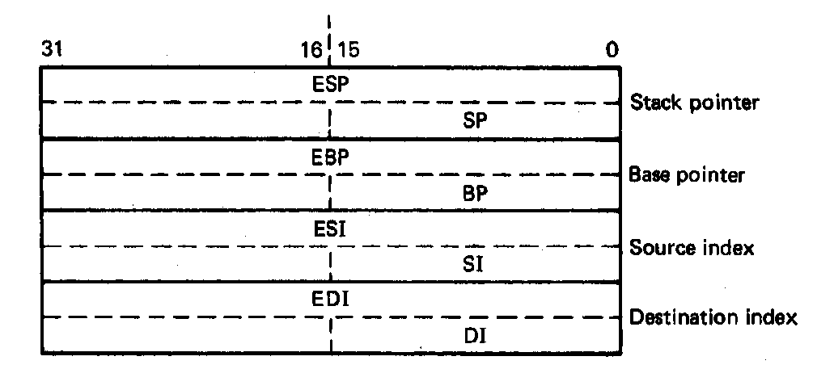
Pointer Registers
Two pointer registers
  Stack pointer register
    ESP = 32-bit extended stack pointer
    SP = 16-bit stack pointer
    Points to top of stack
  Base pointer register
    EBP = 32-bit extended base pointer
    BP = 16-bit base pointer
    Points to fixed location within current stack frame
Microprocessors I: Lecture 3
Notes:
Chapter 2

Slide 12
Index Registers
Source index register
  ESI = 32-bit source index register
  SI = 16-bit source index register
Destination index registers
  EDI = 32-bit destination index register
  DI = 16-bit destination index register
Typically used to access source and destination operands
Microprocessors I: Lecture 3
Notes:
Chapter 2

Slide 13
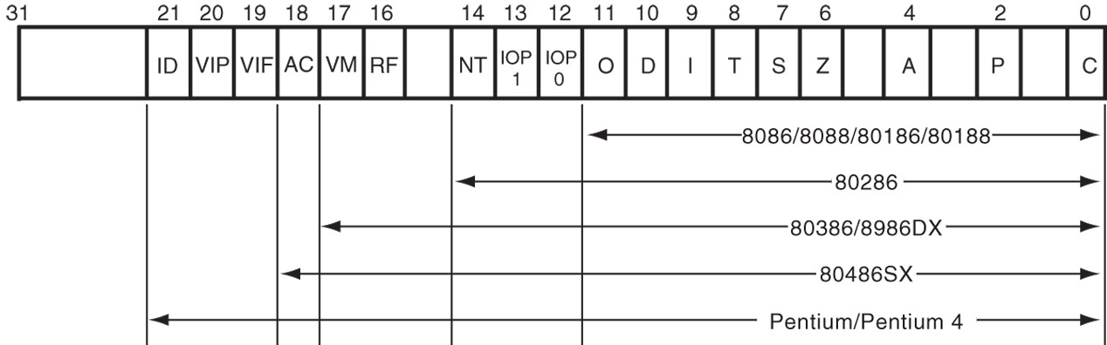
Flags Register
32-bit register holding single bit status and control information
9 active flags in real mode
Two categories
  Status flags: conditions resulting from instruction
    Most instructions update status
    Used as test conditions
  Control flags: control processor functions
    Used by software to turn on/off operating capabilities
Microprocessors I: Lecture 3
Notes:
Chapter 2

Slide 14
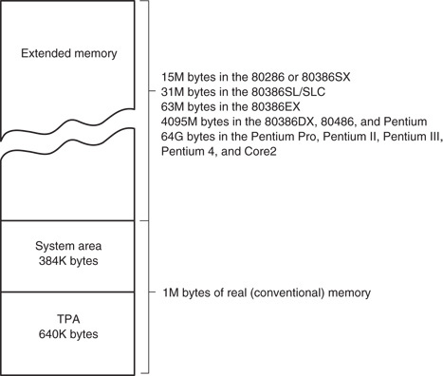
x86 memory spaces
x86 architecture implements independent memory and input/output (not shown) address spaces
Memory address space
  1 MB “real” memory
    System + transient program area (TPA)
  Extended memory size dependent on processor
Input/output address space- 65,536 bytes long (64KB)
Microprocessors I: Lecture 3
Notes:
Chapter 2

Slide 15
x86 memory modes
Two general modes of access
  Real mode (DOS)
  Protected mode (Windows)
Two memory models
  Segmented memory model
  Flat memory model
Microprocessors I: Lecture 3

Slide 16
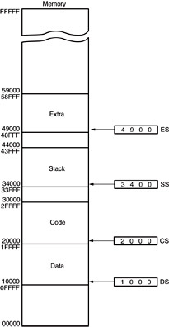
Memory segmentation
Only subset of address space is active (accessible)
Memory split into segments
  Active sections of memory
  Segments may overlap
  Segment size can be fixed (as in x86 real mode) or variable (as in protected mode)
Architecture requires register(s) to store start of active segment(s)
Microprocessors I: Lecture 3
Notes:
Chapter 2

Slide 17
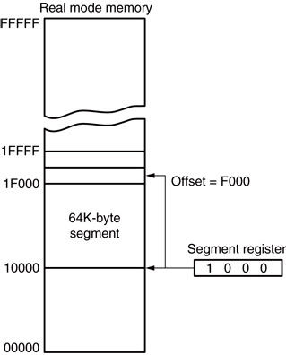
Real mode addressing
Primarily for DOS
Only accesses first 1 MB of memory
20-bit addresses
Segment register holds start of segment
Microprocessors I: Lecture 3

Slide 18
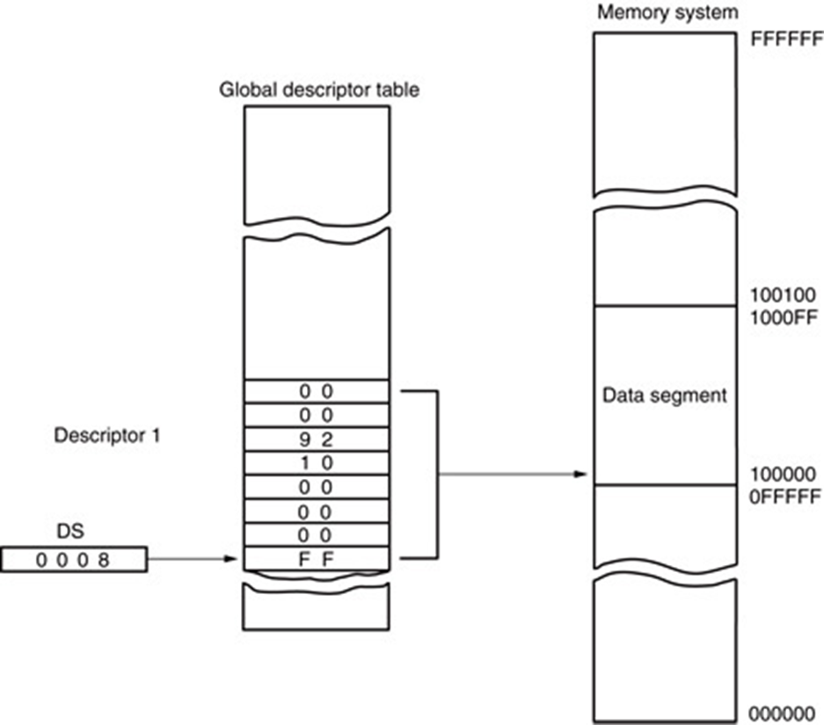
Protected mode addressing
Segment register holds selector
Selector chooses descriptor, which holds info about segment
  Location
  Length
  Access rights
Global descriptors: system
Local descriptors: applications
Microprocessors I: Lecture 3

Slide 19
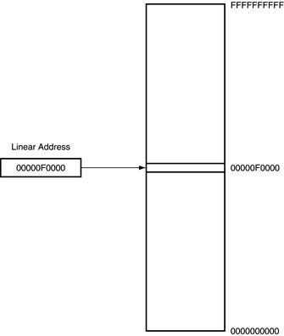
Flat mode addressing
No segmentation
Address generated by instruction = linear address being accessed
Generates 40-bit external address
Microprocessors I: Lecture 3

Slide 20
x86 addressing modes
Addresses in x86 instructions enclosed by brackets
Addressing modes: all examples of general addressing modes discussed earlier
Direct addressing
  EA = constant value
  Example: MOV AX, [0100H]
Register indirect addressing
  EA = value stored in register
  Example: MOV [EDI], AX
Base-plus-index addressing
  EA = sum of two registers
  Example: MOV AX, [EBX+ESI]
Microprocessors I: Lecture 3

Slide 21
x86 addressing modes (cont.)
Register relative addressing
  EA = register + constant
  Examples:
    MOV CL, [EBX+4]
    MOV AX, ARRAY[EBX] ARRAY is constant memory location
Base relative-plus-index addressing
  EA = base register + index register + constant
  Example: MOV AX, 10H[ESI][EBX] -or-
  MOV AX, [10H+SI+BX]
Scaled-index addressing
  EA = register + (scaling factor * second register)
  Often useful for array accesses
    Scaling factor = element size (2, 4, 8 bytes)
  Example: MOV EDX, [EAX + 4*EBX]
Microprocessors I: Lecture 3

Slide 22
Example
Compute the address for the specified operand in each of the following instructions. The register contents and variables are as follows:
  (ESI) = 00000100₁₆
  (EDI) = 00000200₁₆
  (EBX) = 00000300₁₆
Memory operand in: MOV [EBX+0400h], CX
Memory operand in: MOV [EDI+2*EBX], AH
Memory operand in MOV [EBX+EDI+0400h], AL
Microprocessors I: Lecture 3

Slide 23
Example solutions
Memory operand in: MOV [EBX+0400h], CX
  Addr = value in EBX + 0400h
  = 00000300h + 0400h = 00000700h
Memory operand in: MOV [EDI+2*EBX], AH
  Addr = value in EDI + 2 * value in EBX
  = 00000200h + 2 * 00000300h
  = 00000200h + 00006000h
Memory operand in MOV [EBX+EDI+0400h], AL
  Addr = EBX + EDI + 0400h
  = 00000300H + 00000200H + 0400h = 00000900h
Microprocessors I: Lecture 3

Slide 24
Final notes
Next time:
  Assembly programming basics
Reminders:
  Sign up for the discussion group on Piazza
  HW 1 to be posted this week; due date TBD
Microprocessors I: Lecture 3

