Slide 1
16.317: Microprocessor System Design I
Instructor: Dr. Michael Geiger
Spring 2012
Lecture 10: Multiplication/division, logical and operations
Notes:
Chapter 2

Slide 2
Lecture outline
Announcements/reminders
  HW 2 due Friday, 2/17
  Lab 1 posted; due 2/29
    Amanda’s OH: M/W 2:30-5, T 5-7
    Lab: Ball 407
Lecture outline
  Review: LEA/load full pointer, add/subtract
  Today
    Multiplication/division
    Logical instructions
Microprocessors I: Lecture 10

Slide 3
Review
LEA: load effective address
  Calculate EA/store in register
Load full pointer (LDS/LES/LFS/LGS/LSS)
  Load dest & segment register from memory
Reviewed flags: CF, AF, SF, ZF, PF, OF
Addition instructions
  ADD AX,BX → AX = AX + BX
  ADC AX,BX → AX = AX + BX + CF
  INC AX → AX = AX + 1
Subtraction instructions
  SUB AX,BX → AX = AX – BX
  SBB AX,BX → AX = AX – BX – CF
  DEC AX → AX = AX – 1
  NEG AX → AX = -AX = 0 - AX
Microprocessors I: Lecture 10

Slide 4
Addition/subtraction examples
Given the following initial state:
  AX = 1234H
  BL = ABH
  Memory location SUM = 00CDH
Show the results of each step of the following instruction sequences:
  ADD AX, [SUM]
  ADC BL, 05H
  NEG BL
  SUB AX, 12H
  INC WORD PTR [SUM]
Microprocessors I: Lecture 10

Slide 5
Example solution
ADD AX, [SUM]
  (DS:SUM) + (AX) → (AX)
  00CDH + 1234H = 1301H
  (AX) = 1301H, (CF) = unchanged
ADC BL,05H
  (BL) + IMM8 +(CF) → BL
  ABH + 05H + 0 = B0H
  (BL) = B0H, (CF) = unchanged
NEG BL
  –(BL) → BL
  –B0H = –(1011 0000)₂ = 0101 0000₂ = 50H
Microprocessors I: Lecture 10
Notes:
Chapter 5 (I)

Slide 6
Example solution (cont.)
SUB AX, 12H
  (AX) – 0012H → AX
  1301H – 0012H = 12EFH
  (AX) = 12EFH, (CF) = unchanged
INC WORD PTR [SUM]
  (DS:SUM) + 1 → (DS:SUM)
  00CDH + 1 = 00CEH
  (SUM) = 00CEH, (CF) = unchanged
Microprocessors I: Lecture 10

Slide 7
Multiplication Instructions
Integer multiply instructions—MUL and IMUL
  Multiply two unsigned or signed byte, word, or double word operands
  General format and operation
    MUL S = Unsigned integer multiply
    IMUL S = Signed integer multiply
    (AL) X (S8)→ (AX) 8-bit product gives 16 bit result
    (AX) X (S16) → (DX), (AX) 16-bit product gives 32 bit result
    (EAX) X (S32)→ (EDX), (EAX) 32-bit product gives 64 bit result
    Source operand (S) can be an 8-bit, 16-bit, or 32-bit value in a register or memory
      Other source operand is “implicit” and is AL, AX, or EAX
    Destination is “implicit”
      AX assumed to be destination for 16 bit result
      DX,AX assumed destination for 32 bit result
      EDX,EAX assumed destination for 64 bit result
    Only CF and OF flags updated; other undefined
Microprocessors I: Lecture 10
Notes:
Chapter 5 (I)

Slide 8
Multiplication Instructions
Integer multiply instructions—MUL and IMUL
  Other formats of the signed multiply instruction
    IMUL R,I = Register operand times immediate operand; result in the register
    Typical operation: (R16) X IMM8 → (R16)
    IMUL R,S,I = Source in a register or memory times immediate operand; result in the register
    Typical operation: (S32) X IMM8 → (R32)
    IMUL R,S = Source time register; result in the register
    Typical operation: (R32) X (S32) → (R32)
Microprocessors I: Lecture 10
Notes:
Chapter 5 (I)

Slide 9
Multiplication Instruction Example
Example: unsigned multiply
  MUL CL
  (AL) = -1₁₀
  (CL) = -2₁₀
  Expressing in 2’s complement
  (AL) = -1 = 11111111₂ = FFH
  (CL) = -2 = 11111110₂ = FEH
  Operation: numbers are treated as unsigned integers
  (AL) X (CL) → (AX)
  255 X 254 = ?
11111111₂ X 11111110₂ = ?
= 1111 1101 0000 0010
(AX) = FD02H
(CF) = CY → carry from AL to AH
Microprocessors I: Lecture 10
Notes:
Chapter 5 (I)

Slide 10
Multiplication Instructions Example
Example: multiplying as signed numbers
  IMUL CL
  (AL) = -1₁₀
  (CL) = -2₁₀
  Result
  (-1) X (-2) = +2
Microprocessors I: Lecture 10
Notes:
Chapter 5 (I)

Slide 11
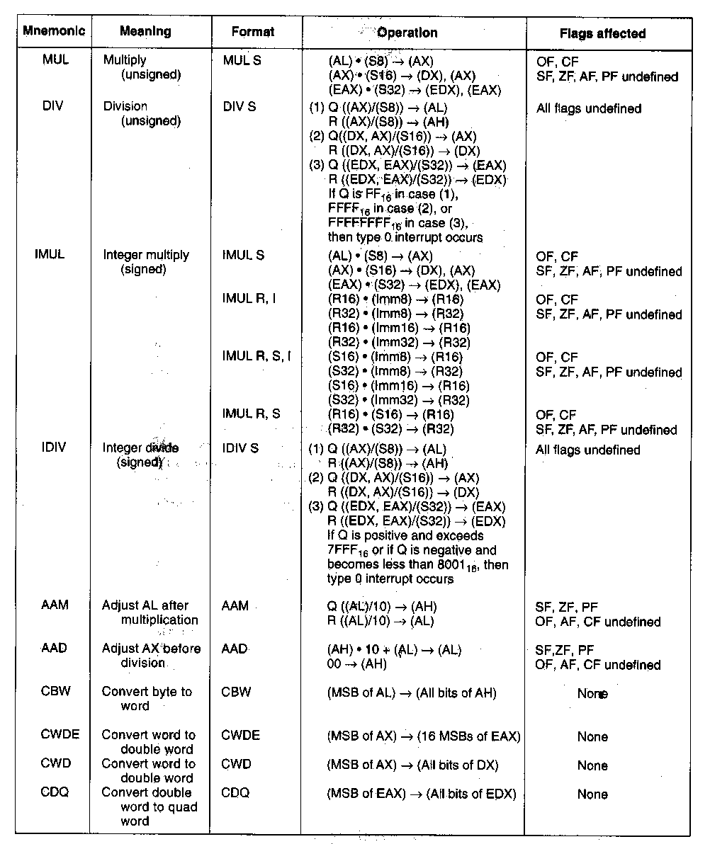
Division Instruction
Integer divide instructions—DIV and IDIV
  Divide unsigned– DIV S
    Operations:
    (AX) / (S8) → (AL) =quotient
        (AH) = remainder
      16 bit dividend in AX divided by 8-bit divisor in a register or memory,
      Quotient of result produced in AL
      Remainder of result produced in AH
    (DX,AX) / (S16) → (AX) =quotient
        (DX) = remainder
      32 bit dividend in DX,AX divided by 16-bit divisor in a register or memory
      Quotient of result produced in AX
      Remainder of result produced in DX
    (EDX,EAX) / (S32) → (EAX) =quotient
        (EDX) = remainder
      64 bit dividend in EDX,EAX divided by 32-bit divisor in a register or memory
      Quotient of result in EAX
      Remainder of result in EDX
    Divide error (Type 0) interrupt may occur
Microprocessors I: Lecture 10
Notes:
Chapter 5 (I)

Slide 12
Convert Instructions
Convert instructions
  Used to sign extension signed numbers for division
  Operations
    CBW = convert byte to word
      (MSB of AL) → (all bits of AH)
    CWDE = convert word to double word
    (MSB of AX) → (16 MSBs of EAX)
    CWD = convert word to double word
      (MSB of AX) → (all bits of DX)
    CDQ = convert double word to quad word
      (MSB of EAX) → (all bits of EDX)
  Application:
    To divide two signed 8-bit numbers, the value of the dividend must be sign extended in AX– load into AL and then use CBW to sign extend to 16 bits
  Example
  A1H → AL
  CBW sign extends to give
  FFA1H → AX
  CWD sign extends to give
  FFFFH → DX
Microprocessors I: Lecture 10
Notes:
Chapter 5 (I)

Slide 13
Instruction types
80386DX instruction types
  Data Transfer instructions
  Input/output instructions
  Arithmetic instructions
  Logic instructions
  String Instructions
  Control transfer instructions
  Processor control
Microprocessors I: Lecture 9

Slide 14
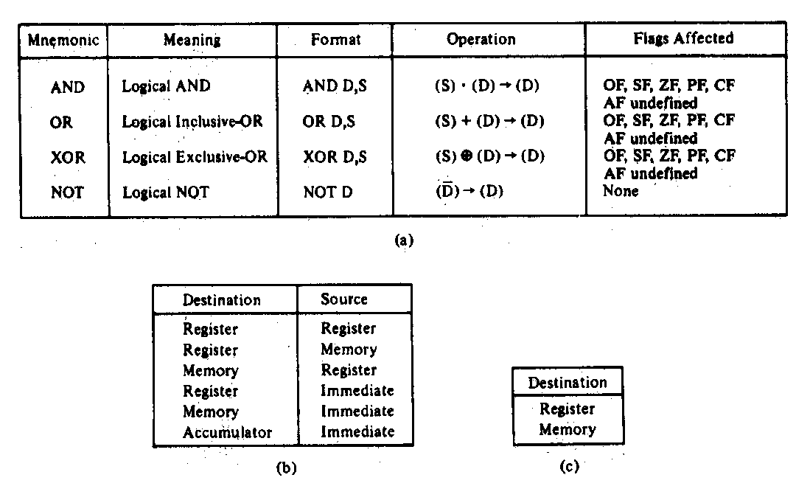
Logic Instructions
  AND → Logical AND
  OR → Logical inclusive-OR
  XOR → Logical exclusive-OR
  NOT → Logical NOT
Logical AND Instruction—AND
  AND format and operation:
    AND D,S
    (S) AND (D) → (D)
    Logical AND of values in two registers
    AND AX,BX
    (AX) AND (BX) → (AX)
    Logical AND of a value in memory and a value in a register
    AND [DI],AX
    (DS:DI) AND (AX) → (DS:DI)
    Logical AND of an immediate operand with a value in a register or memory
    AND AX,100H
    (AX) AND IMM16 → (AX)
Flags updated based on result
  CF, OF, SF, ZF, PF
  AF undefined
Microprocessors I: Lecture 10
Notes:
Chapter 5 part 2

Slide 15
Logic instructions: example
Show the state of AL after each instruction in the following sequence:
  MOV AL, 55H
  AND AL, 1FH
  OR AL, C0H
  XOR AL, 0FH
  NOT AL
Microprocessors I: Lecture 10

Slide 16
Logic instructions: solution
Show the state of AL after each instruction
  MOV AL, 55H
    AL = 55H
  AND AL, 1FH
    AL = 55H AND 1FH = 01010101 AND 00011111
    = 00010101 = 15H
  OR AL, C0H
    AL = 15H OR C0H = 00010101 OR 11000000
    = 11010101 = D5H
  XOR AL, 0FH
    AL = D5H XOR 0FH = 11010101 XOR 00001111
    = 11011010 = DAH
  NOT AL
    AL = NOT DAH = NOT(11011010) = 00100101 = 25H
Microprocessors I: Lecture 11

Slide 17
Next time
Shift instructions
Rotate and bitwise instructions
Microprocessors I: Lecture 10

