Slide 1
16.317: Microprocessor System Design I
Instructor: Dr. Michael Geiger
Spring 2012
Lecture 14: Exam 1 Review
Notes:
Chapter 2

Slide 2
Lecture outline
Announcements/reminders
  Lab 1 report due 2/29
    Must have work checked off
    Amanda’s OH: M/W 2:30-5, Tuesday 5-7 in Ball 407
  HW3, Lab 2 to be posted ASAP
  Early feedback forms at end of Wed. lecture
Today: Exam 1 Review
  Exam stats
  Regrades
  Exam solution
Microprocessors I: Exam 1 Review

Slide 3
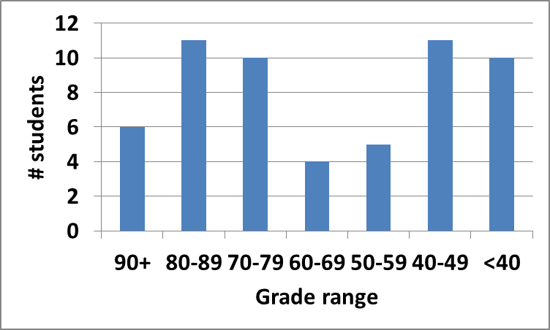
Exam stats & grade distribution
Average: 62.3
Median: 65
Std. deviation: 21.6
Max: 93
Question-by-question averages:
  Q1: 13.2 / 20 (66%)
  Q2: 26.0 / 40 (65%)
  Q3: 23.2 / 40 (58%)
Microprocessors I: Exam 1 Review

Slide 4
Regrade requests
Due Monday, 3/5
Must be written (preferably on a separate sheet)
You must also return your exam
  Do not write on your exam if you plan on submitting a regrade request
Must demonstrate understanding of problem
  Bad: “I deserve more points on Problem 3a.”
  Good: “I deserve more points on Problem 3a because I calculated a wrong result for one instruction based on a wrong result from a previous instruction. I used the right operation; I just plugged in the wrong value.”
Microprocessors I: Exam 1 Review

Slide 5
Next time
Continue with assembly language
Early feedback forms
Microprocessors I: Exam 1 Review

