Slide 1
16.317: Microprocessor System Design I
Instructor: Dr. Michael Geiger
Spring 2012
Lecture 17: Jump instructions
Notes:
Chapter 2

Slide 2
Lecture outline
Announcements/reminders
  Exam 1 regrades due today
    In writing; must show understanding of problem
  Lab 2 to be posted later today
  HW 3 later in week
  No office hours today
Lecture outline
  Early feedback discussion
  Review: compare instructions
  Jump instructions
Microprocessors I: Lecture 17

Slide 3
Early feedback: results
Pace of course
  Slow: 2% Appropriate: 86% Fast: 12%
Are lectures helpful?
  No: 2% Somewhat: 32% Very: 66%
Are lecture handouts helpful?
  No: 2% Somewhat: 46% Very: 52%
Are in-class exercises helpful?
  No: 12% Somewhat: 20% Very: 68%
Microprocessors I: Lecture 17

Slide 4
Early feedback: results (cont.)
Is website helpful?
  No: 2% Somewhat: 33% Very: 65%
Are recorded lectures helpful?
  No: 9% Somewhat: 55% Very: 36%
  Several people said they didn’t use these
Homework difficulty:
  Easy: 0% Moderate: 45%
  Difficult but fair: 48% Too hard: 7%
Do homeworks help you learn concepts?
  Yes: 90.5% No: 9.5%
Microprocessors I: Lecture 17

Slide 5
Early feedback: comments
Lectures
  More examples in class (with more practical focus)
  Record examples written on board (if possible?)
Homework
  Grading too harsh (more an issue with rubric than TA)
  Overall length (students want less writing)
Exam
  More problems/examples outside of class
  First exam was too long; second will be shorter
Other comments
  Someone explicitly said the class is not boring
  Someone asked for more sarcastic comments
  And the most frequent “other” comment I saw was:
    The lecture is too early! (I agree completely)
Microprocessors I: Lecture 17

Slide 6
Review
CMP D, S
  Flags show result of (D) – (S)
    Assumes signed computation
  ZF = 1 → D == S
  ZF = 0, (SF XOR OF) = 1 → D < S
  ZF = 0, (SF XOR OF) = 0 → D > S
Condition codes: mnemonics implying certain flag conditions
SETcc D
  Sets single byte destination to all 1s (FFH) if condition true; all 0s (00H) if condition false
  Can be used to build up complex conditions
Microprocessors I: Lecture 17

Slide 7
Jump instructions
Used to change flow of program
  Next instruction specified by operand
Two general types
  Unconditional: JMP <target>
    Always goes to address indicated by <target>
  Conditional: Jcc <target>
    Jump only occurs if condition true
    cc replaced by valid condition code
      Most codes discussed in previous lecture
      Additional codes: CXZ/ECXZ
      → CX/ECX register is zero
Microprocessors I: Lecture 17

Slide 8
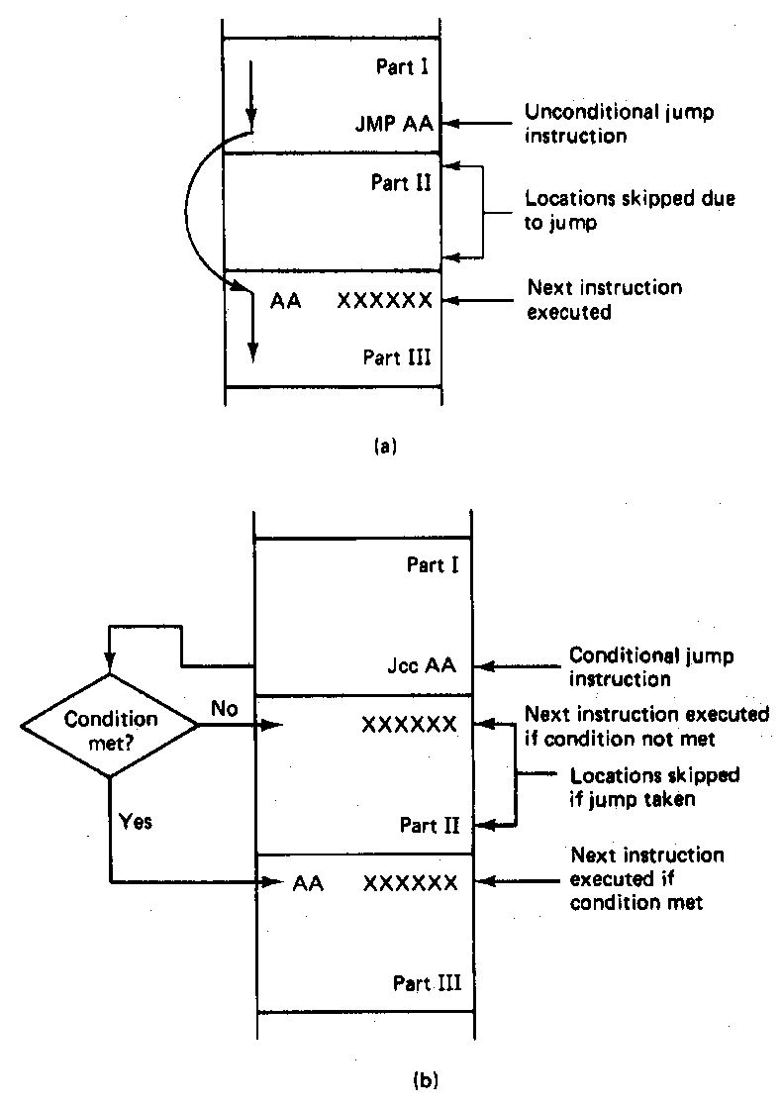
Jump Instructions
Microprocessors I: Lecture 17
Notes:
Chapter 6 part 1

Slide 9
Jump targets
Depends on distance from jump instruction
  Recall: CS:IP is logical addr. of current inst.
Intrasegment: target in same segment
  8-bit (short-label)/16-bit (near-label) immediate
    Signed offset added to current IP
    Usually specified by code writer simply as label
      E.g., JMP LABEL1
  16-bit register or memory location
    IP overwritten by contents of memory or register
    Register example: JE BX
    Memory example: JE WORD PTR [BX]
Microprocessors I: Lecture 17

Slide 10
Jump targets (cont.)
Depends on distance from jump instruction
  Recall: CS:IP is logical addr. of current inst.
Intersegment: target in different segment
  32-bit (far-label) immediate
  32-bit register
  32-bit memory location (DWORD PTR)
  In all cases, CS = upper 16 bits; IP = lower 16 bits
Microprocessors I: Lecture 17

Slide 11
Example: jump targets
Given CS = 1200H, IP = 0100H, and EBX = 14000020H, what are the target addresses of the following jump instructions?
  JMP 08H
  JPE FFF0H
  JE BX
  JNZ EBX
Microprocessors I: Lecture 17

Slide 12
Example solution
JMP 08H
  Short-label jump → add constant value to IP
  IP = 0100 + 08 = 0108H
  Target = CS:IP = 12000+0108 = 12108H
JPE FFF0H
  Near-label jump → add constant value to IP
  IP = 0100 + FFF0 = 00F0H
  Target = CS:IP = 12000+00F0 = 120F0H
Microprocessors I: Lecture 17

Slide 13
Example solution (cont.)
JE BX
  Register jump → overwrite IP with 16-bit register value
  IP = BX = 0020H
  Target = CS:IP = 12000 + 0020 = 12020H
JNZ EBX
  Register jump → overwrite CS, IP with 32-bit register value
  CS = upper word of EBX = 1400H
  IP = BX = 0020H
  Target = CS:IP = 14000 + 0020 = 14020H
Microprocessors I: Lecture 17

Slide 14
Example: program structure 1
Given the instructions below, what are the resulting register values if:
  AX = 0010H, BX = 0010H
  AX = 1234H, BX = 4321H
What type of high-level program structure does this sequence demonstrate?
Instructions
  CMP AX, BX
  JE L1
  ADD AX, 1
  JMP L2
  L1: SUB AX, 1
  L2: MOV [100H], AX
Microprocessors I: Lecture 17

Slide 15
Example solution
First case: AX = BX = 0010H
  CMP AX, BX → Shows AX == BX
  JE L1 → Cond. true—jump to L1
  ADD AX, 1
  JMP L2
  L1: SUB AX, 1 → AX = AX – 1 = 000F
  L2: MOV [100H], AX → Store 000F at DS:100H
Microprocessors I: Lecture 17

Slide 16
Example solution (cont.)
Second case: AX = 1234H, BX = 4321H
  CMP AX, BX → Shows AX < BX
  JE L1 → Cond. false—no jump
  ADD AX, 1 → AX = AX + 1 = 1235H
  JMP L2
  L1: SUB AX, 1 → AX = AX – 1 = 000F
  L2: MOV [100H], AX → Store 000F at DS:100H
Microprocessors I: Lecture 17

Slide 17
Example solution (cont.)
High-level program structure: if/else statement
  If part: compare + jump (if (AX == BX))
  Else part: what follows if condition false
  Unconditional jump used to skip “if” part
  Both parts have same exit (L2)
Microprocessors I: Lecture 17

Slide 18
Example: program structure 2
Given the instructions below, what are the resulting register values if, initially, AX = 0001H?
What type of high-level program structure does this sequence demonstrate?
Instructions
  MOV CL, 5
  L: SHL AX, 1
  DEC CL
  JNZ L
Microprocessors I: Lecture 17

Slide 19
Example: program structure 3
Given the instructions below, what are the resulting register values if, initially, AX = 0001H?
What type of high-level program structure does this sequence demonstrate?
Instructions
  MOV CL, 5
  L: JZ END
  ADD AX, AX
  DEC CL
  JMP L
  END: MOV [10H], AX
Microprocessors I: Lecture 17

Slide 20
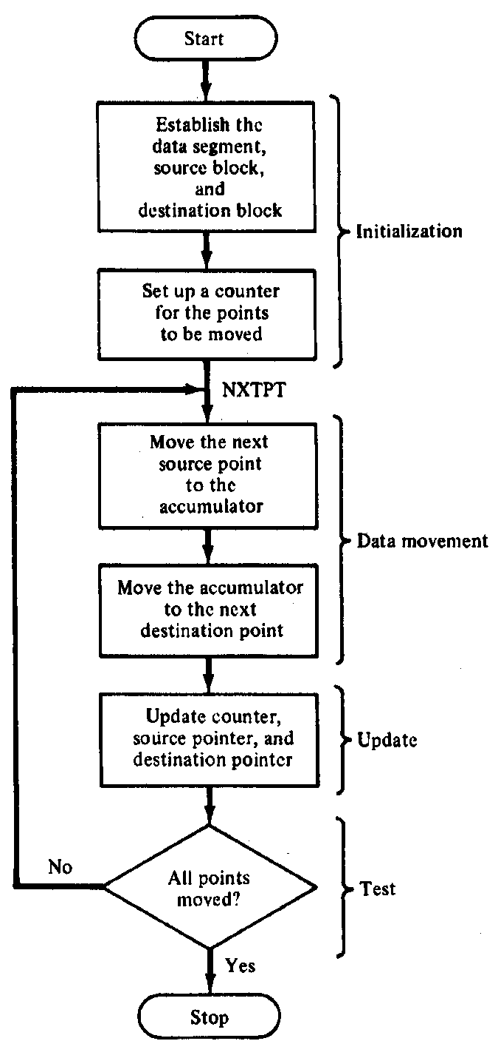
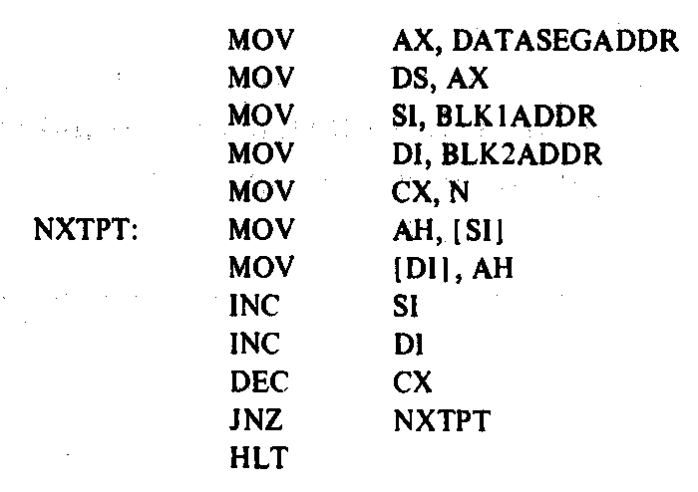
Block Move Program
Microprocessors I: Lecture 17
Notes:
Chapter 6 part 1

Slide 21
Next time
Loop instructions
Subroutine instructions
Microprocessors I: Lecture 17

