Slide 1
16.317: Microprocessor System Design I
Instructor: Dr. Michael Geiger
Spring 2012
Lecture 28: Memory organization and interfacing
Notes:
Chapter 2

Slide 2
Lecture outline
Announcements/reminders
  Lab 3 report due 4/11
  HW 4, Lab 4 to be posted ASAP
  Exam regrade requests due by Friday, 4/13
Lecture outline
  Memory organization
  Memory interfacing
Microprocessors I: Lecture 28

Slide 3
Memory organization
Memory frequently split into banks
  Independent groups of data that can be accessed separately
In older modules, 1 bank per byte
  BE lines on 80386 enable individual banks
  Each bank drives 8 bits of data bus
In newer modules, each bank may hold word/double-word
  1 bank enabled at time
  Can start accesses to different banks
Data typically interleaved—consecutive bytes placed in different banks
  Why?
Microprocessors I: Lecture 28

Slide 4
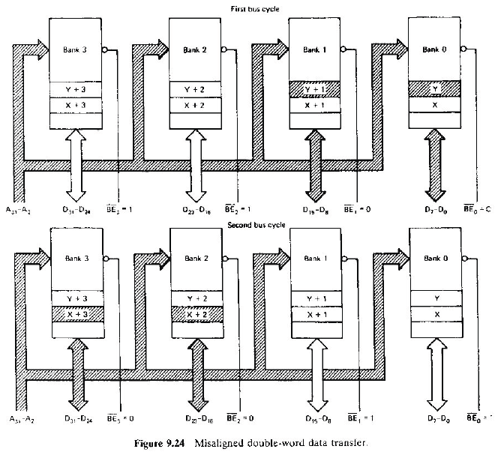
Misaligned data transfer
Data split across multiple lines
More significant bytes accessed first
Microprocessors I: Lecture 28

Slide 5
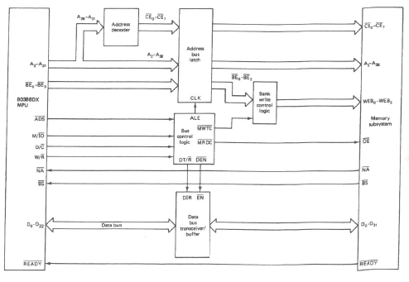
Memory interfacing
Microprocessors I: Lecture 28

Slide 6
Memory interfacing (cont.)
Address decoding: using address bits to identify proper device
  In previous example, decoded to identify different chip(s) in memory module
  Upper address bits typically used to select specific device; lower bits used to choose location within device
    Why?
Microprocessors I: Lecture 28

Slide 7
Memory interfacing (cont.)
Address latch
  Ensures address (and other) inputs to memory module remain consistent throughout transaction
  Why might address change?
Bus control:
  Incorporates:
    ADS: address valid
    Transaction type: R/W, M/IO, D/C
  Controls
    Timing (address latching, data buffering)
    Operation type (read/write)
Microprocessors I: Lecture 28

Slide 8
Next time
PIC intro
Microprocessors I: Lecture 28

