Slide 1
16.317: Microprocessor System Design I
Instructor: Dr. Michael Geiger
Spring 2012
Lecture 31: PIC instruction set, pt. 1
Notes:
Chapter 2

Slide 2
Lecture outline
Announcements/reminders
  Lab 4 due 4/25
    Limited # of PICkits → strongly suggest you work in a group for the last two assignments
    PICkits can be checked out from the lab
  HW 4 to be posted this week
Lecture outline
  Review
    PIC data memory
  PIC instructions
    Instruction formats
    Variable declarations in PIC assembly
    Clear/move
    Single bit manipulation
    Arithmetic
Microprocessors I: Lecture 31

Slide 3
Review: Data Memory Organization
Made up of SFRs and GFRs
Banking: 128 byte chunks
  Max offset within bank 0x7f
  Controller may have 2 or 4 banks
Addressing Modes
  Direct addressing:
    7 bit address (within bank)
    RP1:RP0 selects bank
  Indirect addressing:
    Access to INDF causes indirect addressing
    Actual memory address in IRP+FSR
I/O ports
  Control register (e.g. TRISA) controls direction of each pin
    Bit = 1 → input, Bit = 0 → output
  Data register (e.g. PORTA) contains actual port state
Microprocessors I: Lecture 31

Slide 4
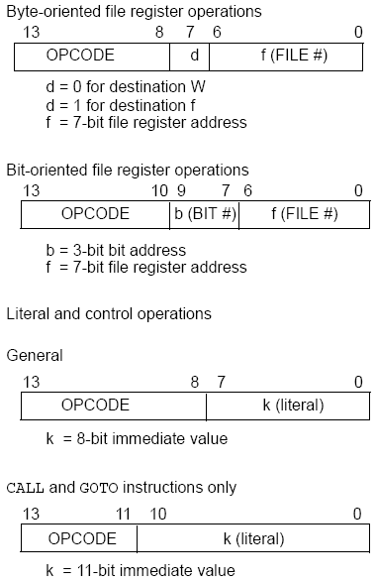
PIC16F684
Instructions
35 instructions
Each instruction is 14 bits
Byte-oriented OPCODE f, F(W)
  Source f: name of a SFR or a RAM variable
  Destination F(W):
    F if the destination is to be the same as the source register
    W if the destination is to be the working register
Bit-oriented OPCODE f, b
  Bit address b (0≤b≤7)
Literal and control OPCODE k
  Literal value k
Microprocessors I: Lecture 31
Notes:
Chapter 9

Slide 5
RAM variables
Memory variable: symbolic name to refer to space in memory (GPRs)
  Usable space on 16F684: 0x20–0x7F (Bank 0), 0xA0 – 0xBF (Bank 1)
  Once declared, use symbolic name, not address
Example PIC syntax (cblock/endc):
  cblock 0x20 ; cblock directive needs starting
  ; address
  var1 ; var1 = byte at 0x20
  var2 ; var2 = byte at 0x21
  var3 ; var3 = byte at 0x22
  endc ; End of variable block
Microprocessors I: Lecture 31

Slide 6
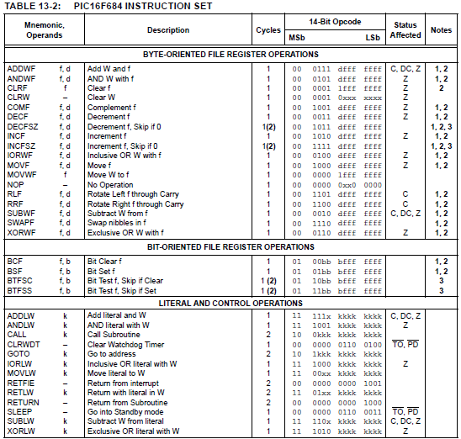
Microprocessors I: Lecture 31

Slide 7
Clear/Move
clrw ; Clear W register
clrf f ; Clear f register
movlw k ; move literal value k to W
movwf f ; move W to f
movf f, F(W) ; move f to F or W
swapf f, F(W) ; swap nibbles of f, putting result in F or W
STATUS bits:
clrw, clrf, movf: Z
movlw, movwf, swapf: none
Examples:
clrf TEMP1 ;Clear variable TEMP1
movlw 5 ;load 5 into W
movwf TEMP1 ;move W into TEMP1
movwf TEMP1, F ;Incorrect Syntax
movf TEMP1, W ;move TEMP1 into W ;
movf TEMP1, TEMP2 ;Incorrect Syntax
swapf TEMP1, F ;Swap 4-bit nibbles of TEMP1
swapf TEMP1, W ;Move TEMP1 to W, swap nibbles, leave TEMP1 unchanged
Microprocessors I: Lecture 31
Notes:
Chapter 9

Slide 8
Single Bit Manipulation
bcf f,b
Operation: Clear bit b of register f, where b=0 to 7
bsf f,b
Operation: Set bit b of register f, where b=0 to 7
STATUS bits:
none
Examples:
bcf PORTB, 0 ;Clear bit 0 off PORTB
bsf STATUS, C ;Set the Carry bit
bcf STATUS, RP1 ;
bsf STATUS, RP0 ;Select Bank 1
Microprocessors I: Lecture 31
Notes:
Chapter 9

Slide 9
Example
Show the values of all changed registers after the following sequence
cblock 0x30
x
y
endc
clrw
movwf x
movlw 0xFE
movwf y
swapf y, F
bcf y, 3
bsf x, 3
movf y, W
Microprocessors I: Lecture 31

Slide 10
Example solution
clrw → W = 0x00
movwf x → x = W = 0x00
movlw 0xFE → W = 0xFE
movwf y → y = W = 0xFE
swapf y, F → Swap nibbles of y → y = 0xEF
bcf y, 3 → Clear bit 3 of y = 1110 1111₂
→ y = 1110 0111₂ = 0xE7
bsf x, 3 → Set bit 3 of x
→ x = 0000 1000₂ = 0x08
movf y, W → W = y = 0xE7
Microprocessors I: Lecture 31

Slide 11
Increment/Decrement/
Complement
incf f, F(W) ; increment f, putting result in F or W
decf f, F(W) ;decrement f, putting result in F or W
comf f, F(W) ;complement f, putting result in F or W
STATUS bits:
Z
Examples:
incf TEMP1, F ;Increment TEMP1
incf TEMP1, W ;W <- TEMP1+1; TEMP1 unchanged
decf TEMP1, F ;Decrement TEMP1
comf TEMP1, F ;Change 0s and 1s to 1s and 0s
Microprocessors I: Lecture 31
Notes:
Chapter 9

Slide 12
Addition/Subtraction
addlw k ;add literal value k into W
addwf f, F(W) ;add w and f, putting result in F or W
sublw k ;subtract W from literal value k, putting
;result in W
subwf f, F(W) ;subtract W from f, putting result in F or W
STATUS bits:
C, DC, Z
Examples:
addlw 5 ; W <= 5+W
addwf TEMP1, F ; TEMP1 <- TEMP1+W
sublw 5 ; W <= 5-W (not W <= W-5 )
subwf TEMP1, F ; TEMP1 <= TEMP1 - W
Microprocessors I: Lecture 31
Notes:
Chapter 9

Slide 13
Next time
Continue with discussion of PIC instructions
  Logical instructions
  Rotates
  Goto/call/return
Microprocessors I: Lecture 31

