Slide 1
16.317
Microprocessor Systems Design I
Instructor: Dr. Michael Geiger
Spring 2013
Lecture 15:
Subroutines; stack details

Slide 2
Lecture outline
Announcements/reminders
  Lab 1 due 3/6
  Exam 1 regrades due today
Today’s lecture
  80386DX subroutine instructions
  Stack discussion
Microprocessors I: Lecture 15

Slide 3
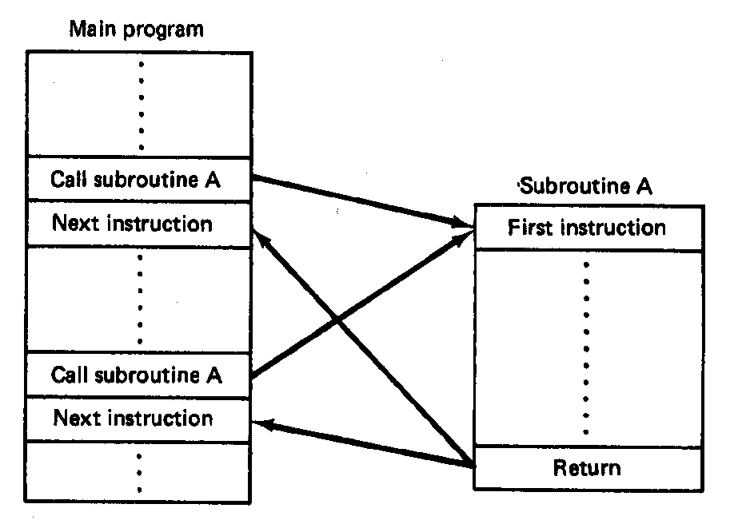
Subroutines
Subroutine: special program segment that can be “called” from any point in program
  Implements HLL functions/procedures
  Written to perform operation that must be repeated in program
  Actual subroutine code only written once
Microprocessors I: Lecture 15
Notes:
Chapter 6 part 2

Slide 4
Subroutine operation
When called, address of next instruction saved
  State may need to be saved before call
  Parameters can be passed
Control of program transferred to subroutine
After subroutine finished, return instruction goes back to saved address
Microprocessors I: Lecture 15
Notes:
Chapter 6 part 2

Slide 5
80386 subroutines
Specify starting point with pseudo-op
  <name> PROC NEAR → same segment
  <name> PROC FAR → different segment
May save state/allocate variables at start
  If so, will restore at end of subroutine
Last instruction returns to saved address
  Always RET
Pseudo-op after RET indicates routine end
  <name> ENDP
Microprocessors I: Lecture 15

Slide 6
Subroutine example
SQUARE PROC NEAR
PUSH AX ; Save AX to stack
MOV AL, BL ; Copy BL to AL
IMUL BL ; AL = BL * AL
; = original BL squared
MOV BX, AX ; Copy result to BX
POP AX ; Restore AX
RET
SQUARE ENDP
Microprocessors I: Lecture 15

Slide 7
Call/return
Calling subroutine: CALL <proc>
  Address of next instruction saved on stack
    Either IP (near) or CS, IP (far)
  <proc> can be 16- or 32-bit label/immediate, register, memory operand
    16-bit immediate added to IP
    16-bit register/memory replaces IP
    32-bit values replace CS/IP
Ending subroutine: RET
  Saved address restored to IP (& CS if needed)
Microprocessors I: Lecture 15

Slide 8
Example
Assuming AX = 2 and BX = 4, show the results of the following sequence (Ex. 6.11):
  Assume the addresses of the first three instructions are CS:0005, CS:0008, and CS:0009, respectively
  CALL SUM
  RET ; End main function
  SUM PROC NEAR
  MOV DX, AX
  ADD DX, BX
  RET
  SUM ENDP
Microprocessors I: Lecture 15

Slide 9
Example results
  CALL SUM
  RET ; End main function
  SUM PROC NEAR
  MOV DX, AX DX = AX = 4
  ADD DX, BX DX = DX + BX = 4 + 2 = 6
  RET
  SUM ENDP
Microprocessors I: Lecture 15

Slide 10
Saving state
May need to save state before routine starts
  Overwritten registers (that aren’t return values)
  Flags
Placing data on stack: PUSH
  Store data “above” current TOS; decrement SP
    Stack grows toward lower addresses
    New SP points to start of data just stored
  Basic PUSH stores word or double word
  Directly storing flags: PUSHF
  Storing all 16-/32-bit general purpose registers: PUSHA/PUSHAD
Microprocessors I: Lecture 15

Slide 11
Restoring state
Removing data from TOS: POP
  Data removed from TOS; SP incremented
  Basic POP removes word/double word
  Directly removing flags: POPF
  Removing all 16-/32-bit general purpose registers: POPA/POPAD
POP instructions generally executed in reverse order of corresponding PUSH instructions
Microprocessors I: Lecture 15

Slide 12
Revisiting subroutine example
SQUARE PROC NEAR
PUSH AX ; Save AX to stack
MOV AL, BL ; Copy BL to AL
IMUL BL ; AL = BL * AL
; = original BL squared
MOV BX, AX ; Copy result to BX
POP AX ; Restore AX
RET
SQUARE ENDP
Microprocessors I: Lecture 15

Slide 13
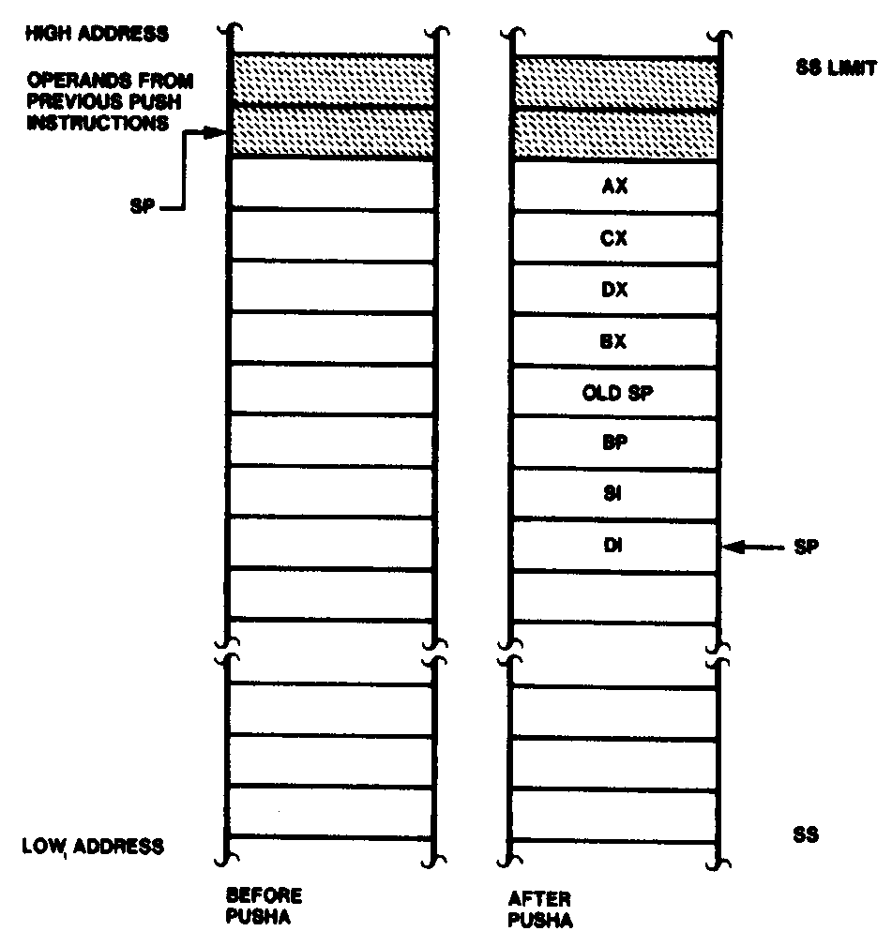
Push All and Pop All Operations
Microprocessors I: Lecture 15
Notes:
Chapter 6 part 2

Slide 14
Stack examples
Assume initial state shown in handout
What is the resulting stack state of each of the following sequences?
  PUSH BX
  PUSH AX
  PUSH EBX
  PUSH EAX
  PUSHA
Microprocessors I: Lecture 15

Slide 15
Solution
What is the resulting stack state of each of the following sequences?
  PUSH BX
  PUSH AX
  4 bytes pushed to stack, so SP decremented by 4 → ESP = 00001FFCH
  AX is at top of stack; BX is below that
  PUSH EBX
  PUSH EAX
  8 bytes pushed to stack, so SP decremented by 8 → ESP = 00001FF8H
  EAX is at top of stack; EBX is below that
  PUSHA
  8 words = 16 bytes pushed to stack, so SP decremented by 16 → ESP = 00001FF0H
  As shown in slide 13, DI is at top of stack, followed by SI, BP, old SP, BX, DX, CX, and AX
Microprocessors I: Lecture 15

Slide 16
Final notes
Next time: 80386 protected mode
Reminders:
  Lab 1 due 3/6
  Exam 1 regrades due today
Microprocessors I: Lecture 15

