Slide 1
16.317
Microprocessor Systems Design I
Instructor: Dr. Michael Geiger
Spring 2013
Lecture 22:
Exam 2 Review

Slide 2
Lecture outline
Announcements/reminders
  Lab 2 due 4/5
Today’s lecture: Exam 2 Review
  Exam stats
  Regrade requests: due in writing, 4/5
  Figuring out where you stand
  Exam solution
Microprocessors I: Exam 2 Review

Slide 3
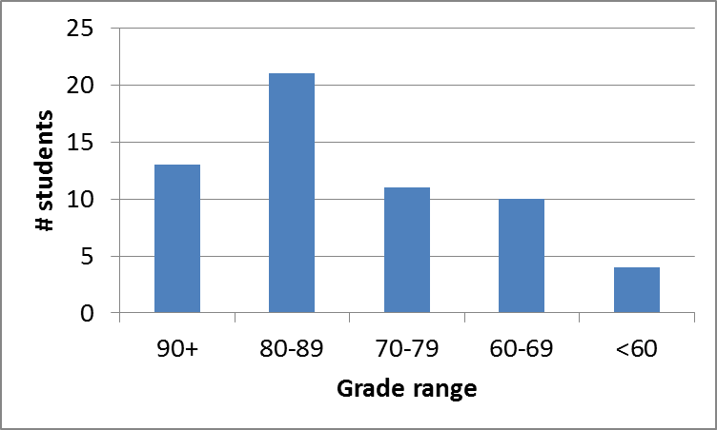
Exam stats & grade distribution
Question-by-question averages:
  Q1: 10.6 / 20 (53%)
  Q2: 37.8 / 40 (94%)
  Q3: 30.2 / 40 (75%)
Extra credit
  46 students
  6.9 / 10 average
Average: 78.6
Median: 81
Std. deviation: 13.1
Max: 100
Microprocessors I: Exam 2 Review

Slide 4
Figuring out where you stand
Homework: 25% (3/5 done; 2/5 graded)
Labs: 30% (1/4 done)
Exams: 45% (15% + 15% + 15%)
47.5% of your grade still to be determined
Estimating your grade
  Homework avg (HWA) =
  (total homework points) / 2
  Lab avg (LA) = score from Lab 1
  Exam avg (EA) =
  ((Exam1) + (Exam2)) / 2
  Overall avg = HWA * 0.25 + LA * 0.30 + EA * 0.45
Microprocessors I: Exam 2 Review

Slide 5
Figuring out where you stand
Estimated avg.
= HWA * 0.25 + LA * 0.3 + EA * 0.45
Current course average: ~84%, SD ≈ 10
  “Curve” would add at most ~1-2 points to those below mean
  Very possible there will be no grading curve
  Therefore, right now:
    Min grade for C-: 68
    Min grade for D: 56
    THESE NUMBERS WILL ALMOST CERTAINLY CHANGE BEFORE SEMESTER’S END—THESE FIGURES ARE JUST ROUGH ESTIMATES!!!!!
Microprocessors I: Exam 2 Review

Slide 6
Final notes
Next time:
  PIC introduction
Reminders:
  Lab 2 due 4/5
Microprocessors I: Exam 2 Review

