Slide 1
16.317
Microprocessor Systems Design I
Instructor: Dr. Michael Geiger
Spring 2014
Lecture 25:
Exam 2 Review

Slide 2
Lecture outline
Announcements/reminders
  HW 5 to be posted; due date TBD
  Advising starts today
Today’s lecture
  Exam 2 Review
Microprocessors I: Lecture 25

Slide 3
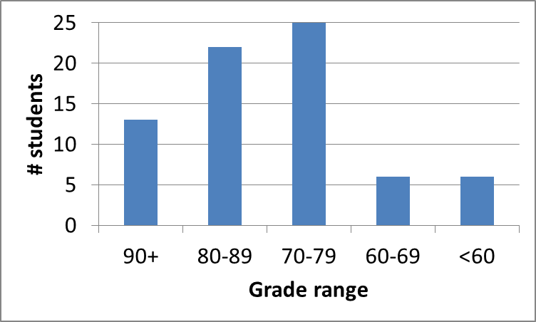
Exam stats & grade distribution
Question-by-question averages:
  Q1: 8.2 / 16 (51%)
  Q2: 12.3 / 16 (77%)
  Q3: 28.9 / 32 (90%)
  Q4: 27.7 / 36 (77%)
Extra credit
  44 students
  6.3 / 10 average
Average: 77
Median: 79
Std. deviation: 13.9
Max: 96
Microprocessors I: Lecture 25

Slide 4
Figuring out where you stand
Homework: 55% (4/8 done; 3/8 graded)
Exams: 45% (15% + 15% + 15%)
~40% of your grade still to be determined
Estimating your grade
  Homework avg (HWA) =
  (total homework points) / 1.5
  Exam avg (EA) =
  ((Exam1) + (Exam2)) / 2
  Overall avg = HWA * 0.55 + EA * 0.45
Microprocessors I: Lecture 25

Slide 5
Figuring out where you stand
Estimated avg. = HWA * 0.55 + EA * 0.45
Current course averages
  Without extra credit: ~82%, SD ≈ 10.8
  With extra credit: ~83%, SD ≈ 11.4
Key points
  Very possible there will be no grading curve
  Therefore, right now:
    Min grade for C-: 70
    Min grade for D: 60
    THESE NUMBERS WILL ALMOST CERTAINLY CHANGE BEFORE SEMESTER’S END—THESE FIGURES ARE JUST ROUGH ESTIMATES!!!!!
Microprocessors I: Lecture 25

Slide 6
Final notes
Next time:
  Finish PIC instructions
Reminders:
  HW 5 to be posted; due date TBD
  Advising starts today
Microprocessors I: Lecture 25

