Slide 1
16.317
Microprocessor Systems Design I
Instructor: Dr. Michael Geiger
Summer 2012
Lecture 1: Course Overview
General Microprocessor Introduction
80386DX Introduction

Slide 2
Lecture outline
Course overview
  Instructor information
  Course materials
  Course policies
  Resources
  Tentative course outline
General microprocessor introduction
  Computer history and organization
  Microprocessor architecture
  Instruction set architecture
  Operations
  Data
80386DX introduction
Microprocessors I: Lecture 1

Slide 3
Course staff & meeting times
Lectures:
  MW 2-5, Olsen 405
  F (7/20 & 8/3 only), Olsen 407
Labs:
  Open lab hours in Ball Hall 407
  Will get card access ASAP
Instructor: Dr. Michael Geiger
  E-mail: Michael_Geiger@uml.edu
  Phone: 978-934-3618 (x3618 on campus)
  Office: Perry Hall 118A
  Office hours: MTTh 10-12 (tentatively)
Microprocessors I: Lecture 1

Slide 4
Course materials
Textbook: Walter Triebel, The 80386, 80486, and Pentium Processors: Hardware, Software, and Interfacing, 1998, Prentice Hall.
  ISBN: 0-13-533225-7
Course website: http://mgeiger.eng.uml.edu/16317/sum12/index.htm
  Will contain lecture slides, handouts, assignments
Discussion group through piazza.com
  Allow common questions to be answered for everyone
  All course announcements will be posted here
  Will use as class mailing list—you must enroll by the end of the week
Microprocessors I: Lecture 1

Slide 5
Course policies
Prerequisites: 16.265 (Logic Design), 16.365 (Electronics I)
Labs
  Can work in groups of 1 or 2 students
    No group changes without Dr. Geiger’s permission
  All labs must be checked off by instructor
  Each student must complete individual lab report
    Group members may share data generated in lab (screenshots, etc.) but must write own description
    Report format specified in separate document
  Typed reports due in class on due date
    Late reports penalized 20% per weekday
Microprocessors I: Lecture 1

Slide 6
Course policies (cont.)
Academic honesty
  All assignments are to be done individually unless explicitly specified otherwise by the instructor
  Any copied solutions, whether from another student or an outside source, are subject to penalty
  You may discuss general topics or help one another with specific errors, but not share assignment solutions
    Must acknowledge assistance from classmate in submission
Microprocessors I: Lecture 1

Slide 7
Course policies (cont.)
Grading breakdown
  Labs: 35%
  Homework: 20%
  Exam 1: 15%
  Exam 2: 15%
  Final: 15%
Exam dates
  Exam 1: Friday, July 20
  Exam 2: Wednesday, August 1
  Final: Wednesday, August 15
Microprocessors I: Lecture 1

Slide 8
What you should learn in this class
Basics of computers vs. microprocessors
Two major aspects:
  How to program
    Focus on assembly language
  How a microprocessor works with other components
    Focus on interfacing circuits and control schemes
Will work with two processors:
  Intel 80386DX → assembly language simulation
  PIC microcontroller → actual microcontroller programming, interfacing
Microprocessors I: Lecture 1
· To understand the interconnection of the CPU, memory, and I/O

Slide 9
Tentative course outline
General microprocessor introduction
Assembly language programming
  Start with 80386DX; PIC microcontroller at end
  Areas will include
    Addressing modes
    Instruction types
    Programming modes
Memory management
  Segmentation
  Virtual memory
External interfacing
  Processor signals used in interfacing
  Interface circuitry
  External memory
Microcontroller-based systems
Microprocessors I: Lecture 1

Slide 10
What is a computer?
From The American Heritage Dictionary:
  “One who computes”
    We could argue that people are computers
  “A device that computes, especially a programmable electronic machine that performs high-speed mathematical or logical operations or that assembles, stores, correlates, or otherwise processes information.”
    Anything from a simple abacus to the microprocessor-based computers of today
“Microcomputer”: computer system with changeable functionality, based on microprocessor
Microprocessors I: Lecture 1

Slide 11
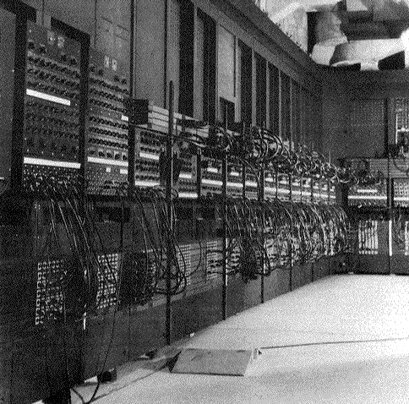
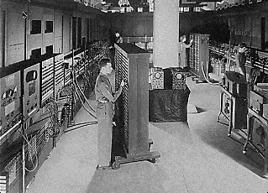
Computing history
Thirty tons
Forced air cooling
200KW
19,000 vacuum tubes
Punch card
Manual wiring
Numerical computation
The first electronic digital computer – ENIAC, built in UPenn in 1946
Source: http://ei.cs.vt.edu/~history/ENIAC.Richey.HTML
Microprocessors I: Lecture 1
Notes:
Chapter 1

Slide 12
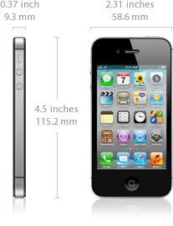
Today’s computer: one example
iPhone 4S Technical Specifications
Screen size 3.5 inches
Screen resolution 960 by 640 at 326 ppi
Input method Multi-touch
Operating system iOS 5.0
Storage 16 / 32 / 64 GB
Cellular network UMTS/GSM/CDMA
Wireless data Wi-Fi (802.11b/g/n) + EDGE + Bluetooth 4.0
Camera 8.0 megapixels
Battery Up to 6 hrs Internet, 8 hrs talk,
10 hrs video, 40 hrs audio,
200 hrs standby
Dimensions 4.5 x 2.3 x 0.37 inches
Weight 4.9 ounces
Microprocessors I: Lecture 1
Notes:
Chapter 1

Slide 13
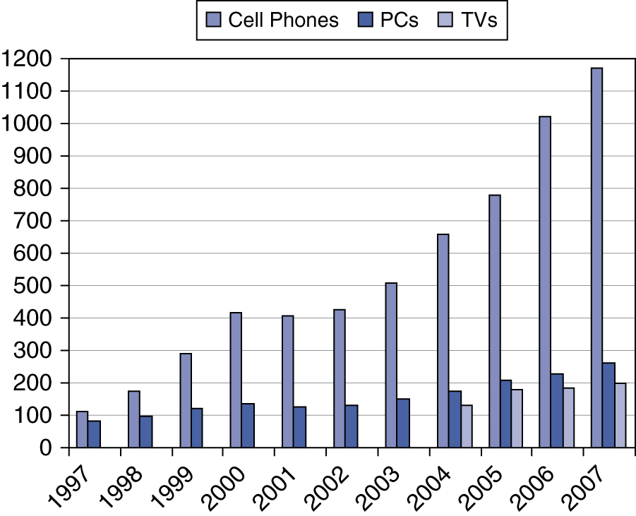
Processor market (as of 2007)
“Computer” used to just refer to PCs
Processors—and, therefore, computers—are now everywhere
Microprocessors I: Lecture 1

Slide 14
Computer components
What are the key components of a computer?
  Microprocessor (MPU/CPU) performs computation
  Input to read data from external devices
    Examples: Keyboard, mouse, ports (Ethernet, USB, etc.)
  Output to transmit data to external devices
    Examples: screen, speaker, VGA interface, ports (Ethernet, USB, etc.)
  Storage to hold program code and data
    RAM, hard disk, possibly other media (CD/DVD, external drive)
Will see that microprocessor contains smaller-scale versions of these components
  Computation engine
  I/O interface
  Internal storage
Microprocessors I: Lecture 1
Notes:
Chapter 1

Slide 15

Abstraction of program control
Easiest for humans to understand high-level languages
Processor interprets machine language
Assembly language: abstraction with intermediate level of detail
  Breaks machine code into instructions
  Gives some insight into how each instruction behaves
  More readable than bit patterns!
Microprocessors I: Lecture 1

Slide 16
Processor architecture
“Architecture” can refer to
  High-level description of hardware; could be
    Overall system
    Microprocessor
    Subsystem within processor
  Operations available to programmer
    Instruction set architecture
  Other applications to computing (e.g., “software architecture”) we won’t discuss
Commonly used to discuss functional units and how they work together
Microprocessors I: Lecture 1

Slide 17
Role of the ISA
User writes high-level language (HLL) program
Compiler converts HLL program into assembly for the particular instruction set architecture (ISA)
Assembler converts assembly into machine language (bits) for that ISA
Resulting machine language program is loaded into memory and run
Microprocessors I: Lecture 1

Slide 18
ISA design
Think about a HLL statement like
X[i] = i * 2;
ISA defines how such statements are translated to machine code
  What information is needed?
Microprocessors I: Lecture 1

Slide 19
ISA design (cont.)
Think about a HLL statement like
X[i] = i * 2;
Questions answered in every ISA (or “software model”)
  How will the processor implement this statement?
    What operations are available?
    How many operands does each instruction use?
  Where are X[i] and i?
    How do we reference the operands?
  What type(s) of data are X[i] and i?
    What types of operands are supported?
    How big are those operands?
  Instruction format issues
    How many bits per instruction?
    What does each bit or set of bits represent?
    Are all instructions the same length?
Microprocessors I: Lecture 1

Slide 20
Operation types
Operations: what should processor be able to do?
  Data transfer
    Move data between storage locations
  Arithmetic operations
    Typical: add, subtract, maybe multiply/divide, negation
  Logical operations
    Typical: AND, OR, NOT, XOR
    Often includes bit manipulation: shifts, rotates, test/set/clear single bit
  Program control
    “Jump” to another part of program
    May be based on condition
    Used to implement loops, conditionals, function call/return
  Typically some processor-specific special purpose ops
Microprocessors I: Lecture 1

Slide 21
Operands
Two major questions when dealing with data
  “How” do we store them? → what do the bits represent?
  Where do we store them?
    … and how do we access those locations)?
First question deals with data types
Second question deals with data storage and addressing
Microprocessors I: Lecture 1

Slide 22
Data types
Also seen in high-level languages
  Think about C types: int, double, char, etc.
  What does a data type specify?
    How big is each piece of data?
    How do we interpret the bits representing those data?
Data sizes
  Smallest addressable unit: byte (8 bits)
  Can also deal with multi-byte data: 16, 32, 64 bits
  Often deal with words of data
    Word size processor-dependent (16 bits on x86, 32 bits on MIPS)
    Can have double words, quad words, half words …
Interpreting bits
  Numbers: Integers, floating-point; signed vs. unsigned
  May treat as characters, other special formats
Microprocessors I: Lecture 1

Slide 23
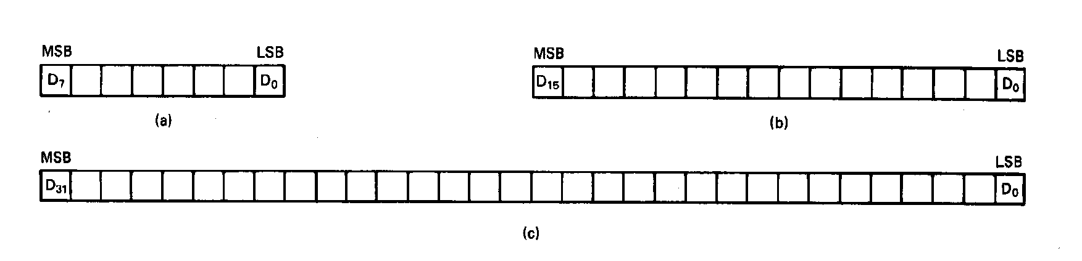
Unsigned Integers
All numbers are binary in memory
All bits represent data
Types:
Sizes Range
8-bit 0H → 255₁₀
16-bit 0H → 65,535₁₀
32-bit 0H → 4,294,967,295₁₀
Microprocessors I: Lecture 1
Notes:
Chapter 2

Slide 24
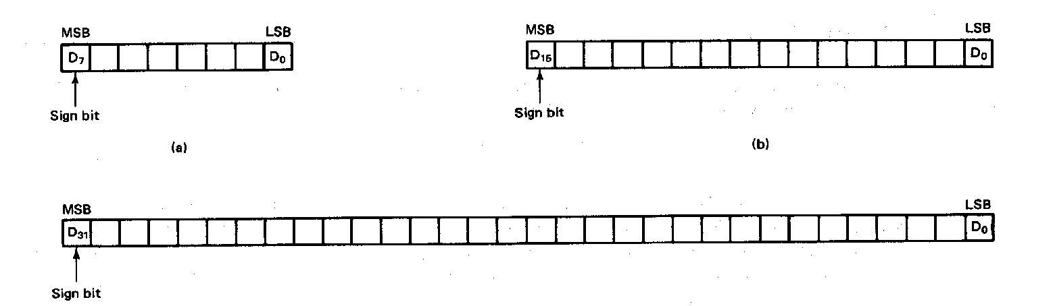
Signed Integers
MSB is sign bit ( 0/1 -> +/-)
Remaining bits represent value
Negative numbers expressed in 2’s complement notation
Types:
Sizes Range
8-bit -128 → +127
16-bit -32,768 → +32,767
32-bit -2,147,483,648 → +2,147,483,647
Microprocessors I: Lecture 1
Notes:
Chapter 2

Slide 25
Integer Examples
Given the 8-bit value: 1001 1111₂
Calculate the decimal value of this integer as
  An unsigned integer
  A signed integer
Microprocessors I: Lecture 1
Notes:
Chapter 2

Slide 26
Integer example solution
Given the 8-bit value: 1001 1111₂
Calculate the decimal value of this integer as
  An unsigned integer
  Solution:
    (1 x 2⁷) + (1 x 2⁴) + (1 x 2³) + (1 x 2²) + (1 x 2¹) + (1 x 2⁰)
    = 128 + 16 + 8 + 4 + 2 + 1 = 159
  A signed integer
  Solution:
    MSB = 1 → negative value
    To get magnitude, take 2’s complement:
    0110 0001₂ = (1 x 2⁶) + (1 x 2⁵) + (1 x 2⁰)
    = 64 + 32 + 1 = 97
    → Result = -97
Microprocessors I: Lecture 1

Slide 27
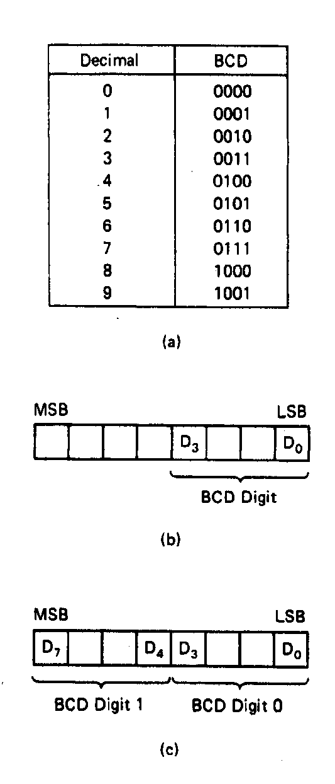
BCD Numbers
Direct coding of numbers as binary coded decimal (BCD) numbers supported
Unpacked BCD [Fig.2.10(b)]
  Lower four bits contain a digit of a BCD number
  Upper four bits filled with zeros (zero filled)
Packed BCD [Fig. 2.10(c)]
  Lower significant BCD digit held in lower 4 bits of byte
  More significant BCD digit held in upper 4 bits of byte
Example: Packed BCD byte at address 01000H is 10010001₂, what is the decimal number?
Organizing as BCD digits gives,
1001_{BCD} 0001_{BCD} = 91₁₀
Microprocessors I: Lecture 1
Notes:
Chapter 2

Slide 28
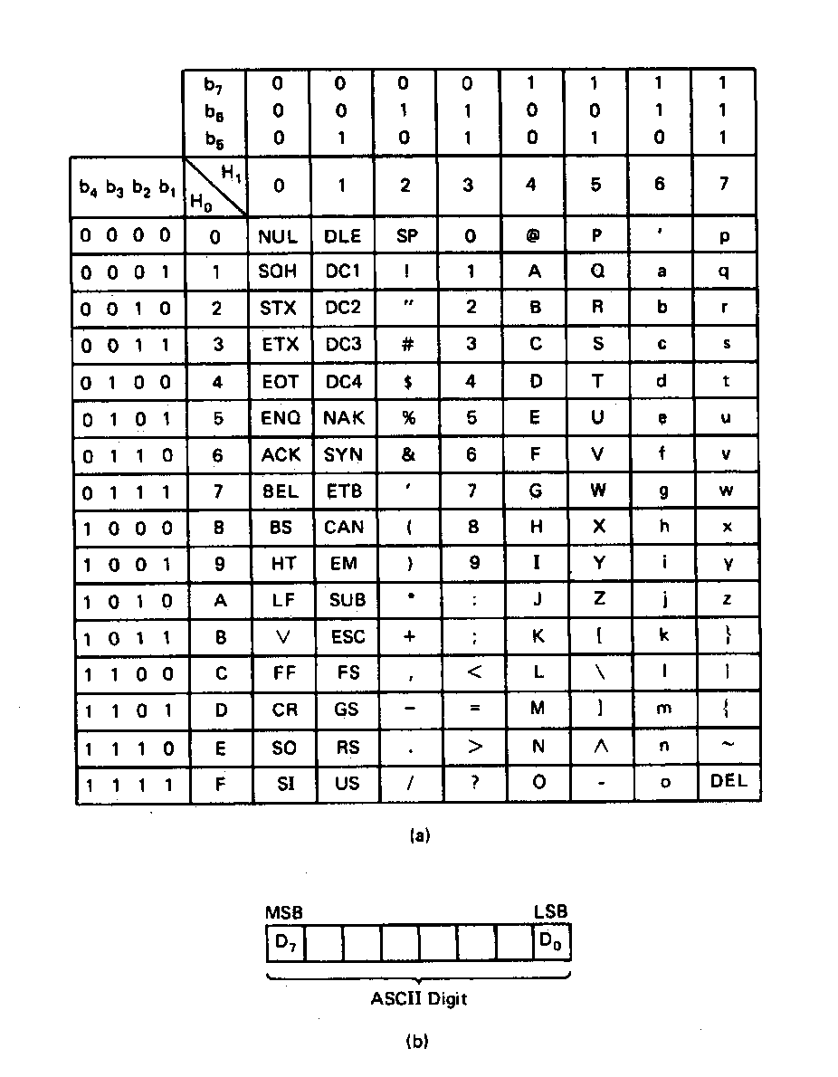
ASCII Data
American Code for Information Interchange (ASCII) code
ASCII information storage in memory
  Coded one character per byte
  7 LS-bits = b₇b₆b₅b₄b₃b₂b₁
  MS-bit filled with 0
Example: Addresses 01100H-01104H contain ASCII coded data 01000001, 01010011, 01000011, 01001001, and 01001001, respectively. What does the data stand for?
0 100 0001_{ASCII} = A
0 101 0011_{ASCI} = S
0 100 0011_{ASCII} = C
0 100 1001_{ASCII} = I
0 100 1001_{ASCII} = I
Microprocessors I: Lecture 1
Notes:
Chapter 2

Slide 29
Data storage
What characteristics do we want storage media to have?
Two primary answers
  Speed
  Capacity
  Very difficult to get both in single storage unit
Processors use two different types of storage
  Registers
  Memory
Microprocessors I: Lecture 1

Slide 30
Registers
Small, fast set of storage locations close to processor
Primarily used for computation, short-term storage
  Speed → ideal for individual operations
  Lack of capacity → will frequently overwrite
Reference registers by name
  Example: ADD AX, BX → AX = AX + BX
  AX, BX are registers in x86 architecture
Microprocessors I: Lecture 1

Slide 31
Memory
Provides enough capacity for all code, data (possibly I/O as well)
Typically organized as hierarchy
Used primarily for long-term storage
  Lacks speed of registers
  Provides capacity to ensure data not overwritten
Reference memory by address
  Example: MOV AX, DS:[100H]
  → AX = memory at address DS:[100H]
Microprocessors I: Lecture 1

Slide 32
Memory (cont.)
Accessing single byte is easy
Considerations with multi-byte data
  Are the data aligned?
    Easier/faster to access aligned data
  How are the data organized in memory (“endianness”)?
    Given 32-bit number: DEADBEEFH or 0xDEADBEEF
    Which byte—MSB (0xDE) or LSB (0xEF) gets stored in memory first?
Microprocessors I: Lecture 1

Slide 33
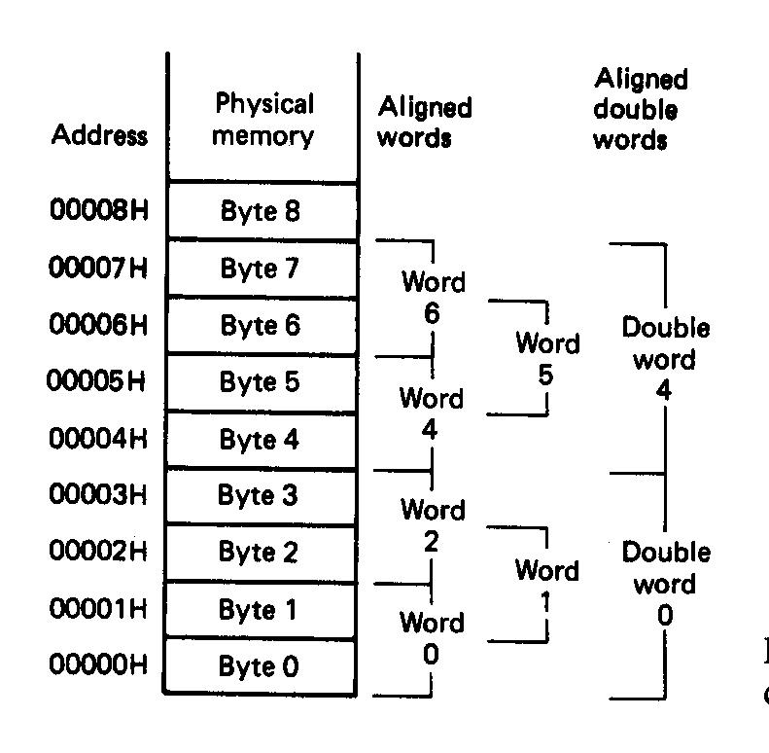
Aligned Words, Double words
Aligned data: address is divisible by number of bytes
  2 bytes → address must be even
  4 bytes → address must be multiple of 4
In figure at left
  Words 0, 2, 4, 6 aligned
  Double words 0, 4 aligned
  “Word X” = word with starting address X
Microprocessors I: Lecture 1
Notes:
Chapter 2

Slide 34
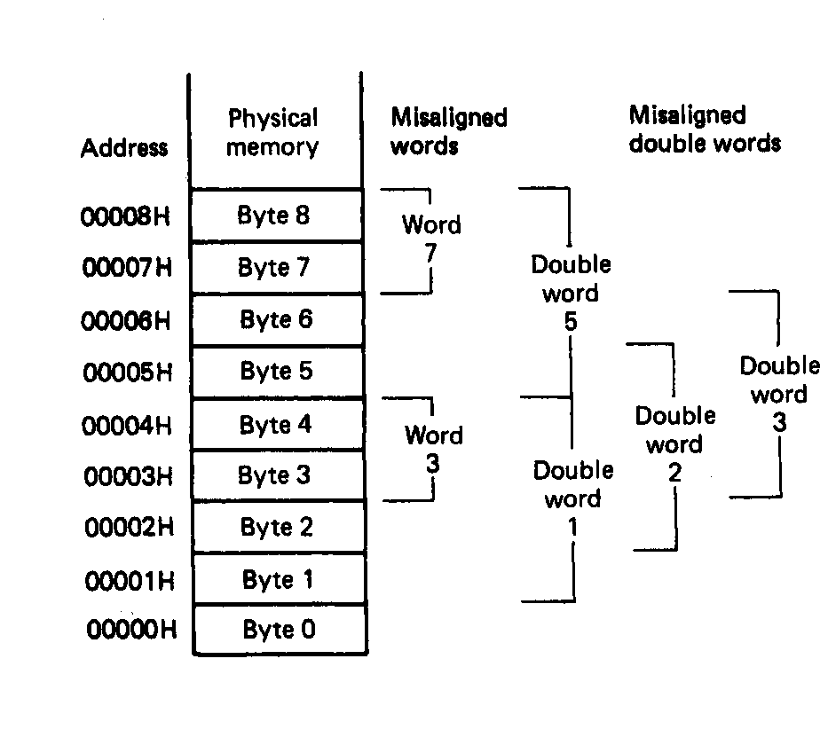
Misaligned Words
x86 architecture doesn’t require aligned data access
In figure, misaligned data:
  Words 3, 7
  Double words 1, 2, 3, 5
Performance impact for accessing unaligned data in memory (32-bit data bus)
Microprocessors I: Lecture 1
Notes:
Chapter 2

Slide 35
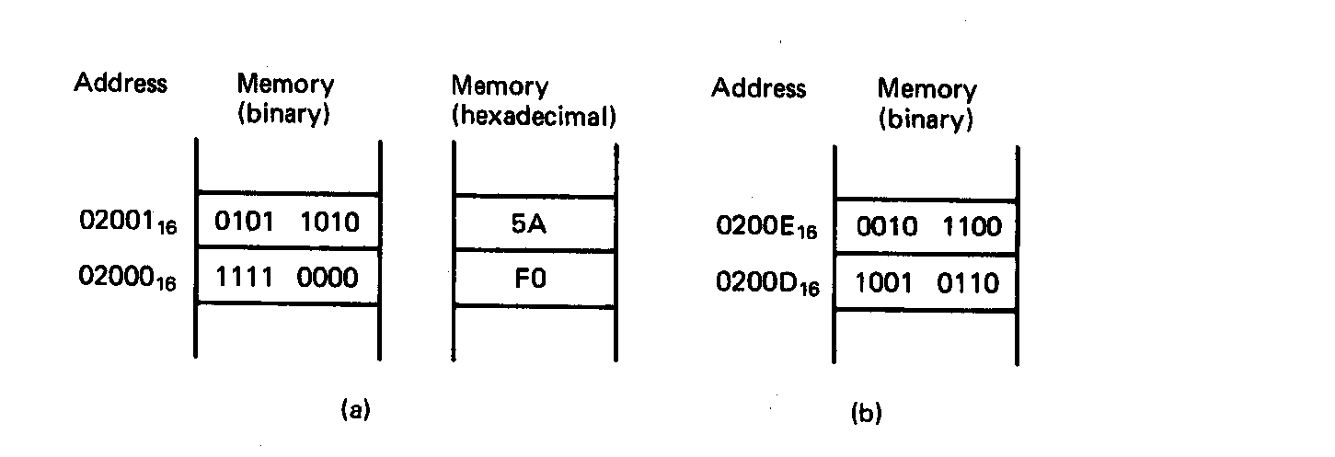
Examples of Words of Data
“Little endian” organization
Most significant byte at high address
Least significant byte at low address
Example [Fig. 2.5 (a)]
(02001₁₆) = 0101 1010₂=5AH= MS-byte
(02000₁₆) = 1111 0000₂=F0H= LS-byte
as a word they give
01011010 11110000₂=5AF0H
Microprocessors I: Lecture 1
Notes:
Chapter 2

Slide 36
Examples of Words of Data
What is the data word shown in this figure?
  Express your result in hexadecimal
Is the word aligned?
Answer:
  MSB = 00101100₂ = 2C₁₆
  LSB = 10010110₂ = 96₁₆
  → Full word = 2C96₁₆
  Starting address = 0200D₁₆
  → Address not divisible by 2
  → Word is not aligned
Microprocessors I: Lecture 1
Notes:
Chapter 2

Slide 37
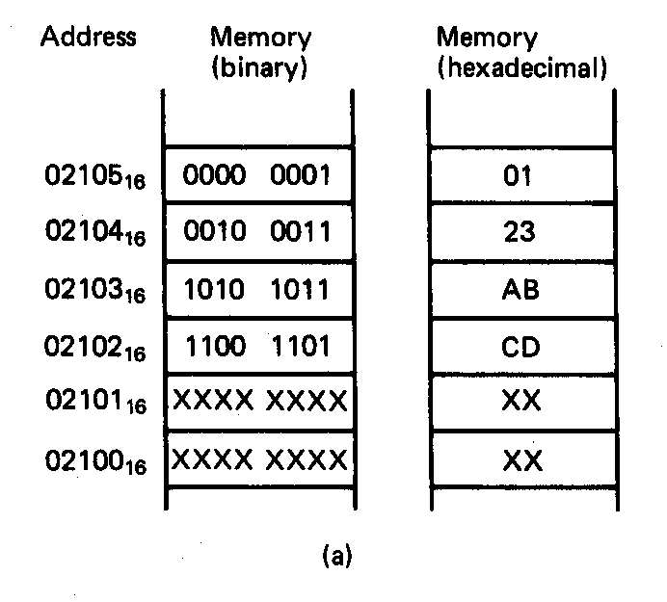
Example of Double Word
What is the double word shown in this figure?
Is it aligned?
Answer:
  LSB = CD₁₆
  MSB = 01₁₆
  → Arranging as 32-bit data:
  0123ABCD₁₆
  Starting address = 02102₁₆
  → Not divisible by 4
  → Double word is unaligned
Microprocessors I: Lecture 1
Notes:
Chapter 2

Slide 38
80386DX intro
General purpose processor
Supports use of 8, 16, or 32 bit data
Allows both register and memory operands
Segmented memory architecture
Real and protected mode operation
  Protected mode supports virtual memory
Microprocessors I: Lecture 1

Slide 39
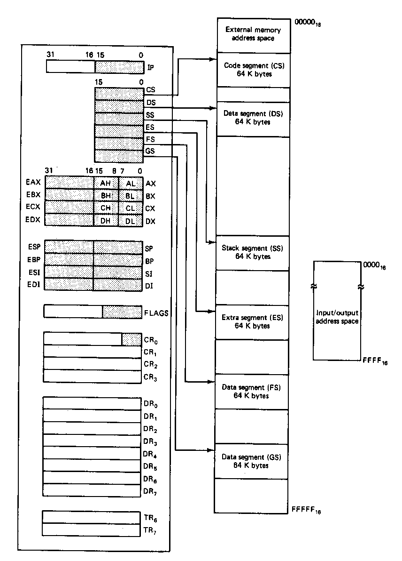
Register Set
Eight 32-bit registers
  (4) Data registers- EAX, EBX, ECX, EDX, can be used as 32, 16 or 8bit
  (2) Pointer registers- EBP, ESP
  (2) Index registers- ESI, EDI
Seven 16-bit registers
  (1) Instruction pointer- IP
  (6) Segment registers- CS, DS, SS, ES, FS, GS
Flags (status) register-EFLAGS
Control register- CR0
Microprocessors I: Lecture 1
Notes:
Chapter 2

Slide 40
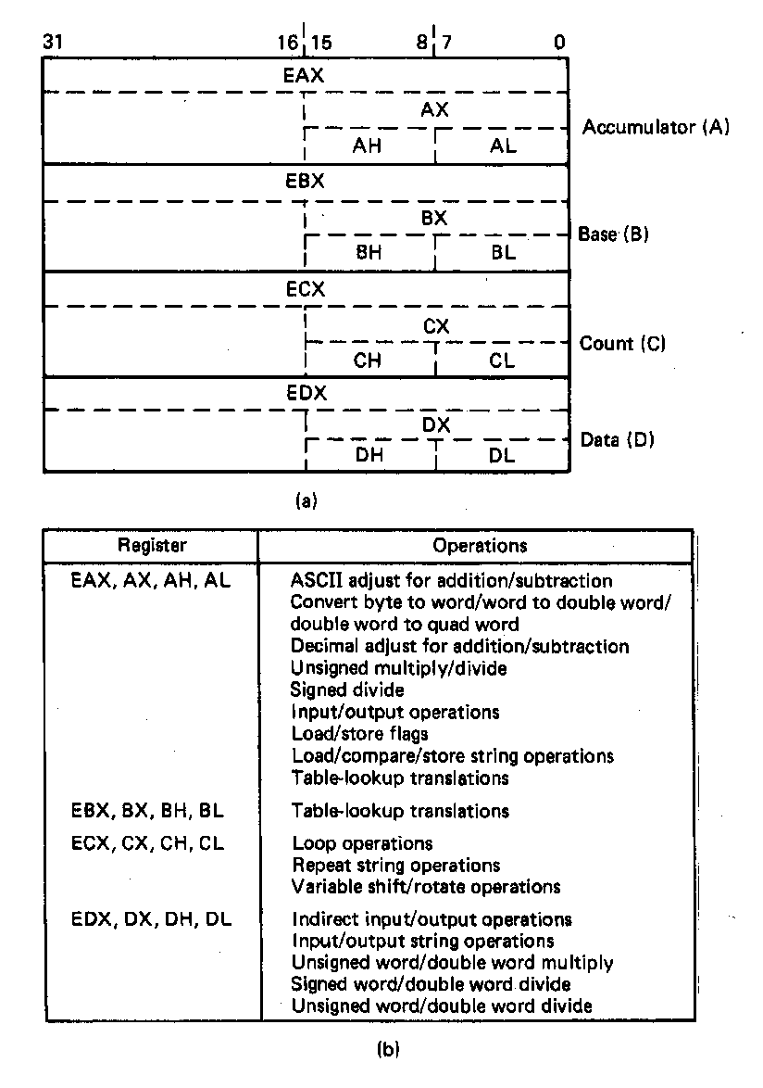
General Purpose Data Registers
Four general purpose data registers
  Accumulator (A) register
  Base (B) register
  Count (C) register
  Data (D) register
Can hold 8-bit, 16-bit, or 32-bit data
  AH/AL = high and low byte value
  AX = word value
  EAX = double word value
General uses:
  Hold data such as source or destination operands for most operations—ADD, AND, SHL
  Hold address pointers for accessing memory
Some also have dedicated special uses
  C—count for loop,
  B—table look-up translations, base address
  D—indirect I/O and string I/O
Microprocessors I: Lecture 1
Notes:
Chapter 2

Slide 41
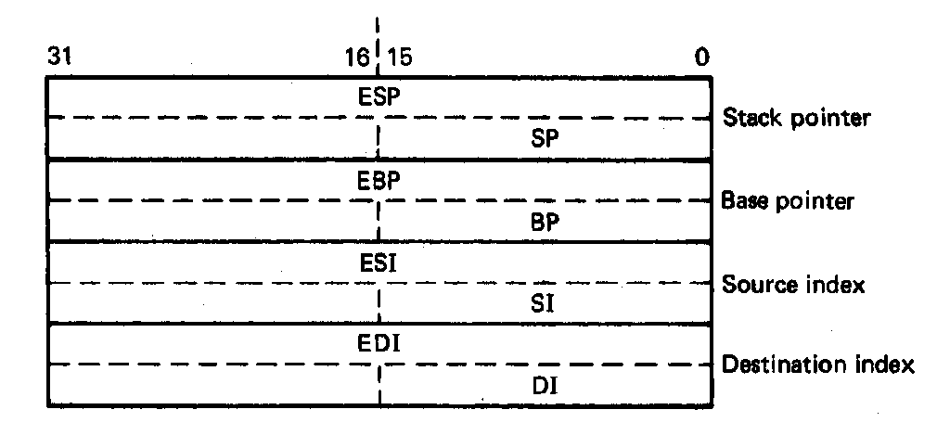
Pointer Registers
Two pointer registers
  Stack pointer register
    ESP = 32-bit extended stack pointer
    SP = 16-bit stack pointer
  Base pointer register
    EBP = 32-bit extended base pointer
    BP = 16-bit base pointer
Use to access information in stack segment of memory
  SP/BP offsets from the current value of the stack segment base address
  Select a specific storage location in the current 64K-byte stack segment
    SS:SP—points to top of stack (TOS)
    SS:BP—points to data in stack
Microprocessors I: Lecture 1
Notes:
Chapter 2

Slide 42
Index Registers
Two index registers
  Source index register
    ESI = 32-bit source index register
    SI = 16-bit source index register
  Destination index registers
    EDI = 32-bit destination index register
    DI = 16-bit destination index register
  Used to access source and destination operands in data segment of memory
    DS:SI—points to source operand in data segment
    DS:DI—points to destination operand in data segment
    Also used to access information in the extra segment (ES)
Microprocessors I: Lecture 1
Notes:
Chapter 2

Slide 43
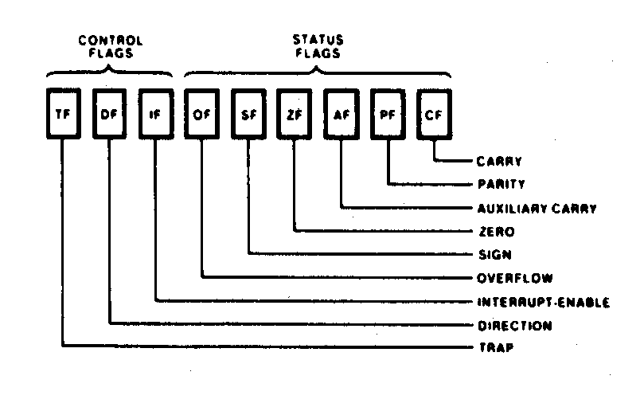
Flags Register
32-bit register holding single bit status and control information
9 active flags in real mode
Two categories
  Status flags: conditions resulting from instruction
    Most instructions update status
    Used as test conditions
  Control flags: control processor functions
    Used by software to turn on/off operating capabilities
Microprocessors I: Lecture 1
Notes:
Chapter 2

Slide 44
Status Flags
Carry flag (CF)
  1 = carry-out or borrow-in from MSB of the result during the execution of an arithmetic instruction
  0 = no carry or borrow has occurred
Parity flag (PF)
  1 = result produced has even parity
  0 = result produced has odd parity
Zero flag (ZF)
  1 = result produced is zero
  0 = result produced is not zero
Sign bit (SF)
  1 = result is negative
  0 = result is positive
Others
  Overflow flag (OF)
  Auxiliary carry flag (AF)
Microprocessors I: Lecture 1
Notes:
Chapter 2

Slide 45
Control Flags
Trap flag (TF)
  1/0 = turn on/off single-step mode
  Mode useful for debugging
  Employed by monitor to execute one instruction at a time (single step execution)
Interrupt flag (IF)
  Used to enable/disable external maskable interrupt requests
  1/0 = enable/disable external interrupts
Direction flag (DF)
  Used to determine the direction in which string operations occur
  1/0 = automatically decrement/increment string address—proceed from high address to low address
Microprocessors I: Lecture 1
Notes:
Chapter 2

Slide 46
Memory and Input/Output
Architecture implements independent memory and input/output address spaces
Memory address space- 1,048,576 bytes long (1MB)
Input/output address space- 65,536 bytes long (64KB)
Microprocessors I: Lecture 1
Notes:
Chapter 2

Slide 47
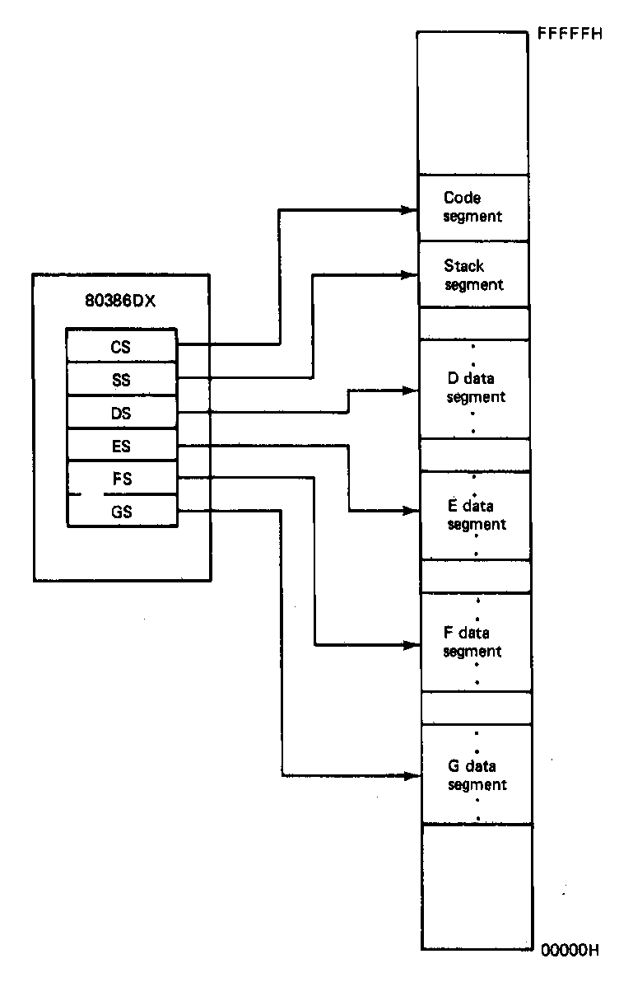
Active Segments of Memory
Memory segmentation
  Only subset of 80386 real-mode address space active
  Each segment register points to lowest address of 64KB contiguous segment
  Total active memory: 384 KB
    64 KB code segment (CS)
    64 KB stack segment (SS)
    256 KB over 4 data segments (DS, ES, FS, GS)
Microprocessors I: Lecture 1
Notes:
Chapter 2

Slide 48
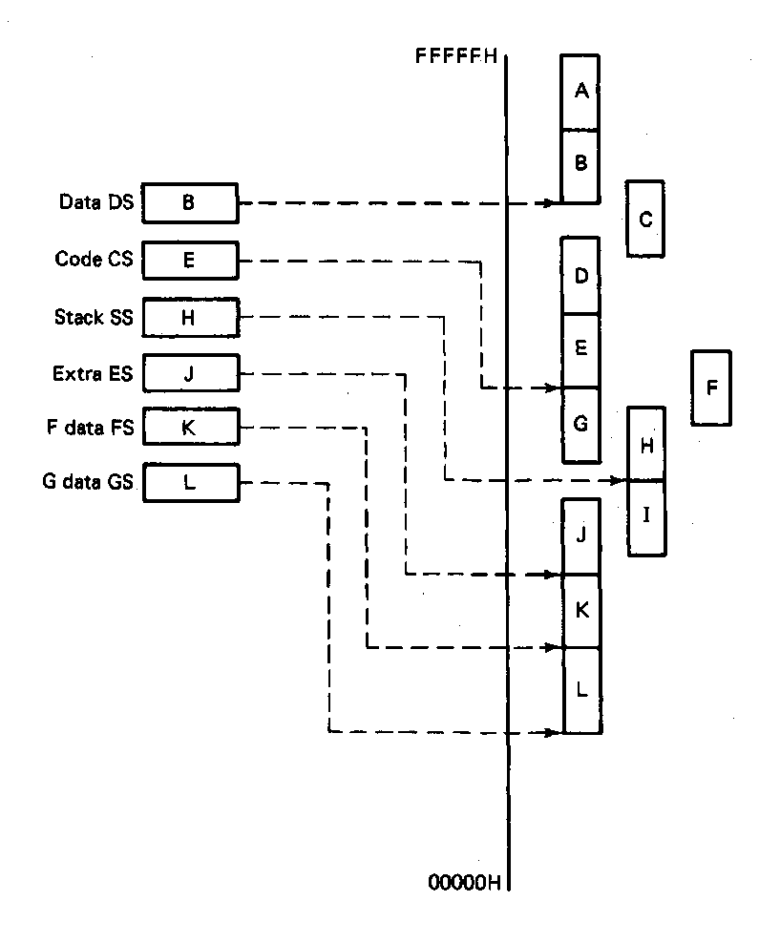
User access, Restrictions, and Orientation
Segment registers are user accessible
  Programmer can change values under software control
  Permits access to other parts of memory
Segments must start on 16-byte boundary
  Examples: 00000H, 00010H, 00020H
Orientation of segments:
  Contiguous—A&B or D,E&G
  Disjointed—C&F
  Overlapping—B&C, E&F, or F,G,&H
Microprocessors I: Lecture 1
Notes:
Chapter 2

Slide 49
Final notes
Next time
  Address generation
  System stack
  Assembly introduction
Lab 1, HW 1 to be posted by Wed. at latest
Reminders:
  Check the course web page
  Join the course discussion group on piazza.com
Microprocessors I: Lecture 1

