Slide 1
16.317
Microprocessor Systems Design I
Instructor: Dr. Michael Geiger
Summer 2012
Lecture 8
PIC overview
PIC16F684 ISA

Slide 2
Lecture outline
Announcements/reminders
  Lab 4 due Wednesday, 8/8
    Will need to check out PICkit from lab—must contact me
  HW 3 due Friday, 8/10
    Turn in to my office by 1:45, or e-mail
  Exam 3: moved to Monday, 8/13 (not Wed 8/15)
  Lab 5 due Tuesday, 8/14
    Same turn-in procedure as HW 3
Today’s lecture
  PIC intro
  Start PIC ISA
Microprocessors I: Lecture 8

Slide 3
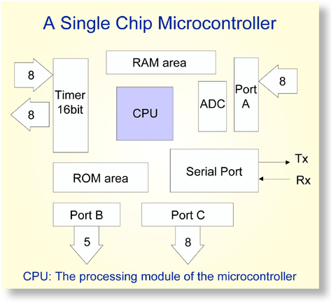
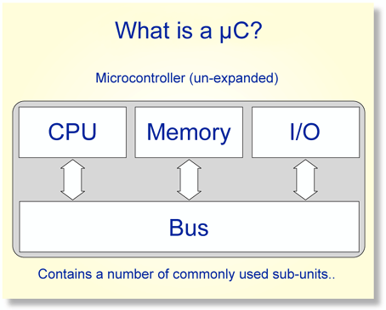
Overview of Microcontrollers
Basically, a microcontroller is a device which integrates a number of the components of a microprocessor system onto a single microchip.
Reference: http://mic.unn.ac.uk/miclearning/modules/micros/ch1/micro01notes.html#1.4
Microprocessors I: Lecture 8
Notes:
Chapter 9

Slide 4
Microcontroller features
Processor
  Usually general-purpose but can be app-specific
On-chip memory
  Often RAM for data, EEPROM/Flash for code
Integrated peripherals
  Common peripherals
    Parallel I/O port(s)
    Clock generator(s)
    Timers/event counters
  Special-purpose devices such as:
    Analog-to-digital converter (sensor inputs)
    Mixed signal components
    Serial port + other serial interfaces (SPI, USB)
    Ethernet
Microprocessors I: Lecture 8

Slide 5
Microcontroller features
Benefits
  Typically low-power/low-cost
    Target for embedded applications
  Easily programmable
    Simple ISAs (RISC processors)
    Use of development kits simplifies process
Limitations
  Small storage space (registers, memory)
  Restricted instruction set
  May be required to multiplex pins
  Not typically used for high performance
Microprocessors I: Lecture 8

Slide 6
PIC Microcontroller (PIC16F684)
High performance, low cost, for embedded applications
  Only 35 different instructions
  Interrupt capability
  Direct, indirect, relative addressing mode
Low Power
  8.5uA @ 32KHz, 2.0V
Peripheral Features
  12 I/O pins with individual direction control
  10-bit A/D converter
  8/16-bit timer/counter
Special Microcontroller Features
  Internal/external oscillator
  Power saving sleep mode
  High Endurance Flash/EEPROM cell
Microprocessors I: Lecture 8
Notes:
Chapter 9

Slide 7
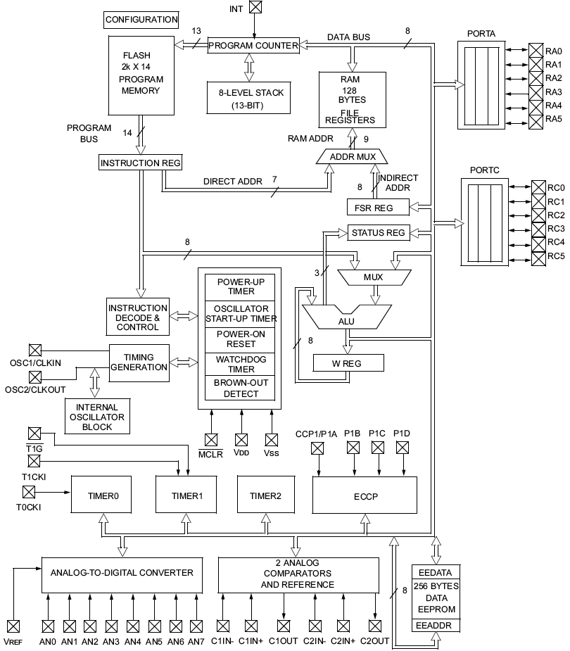
PIC16F684 Block Diagram
Microprocessors I: Lecture 8
Notes:
Chapter 9

Slide 8
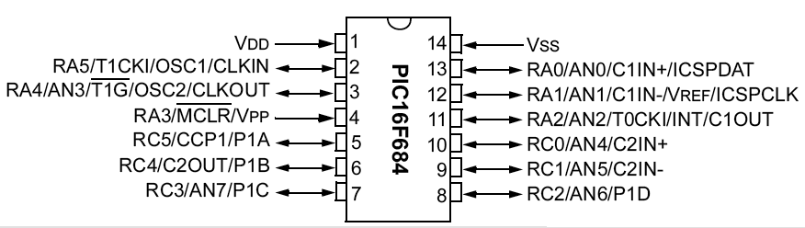
PIC16F684
12 pins, 2048 instructions, 128 byte variable memory, ADC, comparator, Timers, ICD
Microprocessors I: Lecture 8
Notes:
Chapter 9

Slide 9
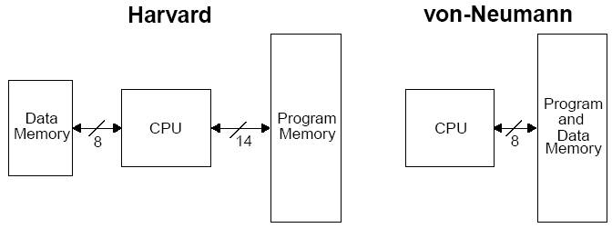
Harvard vs Von Neumann
Organization of program and data memory
Microprocessors I: Lecture 8
Notes:
Chapter 9

Slide 10
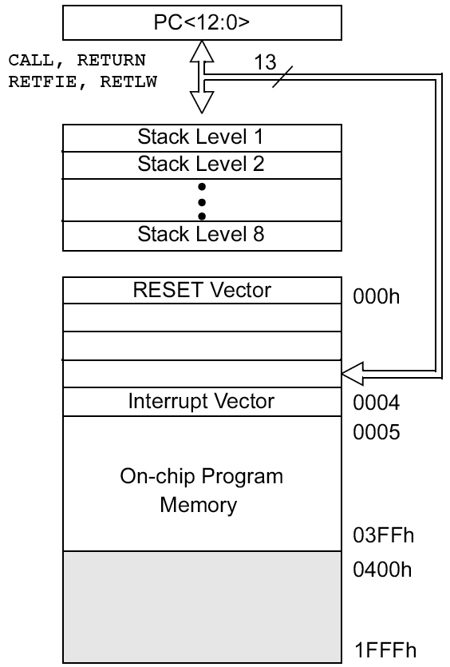
Program Memory Space
13-bit program counter to address 8K locations
Each location is 14-bit wide (instructions are 14 bits long)
RESET vector is 0000h
  When the CPU is reset, its PC is automatically cleared to zero.
Interrupt Vector is 0004h
  0004h is automatically loaded into the program counter when an interrupt occurs
Vector → address of code to be executed for given interrupt
Microprocessors I: Lecture 8
Notes:
Chapter 9

Slide 11
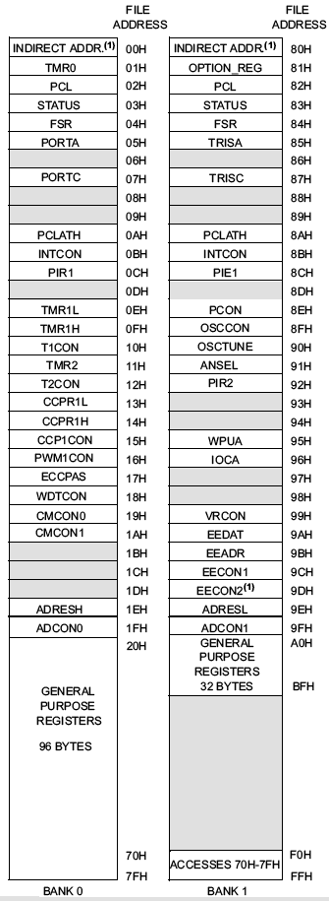
Data Memory Map
Data memory consists of
  Special Function Registers (SFR) area
  General Purpose Registers (GPR) area
SFRs control the operation of the device
GPRs are area for data storage and scratch pad operations
GPRs are at higher address than SFRs in a bank
Different PIC microcontrollers may have different number of GPRs
Microprocessors I: Lecture 8
Notes:
Chapter 9

Slide 12
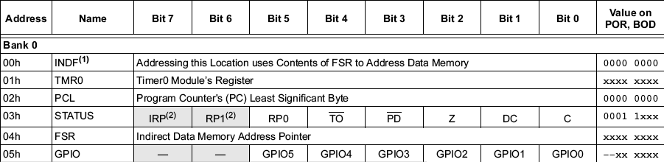
Special Function Registers
Microprocessors I: Lecture 8
Notes:
Chapter 9

Slide 13
Special Function Registers (1)
W, the working register
  To move values from one register to another register, the value must pass through the W register.
FSR (04h,84h,104h,184h), File Select Register
  Indirect data memory addressing pointer
INDF (00h,80h,100h,180h)
  accessing INDF accesses the location pointed by IRP+FSR
PC, the Program Counter, PCL (02h, 82h, 102h, 182h) and PCLATH (0Ah, 8Ah, 10Ah, 18Ah)
Microprocessors I: Lecture 8
Notes:
Chapter 9

Slide 14
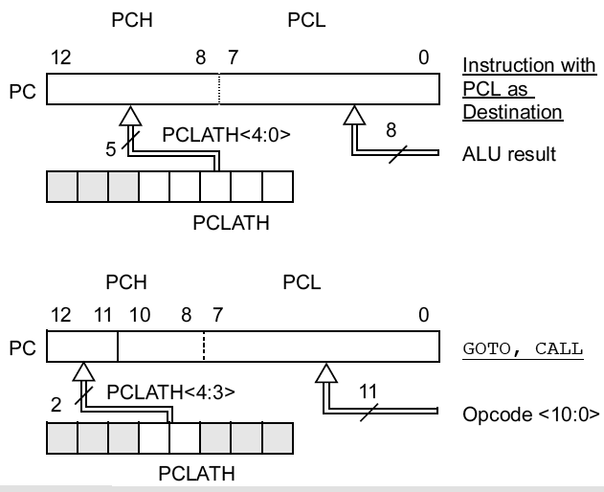
PCL and PCLATH
PC: Program Counter, 13 bits
PCL (02h): 8 bits, the lower 8 bits of PC
PCLATH (0Ah): PC Latch, provides the upper 5 (or 2) bits of PC when PCL is written to
1st example: PC is loaded by writing to PCL
2nd example: PC is loaded during a CALL or GOTO instruciton
Microprocessors I: Lecture 8
Notes:
Chapter 9

Slide 15

Special Function Registers (2)
STATUS (03h, 83h, 103h, 183h)
  IRP: Register bank select bit (indirect addressing)
  RP1:RP0 – Register bank select bits (direct addressing)
  NOT_TO: Time Out bit, reset status bit
  NOT_PD: Power-Down bit, reset status bit
  Z: Zero bit ~ ZF in x86
  DC: Digital Carry bit ~ AF in x86
  C: Carry bit ~ CF in x86 (note: for subtraction, borrow is opposite)
Microprocessors I: Lecture 8
Notes:
Chapter 9

Slide 16
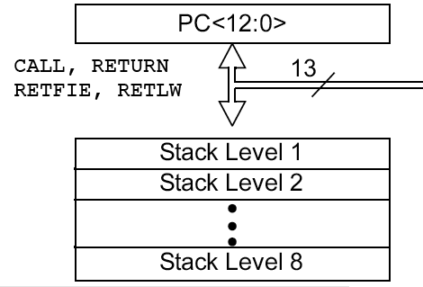
Stack
8-level deep x 13-bit wide hardware stack
The stack space is not part of either program or data space and the stackpointer is not readable or writable.
The PC is “PUSHed” onto the stack when a CALL instruction is executed, or an interrupt causes a branch.
The stack is “POPed” in the event of a RETURN, RETLW or a RETFIE instruction execution.
However, NO PUSH or POP instructions !
PCLATH is not affected by a “PUSH” or “POP” operation.
The stack operates as a circular buffer:
  after the stack has been PUSHed eight times, the ninth push overwrites the value that was stored from the first push.
Microprocessors I: Lecture 8

Slide 17
Banking
Data memory is partitioned into banks
In this PIC family, each bank holds 128 bytes (max offset = 7Fh)
  Processors w/4 banks : 4*128 bytes = 512 bytes
  Processors w/2 banks : 2*128 bytes = 256 bytes
Lower locations of each bank are reserved for SFRs. Above the SFRs are GPRs.
Implemented as Static RAM
Some “high use” SFRs from bank0 are mirrored in the other banks (e.g., INDF, PCL, STATUS, FSR, PCLATH, INTCON)
RP0 and RP1 bits in the STATUS register selects the bank when using direct addressing mode.
Microprocessors I: Lecture 8
Notes:
Chapter 9

Slide 18
Banking (cont.)
14-bit instructions use 7 bits to address a location
Memory space is organized in 128Byte banks.
PIC 16F684 has two banks - Bank 0 and Bank 1.
Bank 1 controls operation of the PIC
  Example: TRISA determines which bits of Port A are inputs/outputs
Bank 0 is used to manipulate the data
  Example: PORTA holds actual state of I/O port A
Microprocessors I: Lecture 8
Notes:
Chapter 9

Slide 19
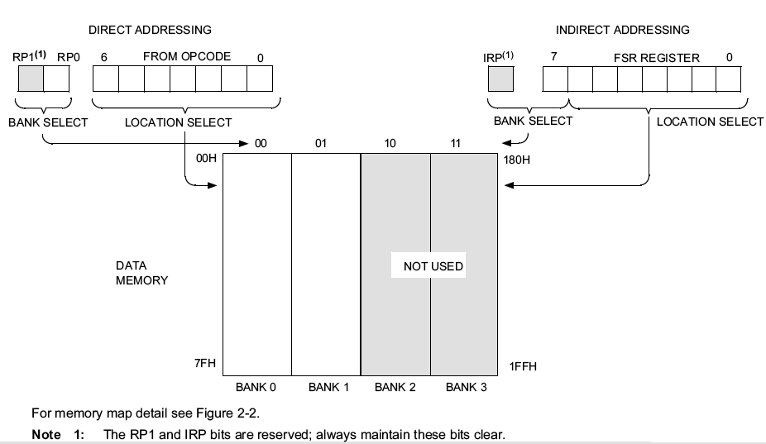
Direct/Indirect Addressing
Microprocessors I: Lecture 8
Notes:
Chapter 9

Slide 20
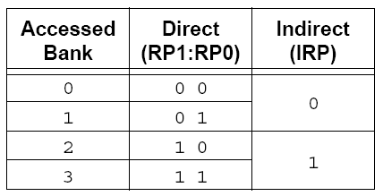
Direct Addressing
Lowest 7 bits of instruction identify a register file address
The other two bits of register address come from RP0 and RP1 bits in the STATUS register
Example: Bank switching (Note: case of 4 banks)
  CLRF STATUS ; Clear STATUS register (Bank0)
  : ;
  BSF STATUS, RP0 ; Bank1
  : ;
  BCF STATUS, RP0 ; Bank0
  : ;
  MOVLW 0x60 ; Set RP0 and RP1 in STATUS register, other
  XORWF STATUS, F ; bits unchanged (Bank3)
  : ;
  BCF STATUS, RP0 ; Bank2
  : ;
  BCF STATUS, RP1 ; Bank0
Microprocessors I: Lecture 8
Notes:
Chapter 9

Slide 21
Direct addressing examples
Assume you are using the PIC 16F684, which has two memory banks
What address is being accessed if:
  STATUS = 60h, instruction = 031Fh?
  STATUS = 40h, instruction = 1F02h?
  STATUS = 13h, instruction = 0793h?
  STATUS = EEh, instruction = 03F1h?
Microprocessors I: Lecture 8

Slide 22
Example solution
Recall that, in direct addressing
  Address is 8 bits
  Lowest 7 bits = lowest 7 bits of instruction
  8th bit = RP0 bit of STATUS = STATUS bit 5
STATUS = 60h, instruction = 031Fh?
  STATUS = 0110 0000₂
  Instruction = 0000 0011 0001 1111₂
  Address = 1001 1111₂ = 0x9F
STATUS = 40h, instruction = 1F02h?
  STATUS = 0100 0000₂
  Instruction = 0001 1111 0000 0010₂
  Address = 0000 0010₂ = 0x02
Microprocessors I: Lecture 8

Slide 23
Example solution (cont.)
Recall that, in direct addressing
  Address is 8 bits
  Lowest 7 bits = lowest 7 bits of instruction
  8th bit = RP0 bit of STATUS = STATUS bit 5
STATUS = 13h, instruction = 0793h?
  STATUS = 0001 0011₂
  Instruction = 0000 0111 1001 0011₂
  Address = 0001 0011₂ = 0x13
STATUS = EEh, instruction = 03F1h?
  STATUS = 1110 1110₂
  Instruction = 0000 0011 1111 0001₂
  Address = 1111 0001₂ = 0xF1
Microprocessors I: Lecture 8

Slide 24
Indirect Addressing
The INDF register is not a physical register. Addressing the INDF register will cause indirect addressing.
Any instruction using the INDF register actually accesses the register pointed to by the File Select Register (FSR).
The effective 9-bit address is obtained by concatenating the 8-bit FSR register and the IRP bit in STATUS register.
Example
    MOVLW 0x20 ;initialize pointer
    MOVWF FSR ;to RAM
    NEXT: CLRF INDF ;clear INDF register
    INCF FSR,F ;inc pointer
    BTFSS FSR,4 ;all done? (to 0x2F)
    GOTO NEXT ;no clear next
    CONTINUE
    : ;yes continue
Microprocessors I: Lecture 8
Notes:
Chapter 9

Slide 25
I/O Ports
General I/O pins are the simplest of peripherals used to monitor and control other devices.
For most ports, the I/O pin’s direction (input or output) is controlled by the data direction register TRISx (x=A,B,C,D,E): a ‘1’ in the TRIS bit corresponds to that pin being an input, while a ‘0’ corresponds to that pin being an output
The PORTx register is the latch for the data to be output. Reading PORTx register read the status of the pins, whereas writing to it will write to the port latch.
Example: Initializing PORTA (PORTA is an 8-bit port. Each pin is individually configurable as an input or output).
bcf STATUS, RP0 ; bank0
bcf STATUS, RP1
clrf PORTA ; initializing PORTA by clearing output data latches
bsf STATUS, RP0 ; select bank1
movlw 0xCF ; value used to initialize data direction
movwf TRISA ; WHAT BITS OF PORT A ARE INPUTS? ; WHAT BITS ARE OUTPUTS?
Microprocessors I: Lecture 8
Notes:
Chapter 9

Slide 26
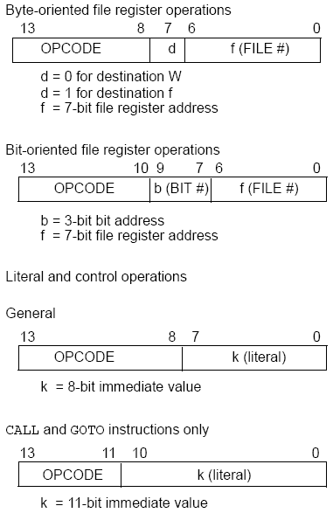
PIC16F684
Instructions
35 instructions
Each instruction is 14 bits
Byte-oriented OPCODE f, F(W)
  Source f: name of a SFR or a RAM variable
  Destination F(W):
    F if the destination is to be the same as the source register
    W if the destination is to be the working register
Bit-oriented OPCODE f, b
  Bit address b (0≤b≤7)
Literal and control OPCODE k
  Literal value k
Microprocessors I: Lecture 8
Notes:
Chapter 9

Slide 27
RAM variables
Memory variable: symbolic name to refer to space in memory (GPRs)
  Usable space on 16F684: 0x20–0x7F (Bank 0), 0xA0 – 0xBF (Bank 1)
  Once declared, use symbolic name, not address
Example PIC syntax (cblock/endc):
  cblock 0x20 ; cblock directive needs starting
  ; address
  var1 ; var1 = byte at 0x20
  var2 ; var2 = byte at 0x21
  var3 ; var3 = byte at 0x22
  endc ; End of variable block
Microprocessors I: Lecture 8

Slide 28
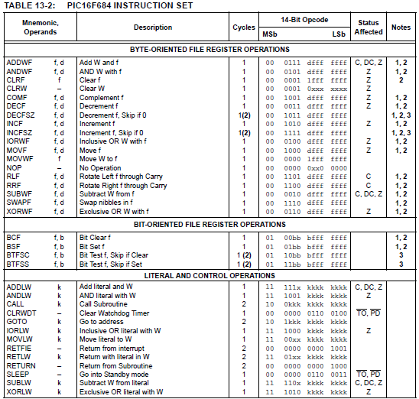
Microprocessors I: Lecture 8

Slide 29
Clear/Move
clrw ; Clear W register
clrf f ; Clear f register
movlw k ; move literal value k to W
movwf f ; move W to f
movf f, F(W) ; move f to F or W
swapf f, F(W) ; swap nibbles of f, putting result in F or W
STATUS bits:
clrw, clrf, movf: Z
movlw, movwf, swapf: none
Examples:
clrf TEMP1 ;Clear variable TEMP1
movlw 5 ;load 5 into W
movwf TEMP1 ;move W into TEMP1
movwf TEMP1, F ;Incorrect Syntax
movf TEMP1, W ;move TEMP1 into W ;
movf TEMP1, TEMP2 ;Incorrect Syntax
swapf TEMP1, F ;Swap 4-bit nibbles of TEMP1
swapf TEMP1, W ;Move TEMP1 to W, swap nibbles, leave TEMP1 unchanged
Microprocessors I: Lecture 8
Notes:
Chapter 9

Slide 30
Single Bit Manipulation
bcf f,b
Operation: Clear bit b of register f, where b=0 to 7
bsf f,b
Operation: Set bit b of register f, where b=0 to 7
STATUS bits:
none
Examples:
bcf PORTB, 0 ;Clear bit 0 off PORTB
bsf STATUS, C ;Set the Carry bit
bcf STATUS, RP1 ;
bsf STATUS, RP0 ;Select Bank 1
Microprocessors I: Lecture 8
Notes:
Chapter 9

Slide 31
Example
Show the values of all changed registers after the following sequence
cblock 0x30
x
y
endc
clrw
movwf x
movlw 0xFE
movwf y
swapf y, F
bcf y, 3
bsf x, 3
movf y, W
Microprocessors I: Lecture 8

Slide 32
Example solution
clrw → W = 0x00
movwf x → x = W = 0x00
movlw 0xFE → W = 0xFE
movwf y → y = W = 0xFE
swapf y, F → Swap nibbles of y → y = 0xEF
bcf y, 3 → Clear bit 3 of y = 1110 1111₂
→ y = 1110 0111₂ = 0xE7
bsf x, 3 → Set bit 3 of x
→ x = 0000 1000₂ = 0x08
movf y, W → W = y = 0xE7
Microprocessors I: Lecture 8

Slide 33
Increment/Decrement/
Complement
incf f, F(W) ; increment f, putting result in F or W
decf f, F(W) ;decrement f, putting result in F or W
comf f, F(W) ;complement f, putting result in F or W
STATUS bits:
Z
Examples:
incf TEMP1, F ;Increment TEMP1
incf TEMP1, W ;W <- TEMP1+1; TEMP1 unchanged
decf TEMP1, F ;Decrement TEMP1
comf TEMP1, F ;Change 0s and 1s to 1s and 0s
Microprocessors I: Lecture 8
Notes:
Chapter 9

Slide 34
Addition/Subtraction
addlw k ;add literal value k into W
addwf f, F(W) ;add w and f, putting result in F or W
sublw k ;subtract W from literal value k, putting
;result in W
subwf f, F(W) ;subtract W from f, putting result in F or W
STATUS bits:
C, DC, Z
Examples:
addlw 5 ; W <= 5+W
addwf TEMP1, F ; TEMP1 <- TEMP1+W
sublw 5 ; W <= 5-W (not W <= W-5 )
subwf TEMP1, F ; TEMP1 <= TEMP1 - W
Microprocessors I: Lecture 8
Notes:
Chapter 9

Slide 35
Example
Show the values of all changed registers after the following sequence
cblock 0x20
varA
varB
varC
endc
clrf varA
clrf varB
clrf varC
incf varA, W
sublw 0x0F
addwf varB, F
decf varB, F
comf varB, W
subwf varC, F
Microprocessors I: Lecture 8

Slide 36
Example solution
clrf varA → varA = 0
clrf varB → varB = 0
clrf varC → varC = 0
incf varA, W → W = varA + 1 = 1
sublw 0x0F → W = 0x0F – W = 0x0F – 1
= 0x0E
addwf varB, F → varB = varB + W = 0x0E
decf varB, F → varB = varB – 1 = 0x0D
comf varB, W → W= ~varB = ~0x0D = 0xF2
subwf varC, F → varC = varC – W = 0x0E
Microprocessors I: Lecture 8

Slide 37
Final notes
Next time
  Finish PIC 16F684 instruction set
  Review Exam 2
Reminders
  Lab 4 due 8/8
  HW 3 due 8/10
  Exam 3 8/13
  Lab 5 due 8/14
Microprocessors I: Lecture 8

