Slide 1
EECE.4810/EECE.5730 Operating Systems
Instructor:
Dr. Michael Geiger
Spring 2018
Lecture 6:
Multithreading examples
Synchronization

Slide 2
Lecture outline
Announcements/reminders
Program 1 due today
Submit via e-mail
All group member names included in e-mail, header comment
Program 2 to be posted; due date TBD
Exam 1: Wednesday, 2/21
Covers through Tues., 2/20 (Mon. lecture on Tues. next week)
Will be allowed one 8.5” x 11” double-sided note sheet
Today’s lecture
Review: Threads
Multithreading examples with Pthreads
Synchronization
Locks
Condition variables
Monitors

Slide 3
Review: Threads
Thread: active sequence of instructions
Basic unit of CPU utilization
Thread creation is lightweight
Multiple threads in same process can share address space
Each thread needs own PC, register copies, stack + SP
Threads provide concurrency within application
HW support necessary for parallelism
Major issue: non-deterministic ordering
Solutions require atomic operations
Avoid race condition: solution depends on timing/ordering of earlier events

Slide 4
Pthreads
POSIX thread API (Pthreads) supported on most systems
Necessary functions included in <pthread.h>
Files may need to be compiled with –pthread or –lpthread option
Library contains functions for:
Thread creation and termination
Thread joining (forced waiting → simple synch)
Synchronization (locks, condition variables, barriers)
Other thread management

Slide 5
Pthread examples
Three example programs
Functions covered
pthread_create(thread, attr, start_routine, arg)
pthread_exit(status)
pthread_join(thread, status)

Slide 6
Review: Non-deterministic ordering
Arithmetic example—assume y is initially 10
Thread A Thread B
x = y + 1 y = y * 2
What’s being shared between these threads?
Possible results?
Arithmetic example 2—assume x is initially 0
Thread A Thread B
x = 0 x = 0
x++ x--
Possible results?
Impossible results?

Slide 7
Synchronization
Constrain interleavings between threads
Goal: force all possible interleavings to produce correct result
Correct concurrent program should work regardless of processor speed
Try to constrain as little as possible
Some events are independent—order irrelevant
Order only matters in dependent events
Synchronization: Controlling execution and order of threads

Slide 8
“Too much milk” problem
Problem definition
Janet & Peter want to keep refrigerator stocked with at most one milk jug
If either sees fridge empty, she/he buys milk
Solution #0 (no synchronization)
Peter Janet
if (noMilk) { if (noMilk) {
buy milk buy milk
} }

Slide 9
Mutual exclusion
Ensure that only 1 thread is doing a certain thing at one time (other threads excluded)
Example: only 1 person shops at a time
Constrains thread interleaving: can’t operate at the same time

Slide 10
Critical section
Code section that needs to be run atomically with respect to selected other pieces of code
If A and B are critical sections with respect to each other, multiple threads can’t interleave events from A and B
A and B mutually exclude each other
A and B often same piece of code
Critical sections must be atomic with respect to each other because they access shared resource
In “too much milk”, critical section is
if (no milk) buy milk
Following “solutions”: need to ensure both don’t enter critical section at same time

Slide 11
“Too much milk:” Solution #1
Assume only atomic operations are load/store (read/write data)
Leave note that you’re going to check on milk, so other person doesn’t also buy
Does solution below work? Is it better than solution #0?
Peter
if (noNote) {
leave note
if (noMilk) {
buy milk
}
remove note
}
Janet
if (noNote) {
leave note
if (noMilk) {
buy milk
}
remove note
}

Slide 12
“Too much milk:” Solution #2
Change order of “leave note” and “check note”
Labeling notes prevents you thinking your note was left by the other person
Does solution below work?
Peter
leave notePeter
if (no noteJanet) {
if (noMilk) {
buy milk
}
}
remove notePeter
Janet
leave noteJanet
if (no notePeter) {
if (noMilk) {
buy milk
}
}
remove noteJanet

Slide 13
“Too much milk:” Solution #3
Decide who will buy milk when both leave notes at same time
Peter hangs around to make sure job is done
Peter’s while statement prevents him from entering critical section
Peter
leave notePeter
while (noteJanet) {
do nothing
}
if (noMilk) {
buy milk
}
remove notePeter
Janet
leave noteJanet
if (no notePeter) {
if (noMilk) {
buy milk
}
}
remove noteJanet

Slide 14
Proof of correctness
Janet
If no notePeter, then Peter hasn’t started yet, so it’s safe to buy, Peter will wait for Janet to be done before checking
If notePeter, Peter is in body of code and will eventually buy milk if needed. Note that Peter may be waiting for Janet to exit
Peter
If no noteJanet, it’s safe to buy. Peter has already left note and Janet will check his note in the future
If noteJanet, Peter waits to see what Janet does
If Janet checked notePeter before Peter left note, Janet will buy milk
If Janet checked notePeter after Peter left note, Janet will not buy milk

Slide 15
Solution #3 analysis
Pros
It actually works
Relies on simple atomic operations
Cons
Complicated; not obviously correct
Asymmetric
Not obvious how to scale to >2 people
Peter consumes CPU time while waiting: busy-waiting

Slide 16
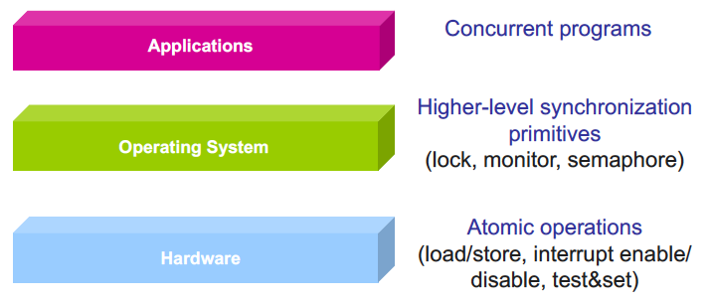
Higher-level synchronization
Higher-level abstraction → easier for programmers

Slide 17
Locks
A lock (or mutex) prevents another thread from entering a critical section
“Lock fridge while checking milk & shopping”
Two operations:
lock(): wait until lock is free, then acquire it
do {
if (lock is free) { // code in red
acquire lock // is atomic
break out of loop
}
} while (1);
unlock(): release lock

Slide 18
Lock usage
Lock initialized to free
Thread acquires lock before entering crit. section
Waits if needed
Thread that acquired lock releases when done with critical section
Locks make earlier problem trivial
Peter
milk.lock()
if (noMilk) {
buy milk
}
milk.unlock()
Janet
milk.lock()
if (noMilk) {
buy milk
}
milk.unlock()

Slide 19
Efficiency with locks
All synchronization involves waiting
Thread can be running or blocked
Blocked thread waits for another event to occur
Blocking reduces efficiency
How can we minimize time lock is held?

Slide 20
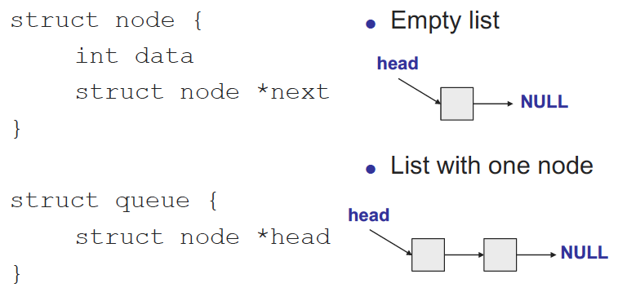
Shared queue

Slide 21
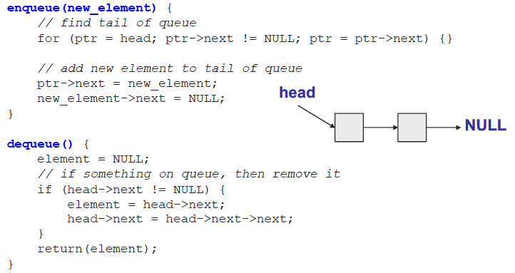
Shared queue (continued)
Minimize waiting by queueing waiting threads
Potential problems with this approach?
What happens if >1 thread accesses queue at once?

Slide 22
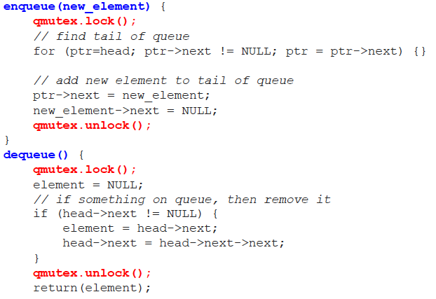
Shared queue with locks

Slide 23
Invariants
When can enqueue() unlock?
Must restore queue to stable state
Stable state is called invariant
Condition that is “always” true for queue
For example, each node appears exactly once when traversing list from head to tail
Hold lock when you’re manipulating shared data (and therefore breaking invariant)

Slide 24
Fine-grained locking
One lock per queue → only one thread can access queue at once
One lock per node: fine-grained locking
What’s the major benefit?
Lock each node as queue is traversed, release once it’s safe, allowing other threads to traverse queue

Slide 25

Fine-grained locking example
lock A
get pointer to B
unlock A
lock B
read B
unlock B
What’s potential downside of this approach?

Slide 26
Hand-over-hand locking
lock A
get pointer to B
lock B
unlock A
read B
unlock B
Lock next node before releasing last node

Slide 27
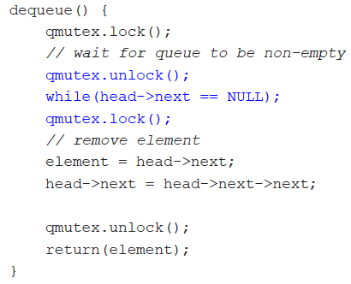
Ordering constraints
What if you want dequeue() to wait if queue is empty?
What’s problem with solution below?

Slide 28
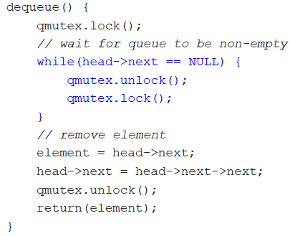
Ordering constraints, pt. 2
What if you want dequeue() to wait if queue is empty?
What’s problem with solution below?

Slide 29
Avoiding busy waiting
Have dequeuer “go to sleep”
Put dequeuer on waiting list, then go to sleep
if (queue is empty) {
add self to waiting list
go to sleep
}
Wait to be awoken once something’s in queue

Slide 30
Synchronization types
Mutual exclusion
Ensures only one thread in critical section
“Not at the same time”
lock/unlock
Condition variables
Used when one thread must wait for another to do something
“Before/after”
dequeue() must wait for enqueue() if empty

Slide 31
Condition variables
Enable thread to sleep inside critical section by (steps in red are atomic):
Release lock
Put thread on waiting list
Go to sleep
After being woken, call lock()
Each condition variable tracks list of threads waiting on that specific condition
Each condition variable associated with lock

Slide 32
Condition variable operations
wait()
Atomically release lock, add thread to waiting list, then go to sleep
Thread must hold lock when calling wait()
signal()
Wake up one thread waiting on condition variable
If no thread waiting, does nothing
broadcast()
Wake up all threads waiting on condition variable
If no thread waiting, does nothing

Slide 33
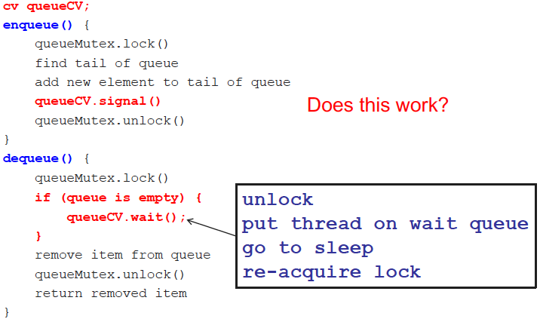
Thread-safe queue with CVs

Slide 34
Monitors
Combine two types of synchronization
Lock for mutual exclusion
Condition variables for ordering constraints
Monitor = 1 lock + CVs associated with lock

Slide 35
Final notes
Next time
Continue synchronization discussion
Reminders:
Program 1 due today
Submit via e-mail
All group member names included in e-mail, header comment
Program 2 to be posted; due date TBD
Exam 1: Wednesday, 2/21
Covers through Tues., 2/20 (Mon. lecture on Tues. next week)
Will be allowed one 8.5” x 11” double-sided note sheet

Slide 36
Acknowledgements
These slides are adapted from the following sources:
Silberschatz, Galvin, & Gagne, Operating Systems Concepts, 9th edition
Chen & Madhyastha, EECS 482 lecture notes, University of Michigan, Fall 2016
Pthread example programs obtained from: https://computing.llnl.gov/tutorials/pthreads/

