Slide 1
EECE.3170 Microprocessor Systems Design I
Instructors: Dr. Michael Geiger & Dr. Lin Li
Fall 2019
Lecture 1:
Course overview
General microprocessor introduction

Slide 2
Lecture outline
Course overview
Instructor information
Course materials
Course policies
Resources
Tentative course outline
General microprocessor introduction
History
Role of the instruction set architecture

Slide 3
Course meeting times
Lectures:
Section 201: MWF 8-8:50 AM, Ball 206
Section 202: MWF 11-11:50 AM, Ball 314
Lab: Not required; may get access to Micros lab as needed

Slide 4
Course instructors
Dr. Lin Li (Section 201)
E-mail: Lin_Li@uml.edu
Office: 310 Ball Hall
Office hours: Th/F 1-3 PM
Dr. Michael Geiger (Section 202)
E-mail: Michael_Geiger@uml.edu
Phone: 978-934-3618 (x43618 on campus)
Office: 301A Ball Hall
Office hours: M/W 2-3 PM, Tu 12:30-2 PM, or by appt.
Additional instructional support
Tutoring through CLASS center
TA TBD

Slide 5
Course materials
Textbook: None
Will post relevant online resources on schedule page
Course websites:
http://mjgeiger.github.io/eece3170/f19/index.htm
http://mjgeiger.github.io/eece3170/f19/schedule.htm
Will contain lecture slides, handouts, assignments
Discussion group through Blackboard
Do not post code/solutions to disc. group
All course announcements will be posted on Blackboard as well
BB site still “under construction” … will update ASAP

Slide 6
Additional course policies
Prerequisites
EECE.2160 (ECE Application Programming)
EECE.2650 (Logic Design)
Must have C- or better in both
Assignments
Homework, labs, and some “hybrid” assignments (problems + programming exercise(s))
Late assignments: 10% penalty per day
All HW individual unless otherwise specified
Some assignments require instructor “check-off”

Slide 7
Academic honesty
All assignments are to be done individually unless explicitly specified otherwise by the instructor
Any copied solutions, whether from another student or an outside source, are subject to penalty
You may discuss general topics or help one another with specific errors, but not share assignment solutions
Must acknowledge assistance from classmate in submission

Slide 8
Course “rules”
A couple of unofficial rules:
Please call me “Dr. Geiger”
“Professor Geiger” is okay (although I’m technically not a professor, I’m a lecturer)
“Michael,” “Mike,” or “Geiger” is not okay
Please don’t talk when I’m talking
Doing so distracts your classmates and me
If you have a question, please raise your hand and ask—I want questions during lecture!

Slide 9
Course policies (cont.)
Grading breakdown
Assignments: 55%
Exam 1: 15%
Exam 2: 15%
Exam 3: 15%
Exam dates
Exam 1: Monday, September 30 in class
Exam 2: Friday, November 1 in class
Exam 3: TBD (common exam; during finals)

Slide 10
What you should learn in this class
Two major aspects:
How to program
Focus on assembly language
Will look at HLL → assembly translation, integration
Use of HLL with microcontrollers
How a microprocessor works with other components
Focus on interfacing circuits and control schemes
Will work with two processor families:
Intel x86 architecture → assembly language simulation
PIC microcontroller → actual microcontroller programming, interfacing
· To understand the interconnection of the CPU, memory, and I/O

Slide 11
Tentative course outline
General microprocessor introduction
Assembly language programming
Start with x86; introduce PIC microcontroller about halfway
Areas will include
Addressing modes
Instruction types
Programming modes
HLL and assembly—translation; combination
External interfacing
Processor signals used in interfacing
Interface circuitry
External memory
Interrupts
Microcontroller-based systems
Microcontrollers vs. microprocessors
Design of microcontroller-based circuits
High-level programming of microcontrollers

Slide 12
What is a computer?
From The American Heritage Dictionary:
“A device that computes, especially a programmable electronic machine that performs high-speed mathematical or logical operations or that assembles, stores, correlates, or otherwise processes information.”
Anything from a simple abacus to the microprocessor-based computers of today

Slide 13
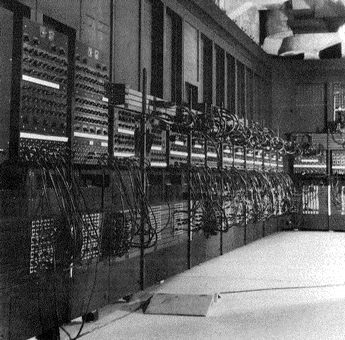
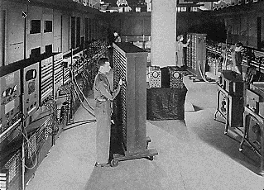
Computing history
Thirty tons
Forced air cooling
200KW
19,000 vacuum tubes
Punch card
Manual wiring
Numerical computation
The first electronic digital computer – ENIAC, built in UPenn in 1946
Source: http://ei.cs.vt.edu/~history/ENIAC.Richey.HTML

Slide 14
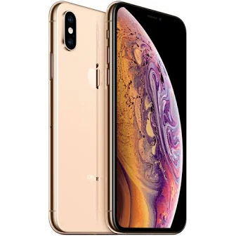
Today’s computer: one example
iPhone Xs Technical Specifications
(the Xs Max wouldn’t fit on the slide)
Screen size 5.8 inches
Screen resolution 2436 by 1125 at 458 ppi
Input method Multi-touch
Operating system iOS 12.4.1
Storage 64 / 256 / 512 GB
Cellular network UMTS/GSM/CDMA
Wireless data Wi-Fi (ac) +
LTE + Bluetooth 5.0 + NFC
Camera 12.0 megapixels
Battery Up to 12 hrs Internet,
20 hrs talk,
14 hrs video, 60 hrs audio,
45 minutes gaming
Dimensions 5.65 x 2.79 x 0.3 inches
Weight 6.24 ounces
Source: http://apple.com

Slide 15
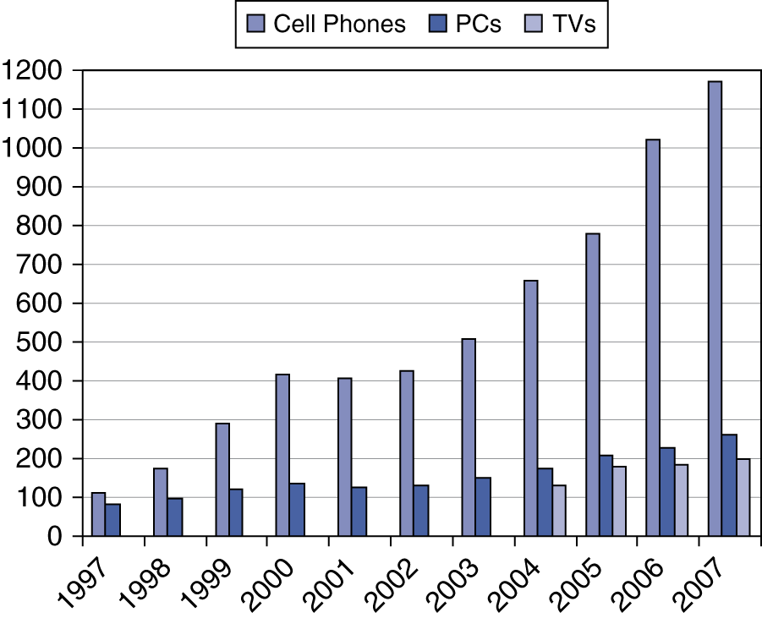
Processor market (as of 2007)
“Computer” used to just refer to PCs
Processors—and, therefore, computers—are now everywhere
Yes, I know the figure’s woefully outdated, but I haven’t found a good replacement and the trend still holds

Slide 16
Computer components
What are the key components of a computer?
Microprocessor (MPU/CPU) performs computation
Input to read data from external devices
Examples: Keyboard, mouse, ports (Ethernet, USB, etc.)
Output to transmit data to external devices
Examples: screen, speaker, VGA interface, ports (Ethernet, USB, etc.)
Storage to hold program code and data
RAM, hard disk, possibly other media (CD/DVD, external drive)
Power supply
Will see that microprocessor contains smaller-scale versions of these components
Computation engine
I/O interface
Internal storage

Slide 17
Final notes
Next time:
Data types
Data storage
Addressing modes
Reminders/notes:
HW 1 to be posted next week; due TBD

