Slide 1
EECE.3220 Data Structures
Instructor:
Dr. Michael Geiger
Fall 2019
Lecture 35:
Priority queues
Hash tables

Slide 2
Lecture outline
Announcements/reminders
New text exercises (Ch. 22, 23) due 12/12
Will count only subset of total text exercise points
Need to figure out exact numbers—will post when I do
Remaining points = extra credit
Will post 1 or 2 short programs
Code submissions allowed until 12/18 (day after final)
Will count subset of programs; others extra credit
Course evals to be posted online; return at final
Final exam: Tuesday, 12/17, 8-11 AM, Olsen 407
Today’s lecture
Priority queues
Hash tables

Slide 3
Review: Heaps
A heap is a binary tree with properties:
It is (nearly) complete
Each level of tree completely filled …
… except possibly bottom level (nodes in left most positions)
Because of this property, can be stored efficiently in arrays
It satisfies heap-order property
Max-heap: Data in each node >= data in children
Min-heap: Data in each node <= data in children

Slide 4
Review: Heapsort
Efficient array sorting algorithm
Can treat array contents as a binary tree using indexing rules described earlier
Heapsort algorithm
Assumes max-heap, want to sort from low → high
Convert array to a heap (“heapify”)
Repeat following steps, assuming n = array size
Swap tree root with item n - 1 → highest item now last
Treat remaining n – 1 items as heap—percolate new root down
Decrement n and return to step (a)

Slide 5
Priority Queue
A collection of data elements
Items stored in order by priority
Higher priority items removed ahead of lower
Operations
Constructor
Insert
Find, remove smallest/largest (priority) element
Replace
Change priority
Delete an item
Join two priority queues into a larger one

Slide 6
Priority Queue
Implementation possibilities
As a list (array, vector, linked list)
As an ordered list
Best is to use a heap Basic operations have O(log₂n) time
Priority queue as heap: use priority for ordering
Highest priority item will always be first
All priority queue operations can be written in terms of heap operations

Slide 7
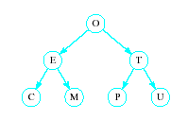
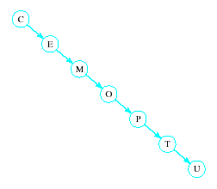
Hash Tables
Recall order of magnitude of searches
Linear search O(n)
Binary search O(log₂n)
Balanced binary tree search O(log₂n)
Unbalanced binary tree can degrade to O(n)

Slide 8
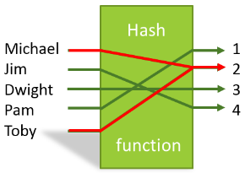
Hash Tables
In some situations faster search is needed
Solution is to use a hash function
Value of key field given to hash function
Location in a hash table is calculated

Slide 9
Hash Functions
Simple function could be to mod the value of the key by some arbitrary integer int h(int i) { return i % someInt; }
Note the max number of locations in the table will be same as someInt
Note that we have traded speed for wasted space
Table must be considerably larger than number of items anticipated

Slide 10
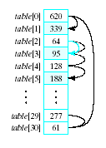
Hash Functions
Observe the problem with same value returned by h(i) for different values of i
Called collisions
A simple solution is linear probing
Linear search begins at collision location
Continues until empty slot found for insertion

Slide 11

Hash Functions
When retrieving a value linear probe until found
If empty slot encountered then value is not in table
If deletions permitted
Slot can be marked so it will not be empty and cause an invalid linear probe

Slide 12
Hash Functions
Strategies for improved performance
Increase table capacity (less collisions)
Use different collision resolution technique
Devise different hash function
Hash table capacity
Size of table must be 1.5 to 2 times the size of the number of items to be stored
Otherwise probability of collisions is too high

Slide 13
Collision Strategies
Linear probing can result in primary clustering
Consider quadratic probing
Probe sequence from location i is i + 1, i – 1, i + 4, i – 4, i + 9, i – 9, …
Secondary clusters can still form
Double hashing
Use a second hash function to determine probe sequence

Slide 14
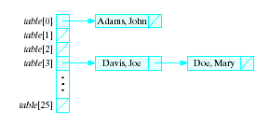
Collision Strategies
Chaining
Table is a list or vector of head nodes to linked lists
When item hashes to location, it is added to that linked list

Slide 15
Improving the Hash Function
Ideal hash function
Simple to evaluate
Scatters items uniformly throughout table
Modulo arithmetic not so good for strings
Possible to manipulate numeric (ASCII) value of first and last characters of a name

Slide 16
Final notes
Next time:
Standard C++ containers
Reminders:
New text exercises (Ch. 22, 23) due 12/12
Will count only subset of total text exercise points
Need to figure out exact numbers—will post when I do
Remaining points = extra credit
Will post 1 or 2 short programs
Code submissions allowed until 12/18 (day after final)
Will count subset of programs; others extra credit
Course evals to be posted online; return at final
Final exam: Tuesday, 12/17, 8-11 AM, Olsen 407

Slide 17
Acknowledgements
These slides are adapted from slides provided with the course textbook:
Larry Nyhoff, ADTs, Data Structures, and Problem Solving with C++, 2nd edition, 2005, Pearson/Prentice Hall. ISBN: 0-13-140909-3

