Slide 1
EECE.4810/EECE.5730 Operating Systems
Instructor:
Dr. Michael Geiger
Spring 2018
Lecture 3:
Processes and process management (continued)

Slide 2
Lecture outline
Announcements/reminders
Sign up for the course discussion group on Piazza!
Currently no TA assigned to course
Please don’t contact Anil with questions!
Program 1 to be posted this week; due TBD
Linux lab (Ball 410) accounts set up
Please contact me for your Linux account info
Will request card access for you ASAP
Lab is (physically) unavailable T 2-5
Today’s lecture: more on processes
Review and go more in depth on fundamentals of process creation

Slide 3
Review: Processes
Process: program in execution
1+ running pieces of code (threads) + everything code can read/write
Program counter
Registers
Address space
Address space: all code/data stored in memory
Text section: code
Data section: global variables
Stack: temporary data related to functions
Heap: dynamically allocated data

Slide 4
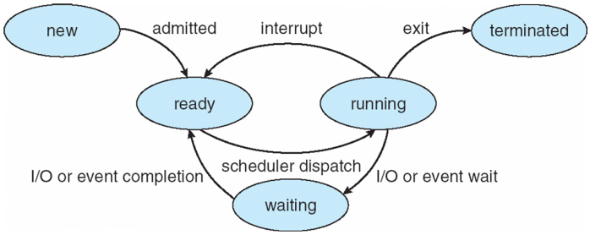
Review: Process State
new: Process is being created
running: Instructions are being executed
waiting: Process waiting for some event to occur
ready: Process waiting to be assigned to a processor
terminated: Process has finished execution

Slide 5
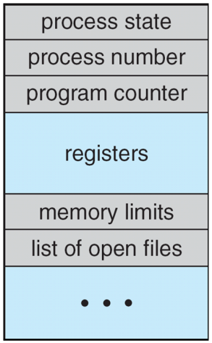
Review: Process Control Block (PCB)
Stored in memory
Used by OS to track process
Some info updated with every change
Process state
Scheduling queue pointers
Accounting info
Memory management
I/O status,
File list
Some info updated on context switch
Running → waiting/ready state
Save copies of PC, regs to PCB
Restored when running again

Slide 6
Review: Process creation
Each process has to be created by another process
Creator is called parent process
Created process is child process
Children can create other processes, forming process tree
Graphical representation of parent/child relationships
Parent/child processes may share resources
Parent/child processes may execute concurrently, or parent may wait for child to terminate

Slide 7
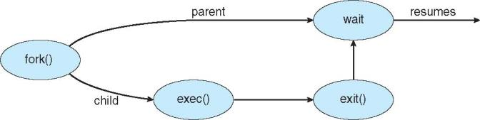
Review: Process creation (cont.)
Address space
Initially, child duplicate of parent
Child can load a separate program
UNIX examples
fork() system call creates duplicate process
exec() system call used after a fork() to replace the process’ memory space with a new program

Slide 8
Example 1: process creation
Remember, fork() system call creates new process as a duplicate of original process
Copies original address space, code and all
I misspoke last Wednesday—parent and child do *not* share an address space after fork()
Including initial parent process, how many processes does the program below create?
Draw a process tree to support your answer
int main() {
for (int i = 0; i < 4; i++)
fork();
return 0;
}

Slide 9
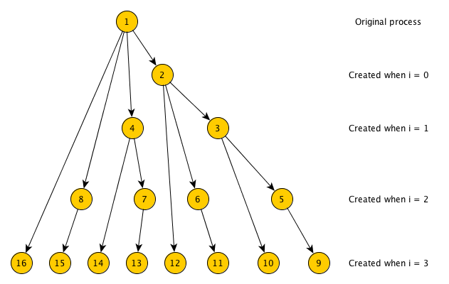
Example 1 solution
Each fork() call creates copy of currently running process
Each copy runs same code!
# processes doubles each loop iteration
1 → 2 → 4 → 8 → 16

Slide 10
Review: more details on fork() and wait()
fork() return value is:
<0 if fork() fails (no child created)
0 within child process
PID of child (>0) within parent process
Can use to differentiate child from parent
Run same program but use conditional statement to send parent/child down different paths
wait() system call allows parent to wait for child to finish execution

Slide 11
Example 2: what does program print?
int nums[5] = {0,1,2,3,4};
int main() {
int i;
pid_t pid;
pid = fork();
if (pid == 0) {
for (i = 0; i < 5; i++) {
nums[i] *= -i;
printf("CHILD: %d\n", nums[i]);
}
}
else if (pid > 0) {
wait(NULL);
for (i = 0; i < 5; i++)
printf("PARENT: %d\n", nums[i]);
}
}

Slide 12
Example 2 solution
Since fork() copies all data from parent process, parent and child each get own copy
Doesn’t matter if data are local or global
nums[] array only changed in child
Parent doesn’t print its array until child done
So, output is:
CHILD: 0
CHILD: -1
CHILD: -4
CHILD: -9
CHILD: -16
PARENT: 0
PARENT: 1
PARENT: 2
PARENT: 3
PARENT: 4

Slide 13
Starting new program: exec system calls
To start new program, replace address space of current process with new process
On UNIX systems, use exec system calls
Family of functions allowing you to specify
Location of executable
execlp(), execvp() don’t require full path
Command line arguments to executable, either as
Separate strings passed to execl(), execle(), execlp()
Array of strings passed to execv(), execve(), execvp()
Optional list of new environment variables

Slide 14
Review: Forking Separate Process
int main() {
pid_t pid;
pid = fork(); // Create a child process
if (pid < 0) { // Error occurred
fprintf(stderr, "Fork failed");
return 1;
}
else if (pid == 0) { // Child process
printf("Child: listing of current directory\n\n");
execlp("/bin/ls", "ls", NULL);
}
else { // Parent process—wait for child to complete
printf("Parent: waits for child to complete\n\n");
wait(NULL);
printf("Child complete\n\n");
}
return 0;
}

Slide 15
Review: Process Termination
Process ends using exit() system call
May be explicit, implicit (return from main → exit())
Returns status data from child to parent (via wait())
Process’ resources are deallocated by operating system
Parent may abort() executing child process if:
Child has exceeded allocated resources
Task assigned to child is no longer required
Parent exiting and OS does not allow child to continue if parent terminates
Not true in Linux, for example
OS initiates cascading termination

Slide 16
Review: Process Termination
Parent may wait() for child termination
wait() returns child PID, passes return status through pointer argument
pid = wait(&status);
If child terminates before parent invokes wait(), process is a zombie
If parent terminated without wait() , process is an orphan
Return status must be checked
In Linux, orphans assigned init as parent

Slide 17
Process termination questions
What’s downside of zombie processes?
Unnecessary clutter and use of resources
Worst case: fill process table
Any reason to allow orphan processes?
Long running process not requiring user
Indefinitely running background process (daemon)
Examples: respond to network requests (i.e. sshd), system logging (syslogd)
Can 1 process be both zombie & orphan?
Sure—child terminates first, then parent terminates without wait
On UNIX system init “adopts” orphans to ensure exit status collected

Slide 18
Final notes
Next time
Inter-process communication
Start multithreading (time permitting)
Reminders:
Sign up for the course discussion group on Piazza!
Currently no TA assigned to course
Please don’t contact Anil with questions!
Program 1 to be posted this week; due TBD
Linux lab (Ball 410) accounts set up
Please contact me for your Linux account info
Will request card access for you ASAP
Lab is (physically) unavailable T 2-5

Slide 19
Acknowledgements
These slides are adapted from the following sources:
Silberschatz, Galvin, & Gagne, Operating Systems Concepts, 9th edition
Chen & Madhyastha, EECS 482 lecture notes, University of Michigan, Fall 2016

