Slide 1
EECE.3170 Microprocessor Systems Design I
Instructors: Dr. Lin Li & Dr. Michael Geiger
Fall 2019
Lectures 2 & 3:
Data storage and addressing

Slide 2
Lecture announcements
HW 1 due Monday, 9/16
Submit work via Blackboard
Can handwrite solution but must scan all pages and combine into single document
Word doc or PDF, no archive files

Slide 3
Lecture outline
Instruction set architecture
Data types
Data storage
Storage media
Alignment
Endianness
Addressing modes
These slides will cover next 2-3 lectures

Slide 4
Processor architecture
“Architecture” can refer to
High-level description of hardware; could be
Overall system
Microprocessor
Subsystem within processor
Operations available to programmer
Instruction set architecture
Other applications to computing (e.g., “software architecture”) we won’t discuss
Commonly used to discuss functional units and how they work together

Slide 5
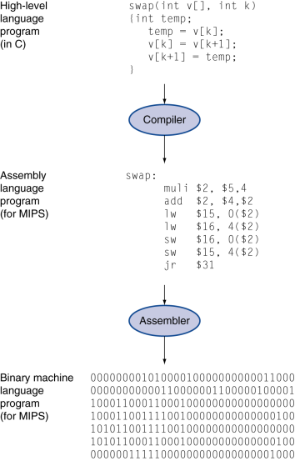
Role of the ISA
User writes high-level language (HLL) program
Compiler converts HLL program into assembly for the particular instruction set architecture (ISA)
Assembler converts assembly into machine language (bits) for that ISA
Resulting machine language program is loaded into memory and run

Slide 6
Abstraction of program control
Easiest for humans to understand high-level languages
Processor interprets machine language
Assembly language: abstraction with intermediate level of detail
Breaks machine code into instructions
Gives some insight into how each instruction behaves
More readable than bit patterns!

Slide 7
ISA design
Think about a HLL statement like
X[i] = i * 2;
ISA defines how such statements are translated to machine code
What information is needed?

Slide 8
ISA design (cont.)
Think about a HLL statement like
X[i] = i * 2;
Questions answered in every ISA (or “software model”)
How will the processor implement this statement?
What operations are available?
How many operands does each instruction use?
Where are X[i] and i?
How do we reference the operands?
What type(s) of data are X[i] and i?
What types of operands are supported?
How big are those operands?
Instruction format issues
How many bits per instruction?
What does each bit or set of bits represent?
Are all instructions the same length?

Slide 9
Operation types
Operations: what should processor be able to do?
Data transfer
Move data between storage locations
Arithmetic operations
Typical: add, subtract, maybe multiply/divide, negation
Logical operations
Typical: AND, OR, NOT, XOR
Often includes bit manipulation: shifts, rotates, test/set/clear single bit
Program control
“Jump” to another part of program
May be based on condition
Used to implement loops, conditionals, function call/return
Typically some processor-specific special purpose ops

Slide 10
Operands
Two major questions when dealing with data
“How” do we store them? → what do the bits represent?
Where do we store them?
… and how do we access those locations?
First question deals with data types
Second question deals with data storage and addressing

Slide 11
Data types
Also seen in high-level languages
Think about C types: int, double, char, etc.
What does a data type specify?
How big is each piece of data?
How do we interpret the bits representing those data?
Data sizes
Smallest addressable unit: byte (8 bits)
Can also deal with multi-byte data: 16, 32, 64 bits
Often deal with words of data
Word size processor-dependent (16 bits on x86, 32 bits on MIPS)
Can have double words, quad words, half words …
Interpreting bits
Numbers: Integers, floating-point; signed vs. unsigned
May treat as characters, other special formats

Slide 12
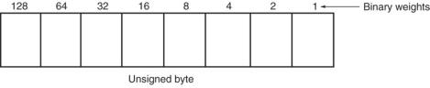
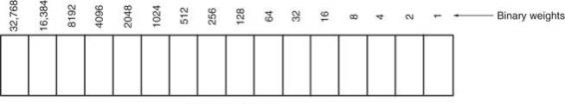
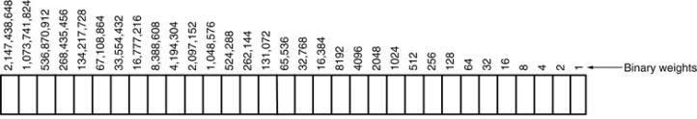
Unsigned Integers
Types:
Sizes Range
8-bit 0H → 255₁₀
16-bit 0H → 65,535₁₀
32-bit 0H → 4,294,967,295₁₀

Slide 13
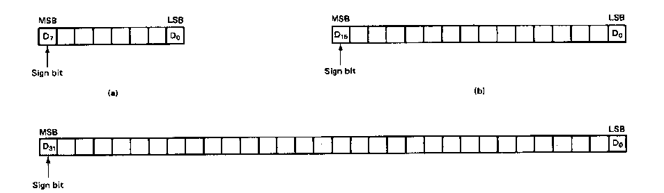
Signed Integers
MSB is sign bit ( 0/1 -> +/-)
Remaining bits represent value
Negative numbers expressed in 2’s complement notation
Types:
Sizes Range
8-bit -128 → +127
16-bit -32,768 → +32,767
32-bit -2,147,483,648 → +2,147,483,647

Slide 14
Integer Examples
Given the 8-bit value: 1001 1111₂
Calculate the decimal value of this integer as
An unsigned integer
A signed integer

Slide 15
Integer example solution
Given the 8-bit value: 1001 1111₂
Calculate the decimal value of this integer as
An unsigned integer
Solution:
(1 x 2⁷) + (1 x 2⁴) + (1 x 2³) + (1 x 2²) + (1 x 2¹) + (1 x 2⁰)
= 128 + 16 + 8 + 4 + 2 + 1 = 159
A signed integer
Solution:
MSB = 1 → negative value
To get magnitude, take 2’s complement:
0110 0001₂ = (1 x 2⁶) + (1 x 2⁵) + (1 x 2⁰)
= 64 + 32 + 1 = 97
→ Result = -97

Slide 16
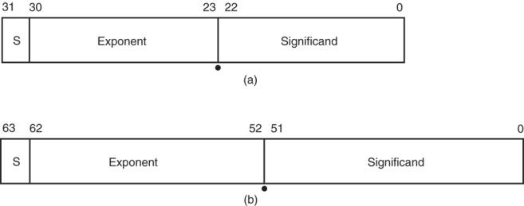
Floating-point Numbers
Floating-point data stored in two parts
Significand (fraction)
Exponent
Single-precision (32 bits) or double-precision (64 bits)

Slide 17
Data storage
What characteristics do we want storage media to have?
Two primary answers
Speed
Capacity
Very difficult to get both in single storage unit
Processors use two different types of storage
Registers
Memory

Slide 18
Registers
Small, fast set of storage locations close to processor core (execution engine)
Primarily used for computation, short-term storage
Speed → ideal for individual operations
Lack of capacity → will frequently overwrite
Reference registers by name
Example: ADD EAX, EBX → EAX = EAX + EBX
EAX, EBX are registers in x86 architecture

Slide 19
Memory
Provides enough capacity for all code, data (possibly I/O as well)
Typically organized as hierarchy
Used primarily for long-term storage
Lacks speed of registers
Provides capacity to ensure data not overwritten
Reference memory by address
Example: MOV EAX, [100h]
→ EAX = memory at address [100h]

Slide 20
Memory (continued)
Accessing single byte is easy
Considerations with multi-byte data
Are the data aligned?
Easier/faster to access aligned data
How are the data organized in memory (“endianness”)?
Given 32-bit number: DEADBEEFh or 0xDEADBEEF
Which byte—MSB (0xDE) or LSB (0xEF) gets stored in memory first?

Slide 21
Aligned Words, Double words
Aligned word
Aligned data: address is divisible by # of bytes
2 bytes → address must be even
4 bytes → address must be multiple of 4
x86 architecture doesn’t require aligned data access
Performance impact for accessing unaligned data in memory (32-bit data bus)
Byte address
0
4
8
12
16
20
Aligned double word
Unaligned
word
Unaligned
double
word

Slide 22
Byte order (“endianness”)
In a multi-byte operand, how are the bytes ordered in memory?
Assume the double word value 1,000,000 (0x000F4240) is stored at address 80
In a little-endian ISA (like x86), the least significant byte (the “little” end) is at address 80
In a big-endian ISA (like MIPS), it’s the other way around
 |  | 40 | 42 | 0F | 00
… | 79 | 80 | 81 | 82 | 83 | 84 | …
 |  | 00 | 0F | 42 | 40
… | 79 | 80 | 81 | 82 | 83 | 84 | …

Slide 23
Examples
Given the following memory contents:
Starting address of each line shown on left
Leftmost byte has lowest address
First line: addresses 0x200C, 0x200D, 0x200E, 0x200F
What is the value of:
The word starting at address 0x200D?
The double word starting at address 0x2012?
Are these data aligned?
 | Lo |  |  | Hi
0x200C | 40 | 96 | 2C | 00
0x2010 | 55 | 12 | CD | AB
0x2014 | 01 | 23 | 88 | 99

Slide 24
Solution
 | Lo |  |  | Hi
0x200C | 40 | 96 | 2C | 00
0x2010 | 55 | 12 | CD | AB
0x2014 | 01 | 23 | 88 | 99
Word at 0x200D = 0x2C96
Address is not divisible by 2 → unaligned
Double word at 0x2012 = 0x2301ABCD
Address is not divisible by 4 → unaligned
Remember, hexadecimal is base 16—0x12 = 18₁₀

Slide 25
Addressing modes
Addressing modes: ways of specifying operand location
Where are operands stored? (3 location types)
Registers → register addressing
Provide name of register; value read from register
Memory
Provide address in memory; value read from that location
Several modes for specifying memory address
In the instruction → immediate addressing

Slide 26
Memory addressing
Instructions accessing memory generate effective address (EA)
Address calculated as part of instruction
EA can be used as
Actual memory address in a simple memory system
Address within a particular segment in a segmented memory architecture
Effective address calculations can involve
A constant value
One or more values stored in registers
Some combination of register and constant

Slide 27
General memory addressing modes
Memory direct addressing
EA = constant value encoded in instruction
Register indirect addressing
EA = value stored in register
Base + displacement addressing
EA = constant displacement + base register(s)
Can have variations of this mode based on number and type of registers
Scaled addressing
EA = base + (scale * index)
Used for array addressing

Slide 28
Final notes
Next time:
x86 introduction
Reminders:
HW 1 due Monday, 9/16
Submit work via Blackboard
Can handwrite solution but must scan all pages and combine into single document
Word doc or PDF, no archive files

