Slide 1
EECE.3220 Data Structures
Instructor:
Dr. Michael Geiger
Fall 2019
Lecture 1:
Course overview
Going from C to C++

Slide 2
Lecture outline
Course overview
Instructor information
Course materials
Course policies
Resources
Course outline
Going from C to C++
Introductory look at basic differences

Slide 3
Course meeting time, instructor info
Lectures: MWF 10-10:50, Olsen 407
Instructor: Dr. Michael Geiger
E-mail: Michael_Geiger@uml.edu
Phone: 978-934-3618 (x43618 on campus)
Office: 301A Ball Hall
Office hours: M/W 2-3 PM, Tu 12:30-2 PM, or by appointment

Slide 4
Course materials
Required Textbook: Programming in C++/Data Structures Essentials, EECE.3220, Fall 2019
Electronic textbook + IDE for writing programs
10% of grade assigned to exercises from text
To subscribe ($88 this term), use Blackboard link
Textbook registration requires you to supply
student.uml.edu e-mail address
Section in which you are enrolled (there’s only one … )
Text composed of 2 different books; currently:
Ch. 1-16: Programming in C++
Ch. 17-29: Data Structures Essentials
Text likely to be reconfigured throughout term—will update you as changes are made

Slide 5
Additional course materials
Course websites:
http://mjgeiger.github.io/eece3220/f19/index.htm
http://mjgeiger.github.io/eece3220/f19/schedule.htm
Will contain lecture slides, handouts, assignments
Course Blackboard site
Will post announcements/email class
May use discussion board feature
Login via https://lowell.umassonline.net/

Slide 6
Grading and exam dates
Grading breakdown
Programming assignments: 50%
No programs will be dropped
Textbook activities: 10%
Typo in syllabus—participation & challenge combined, not worth 5% each
Lowest of first 2 exams: 10%
Highest of first 2 exams: 15%
Exam 3: 15%
Exam dates tentative
Will post survey asking availability for 2-hour blocks
Exam 1: late week 5/early week 6 (10/3-10/8)
Exam 2: week 10 (11/4-11/8)
Exam 3: TBD (during finals)

Slide 7
Academic honesty
All assignments are to be done individually
Don’t share code
Don’t write programs together
Any copied solutions, whether from another student or an outside source, are subject to penalty

Slide 8
Textbook activities
Activities associated with each chapter
Follow Blackboard link to complete
Due dates posted on Blackboard/schedule page
Activities completed >3 days after lecture: 0 credit
No extensions given for these activities
Two activity types
Participation activity: may retry until correct
Challenge activity: problems may change if incorrect certain number of times

Slide 9
Programming assignments
Will submit all code through textbook IDE
Again, follow Blackboard link to submit
Brief “submission” to Blackboard for style grading
Penalty after due date: -(2^{n-1}) points per day
i.e., -1 after 1 day, -2 after 2 days, -4 after 3 days …
After 1 week, grade of 0
Grading generally split as follows:
60%: Code compiles & generates correct output
Output correctness auto-graded within textbook IDE
40%: Programming style
Instructor/grader will examine code and grade accordingly
May resubmit each program once for regrade

Slide 10
Course “rules”
A couple of unofficial rules:
Please call me “Dr. Geiger” or “Prof. Geiger”
Not “Michael,” “Mike,” or “Geiger”
Please don’t talk when I’m talking
Doing so distracts your classmates and me
If you have a question, please raise your hand and ask—I want questions during lecture!

Slide 11
Tentative outline: what you should learn
Fundamentals of C++ programming
Differences between C and C++ (I/O, structs, argument passing)
Object-oriented programming: classes, composition, inheritance
Analyzing algorithmic complexity
How fast is a particular algorithm/data structure, both on average and in the worst case?
Specific types of algorithms: sorting, recursive structure traversal
How to design and use various data structures
Linked lists
Stacks
Queues
Binary trees
Heaps
Priority queues
Hash tables

Slide 12
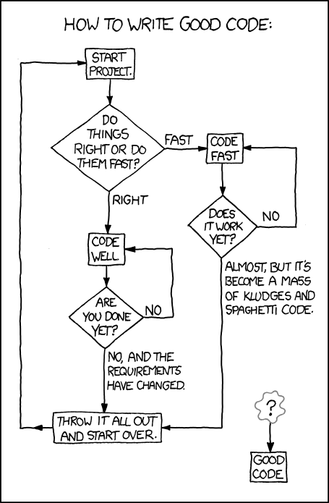
What you’ll really learn … ?
http://xkcd.com/844

Slide 13
C vs. C++: the basics
C is a procedural language
Based around functions (or procedures)—a series of steps to be carried out when called
For a function to operate on data, data must be passed as arguments
C++ is an object-oriented language
Objects contain attributes (data members) and behaviors (member functions)
Function calls (most of them) associated with specific object → no need to pass object to function

Slide 15
Why object-oriented programming?
Object orientation
Natural way of thinking about world (& computer programs)
Object-oriented design (OOD)
Models real-world objects in software
Models communication among objects
Encapsulates attributes and operations (behaviors)
Information hiding
Communication through well-defined interfaces
Object-oriented programming (OOP)
Programmers create user-defined types called classes
Contain data members (attributes) and member functions (behaviors)
Object: specific instance of a given class

Slide 16
Why procedural programming?
If C++ is so great, why learn C in the first place?
C best suited for system-level programming
C language easiest HLL for accessing hardware
Hardware support for procedural programming
Call/return instructions
System stack (or other argument-passing methods)

Slide 17
C vs. C++: simple data types
Most simple data types are the same
From EECE.2160: int, double, float, char
Other matching types (rarely used in EECE.2160)
unsigned: Non-negative whole numbers
Basic int is signed—can be + or –
unsigned is short for “unsigned int”
short: 16-bit integer
Saves space vs. int; has smaller range of values
bool: Boolean (true/false) data
Can set variables of type bool equal to true or false
Recall that non-Boolean data “true” if nonzero

Slide 18
C vs. C++: similarities
Most programming constructs are the same
Variable declarations
Arithmetic operators (+, -, *, /, %)
Boolean operators (&&, ||, !)
Relational operators (<, >, <=, >=, ==, !=)
Bitwise operators (&, |, ^, >>, <<)
Control structures (if/else, switch)
Loops (while, do-while, for)
Non-member functions
Arrays and pointers
Structures

Slide 19
C vs. C++: major differences
Input/output
Use redirection operators, not functions
Formatting done through use of manipulators
Object-oriented programming
Use of objects means different ways of organizing and interacting with data
Most function calls operate on single object that isn’t passed to function

Slide 20
Final notes
Next time: more on going from C to C++
Input and output in C++
Structures in C++

