Slide 1
EECE.3170 Microprocessor Systems Design I
Instructors: Dr. Lin Li & Dr. Michael Geiger
Fall 2019
Lecture 4:
x86 intro

Slide 2
Lecture outline
Announcements/reminders
HW 1 due Monday, 9/16
Submit work via Blackboard
Can handwrite solution but must scan all pages and combine into single document
Word doc or PDF, no archive files
Today’s lecture
x86 introduction
x86 memory accesses

Slide 3
x86 intro
“x86” → family of general purpose Intel processors
Starts with 8086 processor (1978)
Used (w/extensions) in current processors
Supports use of 8, 16, 32, or 64 bit data
“IA-32”: x86 for 32-bit processors (80386 and later)
“x86-64”: x86 with 64-bit extensions (AMD, Intel, VIA)
“IA-64”: old name for Itanium server architecture (not extension of x86)
Allows both register and memory operands
Segmented or flat memory architecture
Real and protected mode operation
Protected mode supports virtual memory

Slide 4
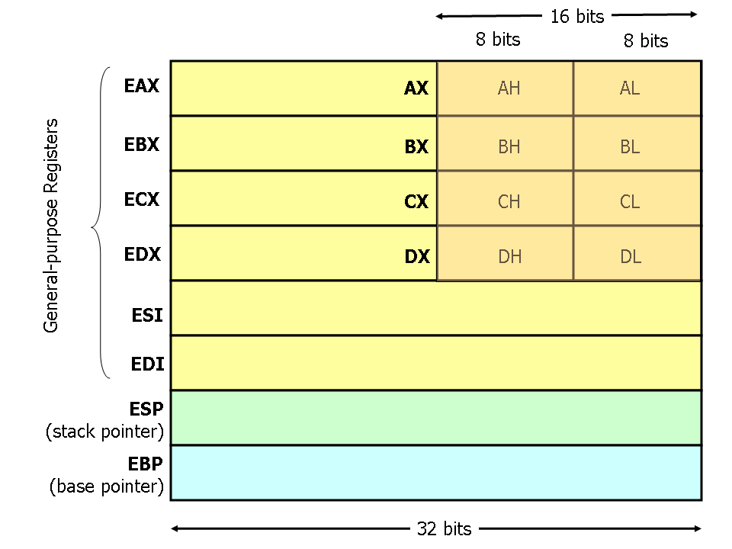
Register Set
Nine 32-bit registers
Data registers- EAX, EBX, ECX, EDX, can be used as 32, 16 or 8bit
Pointer registers- EBP, ESP
Index registers- ESI, EDI
Instruction pointer- EIP (not shown)
Flags (status) register-EFLAGS (not shown)
Source: http://www.cs.virginia.edu/~evans/
cs216/guides/x86.html

Slide 5
Register Set
64-bit extensions added with Pentium 4
Data/pointer/index/IP/ flag register extended to 64 bits
For example:
RAX = 64-bit register A
RSP = 64-bit stack pointer
8 additional data registers (R8-R15)

Slide 6
General Purpose Data Registers
Four general purpose data registers
Accumulator (A) register
Base (B) register
Count (C) register
Data (D) register
Can hold 8-bit, 16-bit, or 32-bit data
AH/AL = high and low byte value
AX = word value
EAX = double word value
General uses:
Hold data such as source or destination operands for most operations—ADD, AND, SHL
Hold address pointers for accessing memory
Some also have dedicated special uses
C—count for loop,
B—table look-up translations, base address
D—indirect I/O and string I/O

Slide 7
Pointer/Index Registers
Two pointer registers (32-/16-bit versions)
Stack pointer register (ESP/SP)
Points to top of stack
Base pointer register (EBP/BP)
Points to fixed location within current stack frame
Two index registers
Source index (ESI/SI)
Destination index (EDI/DI)
Typically used in memory addressing

Slide 8
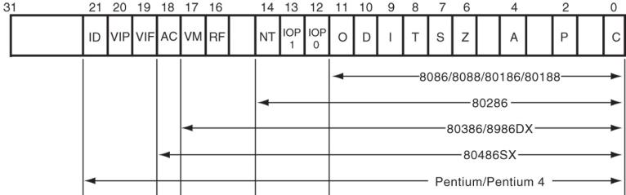
Flags Register
32-bit register holding single bit status and control information
9 active flags in real mode
Two categories
Status flags: conditions resulting from instruction
Most instructions update status
Used as test conditions
Control flags: control processor functions
Used by software to turn on/off operating capabilities

Slide 9
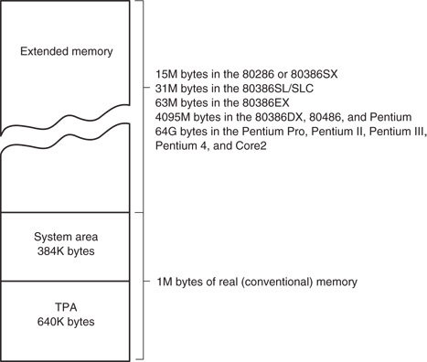
x86 memory spaces
x86 architecture implements independent memory and input/output (not shown) address spaces
Memory address space
1 MB “real” memory
System + transient program area (TPA)
Extended memory size dependent on processor
Input/output address space- 65,536 bytes long (64KB)

Slide 10
x86 memory modes
Two general modes of access
Real mode (DOS)
Protected mode (Windows)
Two memory models
Segmented memory model
Flat memory model
We’ll use this model

Slide 11
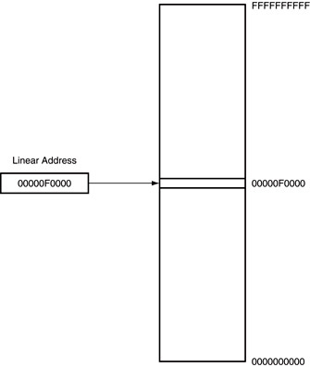
Flat mode addressing
No segmentation
Entire address space active
Address generated by instruction = linear address being accessed
Generates 40-bit external address

Slide 12
x86 addressing modes
Addresses in x86 instructions enclosed by brackets
Addressing modes: all examples of general addressing modes discussed earlier
Direct addressing
EA = constant value
Example: MOV AX, [0x0100]
Register indirect addressing
EA = value stored in register
Example: MOV [EDI], AX
Base-plus-index addressing
EA = sum of two registers
Example: MOV AX, [EBX+ESI]

Slide 13
x86 addressing modes (cont.)
Register relative addressing
EA = register + constant
Examples:
MOV CL, [EBX+4]
MOV AX, ARRAY[EBX] ARRAY is constant memory location
Base relative-plus-index addressing
EA = base register + index register + constant
Example: MOV AX, 0x10[ESI][EBX] -or-
MOV AX, [0x10+SI+BX]
Scaled-index addressing
EA = register + (scaling factor * second register)
Often useful for array accesses
Scaling factor = element size (2, 4, 8 bytes)
Example: MOV EDX, [EAX + 4*EBX]

Slide 14
Example
Compute the address for the memory operand in each of the following instructions.
You do not need to specify what data is transferred
The register contents and variables are as follows:
(ESI) = 0x00000100
(EDI) = 0x00000200
(EBX) = 0x00000300
MOV [EBX+0x0400], CX
MOV [EDI+2*EBX], AH
MOV [EBX+EDI+0x0400], AL

Slide 15
Example solutions
Memory operand in: MOV [EBX+0x0400], CX
Addr = value in EBX + 0x0400
= 0x00000300h + 0x0400 = 0x00000700
Memory operand in: MOV [EDI+2*EBX], AH
Addr = value in EDI + 2 * value in EBX
= 0x00000200 + 2 * 0x00000300
= 0x00000200 + 0x00000600 = 0x00000800
Memory operand in MOV [EBX+EDI+0400h], AL
Addr = EBX + EDI + 0x0400
= 0x00000300 + 0x00000200 + 0x0400
= 0x00000900

Slide 16
Instruction Assembly Notation
Each instruction is represented by a mnemonic that describes its operation—called its operation code (opcode)
MOV = move (data transfer)
ADD = add (arithmetic)
AND = logical AND (logic)
JMP = unconditional jump (control transfer)
Operands are the other parts of an assembly language instructions
Identify whether the elements of data to be processed are in registers or memory
Source operand– location of one operand to be processed
Destination operand—location of the other operand to be processed and the location of the result

Slide 17
Assembly Language Statements
General structure of an assembly language statement
LABEL: INSTRUCTION ;COMMENT
Label—address identifier for the statement
Instruction—the operation to be performed
Comment—documents the purpose of the statement
Example:
START: MOV AX, BX ; Copy BX into AX
Other examples:
INC SI ;Update pointer
ADD AX, BX
Few instructions have a label—usually marks a jump to point
Not all instructions need a comment

Slide 18
x86 memory accesses
# bytes from memory usually = # bytes in register
Example: MOV AX, [0x100]
AX is 16-bit register → copy word from address 0x100 to AX
Sometimes necessary to specify size
Use “<size> PTR”: BYTE PTR, WORD PTR, DWORD PTR
Example: MOVZX EAX, BYTE PTR [0x100]
Take byte from memory
Zero-extend data to 32 bits and store in EAX
Remember, x86 uses little-endian data

Slide 19
Final notes
Next time:
Data transfer instructions
Reminders:
HW 1 due Monday, 9/16
Submit work via Blackboard
Can handwrite solution but must scan all pages and combine into single document
Word doc or PDF, no archive files

