Slide 1
EECE.3170 Microprocessor Systems Design I
Instructor: Dr. Michael Geiger
Summer 2017
Lecture 4:
Logical instructions
Shift and rotate instructions

Slide 2
Lecture outline
Announcements/reminders
HW 2 due 1:00 PM today
Exam 1 on Thursday, 5/25
Will be allowed one double-sided 8.5” x 11” note sheet, calculator
No other electronic devices allowed
Instruction list provided (see website)
Review
Arithmetic instructions
Today’s lecture
Logical, shift, and rotate instructions

Slide 3
Review: addition and subtraction
Reviewed flags: CF, AF, SF, ZF, PF, OF
Addition instructions
ADD AX,BX → AX = AX + BX
ADC AX,BX → AX = AX + BX + CF
INC AX → AX = AX + 1
Subtraction instructions
SUB AX,BX → AX = AX – BX
SBB AX,BX → AX = AX – BX – CF
DEC AX → AX = AX – 1
NEG AX → AX = -AX = 0 - AX

Slide 4
Review: MUL/IMUL
MUL S → unsigned multiplication
IMUL S → signed multiplication
Byte: (AX) = (AL) * (S)
Word: (DX,AX) = (AX) * (S)
Double-word: (EDX,EAX) = (EAX) * (S)
Only CF, OF updated
If upper half of result = 0, CF & OF = 0
Otherwise, CF & OF = 1

Slide 5
Review: DIV/IDIV
DIV S → unsigned division
IDIV S → signed division
Result split into quotient, remainder
Byte: (AL) = (AX) / (S)
(AH) = (AX) % (S)
Word: (AX) = (DX,AX) / (S)
(DX) = (DX,AX) % (S)
Dword: (EAX) = (EDX,EAX) / (S)
(EDX) = (EDX,EAX) % (S)
Flags undefined
Overflow causes exception

Slide 6
Logical instructions (+ shift, rotate)
AND
OR
XOR
NOT
SAL/SHL
SHR
SAR
SHLD
SHRD
ROL
ROR
RCL
RCR

Slide 7
AND / OR / XOR / NOT
All logical operations use form: <op> D, S →
(D) = (D) <op> (S)
May have one memory operand
Source may be immediate
Flags updated: CF, OF, SF, ZF, PF
CF, OF always set to 0
AND → Logical AND
OR → Logical inclusive-OR
XOR → Logical exclusive-OR
NOT → Logical NOT

Slide 8
Logical instructions: example
Show the state of AL after each instruction in the following sequence:
MOV AL, 0x55
AND AL, 0x1F
OR AL, 0xC0
XOR AL, 0x0F
NOT AL

Slide 9
Logical instructions: solution
Show the state of AL after each instruction
MOV AL, 0x55
AL = 0x55
AND AL, 0x1FH
AL = 0x55 AND 0x1F = 01010101 AND 00011111
= 00010101 = 0x15
OR AL, 0xC0
AL = 0x15 OR 0xC0 = 00010101 OR 11000000
= 11010101 = 0xD5
XOR AL, 0x0F
AL = 0xD5 XOR 0x0F = 11010101 XOR 00001111
= 11011010 = 0xDA
NOT AL
AL = NOT 0xDA = NOT(11011010) = 00100101 = 0x25

Slide 10
SHL / SAL / SHR / SAR
Shift instruction format: <op> D, <shamt>
Destination may be register/memory
<shamt>: shift amount
May be immediate or register CL
All shift instructions store last bit shifted out in carry flag (CF)
SHL: logical shift left (double-precision version SHLD)
SAL: arithmetic shift left
Shift to left by <shamt> bits; shift 0s into LS bits
SHR: logical shift right (double-precision version SHRD)
Shift to right by <shamt> bits; shift 0s into MS bits
SAR: arithmetic shift right
Shift to right by <shamt> bits; copy original MSB to fill MS bits (keep sign of value intact)

Slide 11
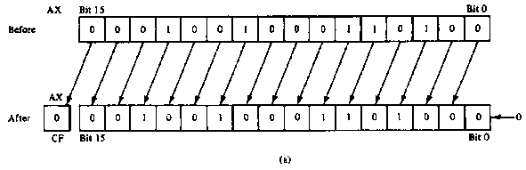
SAL/SHL example
SHL AX,1
Before execution
Dest = (AX) = 0x1234 = 0001 0010 0011 0100₂ ,
Count = 1, CF = X
Operation
The value in all bits of AX are shifted left one bit position
Emptied LSB is filled with 0
Value shifted out of MSB goes to carry flag
After execution
Dest = (AX) = 0x2468 = 0010 0100 0110 1000₂ , CF = 0
Notes
MSB isolated in CF; can be used by conditional instruction
Result has been multiplied by 2

Slide 12
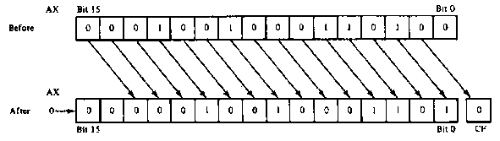
SHR example
SHR AX,CL
Before execution
Dest = (AX) = 0x1234 = 4660₁₀ = 0001 00100011 0100₂
Count = (CL) = 0x02 , CF = X
Operation
The value in all bits of AX are shifted right two bit positions
Emptied MSBs are filled with 0s
Values shifted out of LSBs go to carry flag
After execution
Dest = (AX) = 0x048D = 1165₁₀ = 0000 0100 1000 1101₂ ,CF = 0
Notes:
Bit 1 isolated in CF
Result has been divided by 4
4 X 1165 = 4660

Slide 13
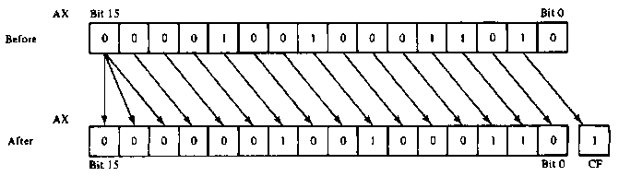
SAR example
SAR AX,CL
Before execution
Dest = (AX) = 0x091A = 0000100100011010₂ = +2330, Count = 0x02 , CF = X
Operation
The value in all bits of AX are shifted right two bit positions
Emptied MSB is filled with the value of the sign bit—sign maintained
Values shifted out of LSBs go to carry flag
After execution
Dest = (AX) = 0x0246 = 0000001001000110₂ = +582 , CF = 1
Conclusion
Bit 1 isolated in CF
Result has been sign extended
Result value has been divided by 4 and rounded to integer
4 X +582 = +2328

Slide 14
Shift example
Example: Given AL = 0x15, CL = 0x03, and CF = 0 show the state of AL and CF after each instruction in the sequence below:
SHL AL, 1
SHR AL, CL
SAL AL, 5
SAR AL, 2

Slide 15
Solution
Initially, AL = 0x15 = 00010101₂
SHL AL, 1
AL = (00010101 << 1) = 00101010₂ = 0x2A
CF = last bit shifted out = 0
SHR AL, CL
AL = (00101010 >> 3) = 00000101₂ = 0x05
CF = last bit shifted out = 0
SAL AL, 5
“Arithmetic” left shift same as SHL
AL = (00000101 << 5) = 10100000₂ = 0xA0
CF = last bit shifted out = 0
SAR AL, 2
Arithmetic right shift keeps sign intact—copy MSB to fill leftmost positions
AL = (10100000 >> 2) = 11101000₂ = 0xE8
CF = last bit shifted out = 0

Slide 16
Rotate instructions
Difference between rotates and shifts
Shifts discard bits that are shifted out
Rotates take bits that are shifted out and use them to fill vacated bits
Rotate instruction format: <op> D, <shamt>
Destination may be register/memory
<shamt>: shift amount
May be immediate or register CL
All rotate instructions store last bit shifted out in carry flag (CF)

Slide 17
ROR / ROL / RCR / RCL
ROR: rotate right
Shift (D) to right by <shamt> bits
<shamt> LS bits are moved to MS bits
ROL: rotate left
Shift (D) to left by <shamt> bits
<shamt> MS bits are moved to LS bits
RCR: rotate right through carry
Treat (CF) as extra LS bit
Shift (D,CF) to right by <shamt> bits
<shamt> LS bits (from (D,CF)) are moved to MS bits
RCL: rotate left through carry
Treat (CF) as extra MS bit
Shift (CF,D) to left by <shamt> bits
<shamt> MS bits (from (CF,D)) are moved to LS bits

Slide 18
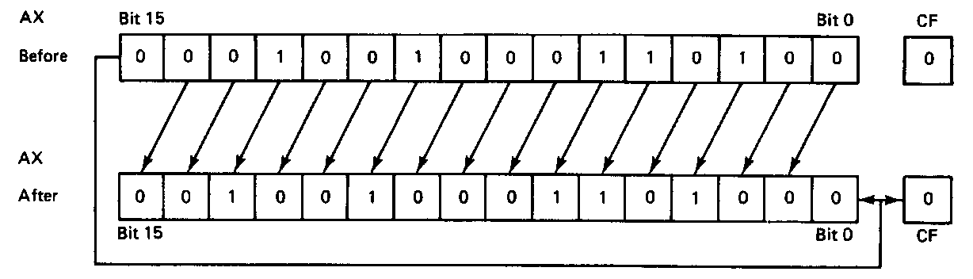
ROL example
ROL AX,1
Before execution
Dest = (AX) = 0x1234 = 0001 0010 0011 0100₂
Count = 1, CF = 0
Operation
The value in all bits of AX are rotated left one bit position
Value rotated out of the MSB is reloaded at LSB
Value rotated out of MSB copied to carry flag
After execution
Dest = (AX) = 0x2468 = 0010010001101000₂
CF = 0

Slide 19
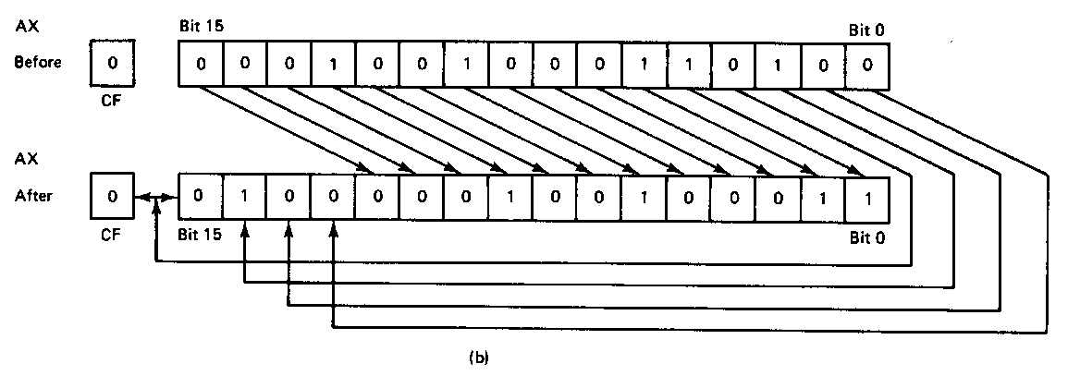
ROR example
ROR AX,CL
Before execution
Dest = (AX) = 0x1234 = 0001 0010 0011 0100₂
Count = 0x04, CF = 0
Operation
The value in all bits of AX are rotated right four bit positions
Values rotated out of the LSB are reloaded at MSB
Values rotated out of MSB copied to carry flag
After execution
Dest = (AX) = 0x4123 = 0100000100100011₂
CF = 0
Note position of hex characters in AX have been rearranged

Slide 20
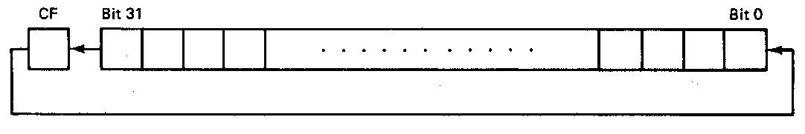
RCL example
RCL BX,CL
Before execution
Dest = (BX) = 0x1234 = 0001 0010 0011 0100₂
Count = 0x04, CF = 0
Operation
The value in all bits of AX are shifted left four bit positions
Emptied MSBs are rotated through the carry bit back into the LSB
Last value rotated out of MSB retained in carry flag
First rotate loads prior value of CF at the LSB
After execution
Dest = (BX) = 0x2340 = 0010 0011 0100 0000₂
CF = 1

Slide 21
Rotate example
Given AL = 0x43, CL = 0x04, and CF = 0, show the state of AL after each instruction in the sequence below:
ROR AL, 2
ROL AL, CL
RCR AL, 3
RCL AL, 4

Slide 22
Solution
Initially, AL = 0x43 = 01000011₂
ROR AL, 2
AL = 01000011 rotated right by 2
= 11010000 = 0xD0
CF = last bit rotated in = 1
ROL AL, CL
AL = 11010000 rotated left by 4
= 00001101 = 0x0D
CF = last bit rotated in = 1

Slide 23
Solution (cont.)
RCR AL, 3
(AL,CF) = 00001101 1 rotated right by 3
= 01100001 1
CF = 1, AL = 01100001₂ = 0x61
RCL AL, 4
(CF,AL) = 1 01100001 rotated left by 4
= 0 00011011
CF = 0, AL = 00011011₂ = 0x1B

Slide 24
Final notes
Next time:
Bit test and bit scan instructions
Exam 1 Preview
Reminders:
HW 2 due 1:00 PM today
Exam 1 on Thursday, 5/25
Will be allowed one double-sided 8.5” x 11” note sheet, calculator
No other electronic devices allowed
Instruction list provided (see website)

