Slide 1
EECE.4810/EECE.5730 Operating Systems
Instructor:
Dr. Michael Geiger
Spring 2018
Lecture 21:
File systems (continued)

Slide 2
Lecture outline
Announcements/reminders
Program 3 now due 4/30
Point value now 150 points, not 100
Extra credit problem set to be posted; due Thursday 5/3
Today’s lecture
Review:
File details
File operations
Open files
Directories
More on file systems
File system examples
Space allocation
Free space management

Slide 3
Review: File details
File: unit of logical storage
Abstract away low-level details of storage device
Contiguous logical address space
Structure of file defines types
At a minimum, OS supports executable file
Other types usually imposed by applications
Text, source, etc.
Extensions → more detailed file typing
File system tracks file attributes (name, ID, type, file pointer, etc.)

Slide 4
Review: File Operations
Operations provide programmer interface to file system
What operations should file system provide?
Create
Write – at write pointer location
Read – at read pointer location
Reposition within file - seek
Delete
Truncate – remove some data from file without deleting entire file
Open(F_{i}) – search the directory structure on disk for entry F_{i}, and move the content of entry to memory
Close (F_{i}) – move the content of entry Fi in memory to directory structure on disk

Slide 5
Review: Working with open files
Open-file table: tracks open files
Per-process info
File pointer: pointer to last read/write location
Access rights: operations allowed by this process
Centralized info
File-open count: number of processes accessing file
Table entry can be removed when count == 0
Disk location of the file: cache of data access information
Accesses supported as sequential or direct (relative to start of file)

Slide 6
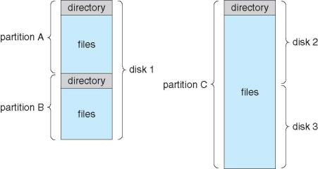
Review: Directory structure
Disk can be split into multiple partitions
Partitions can be raw (no file system) or formatted
Volume: formatted partition (e.g., C:\ on Windows)
Each volume needs its own directory
Effectively table of contents for volume
Tracks information about all files on volume
Imposes hierarchical structure in flat space

Slide 7
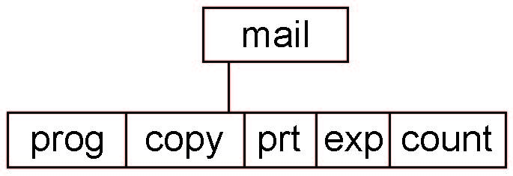
Review: Tree-Structured Directories
Absolute or relative path name
Absolute name is full path
Relative name—relative to current subdirectory or some other subdirectory
Creating a new file is done in current directory
Delete a file
rm <file-name>
Creating a new subdirectory is done in current directory
mkdir <dir-name>
Example: if in current directory /mail
mkdir count
Deleting “mail” ⇒ deleting the entire subtree rooted by “mail”

Slide 8
Named Data in a File System

Slide 9
Directories Are Files

Slide 10
Recursive Filename Lookup

Slide 11
Directory Layout
Directory stored as a file
Linear search to find filename (small directories)

Slide 12
Large Directories: B Trees

Slide 13
Large Directories: Layout

Slide 14
File system issues to be discussed
How does the file system allocate space for a new file?
How do different allocation schemes affect the way files are accessed?
How does the file system store information about each file (metadata)?
Includes time of last modification, access, etc.
What are the different types of file systems and how do they differ?

Slide 15
Design Challenges
Index structure
How do we locate the blocks of a file?
Index granularity
What block size do we use?
Free space
How do we find unused blocks on disk?
Locality
How do we preserve spatial locality?
Reliability
What if machine crashes in middle of a file system op?

Slide 16
Some File System Design Options
 | FAT | FFS | NTFS
Index structure | Linked list | Tree (fixed, asym) | Tree (dynamic)
granularity | block | block | extent
free space allocation | FAT array | Bitmap (fixed location) | Bitmap (file)
Locality | defrag | Block groups + reserve space | Extents Best fit defrag

Slide 17
Named Data in a File System

Slide 18
Microsoft File Allocation Table (FAT)
Linked list index structure
Simple, easy to implement
Still widely used (e.g., thumb drives)
File table:
Linear map of all blocks on disk
Each file a linked list of blocks

Slide 19
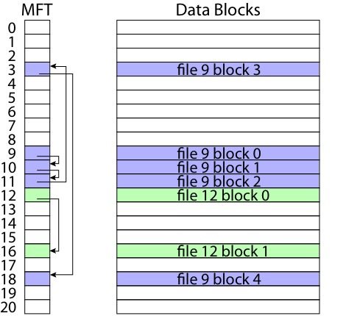
FAT

Slide 20
FAT
Pros:
Easy to find free block
Easy to append to a file
Easy to delete a file
Cons:
Small file access is slow
Random access is very slow
Fragmentation
File blocks for a given file may be scattered
Files in the same directory may be scattered
Problem becomes worse as disk fills

Slide 21
Berkeley UNIX FFS (Fast File System)
inode table
Analogous to FAT table
inode
Metadata
File owner, access permissions, access times, …
Set of 12 data pointers
With 4KB blocks => max size of 48KB files

Slide 22
FFS inode
Metadata
File owner, access permissions, access times, …
Set of 12 data pointers
With 4KB blocks => max size of 48KB files
Indirect block pointer
pointer to disk block of data pointers
Indirect block: 1K data blocks => 4MB (+48KB)

Slide 23
FFS inode
Metadata
File owner, access permissions, access times, …
Set of 12 data pointers
With 4KB blocks => max size of 48KB
Indirect block pointer
pointer to disk block of data pointers
4KB block size => 1K data blocks => 4MB
Doubly indirect block pointer
Doubly indirect block => 1K indirect blocks
4GB (+ 4MB + 48KB)

Slide 24
FFS inode
Metadata
File owner, access permissions, access times, …
Set of 12 data pointers
With 4KB blocks => max size of 48KB
Indirect block pointer
pointer to disk block of data pointers
4KB block size => 1K data blocks => 4MB
Doubly indirect block pointer
Doubly indirect block => 1K indirect blocks
4GB (+ 4MB + 48KB)
Triply indirect block pointer
Triply indirect block => 1K doubly indirect blocks
4TB (+ 4GB + 4MB + 48KB)

Slide 26
FFS Asymmetric Tree
Small files: shallow tree
Efficient storage for small files
Large files: deep tree
Efficient lookup for random access in large files
Sparse files: only fill pointers if needed

Slide 27
FFS Locality
Block group allocation
Block group is a set of nearby cylinders
Files in same directory located in same group
Subdirectories located in different block groups
inode table spread throughout disk
inodes, bitmap near file blocks
First fit allocation
Small files fragmented, large files contiguous

Slide 29
FFS First Fit Block Allocation

Slide 30
FFS First Fit Block Allocation

Slide 31
FFS First Fit Block Allocation

Slide 32
FFS
Pros
Efficient storage for both small and large files
Locality for both small and large files
Locality for metadata and data
Cons
Inefficient for tiny files (a 1 byte file requires both an inode and a data block)
Inefficient encoding when file is mostly contiguous on disk (no equivalent to superpages)
Need to reserve 10-20% of free space to prevent fragmentation

Slide 33
NTFS
Master File Table
Flexible 1KB storage for metadata and data
Extents
Block pointers cover runs of blocks
Similar approach in linux (ext4)
File create can provide hint as to size of file
Journalling for reliability
Will cover later this week/early next week

Slide 34
NTFS Small File

Slide 35
NTFS Medium-Sized File

Slide 36
NTFS Indirect Block

Slide 38
Free-Space Management
File system maintains free-space list to track available blocks/clusters
(Using term “block” for simplicity)
Bit vector or bit map (n blocks)
0
1
2
n-1
…
1 ⇒ block[i] free
0 ⇒ block[i] occupied
bit[i] =

Block number calculation
(number of bits per word) *
(number of 0-value words) +
offset of first 1 bit
CPUs have instructions to return offset within word of first “1” bit

Slide 39
Free-Space Management (Cont.)
Bit map requires extra space
Example:
block size = 4KB = 2¹² bytes
disk size = 2⁴⁰ bytes (1 terabyte)
n = 2⁴⁰/2¹² = 2²⁸ bits (or 32MB)
if clusters of 4 blocks -> 8MB of memory
Easy to get contiguous files

Slide 40
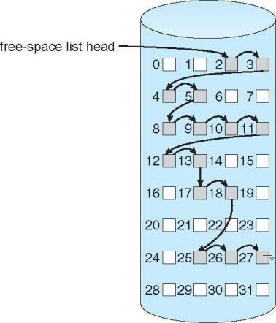
Linked Free Space List on Disk
Linked list (free list)
Cannot get contiguous space easily
No waste of space
No need to traverse the entire list (if # free blocks recorded)

Slide 41
Free-Space Management (Cont.)
Grouping
Modify linked list to store address of next n-1 free blocks in first free block, plus a pointer to next block that contains free-block-pointers (like this one)
Counting
Because space is frequently contiguously used and freed, with contiguous-allocation allocation, extents, or clustering
Keep address of first free block and count of following free blocks
Free space list then has entries containing addresses and counts

Slide 42
Final notes
Next time
Finish file system discussion
Reminders:
Program 3 now due 4/30
Point value now 150 points, not 100
Extra credit problem set to be posted; due Thursday 5/3

Slide 43
Acknowledgements
These slides are adapted from the following sources:
Silberschatz, Galvin, & Gagne, Operating Systems Concepts, 9th edition
Anderson & Dahlin, Operating Systems: Principles and Practice, 2nd edition
Chen & Madhyastha, EECS 482 lecture notes, University of Michigan, Fall 2016

