Slide 1
16.216
ECE Application Programming
Instructor: Dr. Michael Geiger
Fall 2012
Lecture 31:
Dynamic memory allocation

Slide 2
Lecture outline
Announcements/reminders
  Program 9 due 12/5
  Program 10 to be posted, due 12/10
  Will drop lowest grade
Today’s class: Dynamic memory allocation
  Allocation functions
    malloc()
    calloc()
    realloc()
  Type casting
  Deallocating memory using free()
  Dynamic memory allocation and arrays
ECE Application Programming: Lecture 31

Slide 3
Justifying dynamic memory allocation
Data structures (i.e., arrays) usually fixed size
  Array length set at compile time
  Can often lead to wasted space
May want ability to:
  Choose amount of space needed at run time
    Allows program to determine amount
  Modify size as program runs
    Data structures can grow or shrink as needed
Dynamic memory allocation allows above characteristics
ECE Application Programming: Lecture 31

Slide 4
Allocation functions (in <stdlib.h>)
All return pointer to allocated data of type void * (no base type—just an address)
  Must cast to appropriate type
Arguments of type size_t: unsigned integer
Basic block allocation:
void *malloc(size_t size);
Allocate block and clear it:
void *calloc(size_t nmemb,
size_t size);
Resize previously allocated block:
void *realloc(void *ptr,
size_t size);
ECE Application Programming: Lecture 31

Slide 5
Basic allocation with malloc()
void *malloc(size_t size);
Allocates size bytes; returns pointer
  Returns NULL if unsuccessful
Example:
int *p;
p = malloc(10000);
if (p == NULL) {
/* Allocation failed */
}
ECE Application Programming: Lecture 31

Slide 6
Type casting
All allocation functions return void *
Automatically type cast to appropriate type
Can explicitly perform type cast:
int *p;
p = (int *)malloc(10000);
Some IDEs (including Visual Studio) strictly require type cast
ECE Application Programming: Lecture 31

Slide 7
Allocating/clearing memory: calloc()
void *calloc(size_t nmemb,
size_t size);
Allocates (nmemb * size) bytes
Sets all bits in range to 0
Returns pointer (NULL if unsuccessful)
Example: integer array with n values
int *p;
p = (int *)calloc(n, sizeof(int));
ECE Application Programming: Lecture 31

Slide 8
Resizing allocated space: realloc()
void *realloc(void *ptr,
size_t size);
ptr must point to previously allocated space
Will allocate size bytes and return pointer
  size = new block size
Rules:
  If block expanded, new bytes aren’t initialized
  If block can’t be expanded, returns NULL; original block unchanged
  If ptr == NULL, behaves like malloc()
  If size == 0, will free (deallocate) space
Example: expanding array from previous slide
p = (int *)realloc(p,
(n+1)*sizeof(int));
ECE Application Programming: Lecture 31

Slide 9
Deallocating memory: free()
All dynamically allocated memory should be deallocated when you are done using it
  Returns memory to list of free storage
  Once freed, program should not use location
Deallocation function:
void free(void *ptr);
Example:
int *p;
p = (int *)malloc(10000);
...
free(p);
ECE Application Programming: Lecture 31

Slide 10
Pitfalls: memory leaks
Changing pointers leaves inaccessible blocks
Example:
p = malloc(1000);
q = malloc(1000);
p = q;
Block originally accessed by p is “garbage”
  Won’t be deallocated—wasted space
Solution: free memory before changing pointer
p = malloc(1000);
q = malloc(1000);
free(p);
p = q;
ECE Application Programming: Lecture 31

Slide 11
Pitfalls: dangling pointers
free() doesn’t change pointer
  Only returns space to free list
Pointer is left “dangling”
  Holds address that shouldn’t be accessed
Solution: assign new value to pointer
  Could reassign immediately (as in previous slide)
  Otherwise, set to NULL
  free(p);
  p = NULL;
ECE Application Programming: Lecture 31

Slide 12
Application: arrays
One common use of dynamic allocation: arrays
Can determine array size, then create space
  Use sizeof() to get # bytes per element
Array notation can be used with pointers
int i, n;
int *arr;
printf("Enter n: ");
scanf("%d", &n);
arr = (int *)malloc(n * sizeof(int));
for (i = 0; i < n; i++)
arr[i] = i;
ECE Application Programming: Lecture 31

Slide 13
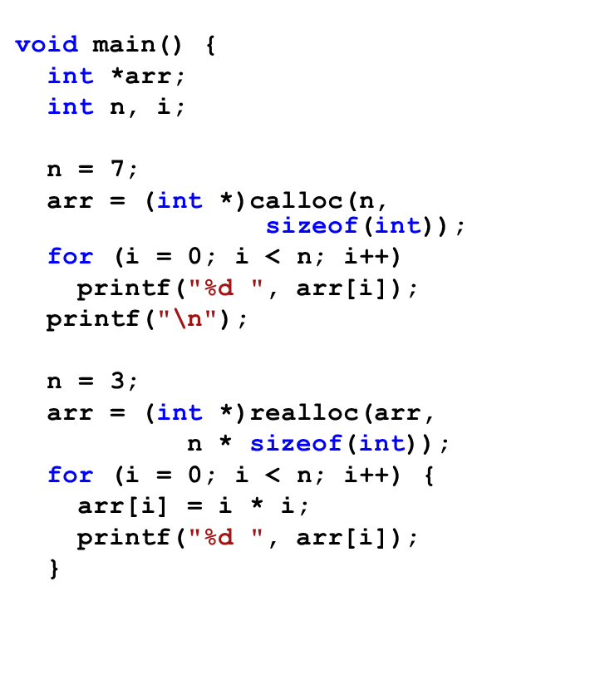
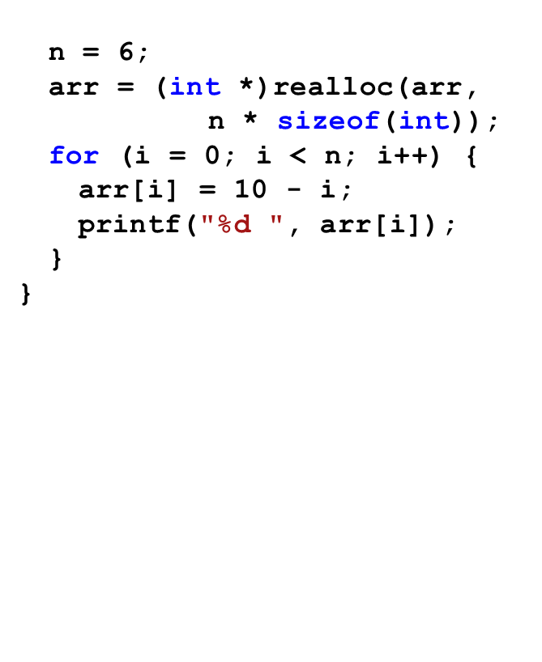
Example: what does program print?
ECE Application Programming: Lecture 31

Slide 14
Next time
More applications of dynamic memory allocation
  Strings (and arrays of strings)
  Multi-dimensional arrays
  Data structures
Reminders:
  Program 9 due 12/5
  Program 10 to be posted, due 12/10
ECE Application Programming: Lecture 31

