Slide 1
16.216
ECE Application Programming
Instructor: Dr. Michael Geiger
Fall 2014
Lecture 34:
Dynamically allocated data structures

Slide 2
Lecture outline
Announcements/reminders
  Program 10 due 12/10 (last day of classes)
  Grading notes
    P5 grading done; just needs review
    Late penalties halved (starting with P4)
      Divide actual late days by 2
      No deduction for 1 day late, -1 for 2-3 days late, etc.
    Max penalty still -32
    Will drop lowest of 10 program grades
Today’s class
  Dynamically allocated data structures
ECE Application Programming: Lecture 33

Slide 3
Dynamic allocation and structures
Can use sizeof() to get # bytes in structure
Examples (using StudentInfo struct):
StudentInfo *p;
p = (StudentInfo *)malloc(sizeof(StudentInfo));
StudentInfo *arr;
int n;
printf("Enter array size: ");
scanf("%d", &n);
arr = (StudentInfo *)malloc(n * sizeof(StudentInfo));
ECE Application Programming: Lecture 33

Slide 4
Data structures
Data structure: way of storing and organizing data
  Arrays are one relatively inefficient example
Other structures designed to optimize:
  Organizing / sorting data
  Adding new data
  Removing unwanted data
  Searching for data
ECE Application Programming: Lecture 33

Slide 5
Pointer-based data structures
Many structures extensively use pointers
Each element within structure contains data + pointer(s) to one or more other elements
Usually functions for common operations
  Add new element
    Dynamically allocate new element
    Modify appropriate pointer(s) in other element(s) to point to new element
    Set pointer(s) in new element to point to other(s)
  Delete element
    Modify pointer(s) in other element(s) so they don’t point to element being removed
    Deallocate removed element
  Find element
    Follow pointers to move from one element to next
ECE Application Programming: Lecture 33

Slide 6

Linked list
Simple pointer-based structure: linked list
Each element (node) contains data + pointer to next element in list
Last element points to NULL
Program using list needs pointer to first node
Image source: http://en.wikipedia.org/wiki/Linked_list
ECE Application Programming: Lecture 33

Slide 7
Linked list definition
Structure to hold list of integers
typedef struct node {
int value; // Data
struct node *next; // Pointer to
// next node
} LLnode;
Note definition style has changed slightly
  Type “name” both before and after { }
  Name before (struct node) is necessary to use type inside structure definition
  Name after (LLnode) can be used in rest of program
ECE Application Programming: Lecture 33

Slide 8
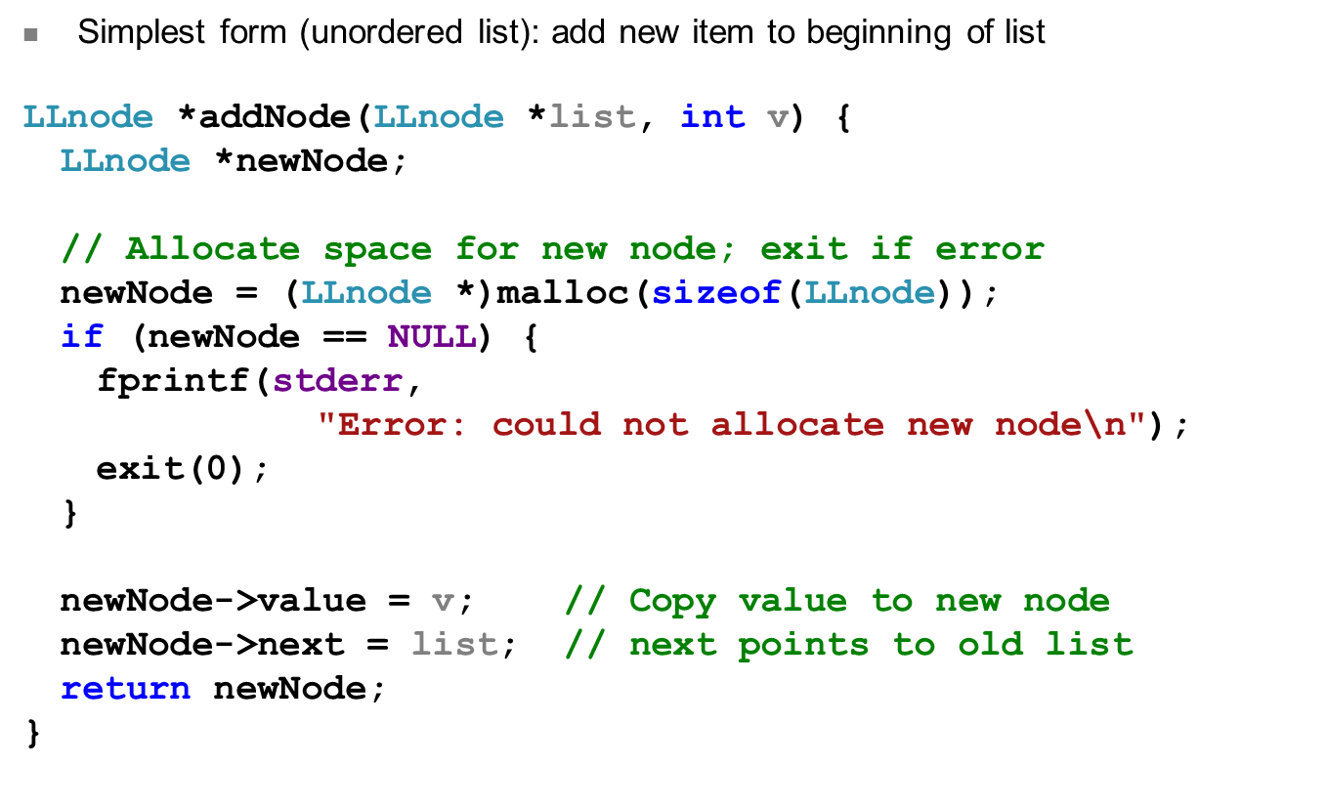
Adding to list
ECE Application Programming: Lecture 33

Slide 9
Next time
Continue discussing dynamically allocated data structures
Reminders:
  Program 10 due 12/10 (last day of classes)
  Grading notes
    P5 grading done; just needs review
    Late penalties halved (starting with P4)
      Divide actual late days by 2
      No deduction for 1 day late, -1 for 2-3 days late, etc.
    Max penalty still -32
    Will drop lowest of 10 program grades
ECE Application Programming: Lecture 33

