Slide 1
16.216
ECE Application Programming
Instructor: Dr. Michael Geiger
Spring 2012
Lecture 25: PE4 (cont.)

Slide 2
Lecture outline
Announcements/reminders
  All outstanding grading to be completed ASAP
  Program 6 coming next week
  Exam 2: next Wednesday
    Once again allowed one 8.5” x 11” note sheet
    Practice problems, old exams online
Today
  Finish PE4
ECE Application Programming: Lecture 25

Slide 3
PE4: Change problem
Given any amount of change under $2.00, determine and print out the minimum number of coins required to make that amount of change.
  Available coins are Halves (half dollars), Quarters, Dimes, Nickels, and Pennies.
ECE Application Programming: Lecture 25

Slide 4
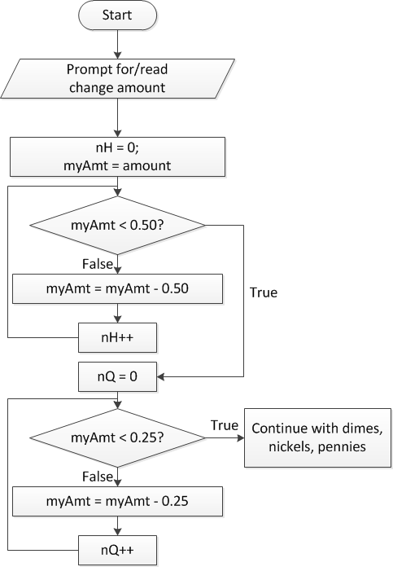
Flowchart, version 1
Loop that repeatedly subtracts coin amount, increment # of that type of coin
Loop ends when remaining change < value of coin
ECE Application Programming: Lecture 25

Slide 5
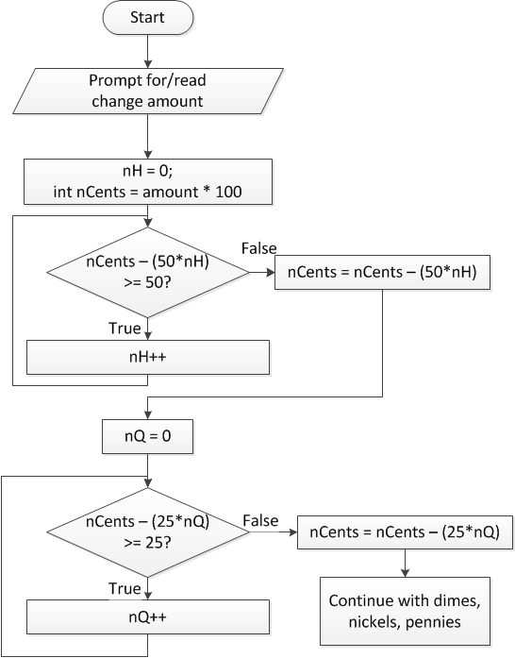
Flowchart, version 2
Treat change amount as integer (nCents)
Most work actually done in loop structure here
  for (nH = 0;
  nCents – (50*nH) >= 50;
  nH++) ;
  Loop body is empty
Must be sure to update amount of remaining change after loop
ECE Application Programming: Lecture 25

Slide 6
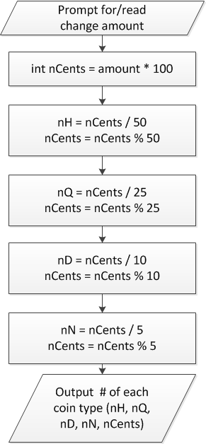
Flowchart, version 3
Don’t really need loop if change amount converted to integer
nCents = # pennies after previous four coin types have been taken out
ECE Application Programming: Lecture 25

Slide 7
When to use functions
Find a particular step or series of steps being repeated in your code
  If code is exactly the same, you need no arguments
  If one or more values change, but actual calculations are the same, values can be function arguments
  If function modifies:
    1 variable: just return it
    2+ variables: use pointer argument(s)
Reassess change example
  Steps for creating change are extremely similar
  What changes each time?
  How should we use those values in a function?
    Inputs, outputs, variables … ?
ECE Application Programming: Lecture 25

Slide 8
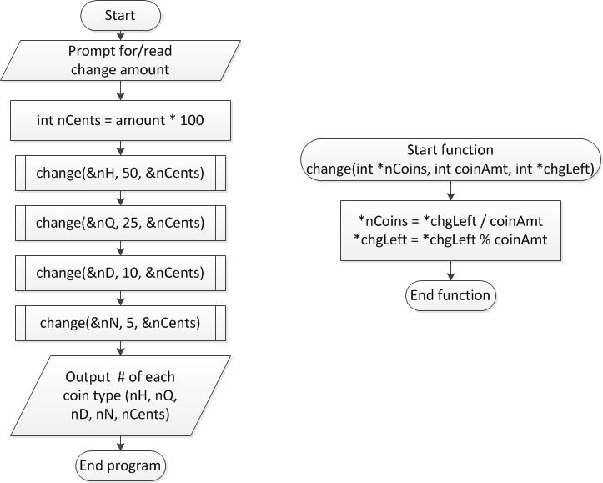
Overall flowchart
ECE Application Programming: Lecture 25

Slide 9
Next time
Exam 2 Review
  Will post slides shortly
  Please come prepared with questions for Monday!
ECE Application Programming: Lecture 25

