Slide 1
16.216
ECE Application Programming
Instructor: Dr. Michael Geiger
Spring 2013
Lecture 34:
PE6: Dynamic memory allocation in data structures

Slide 2
Lecture outline
Announcements/reminders
  Program 11 due 5/1
  Will drop lowest grade
  Looking ahead: Final exam Thursday, 5/9 8-11 AM
    Covers last third of course
    Preview lecture 5/1
    Q&A session Wednesday, 5/8?
  Course evals: to be posted online; bring completed eval to final
Today’s class: Dynamic memory allocation and data structures
  Dynamic memory allocation and structures
  Pointer-based structures
  Linked lists
    Adding data
    Finding data
    Deleting data
  Sorted linked lists (time permitting)
ECE Application Programming: Lecture 34

Slide 3
Dynamic allocation and structures
Can use sizeof() to get # bytes in structure
Examples (using StudentInfo struct):
StudentInfo *p;
p = (StudentInfo *)malloc(sizeof(StudentInfo));
StudentInfo *arr;
int n;
printf("Enter array size: ");
scanf("%d", &n);
arr = (StudentInfo *)malloc(n * sizeof(StudentInfo));
ECE Application Programming: Lecture 34

Slide 4
Data structures
Data structure: way of storing and organizing data
  Arrays are one relatively inefficient example
Other structures designed to optimize:
  Organizing / sorting data
  Adding new data
  Removing unwanted data
  Searching for data
ECE Application Programming: Lecture 34

Slide 5
Pointer-based data structures
Many structures extensively use pointers
Each element within structure contains data + pointer(s) to one or more other elements
Usually functions for common operations
  Add new element
    Dynamically allocate new element
    Modify appropriate pointer(s) in other element(s) to point to new element
    Set pointer(s) in new element to point to other(s)
  Delete element
    Modify pointer(s) in other element(s) so they don’t point to element being removed
    Deallocate removed element
  Find element
    Follow pointers to move from one element to next
ECE Application Programming: Lecture 34

Slide 6

Linked list
Simple pointer-based structure: linked list
Each element (node) contains data + pointer to next element in list
Last element points to NULL
Program using list needs pointer to first node
Image source: http://en.wikipedia.org/wiki/Linked_list
ECE Application Programming: Lecture 34

Slide 7
Linked list definition
Structure to hold list of integers
typedef struct node {
int value; // Data
struct node *next; // Pointer to
// next node
} LLnode;
Note definition style has changed slightly
  Type “name” both before and after { }
  Name before (struct node) is necessary to use type inside structure definition
  Name after (LLnode) can be used in rest of program
ECE Application Programming: Lecture 34

Slide 8
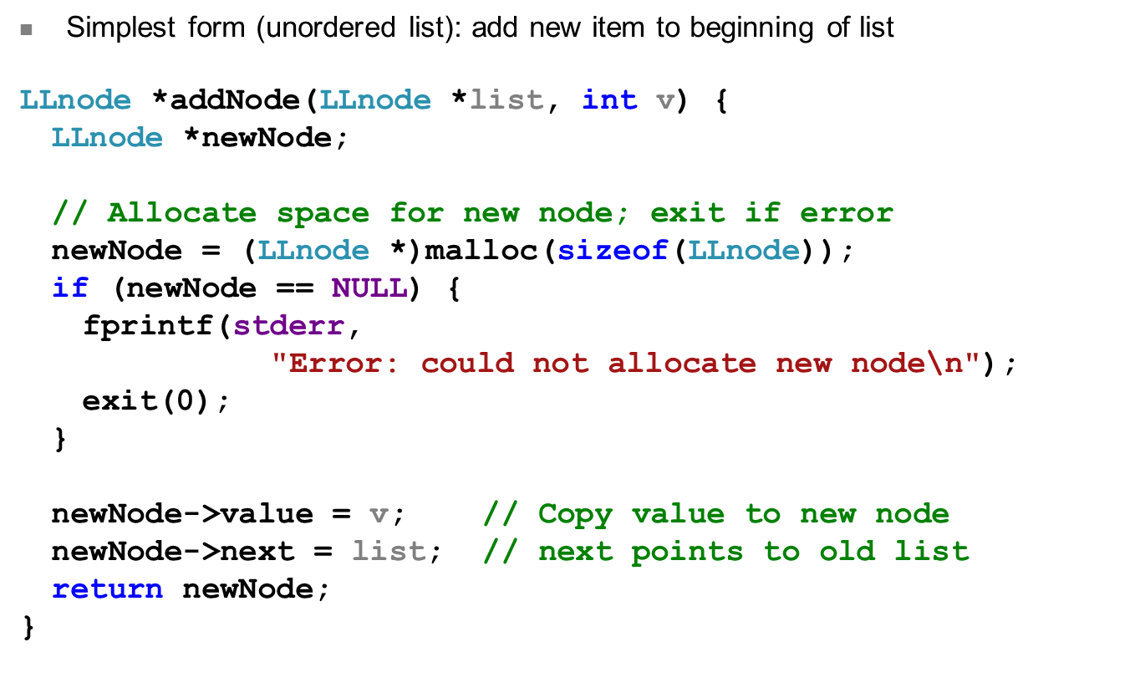
Adding to list
ECE Application Programming: Lecture 34

Slide 9
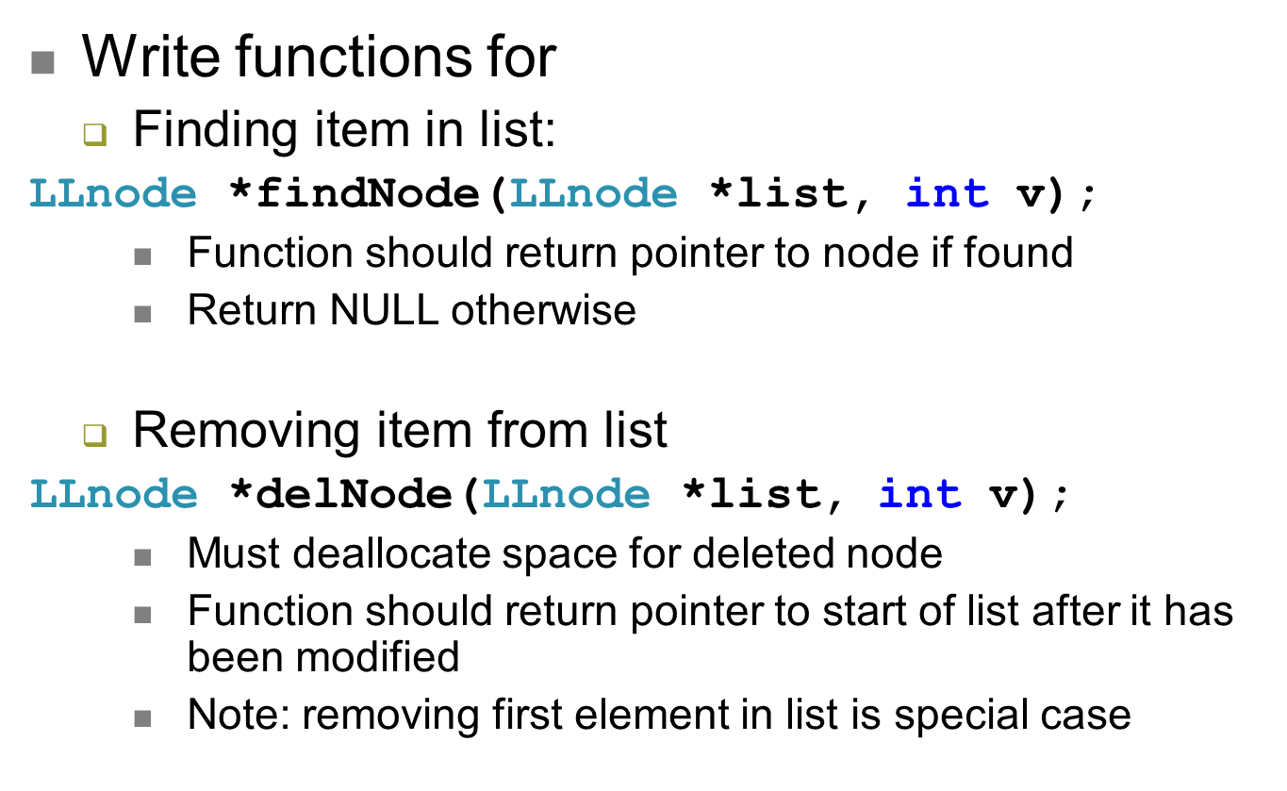
Examples
ECE Application Programming: Lecture 34

Slide 10
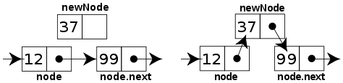
Sorted linked list
Can ensure each item is sorted as it’s added
  Slower item insertion, but faster search
Not easy with arrays: must move existing data
Keeping linked list sorted
  Find appropriate location
    Often done by going “past” appropriate spot
  Modify pointers
    Node before correct spot points to new node
    New node points to node after correct spot
    Image source: http://en.wikipedia.org/wiki/Linked_list
ECE Application Programming: Lecture 34

Slide 11
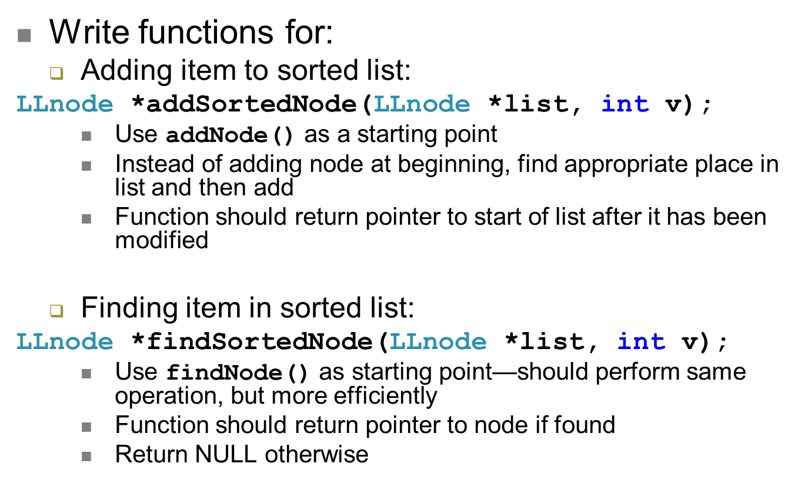
Examples
ECE Application Programming: Lecture 34

Slide 12
Next time
Exam 3 Preview
  Will likely discuss Q&A session scheduling for week of exam (some time Wednesday, 5/8?)
Course evaluations
  Will be posted on website
  Print and bring to final (or I’ll have hard copies there)
  Must turn in your evaluation to get the exam
Reminders:
  Program 11 due 5/1
ECE Application Programming: Lecture 34

