Slide 1
16.216
ECE Application Programming
Instructor: Dr. Michael Geiger
Spring 2014
Lecture 14:
Functions

Slide 2
Lecture outline
Announcements/reminders
  Program 4 due 2/28
  Exam regrades due 2/28
Review
  For loops
Today’s lecture
  Finish PE2
  Functions
  Early course evaluations
ECE Application Programming: Lecture 13

Slide 3
Review: for loops
for (<init var>; <test>; <change var>)
<statements>
Operators to directly change variable
  x++, x-- → post-increment/decrement
  ++x, --x → pre-increment/decrement
  +=, -=, *=, /= → augmented assignment
ECE Application Programming: Lecture 10

Slide 4
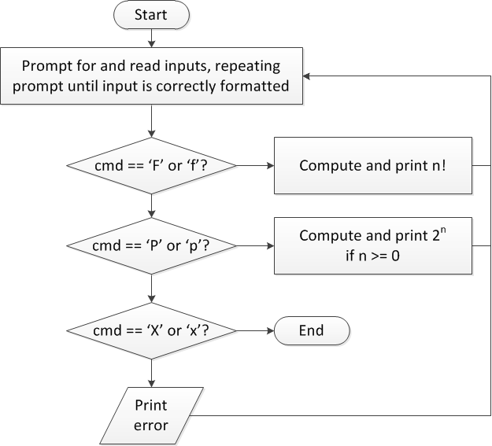
Finishing PE2: Overall flowchart
ECE Application Programming: Lecture 13

Slide 5
PE2 skeleton code
while (1) { // Loop repeats until user enters 'X' or 'x'
/* Code to read cmd, n */
/* Evaluate cmd and perform appropriate operation */
switch (cmd) {
case 'F':
case 'f':
/* Calculate n! */
break;
case 'P':
case 'p':
/* Calculate 2^n, if n >= 0; print error otherwise */
break;
case 'X':
case 'x':
return; // Exit program
default:
printf("Invalid command %c entered\n", cmd);
}
}
ECE Application Programming: Lecture 13

Slide 6
Next step
Write flowcharts for
  Computing n!
  Computing 2^{n} if n >= 0
Complete code
ECE Application Programming: Lecture 13

Slide 7
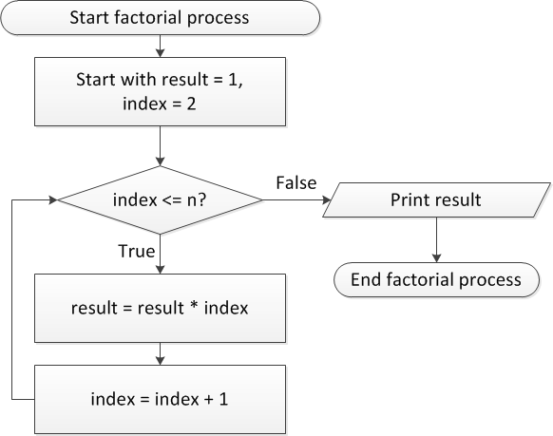
Flow charts: Calculating n!
ECE Application Programming: Lecture 13

Slide 8
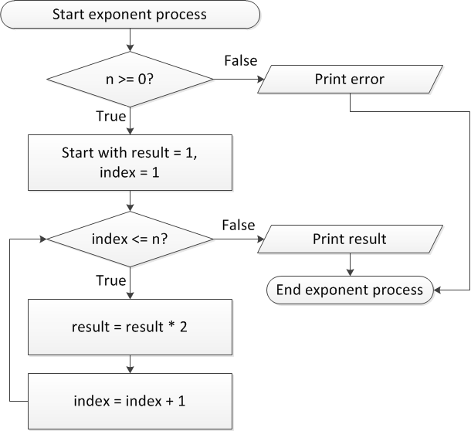
Flow charts: Calculating 2^{n}
ECE Application Programming: Lecture 13

Slide 9
Discussion: Factorial/2^{n}
Loop for each process covers fixed range of values
  Use for loop
Can declare single variable to hold both results, since only one will be calculated
ECE Application Programming: Lecture 13

Slide 10
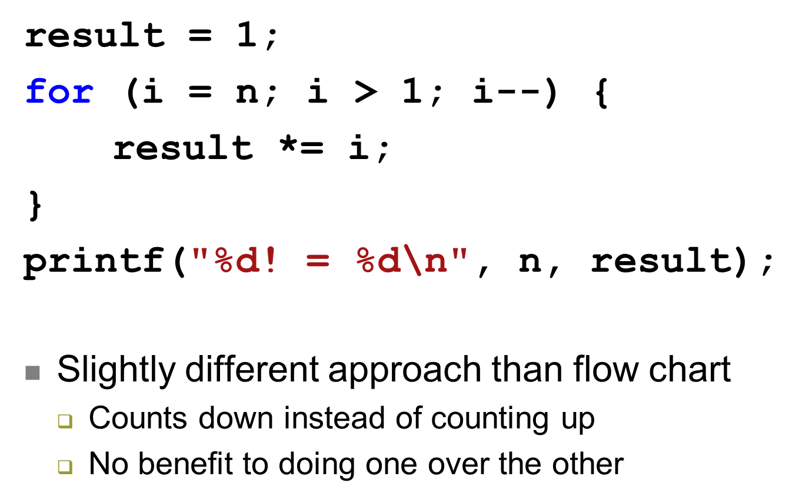
Code: factorial
ECE Application Programming: Lecture 13

Slide 11
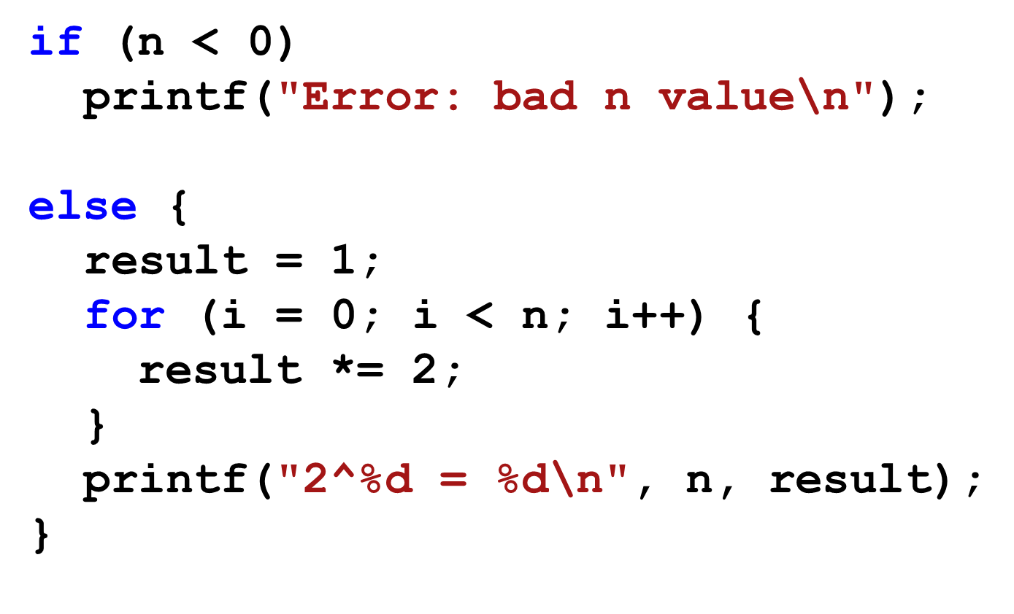
Code: 2^{n}
ECE Application Programming: Lecture 13

Slide 12
Functions
Functions used to break problem down into small, "bite-sized" pieces.
  Make code more manageable and readable
  Identify reusable pieces
Functions have an optional type of return value, a name, and optional arguments
Functions return at most, ONE value
Functions must be either "prototyped" or declared prior to use. Good programming practices requires all functions to be prototyped.
ECE Application Programming: Lecture 14
Notes:
ECE 160 - Introduction to Computer Engineering I
02/09/2005
(c) 2005, P. H. Viall

Slide 13
Functions
name of function
type of value returned
parameters of function (variables in)
double hyp(double a, double b)
{
double sum, result;
sum = a*a + b*b;
result = sqrt(sum);
return result;
}
Alternate way of writing above function
double hyp(double a, double b)
{
return sqrt(a*a + b*b);
}
Single value returned by function
ECE Application Programming: Lecture 14

Slide 14
Functions - complete program
#include <stdio.h>
#include <math.h>
double hyp(double a, double b);
void main()
{
double x,y,h;
printf("Enter two legs of triangle: ");
scanf("%lf %lf",&x,&y);
h=hyp(x,y);
printf("Trgle w legs %lf and %lf has hyp of %lf\n",x,y,h);
}
double hyp(double a, double b)
{
double sum, result;
sum = a*a + b*b;
result = sqrt(sum);
return result;
}
prototype (note semi-colon )
actual function definition
(NO semi-colon )
ECE Application Programming: Lecture 14

Slide 15
Functions - scope
#include <stdio.h>
#include <math.h>
double hyp(double a, double b);
void main()
{
double x,y,h;
printf("Enter two legs of triangle: ");
scanf("%lf %lf",&x,&y);
h=hyp(x,y);
printf("Trgle w legs %lf and %lf has hyp of %lf\n",x,y,h);
}
double hyp(double a, double b)
{
double sum, result;
sum = a*a + b*b;
result = sqrt(sum);
return result;
}
x
?
y
?
h
?
a
?
b
?
sum
?
result
?
ECE Application Programming: Lecture 14

Slide 16
Functions - scope
#include <stdio.h>
#include <math.h>
double hyp(double a, double b);
void main()
{
double x,y,h;
printf("Enter two legs of triangle: ");
scanf("%lf %lf",&x,&y);
h=hyp(x,y);
printf("Trgle w legs %lf and %lf has hyp of %lf\n",x,y,h);
}
double hyp(double a, double b)
{
double sum, result;
sum = a*a + b*b;
result = sqrt(sum);
return result;
}
x
3.0
y
4.0
h
?
a
?
b
?
sum
?
result
?
ECE Application Programming: Lecture 14

Slide 17
Functions - scope
#include <stdio.h>
#include <math.h>
double hyp(double a, double b);
void main()
{
double x,y,h;
printf("Enter two legs of triangle: ");
scanf("%lf %lf",&x,&y);
h=hyp(x,y);
printf("Trgle w legs %lf and %lf has hyp of %lf\n",x,y,h);
}
double hyp(double a, double b)
{
double sum, result;
sum = a*a + b*b;
result = sqrt(sum);
return result;
}
x
3.0
y
4.0
h
?
a
3.0
b
4.0
sum
?
result
?
ECE Application Programming: Lecture 14

Slide 18
Functions - scope
#include <stdio.h>
#include <math.h>
double hyp(double a, double b);
void main()
{
double x,y,h;
printf("Enter two legs of triangle: ");
scanf("%lf %lf",&x,&y);
h=hyp(x,y);
printf("Trgle w legs %lf and %lf has hyp of %lf\n",x,y,h);
}
double hyp(double a, double b)
{
double sum, result;
sum = a*a + b*b;
result = sqrt(sum);
return result;
}
x
3.0
y
4.0
h
?
a
3.0
b
4.0
sum
25.0
result
?
ECE Application Programming: Lecture 14

Slide 19
Functions - scope
#include <stdio.h>
#include <math.h>
double hyp(double a, double b);
void main()
{
double x,y,h;
printf("Enter two legs of triangle: ");
scanf("%lf %lf",&x,&y);
h=hyp(x,y);
printf("Trgle w legs %lf and %lf has hyp of %lf\n",x,y,h);
}
double hyp(double a, double b)
{
double sum, result;
sum = a*a + b*b;
result = sqrt(sum);
return result;
}
x
3.0
y
4.0
h
?
a
3.0
b
4.0
sum
25.0
result
5.0
ECE Application Programming: Lecture 14

Slide 20
Functions - scope
#include <stdio.h>
#include <math.h>
double hyp(double a, double b);
void main()
{
double x,y,h;
printf("Enter two legs of triangle: ");
scanf("%lf %lf",&x,&y);
h=hyp(x,y);
printf("Trgle w legs %lf and %lf has hyp of %lf\n",x,y,h);
}
double hyp(double a, double b)
{
double sum, result;
sum = a*a + b*b;
result = sqrt(sum);
return result;
}
x
3.0
y
4.0
h
?
a
3.0
b
4.0
sum
25.0
result
5.0
ECE Application Programming: Lecture 14

Slide 21
Functions - scope
#include <stdio.h>
#include <math.h>
double hyp(double a, double b);
void main()
{
double x,y,h;
printf("Enter two legs of triangle: ");
scanf("%lf %lf",&x,&y);
h=hyp(x,y);
printf("Trgle w legs %lf and %lf has hyp of %lf\n",x,y,h);
}
double hyp(double a, double b)
{
double sum, result;
sum = a*a + b*b;
result = sqrt(sum);
return result;
}
x
3.0
y
4.0
h
5.0
NOTE - a and b are NOT copied back to x and y
ECE Application Programming: Lecture 14

Slide 22
Exercise - What prints (if 5, 12 entered)
#include <stdio.h>
#include <math.h>
double hyp(double a, double b);
void main()
{
double x,y,h;
printf("Enter two legs of triangle: ");
scanf("%lf %lf",&x,&y);
h=hyp(x,y);
printf("Trgle w legs %lf and %lf has hyp of %lf\n",x,y,h);
}
double hyp(double a, double b)
{
double sum, result;
a = 3;
b = 4;
sum = a*a + b*b;
result = sqrt(sum);
return result;
}
x
y
h
a
b
sum
result
ECE Application Programming: Lecture 14

Slide 23
Answer
Trgle w legs 5.000000 and 12.000000 has hyp of 5.00000
ECE Application Programming: Lecture 14

Slide 24
Final notes
Next time
  Continue with functions
Reminders:
  Program 4 due 2/28
  Exam regrades due 2/28
ECE Application Programming: Lecture 13

