Slide 1
16.216
ECE Application Programming
Instructor: Dr. Michael Geiger
Summer 2012
Lecture 7
Pointers
PE4: Writing functions
Exam 2 Preview

Slide 2
Lecture outline
Announcements/reminders
  Program 5 now due Friday, 8/3
  Program 6 now due Tuesday, 8/7
  Will catch up on program grading ASAP
  Exam 2 Thursday, 8/2
Today’s lecture:
  Review: functions
  Pointers
  PE4: Functions
  Exam 2 Preview
ECE Application Programming: Lecture 7

Slide 3
Review: functions
Used to break programs into smaller pieces
  Useful when code sequences repeated
Functions have:
  An optional return value
    Return type is always required
    If function returns nothing, return type is void
  A name
  Optional arguments
Must be prototyped or written completely prior to use
ECE Application Programming: Lecture 7

Slide 4
Justifying pass by address
May want the ability to “return” multiple values from function
  Functions can only return at most one value
Functions can take multiple arguments ...
  ... but, as we’ve discussed so far, passing by value just copies arguments
  No way to change arguments and have change reflected outside of function
Solution uses pointers
ECE Application Programming: Lecture 7

Slide 5
Pointers
Pointer: address of a variable
  Can get address of existing object using &
  Can get value of existing pointer using *
  Pointer declaration:
  <base type>* <pointer name>
    Base type determines how reference is interpreted
    Be careful when declaring multiple pointers
    Be sure to initialize pointer before use
ECE Application Programming: Lecture 7

Slide 6
Pointer example
int *iPtr, i=6;
double *dPtr, d=1.25;
iPtr
dPtr
i
d
6
1.25
ECE Application Programming: Lecture 7

Slide 7
Pointer assignment
The assignment operator (=) is defined for pointers of the same base type.
The right operand of the assignment operator can be any expression that evaluates to the same type as the left operand.
Example:
  int x, *xp, *ip;
  xp = &x;
  ip = xp;
x
xp
ip
ECE Application Programming: Lecture 7

Slide 8
Pointer arguments
Passing pointer gives ability to modify data at that address
  In prototype/definition—argument has pointer type
    For example: int f(int *addr_x);
  When calling function, can pass explicit pointer or use address operator (&<var>)
    Examples:
      int x = 3;
      int y = 2;
      int *xPtr = &x;
      int result1, result2;
      result1 = f(xPtr);
      result2 = f(&y);
ECE Application Programming: Lecture 7

Slide 9
Functions - pass by address
#include <stdio.h>
#include <math.h>
void get_r_theta(double a, double b,
double *adr_r, double *adr_th);
void main()
{
double x,y,r,th;
printf("Enter x, y components of vector: ");
scanf("%lf %lf",&x,&y);
get_r_theta(x,y,&r,&th);
printf("Vector with x=%lf and y=%lf
has r=%lf, theta=%lf\n",x,y,r,th);
}
void get_r_theta(double a, double b,
double *adr_r, double *adr_th) {
double sum;
sum = pow(a,2)+pow(b,2); //or a*a+b*b;
*adr_r = sqrt(sum);
*adr_th = atan2(y,x);
}
x
4600
y
4608
r
4610
th
4618
ECE Application Programming: Lecture 7

Slide 10
Functions - pass by address
#include <stdio.h>
#include <math.h>
void get_r_theta(double a, double b,
double *adr_r, double *adr_th);
void main()
{
double x,y,h;
printf("Enter x, y components of vector: ");
scanf("%lf %lf",&x,&y); // user enters 3,4
get_r_theta(x,y,&r,&th);
printf("Vector with x=%lf and y=%lf
has r=%lf, theta=%lf\n",x,y,r,th);
}
void get_r_theta(double a, double b,
double *adr_r, double *adr_th) {
double sum;
sum = pow(a,2)+pow(b,2); //or a*a+b*b;
*adr_r = sqrt(sum);
*adr_th = atan2(y,x);
}
x
3.0
4600
y
4.0
4608
r
?
4610
th
?
4618
ECE Application Programming: Lecture 7

Slide 11
Functions - pass by address
#include <stdio.h>
#include <math.h>
void get_r_theta(double a, double b,
double *adr_r, double *adr_th);
void main()
{
double x,y,h;
printf("Enter x, y components of vector: ");
scanf("%lf %lf",&x,&y); // user enters 3,4
get_r_theta(x,y,&r,&th);
printf("Vector with x=%lf and y=%lf
has r=%lf, theta=%lf\n",x,y,r,th);
}
void get_r_theta(double a, double b,
double *adr_r, double *adr_th) {
double sum;
sum = pow(a,2)+pow(b,2); //or a*a+b*b;
*adr_r = sqrt(sum);
*adr_th = atan2(b,a);
}
x
3.0
4600
y
4.0
4608
r
4610
th
4618
a
3.0
7380
b
4.0
7385
adr_r
4610
7388
adr_th
4618
738c
sum
7380
ECE Application Programming: Lecture 7

Slide 12
Functions - pass by address
#include <stdio.h>
#include <math.h>
void get_r_theta(double a, double b,
double *adr_r, double *adr_th);
void main()
{
double x,y,h;
printf("Enter x, y components of vector: ");
scanf("%lf %lf",&x,&y); // user enters 3,4
get_r_theta(x,y,&r,&th);
printf("Vector with x=%lf and y=%lf
has r=%lf, theta=%lf\n",x,y,r,th);
}
void get_r_theta(double a, double b,
double *adr_r, double *adr_th) {
double sum;
sum = pow(a,2)+pow(b,2); //or a*a+b*b;
*adr_r = sqrt(sum);
*adr_th = atan2(b,a);
}
x
3.0
4600
y
4.0
4608
r
?
4610
th
?
4618
a
3.0
7380
b
4.0
7385
adr_r
4610
7388
adr_th
4618
738c
sum
25.0
7380
ECE Application Programming: Lecture 7

Slide 13
Functions - pass by address
#include <stdio.h>
#include <math.h>
void get_r_theta(double a, double b,
double *adr_r, double *adr_th);
void main()
{
double x,y,h;
printf("Enter x, y components of vector: ");
scanf("%lf %lf",&x,&y); // user enters 3,4
get_r_theta(x,y,&r,&th);
printf("Vector with x=%lf and y=%lf
has r=%lf, theta=%lf\n",x,y,r,th);
}
void get_r_theta(double a, double b,
double *adr_r, double *adr_th) {
double sum;
sum = pow(a,2)+pow(b,2); //or a*a+b*b;
*adr_r = sqrt(sum);
*adr_th = atan2(b,a);
}
x
3.0
4600
y
4.0
4608
r
5.0
4610
th
?
4618
a
3.0
7380
b
4.0
7385
adr_r
4610
7388
adr_th
4618
738c
sum
25.0
7380
ECE Application Programming: Lecture 7

Slide 14
Functions - pass by address
#include <stdio.h>
#include <math.h>
void get_r_theta(double a, double b,
double *adr_r, double *adr_th);
void main()
{
double x,y,h;
printf("Enter x, y components of vector: ");
scanf("%lf %lf",&x,&y); // user enters 3,4
get_r_theta(x,y,&r,&th);
printf("Vector with x=%lf and y=%lf
has r=%lf, theta=%lf\n",x,y,r,th);
}
void get_r_theta(double a, double b,
double *adr_r, double *adr_th) {
double sum;
sum = pow(a,2)+pow(b,2); //or a*a+b*b;
*adr_r = sqrt(sum);
*adr_th = atan2(b,a);
}
x
3.0
4600
y
4.0
4608
r
5.0
4610
th
36.87
4618
a
3.0
7380
b
4.0
7388
adr_r
4610
7390
adr_th
4618
7394
sum
25.0
7398
ECE Application Programming: Lecture 7

Slide 15
Functions - pass by address
#include <stdio.h>
#include <math.h>
void get_r_theta(double a, double b,
double *adr_r, double *adr_th);
void main()
{
double x,y,h;
printf("Enter x, y components of vector: ");
scanf("%lf %lf",&x,&y); // user enters 3,4
get_r_theta(x,y,&r,&th);
printf("Vector with x=%lf and y=%lf
has r=%lf, theta=%lf\n",x,y,r,th);
}
void get_r_theta(double a, double b,
double *adr_r, double *adr_th) {
double sum;
sum = pow(a,2)+pow(b,2); //or a*a+b*b;
*adr_r = sqrt(sum);
*adr_th = atan2(b,a);
}
x
3.0
4600
y
4.0
4608
r
5.0
4610
th
36.87
4618
ECE Application Programming: Lecture 7
Notes:
ECE 160 - Introduction to Computer Engineering I
02/09/2005
(c) 2005, P. H. Viall

Slide 16
Example: pointer arguments
What does the following print?
int f(int *a, int *b);
int main() {
  int x = 1;
  int y = 2;
  int result1, result2, result3;
  result1 = f(&x, &y);
  result2 = f(&y, &result1);
  result3 = f(&result1, &result2);
  printf("x = %d, y = %d\n", x, y);
  printf("Result 1: %d\n", result1);
  printf("Result 2: %d\n", result2);
  printf("Result 3: %d\n", result3);
  return 0;
}
int f(int *a, int *b)
{
int copyB = *b;
  while (*a > 1) {
  *b += copyB;
  (*a)--;
  }
  return *b;
}
ECE Application Programming: Lecture 7

Slide 17
Example solution
After first call to function
  x = 1, y = 2, result1 = 2
After second call to function
  y = 1, result1 = 4, result2 = 4
After third call to function
  result1 = 1, result2 = 16, result3 = 16
Final output
  x = 1, y = 1
  Result 1: 1
  Result 2: 16
  Result 3: 16
ECE Application Programming: Lecture 7

Slide 18
Example: writing functions with pointers
Write a function that:
  Given two integer arguments, x and y, store the quotient and remainder of x / y into locations specified by arguments q and r, respectively.
  Uses pointers to swap the values of two double-precision variables
ECE Application Programming: Lecture 7

Slide 19
Example solution
  Given two integer arguments, x and y, store the quotient and remainder of x / y into locations specified by arguments q and r, respectively.
void divQR(int x, int y,
int *q, int *r)
{
*q = x / y;
*r = x % y;
}
ECE Application Programming: Lecture 7

Slide 20
Example solution (cont.)
  Use pointers to swap the values of two double-precision variables
void swap(double *a, double *b)
{
double temp;
temp = *a;
*a = *b;
*b = temp;
}
ECE Application Programming: Lecture 7

Slide 21
PE4: Change problem
Given any amount of change under $2.00, determine and print out the minimum number of coins required to make that amount of change.
  Available coins are Halves (half dollars), Quarters, Dimes, Nickels, and Pennies.
ECE Application Programming: Lecture 7

Slide 22
Flowcharting - Sample
Start
scanf amount
nHalves = 0
Given some amount of money, amount, how many half dollars would be returned?
myAmt = amount
myAmt < 0.50
myAmt = myAmt - 0.50
nHalves = nHalves + 1
printf nHalves
Finish
ECE Application Programming: Lecture 7

Slide 23
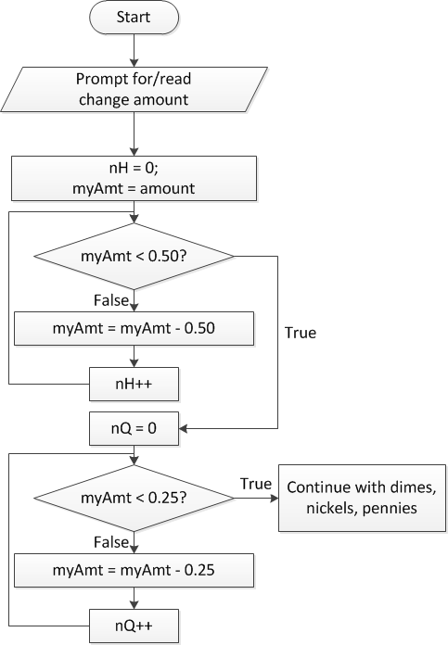
Flowchart, version 1
Loop that repeatedly subtracts coin amount, increment # of that type of coin
Loop ends when remaining change < value of coin
ECE Application Programming: Lecture 7

Slide 24
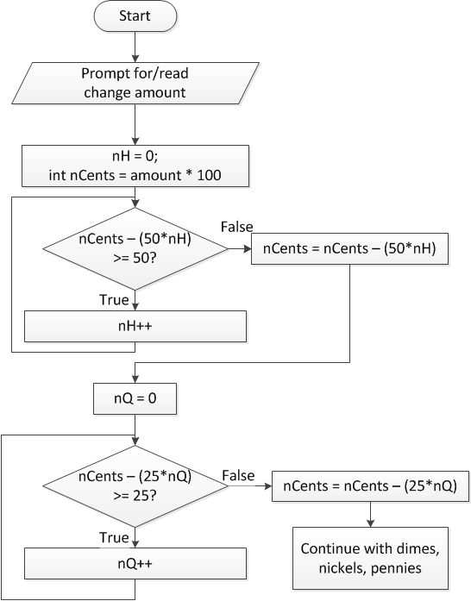
Flowchart, version 2
Treat change amount as integer (nCents)
Most work actually done in loop structure here
  for (nH = 0;
  nCents – (50*nH) >= 50;
  nH++) ;
  Loop body is empty
Must be sure to update amount of remaining change after loop
ECE Application Programming: Lecture 7

Slide 25
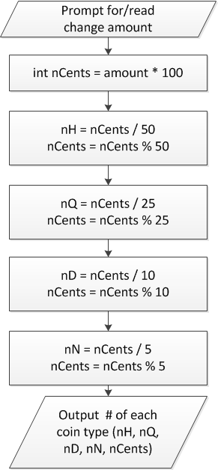
Flowchart, version 3
Don’t really need loop if change amount converted to integer
nCents = # pennies after previous four coin types have been taken out
ECE Application Programming: Lecture 7

Slide 26
When to use functions
Find a particular step or series of steps being repeated in your code
  If code is exactly the same, you need no arguments
  If one or more values change, but actual calculations are the same, values can be function arguments
  If function modifies:
    1 variable: just return it
    2+ variables: use pointer argument(s)
Reassess change example
  Steps for creating change are extremely similar
  What changes each time?
  How should we use those values in a function?
    Inputs, outputs, variables … ?
ECE Application Programming: Lecture 7

Slide 27
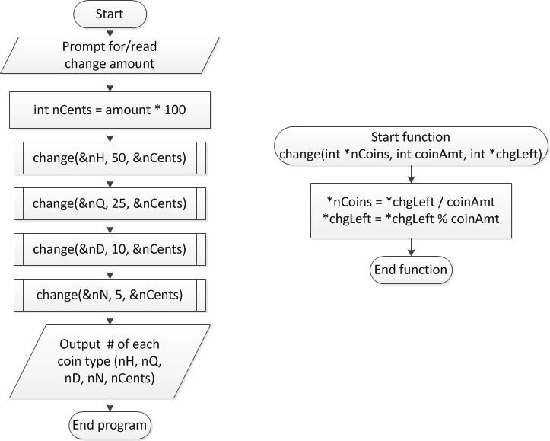
Overall flowchart
ECE Application Programming: Lecture 7

Slide 28
Exam 2 notes
Allowed one 8.5” x 11” double-sided sheet of notes
No other notes
No electronic devices (calculator, phone, etc.)
Exam will last two hours (unless you’re late)
Covers all lectures after Exam 1
Format similar to Exam 1
  1 multiple choice problem
  1 code reading problem
  1 code writing problem
ECE Application Programming: Lecture 7

Slide 29
Review: loops
Used for repetition of code
while (<expression>)
  <statement> ← loop body
do {
<statements>
} while ( <expression> );
for (<init var>; <test>; <change var>)
<statements>
Exiting loop early: break
Skipping rest of loop body (but staying in loop): continue
Operators to directly change variable
  x++, x-- → post-increment/decrement
  ++x, --x → pre-increment/decrement
  +=, -=, *=, /= → augmented assignment
ECE Application Programming: Lecture 7

Slide 30
Review: functions
Used to break programs into smaller pieces
  Useful when code sequences repeated
Functions have:
  An optional return value
  A name
  Optional arguments
Must be prototyped or written completely prior to use
Arguments can be:
  Passed by value: copy of argument is sent to function
    Arguments cannot be modified outside function
  Passed by address: address of argument
    Use pointers or address operator (&)
    Arguments can be modified outside function—used to “return” multiple values
ECE Application Programming: Lecture 7

Slide 31
Review: pointers
Pointer: address of a variable
  Can get address of existing object using &
  Can get value of existing pointer using *
  Can assign pointers of same type to each other
  Pointer declaration:
  <base type>* <pointer name>
    Base type determines how reference is interpreted
Use pointers as function arguments → pass by address
ECE Application Programming: Lecture 7

Slide 32
Next time
Exam 2
Reminders
  Program 5 now due Friday, 8/3
  Program 6 now due Tuesday, 8/7
  Exam 2 Thursday, 8/2
ECE Application Programming: Lecture 7

